Slide 1
CuTe 2 Presentation
Presented By: Batch 14
Shreya Reddy Peesary

Slide 2
Contents
Objective
Dataset Observations
Data Cleansing
Dimensionality Reduction
Model Building
Results

Slide 3
Objective
To Predict the Rating of a Food Item given the ingredients used in it.

Slide 4
Dataset Observations
Dimensions:14038 x 681
Independent variables:’rowId’ (type: int)
‘Itemname’(type: factor)
’attr3’ to ‘attr680’(type: int)
Target variable :'Rating' is continuous(type: numeric)

Slide 5
Data Cleansing
Removed columns with near zero variance (reduced to 61 variables).
Missing values check(11609).
Imputed the missing values with central imputation(numeric data).
Drop ‘rowid’ and ‘itemname’ attributes.(reduced to 59 variables)
Split data into train and validation.(70:30 ratio)
Standardization on train, validation and test(58 variables).

Slide 6
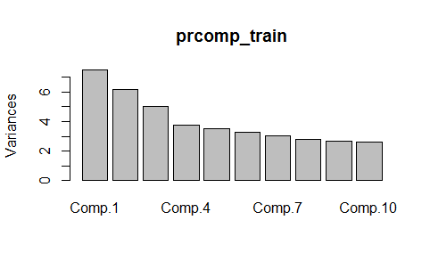
Dimensionality Reduction
PCA(Principal Component Analysis)
0.90 cumulative proportion:attr 1 to 41.
0.80 cumulative proportion:attr 1 to 32

Slide 7
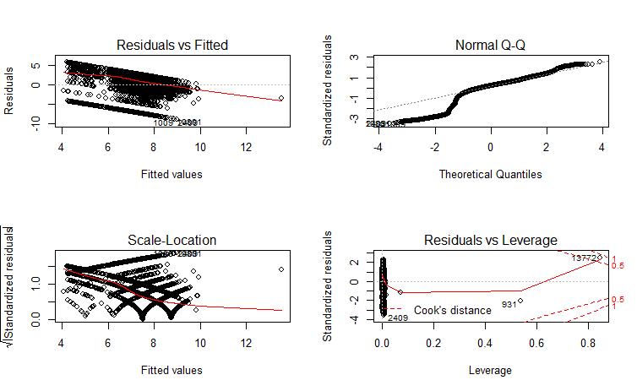
Model Building
Linear Regression

Slide 8
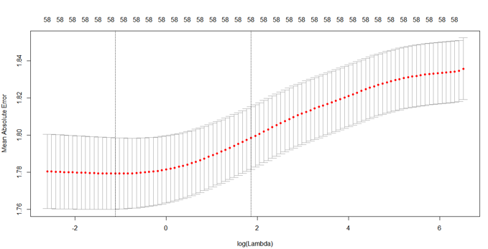
Model Building
Lasso Regression

Slide 9
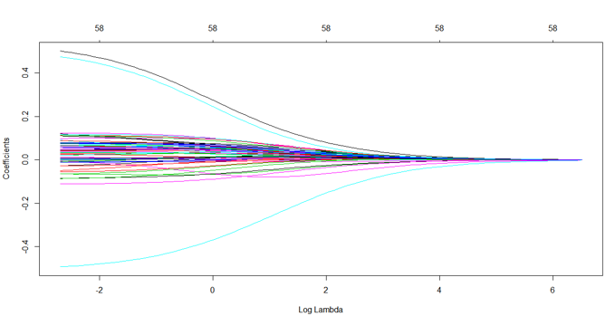
Model Building
Ridge Regression

Slide 10
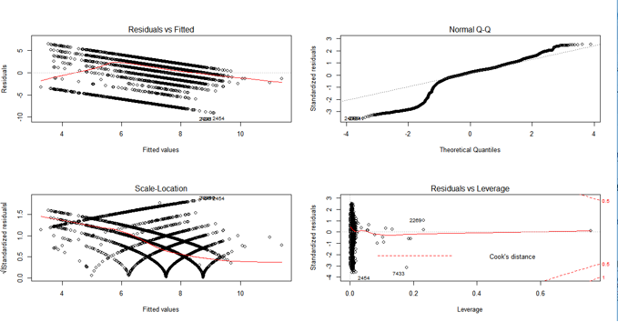
Model Building
Step AIC :

Slide 11
Results
Model | RMSE
PCA | 2.559
PCA with Linear Regression | 2.475772
PCA with Step AIC | 2.478196
PCA with Lasso Regression | 2.475772
Ridge Regression | 2.445258
Linear Regression | 2.454668

