Slide 1
MITH PRESENTATION
Presented By:
Shreya Reddy

Slide 2
Contents
Problem Statement
Objective
Data Exploration
Data Preprocessing
Visualizations
Model Building
Results
Conclusion

Slide 3
Problem Statement
During an earthquake, buildings are the entities which are most affected as they are deeply rooted with their foundation in the earth. Immediately after the tremors, it is critical to determine the degree of damage to prioritize disaster response measures.
Some post-earthquake data is collected which is useful in predicting the state of the building. Hence a machine learning model determining the degree of damage is required.

Slide 4
Objective
Our goal is to build a ML model to predict and classify the degree of damage in the buildings due to earthquakes in three different levels “High” ,”Low” and “Medium”.

Slide 5
Dataset Exploration
We have been given two main files train, test and supporting files BuildingOwnership and BuildingStructure which give additional information about the buildings.
Dimensions:
Train: 249644 x 13
Test: 106988 x 13
BuildingOwnership: 356632 x17
BuildingStructure: 356632x29
Target variable :
‘damage_grade‘ (Levels: High Low Medium)

Slide 6
Dataset Exploration
Merged the train and test files with the building structure and ownership.
New merged data dimensions
Train_data : 249644 x 52
Test_data: 106988 x 52
Removed variables which do not add any information using nerozerovar.
Train_data : 249644 x 29
Test_data: 106988 x 29

Slide 7
Data Preprocessing
Checked the Missing values in train data and test data
Imputed using central imputation.
Removed attributes:
building_id,
vdcmun_id,
district_id,
ward_id
Checked for any duplicate rows.
Conditionofbuildingpostearthquake attribute conversion(It’s a combination with building_id)

Slide 8
Data Preprocessing
Split into train and test(70:30 of target class).
damage_grade Class | Proportion
High | 0.41
Low | 0.29
Medium | 0.30

Slide 9
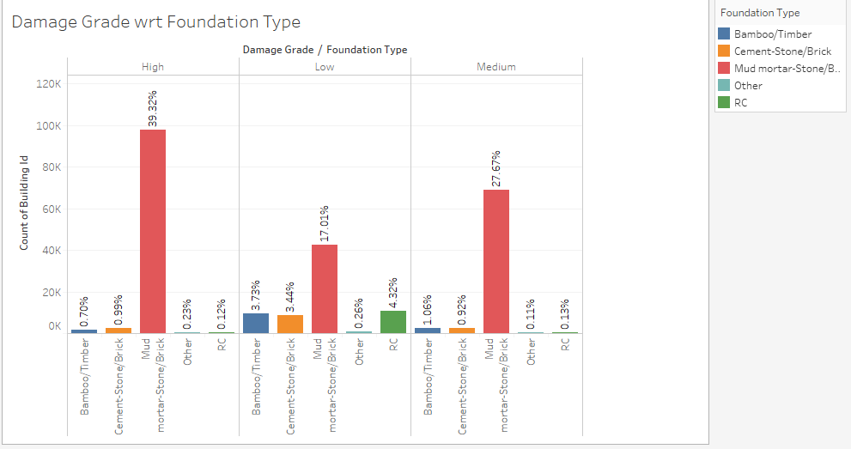
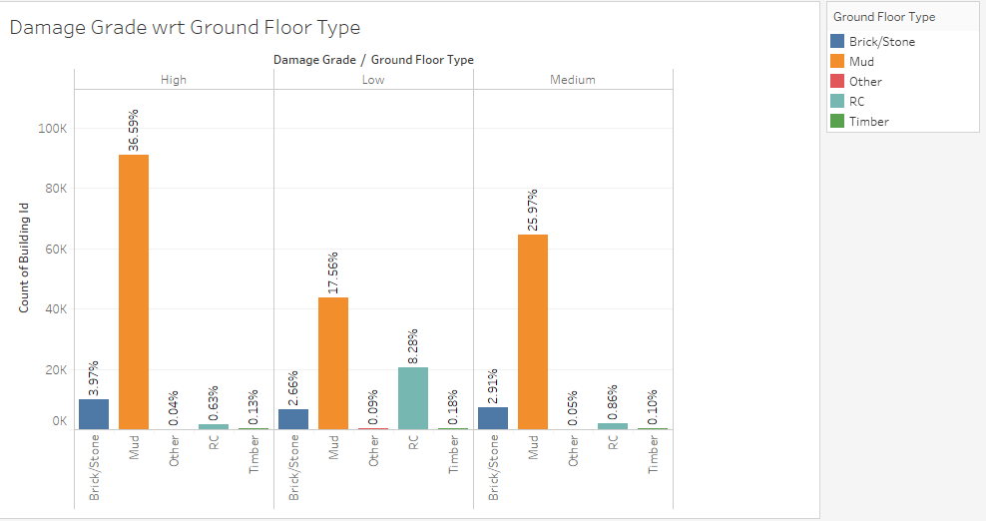
Visualizations

Slide 10
Visualizations

Slide 11
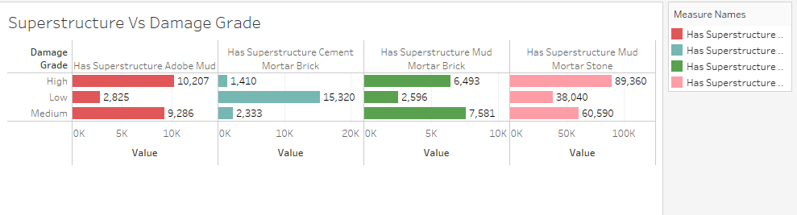
Visualizations

Slide 12
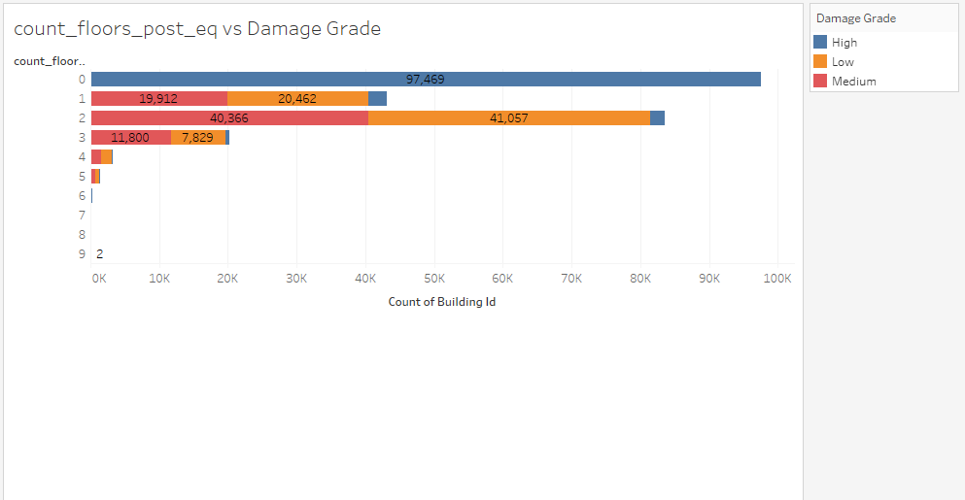
Visualizations

Slide 13
Model Building
Pre processing | Model
Standardize numerical attributes | Naïve Bayes
Standardize numerical attributes + dummification of categories | Xg-boost
Standardize numerical attributes | Decision Tree Rpart
Standardize numerical attributes | Random Forest

Slide 14
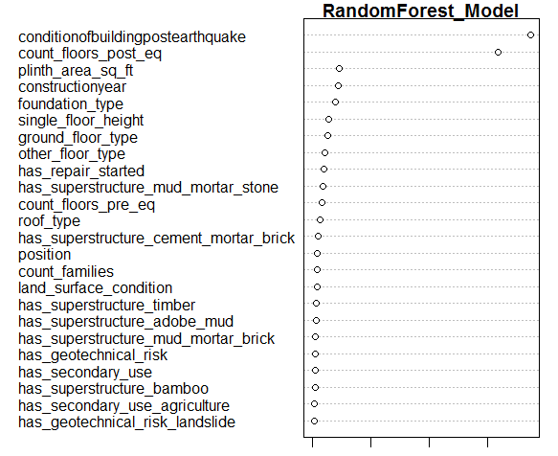
Random Forest
Notes:
Variable Importance Plot

Slide 15
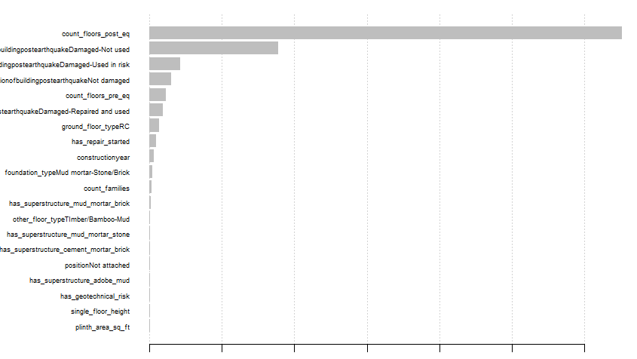
Xgboost

Slide 16
Results
Model | Accuracy on Test
Naïve Bayes | 82.10
Decision Tree Rpart | 85.9
Xg-boost multi:softmax | 88.37

Slide 17
Conclusion
Among the models built, Xg boost gave the maximum accuracy.
Predicted the degree of damage in terms of levels of High, Low and Medium such that disaster management efforts can be prioritized based on the level of damage.

