Slide 1
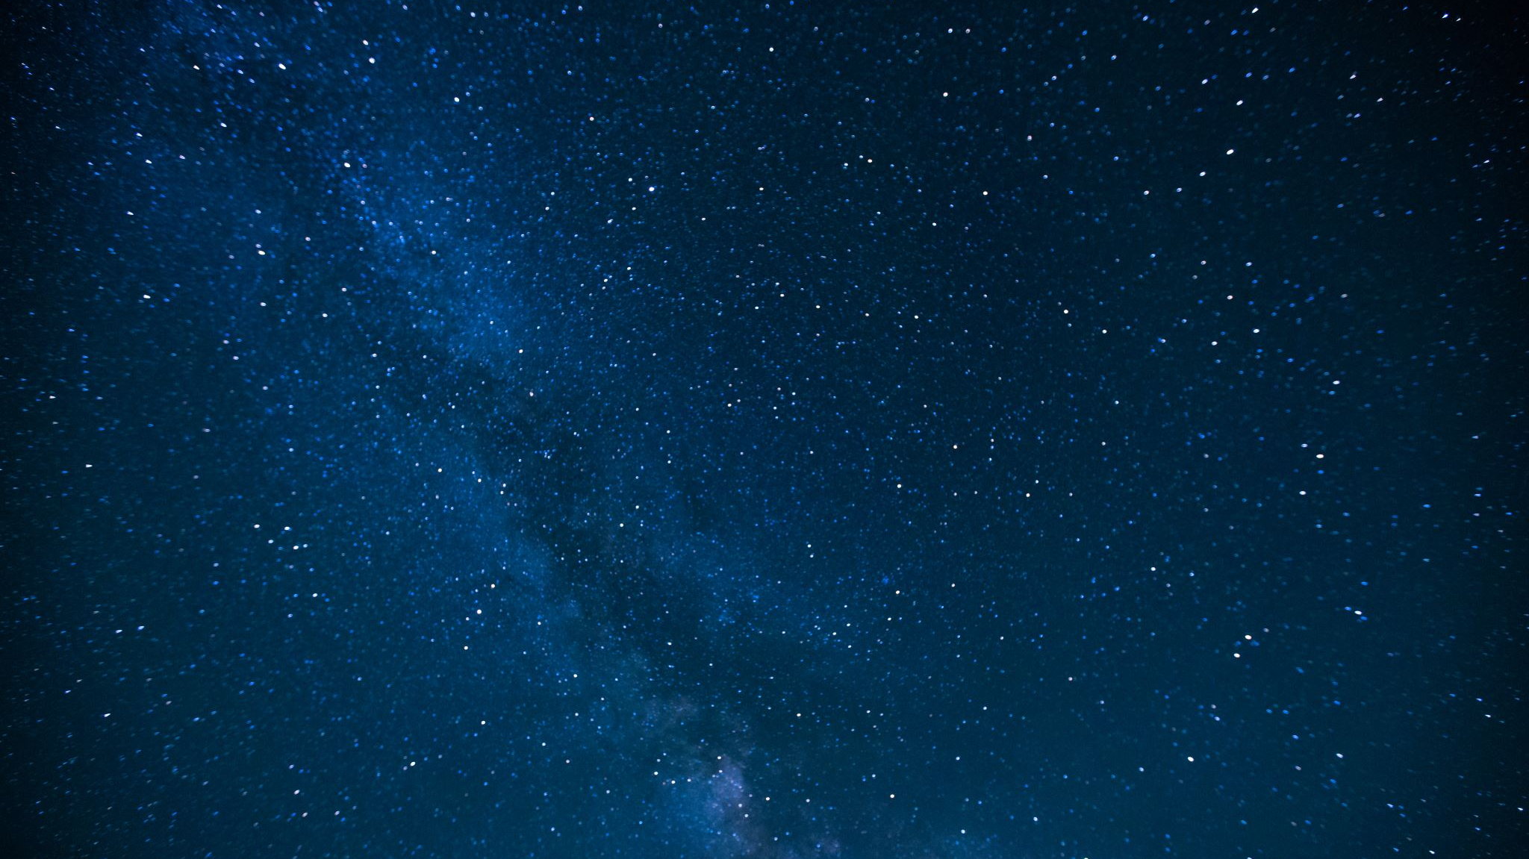
Planet First
By Group 12:
Jayashree Patel
Pranali Ninawe
Utkarsha Pampatwar
Vishaka Varma Vimal

Slide 2






Technologies used:

Slide 3
APIs used:
News API
Twitter API
Google Maps API
React Globe API

Slide 4
About Planet First:
Planet First is a platform which contains information regarding the climate changes all around the world.
Planet First cares about the Earth and want to help the society in return by providing a single platform regarding the climatic changes and also allows users to contribute back to the society.

Slide 5
The website consists of a News Forum, where users can fetch latest news feed regarding the climate changes.
Users can also contribute back to the society by donating money to support any environmental cause.

