Slide 1
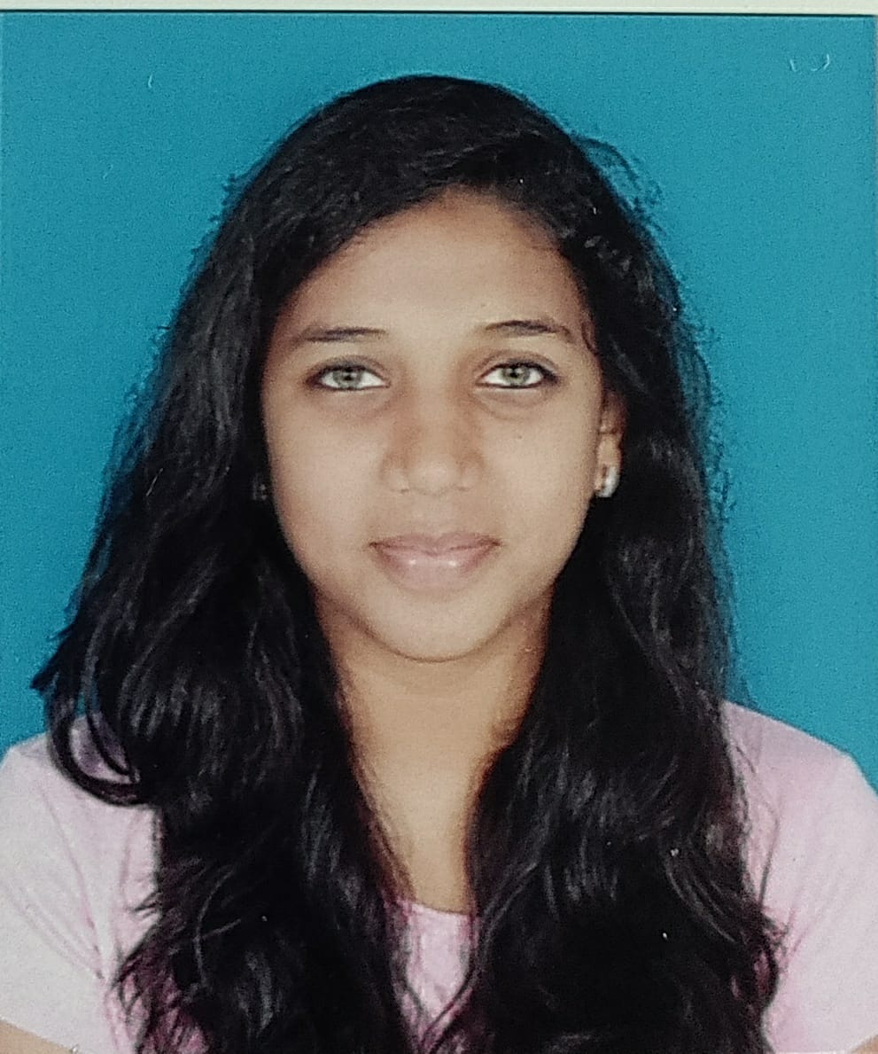



Pranali R. Redgaonkar
Analyst/Software Engineer
Bachelor of Engineering
Computer Science : 2018-2022
Skills
Java 8 /J2EE | Java Basics, OOPS, Generics, Collections, Arrays, Loops, Lambda Exp, Stream API Junit, Mockito, Servlets
Spring core | IOC & Dependency Injection, Autowire
Spring REST | REST controllers, Implementation of GET, POST, PUT & DELETE, Bean Validation & Exception Handling, Testing Services, Controller & Repository layer
Spring Data JPA | Implement DAO layer using spring Data repositories, Transaction Management
Spring Boot Microservices | Spring Boot Starters, annotations, Messaging Service, Sync/Async comms, Swagger API documents
Spring Cloud | Eureka, Netflix Ribbon, Feign Client, Netflix Hystrix, Netflix Zuul & Config Server
Angular | Components, Services, Modules, Routing, Forms & Validation
Database | MongoDB No Sql Basics My SQL RDS Basics.
UI Tech | HTML 5 & CSS 3,JavaScript, ES6 & TypeScript Reusable templates, Optimized UI Designed
Tools | Git, Postman, Maven, IDE,VSCode
Add On skills | Communications, Team management. Peer learning,Content Writing,Decision making,Team leading.
Bangalore
pranalirr96@gmail.com
+91 7218539248
A4
Full Stack Developer
Hands on experience in creating microservices with Springboot, Spring Security, Spring Cloud API Gateway, Eureka server.
Proficient in creating Single page Web Application in Angular with Authentication with route guards, Angular reactive forms, angular routing, bootstrap.
Hands on experience in implementing AngularJs 9 & Spring boot
Experience in creating documentation with Java docs and swagger and increasing code quality compliance using Sonar cube
Pharmacy Management System Application
Completed end to end case study of Shopping Cart Application along with JWT authentication, Swagger and payment using Razorpay, responsive UI with CSS and Angular used for user interface.
Insurance Application System
Developed the Insurance Application using Springboot,MySQL,Angular and did the testing and api calls through Postman
Check out my work on GitHub & Video Profile

