Slide 1

Monsoon Rainfall Analysis and Prediction
Classification and regression on 121 years of rainfall data from 36 Indian subdivisions
Final Year Project | Pranali D. Jadhav | Sandip University
Notes:
Introduce the project: we studied monsoon rainfall (June to September) for 36 subdivisions of India from 1901 to 2021, and built models to classify and predict rainfall. Tools: Python, Pandas, NumPy, Matplotlib, Seaborn, Scikit-Learn.

Slide 2
Why study monsoon rainfall?
Farming, water supply and flood planning all depend on the June to September rains. Early estimates help people prepare.
Our goals
Clean and explore the data
Classify rainfall as Low, Medium or High
Predict total seasonal rainfall (mm)
Compare models and save the best
36
subdivisions
121
years (1901-2021)
4,332
records
Notes:
Explain why the problem matters. The dataset has 36 subdivisions, 121 years and 4,332 records. Two tasks: classification (Low/Medium/High) and regression (rainfall in mm).

Slide 3

Dataset and tools
Tools used
Dataset columns
Python
Pandas
subdivision region name (36)
YEAR 1901 to 2021
JUN, JUL, AUG, SEP monthly rainfall (mm)
JUN-SEP seasonal total (mm)
NumPy
Matplotlib
Seaborn
Scikit-Learn
Notes:
The file has the subdivision, the year, four monthly rainfall columns and the seasonal total. We used only basic Python data science tools, no deep learning.

Slide 4
Clean on the surface, gaps underneath
1
Replace -99.9 with NaN
Missing values become visible
-99.9
2
Remove 10 rows with no total
The target cannot be guessed
A code for "no data", hidden as a normal number. isnull() reported zero missing values.
3
Check duplicates and sums
None found; monthly values add up to the total
4
Keep 295 high outliers
Real records from very wet regions
10 rows (0.23%)
Final dataset: 4,322 rows
Notes:
This is the most important cleaning finding. The describe table showed a minimum of -99.9. Pandas does not count it as missing. All 10 affected rows had a missing total, so we removed them. Outliers were kept because they are real heavy-rain records, for example Konkan and the Karnataka coast.

Slide 5
July is the wettest month
July gives 32.6% of the seasonal rain, then August 27.3%, June 21.5%, September 18.7%
Rainfall is skewed to the right: mean 1060 mm, median 879 mm
June varies the most because the monsoon start date changes
Notes:
Bar chart shows average rainfall in each month. All histograms are right-skewed: many ordinary values and a few very heavy ones.

Slide 6
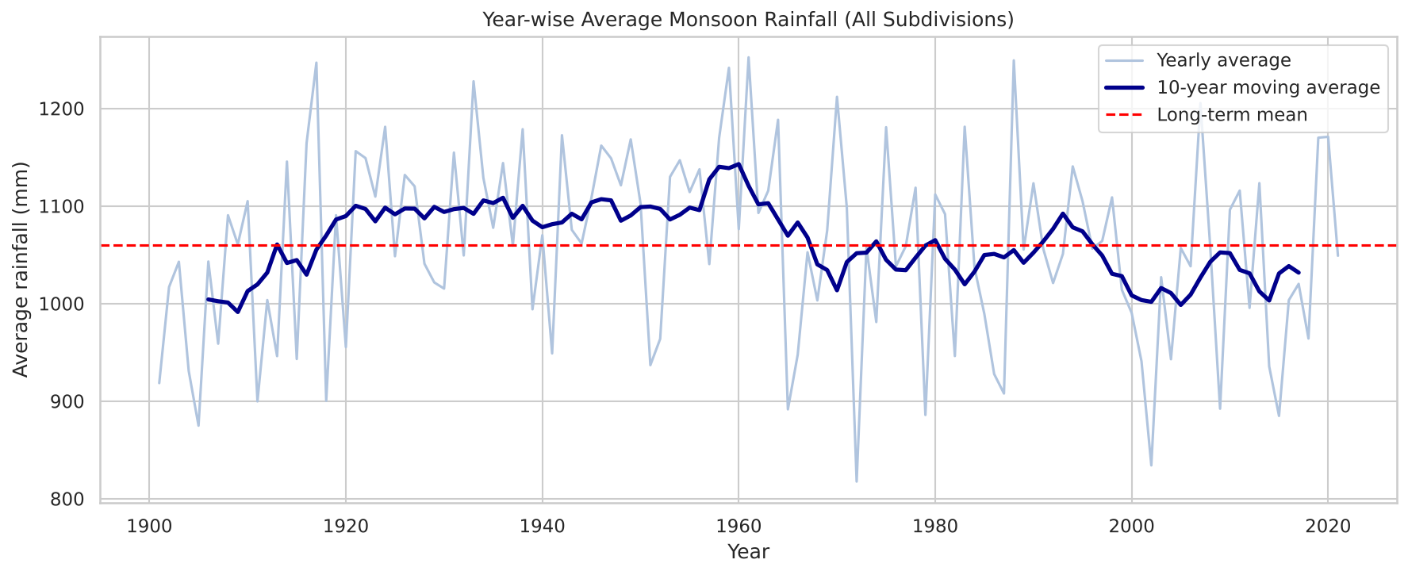
No strong trend over 121 years
-1.7 mm
per decade (almost flat)
Wettest year: 1961 (1252 mm)
Driest year: 1972 (817 mm)
30-year averages stay close: 1044, 1103, 1056, 1037 mm
Notes:
The straight-line trend is tiny compared with the average of about 1060 mm. Year-to-year changes are large, so the year alone is not a useful predictor.

Slide 7
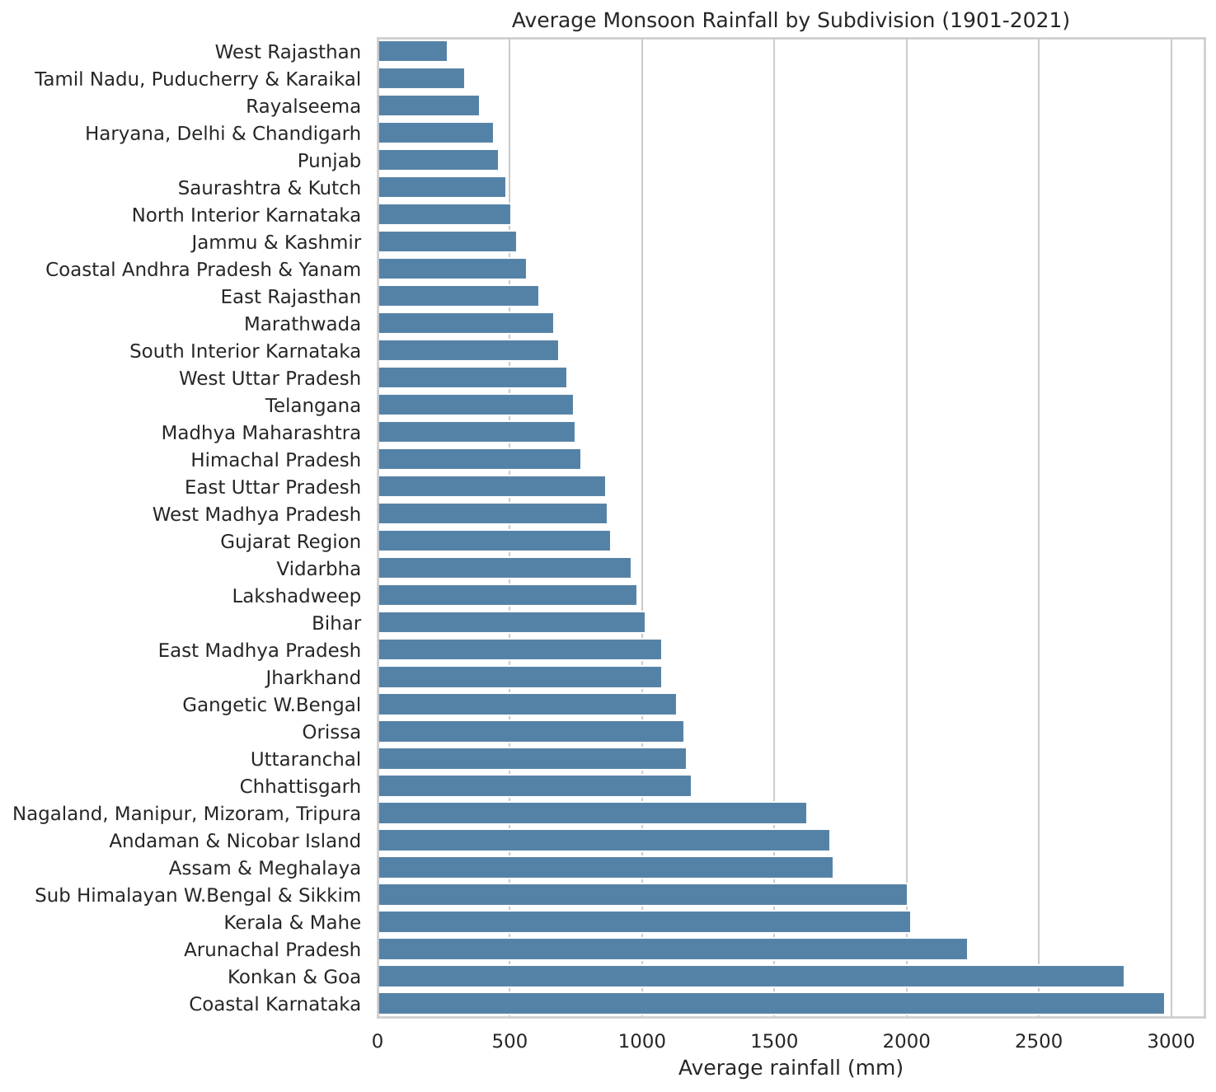
Region matters more than year
2977
264
mm Coastal Karnataka
mm West Rajasthan
The wettest region gets more than 11 times the rain of the driest
Konkan & Goa (2825 mm) and Arunachal Pradesh (2233 mm) are also very wet
Subdivision is encoded and used as a model feature
Notes:
Large regional differences. Tamil Nadu is dry in this dataset because most of its rain comes in October to December, outside the June to September window.

Slide 8
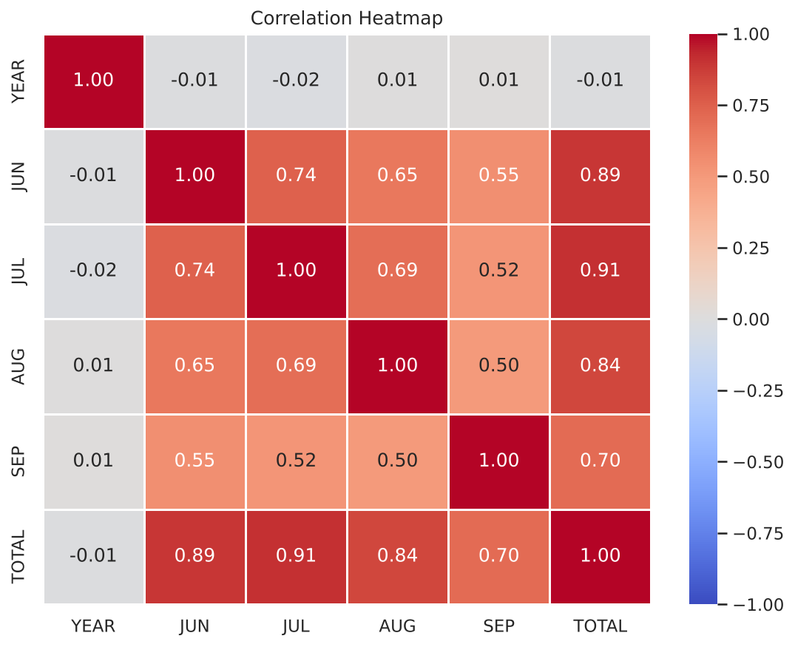
June and July drive the season
July (0.91) and June (0.89) have the strongest link with the seasonal total
Months are linked to each other (0.50 to 0.74)
YEAR is about 0 with everything: no time trend
August and September are parts of the total, so they are left out of the model inputs
Notes:
The heatmap tells us which inputs are useful. Using August and September would be data leakage because June to September add up to the target.

Slide 9
How the models were built
1
2
3
4
5
Features
Preprocess
Split
Train
Evaluate
subdivision, YEAR, JUN, JUL, JUN+JUL
one-hot encoding and scaling in a Pipeline
80% train, 20% test, stratified
GridSearchCV for tree models
test set, compared with a baseline
Mid-season estimate. August and September are not used as inputs because together with June and July they add up exactly to the target (data leakage). The models estimate the season total after July.
Notes:
Classes: Low up to 664.8 mm, Medium 664.8 to 1126.3 mm, High above 1126.3 mm (33rd and 66th percentiles). Pipelines make sure scaling and encoding are learned only from training data. Random seed 42.

Slide 10
Classification: 84.9% accuracy
Logistic Regression
best model, F1 = 0.849
All models are far above the 0.333 baseline
Medium is the hardest class (F1 about 0.78)
Mistakes only happen between neighbouring classes
Notes:
Precision, recall and F1 are macro-averaged. For Logistic Regression, no Low record was predicted as High and no High record as Low. Part of the accuracy comes from knowing the region, because some regions are always Low or always High.

Slide 11
Regression: R² = 0.955
Model | MAE (mm) | RMSE (mm) | R²
Linear Regression | 111.8 | 156.8 | 0.955
Random Forest | 115.6 | 162.4 | 0.952
Decision Tree | 129.9 | 174.8 | 0.944
Baseline (mean) | 538.5 | 739.7 | -0.001
112 mm
average error
10.6%
of mean seasonal rainfall
Test set: 865 records. Lower MAE and RMSE are better.
June + July rainfall is the key input; the year has almost no effect.
Notes:
Linear Regression is the best model: MAE 111.8 mm, RMSE 156.8 mm, R-squared 0.955. Random Forest is a close second. Errors are largest in very wet regions such as Konkan and Goa (266 mm) and smallest in Tamil Nadu (49 mm).

Slide 12


Conclusion and future scope
Conclusion
Future scope
Found and removed 10 hidden missing records (-99.9)
Best classifier: Logistic Regression, 84.9% accuracy
Best regressor: Linear Regression, R² = 0.955
Simple models win when the pattern is mostly linear
Add El Niño, temperature and humidity data
Test with a time-based split (train old, test recent)
Separate models for each region
Build a small Streamlit app for predictions
Notes:
Limitations to mention if asked: the models use the real June and July rainfall of the same year, so this is a mid-season estimate and not a pre-monsoon forecast. The split is random, not by year. Only rainfall data is used.

