Slide 1
Active Control of a vehicle Anti-Roll Bar

Slide 2
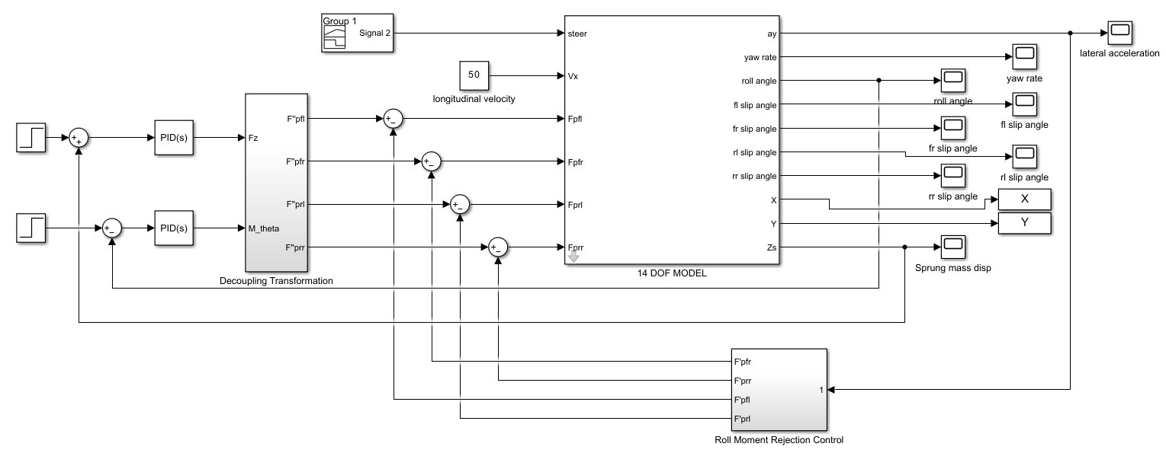
Active Roll Control Suspension System

Slide 3
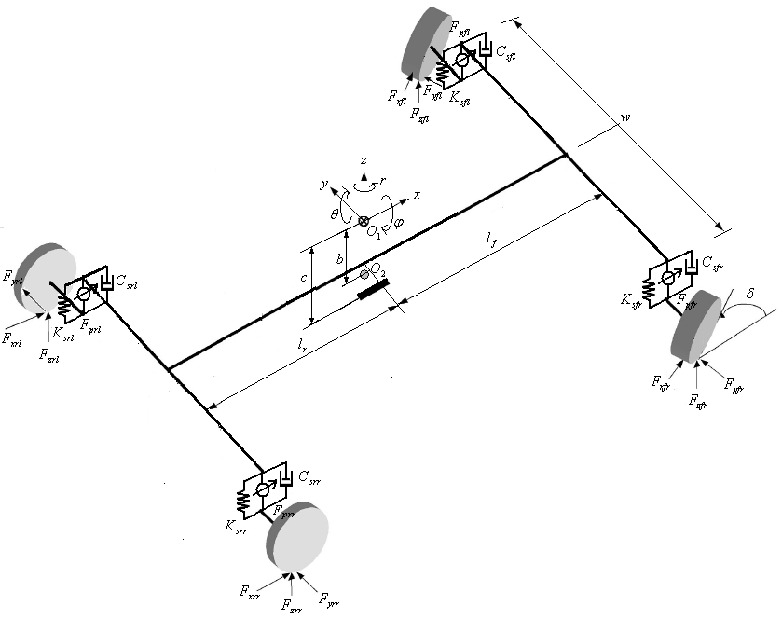
14 DOF Vehicle Model
Single sprung mass connected to four unsprung masses
Sprung mass is allowed to pitch, roll, yaw and to displace in vertical, lateral and longitudinal directions
Unsprung masses are allowed to bounce vertically wrt sprung mass
Each wheel is also allowed to rotate along its axis and two front wheels are free to steer

Slide 4
Vehicle Ride Model
7 DOF System: Sprung mass is free to heave, pitch and roll (3), unsprung masses free to bounce vertically wrt sprung mass (4)
Suspension between Sprung and unsprung masses are modelled as passive viscous dampers and spring element
Tires are modelled as simple linear springs without damping

Slide 5
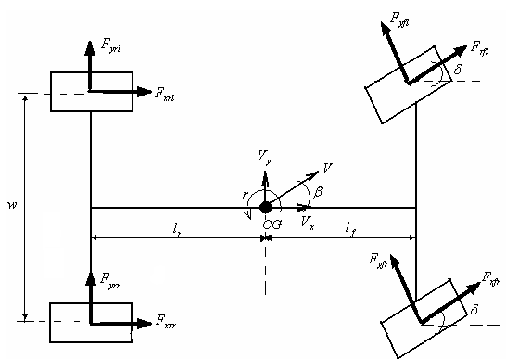
Vehicle Handling Model
7-DOF system: three degrees of freedom for the vehicle body in lateral and longitudinal motions as well as yaw motion (r) and one degree of freedom due to the rotational motion of each tire.
In vehicle handling model, it is assumed that the vehicle is moving on a flat road.

Slide 6
Calspan Tire Model
The longitudinal and lateral forces generated by a tire are a function of the slip angle and longitudinal slip of the tire relative to the road.

Slide 7
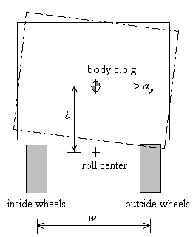
Inner loop : Roll Moment Rejection Loop
During cornering, a vehicle will produce a sideway force namely cornering force at the body center of gravity.
The cornering force generates roll moment to the roll center causing the body center of gravity to shift outward.
Shifting the body center of gravity causes a weight transfer from the inside toward the outside wheels.
The two necessary forces to cancel out the unwanted roll moments are consider on the outside wheels whereas the forces at inside wheels are set to zero.

Slide 8
Outer Loop : Stabilize heave and roll from steering input
The outputs are vertical forces to stabilize body bounce (F_{z}) and moment to stabilize roll (M∅) which are calculated using PID controllers.
These forces and moments are then distributed into target forces calculated using decoupling transformation.

Slide 9
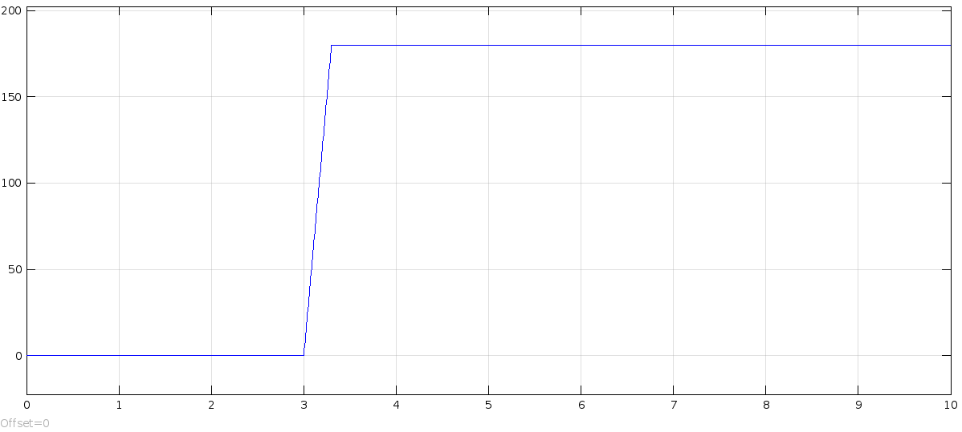
Step Steer Test
Steering Input:

Slide 10
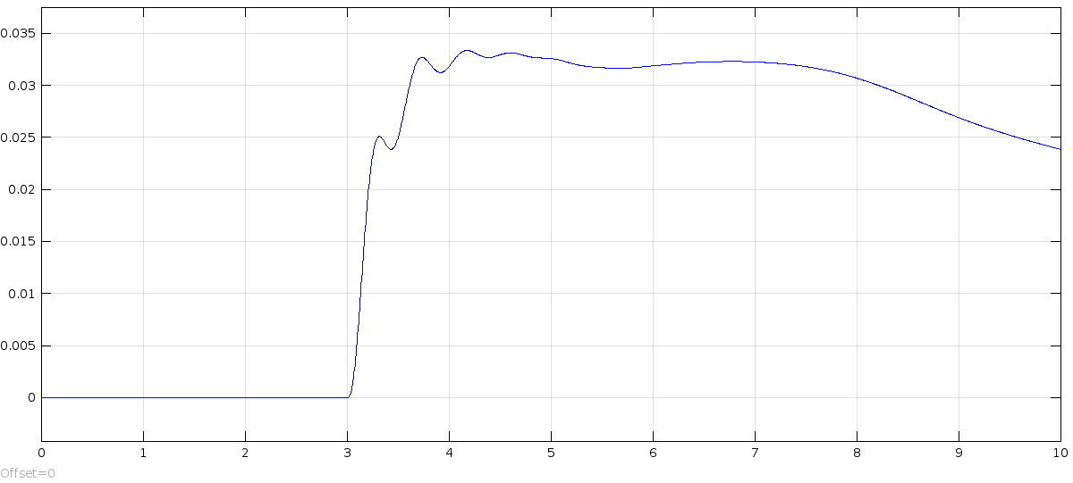
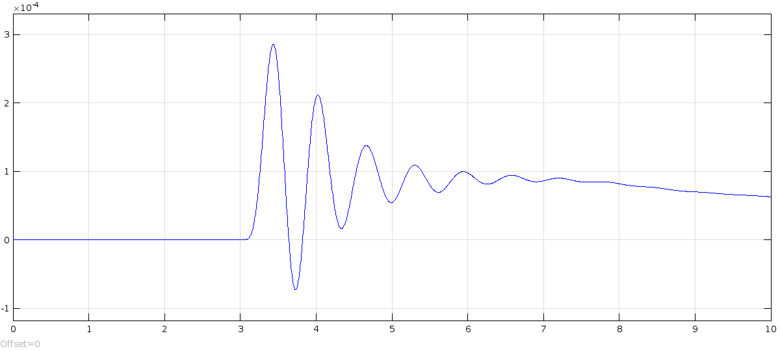
Without control input
Roll Angle
Vertical Heave

Slide 11
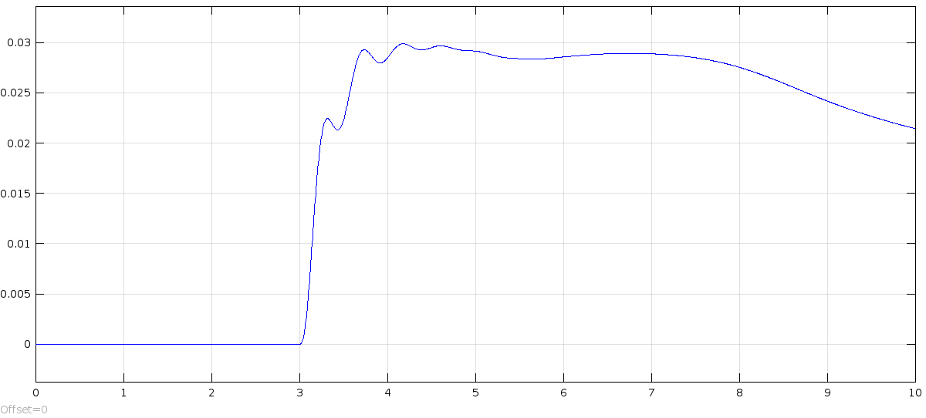
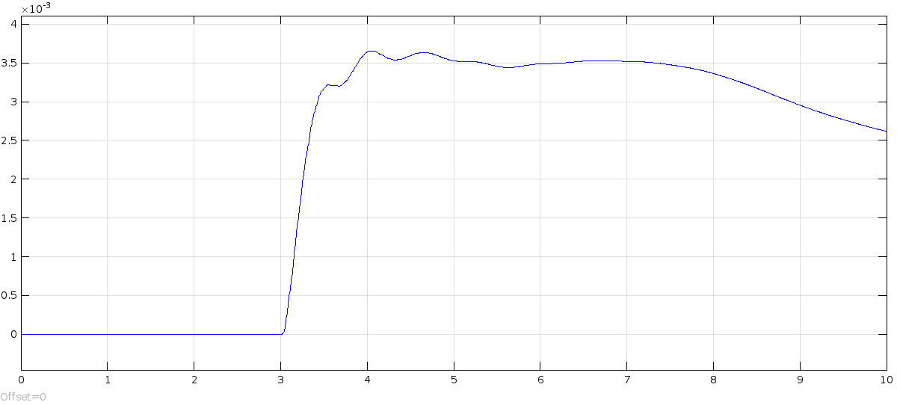
With control input
Roll Angle
Vertical Heave

Slide 12
Questions?

