Slide 1
Introduction to Python
A Simple & Beginner-Friendly Overview

Slide 2
What is Python?
- Python is a high-level, easy-to-learn programming language.
- Used for web development, data science, AI, automation, and more.
- Simple syntax makes it great for beginners.

Slide 3
Why Learn Python?
- Beginner-friendly
- Large community support
- Supports multiple programming styles
- Widely used in the IT industry

Slide 4
Features of Python
- Easy to read and write
- Interpreted language
- Platform-independent
- Huge collection of libraries

Slide 5
Where Python is Used?
- Web development (Django, Flask)
- Data analysis & visualization
- Machine learning & AI
- Automation & scripting
- Game development

Slide 6
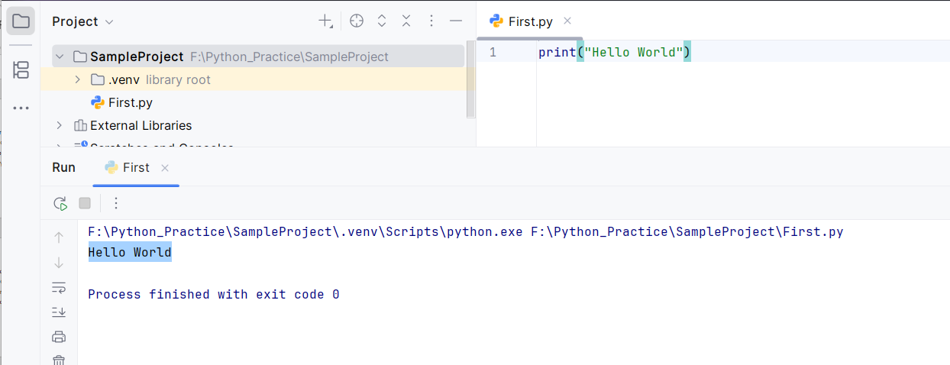
First Python Program
Print Hello World program

