Slide 1
Pandas
(Data Analysis Library)

Slide 2
Pandas library overview
Pandas is a powerful Python library used for data analysis, data manipulation, and data cleaning.
It helps you work with structured data like tables, spreadsheets, CSV files, and databases.
Pandas is built on top of NumPy, making it fast and efficient.
Why Use Pandas?
Easy handling of missing data
Powerful data filtering & transformation
Fast aggregation and grouping
Works well with CSV, Excel, SQL, JSON
Widely used in Data Science & Analytics

Slide 3
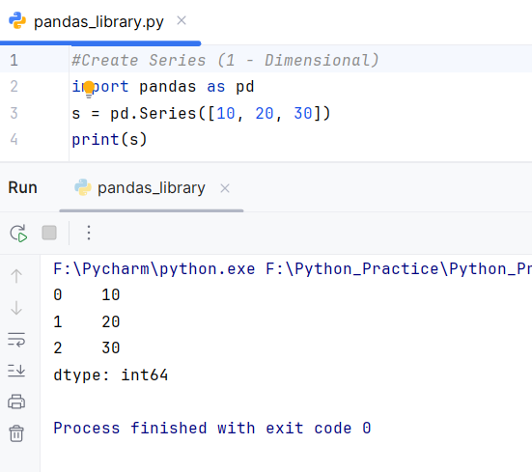
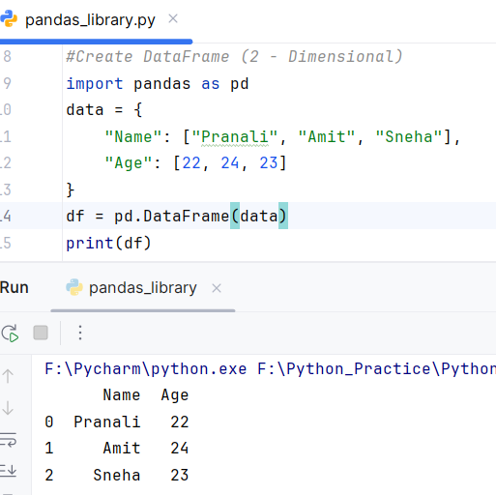
Series & DataFrame
Series (1-Dimensional)
A labeled array similar to a column in excel.
DataFrame (2-Dimensional)
A table with rows and columns.

Slide 4
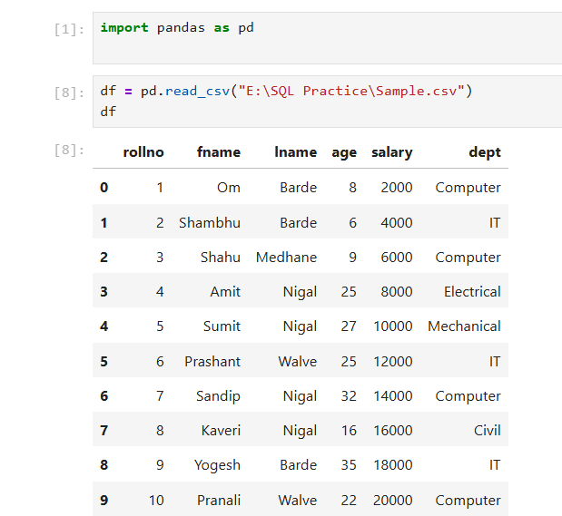
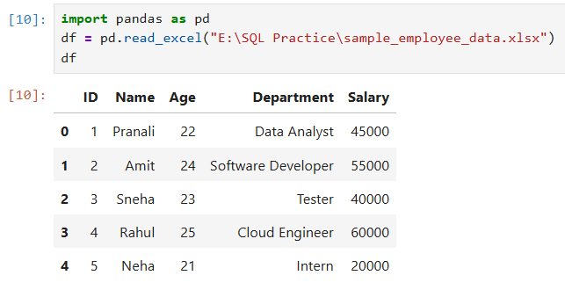
Reading Data from CSV and Excel
CSV
Excel

Slide 5
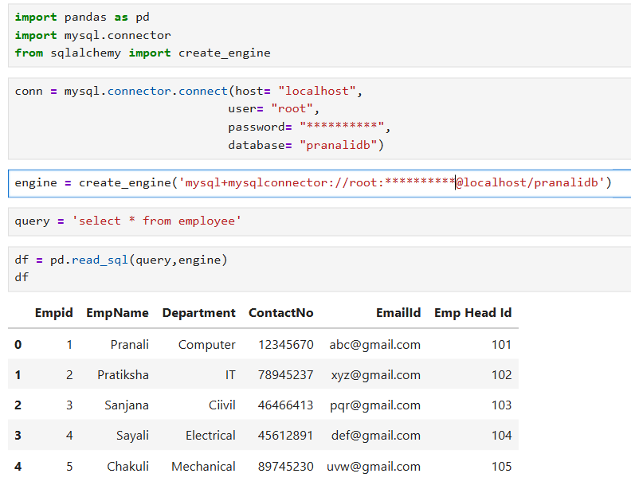
Reading Data from SQL

