Slide 1
Python Basics
Variables • Data Types • I/O • Operators • Conditions • Loops

Slide 2
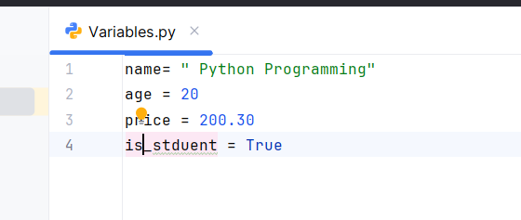
Python Variables
• Containers to store data
• No need to declare type

Slide 3
Python Data Types
• int – Integer numbers
• float – Decimal numbers
• string – Text values
• list – Ordered, mutable
• tuple – Ordered, immutable
• dict – Key-value pairs

Slide 4
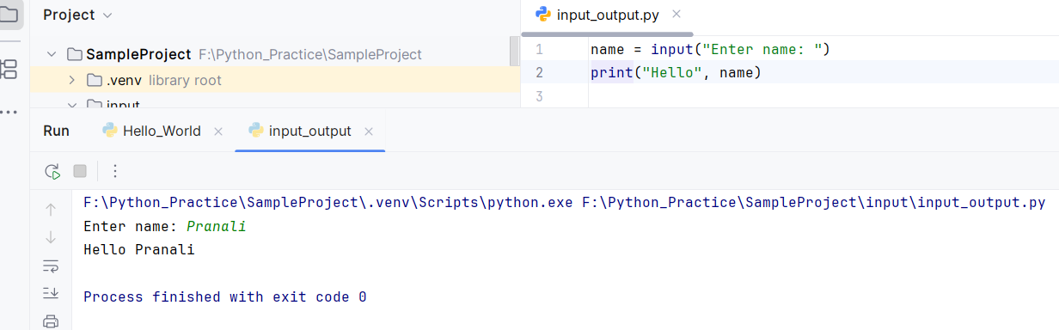
Input & Output
• input() – Takes user input
• print() – Displays output

Slide 5
Operators in Python
• Arithmetic: +, -, *, /, %, **, //
• Comparison: ==, !=, >, <, >=, <=
• Logical: and, or, not

Slide 6
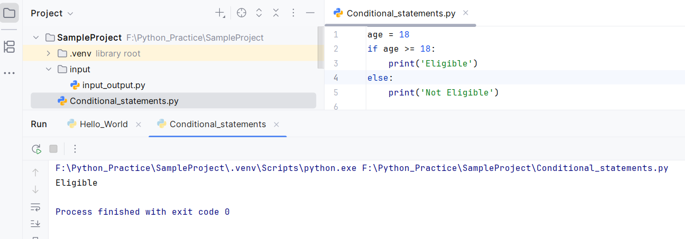
Conditional Statements
Make decisions in your program

Slide 7
Loops in Python
• for loop
It is used to repeat a block of code a specific number of times
• while loop
It repeats a block of code as long as a condition is True

Slide 8
