Slide 1
NYKAA SALES ANALYSIS
Using SQL
Building a Relational Database for Customer,
Product & Sales Analysis
💻 MySQL 📊 SQL 🛍️ Sales 👥 Customers
Prepared By Pranali Wadkar │

Slide 2
Introduction
Nykaa is one of India's leading beauty and personal care e-commerce platforms, offering a wide range of skincare, haircare, makeup, perfumes, and wellness products. As the business grows, analyzing sales and customer data becomes essential for understanding customer behaviour, tracking product performance, and improving business decisions.
This project focuses on designing and managing a Nykaa Sales Database using SQL. It includes creating a relational database, inserting sample data, and performing various SQL operations such as filtering, sorting, grouping, joins, subqueries, and aggregate functions. The project analyzes customer, product, order, and review data to generate meaningful business insights and demonstrate practical SQL skills used in real-world data analysis

Slide 3
🎯 Project Objectives
To create a relational database for Nykaa sales data using SQL.
To store and manage customer, product, order, category, and review information.
To perform data analysis using SQL queries such as SELECT, WHERE, GROUP BY, HAVING, and
ORDER BY.
To retrieve meaningful business insights using Joins, Subqueries, Aggregate Functions, CTEs, and Window Functions.
To understand and apply real-world SQL concepts for solving business-related problems.

Slide 4
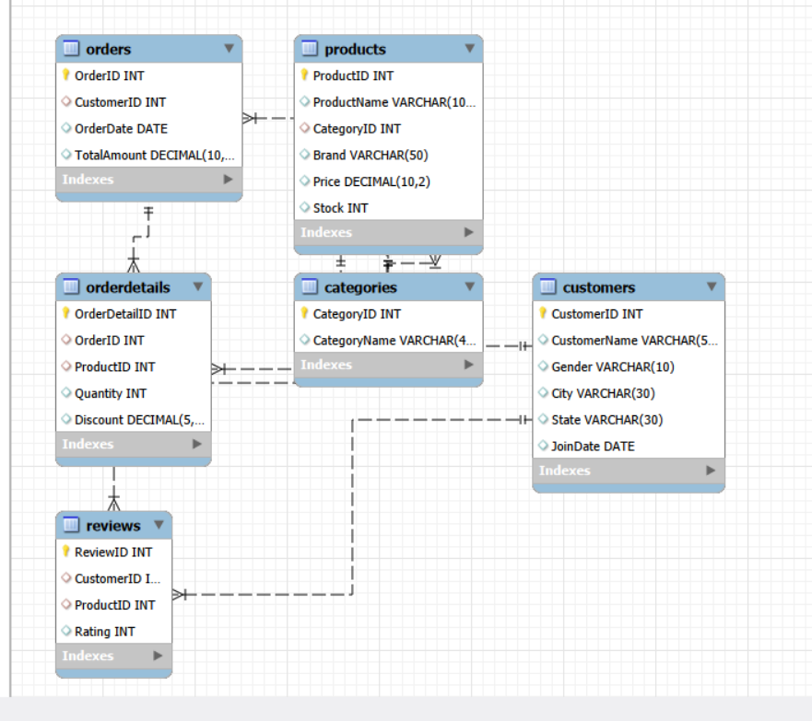
Entity-Relationship (ER) Diagram :

Slide 5
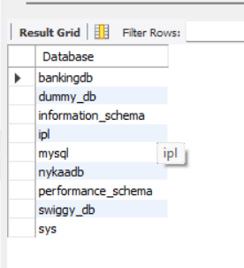
Creating Database :
CREATE DATABASE NykaaDB;
USE NykaaDB;
Show databases;

Slide 6
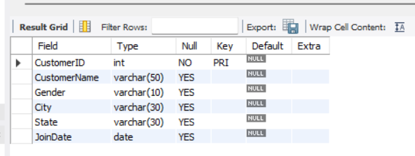
🏗️ Data Definition Language (DDL)
A) Creating Table Customer
CREATE TABLE Customers
(
CustomerID INT PRIMARY KEY,
CustomerName VARCHAR(50),
Gender VARCHAR(10),
City VARCHAR(30),
State VARCHAR(30),
JoinDate DATE
);
desc Customers;

Slide 7
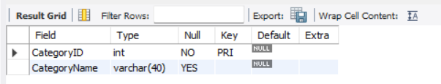
B) Creating Table Categories
CREATE TABLE Categories
(
CategoryID INT PRIMARY KEY,
CategoryName VARCHAR(40)
);
desc Categories;

Slide 8
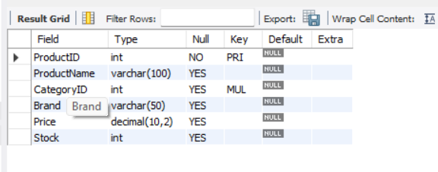
C) Creating Table Products
CREATE TABLE Products
(
ProductID INT PRIMARY KEY,
ProductName VARCHAR(100),
CategoryID INT,
Brand VARCHAR(50),
Price DECIMAL(10,2),
Stock INT,
FOREIGN KEY(CategoryID) REFERENCES Categories(CategoryID)
);
desc Products;

Slide 9
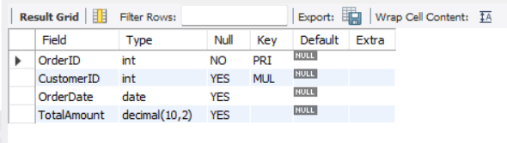
D) Creating Table Orders
CREATE TABLE Orders
(
OrderID INT PRIMARY KEY,
CustomerID INT,
OrderDate DATE,
TotalAmount DECIMAL(10,2),
FOREIGN KEY(CustomerID) REFERENCES Customers(CustomerID)
);
desc Orders;

Slide 10
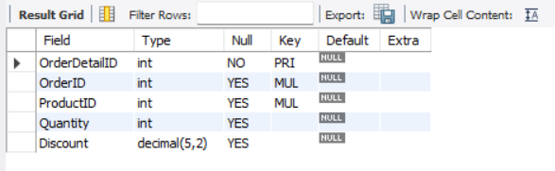
E) Creating Table OrderDetails
E) CREATE TABLE OrderDetails
(
OrderDetailID INT PRIMARY KEY,
OrderID INT,
ProductID INT,
Quantity INT,
Discount DECIMAL(5,2),
FOREIGN KEY(OrderID) REFERENCES Orders(OrderID),
FOREIGN KEY(ProductID) REFERENCES Products(ProductID)
);
desc OrderDetails;

Slide 11
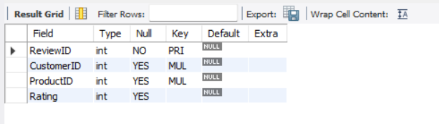
F) Creating Table Reviews
CREATE TABLE Reviews
(
ReviewID INT PRIMARY KEY,
CustomerID INT,
ProductID INT,
Rating INT,
FOREIGN KEY(CustomerID) REFERENCES Customers(CustomerID),
FOREIGN KEY(ProductID) REFERENCES Products(ProductID)
);
desc Reviews;
OrderDetails

Slide 12
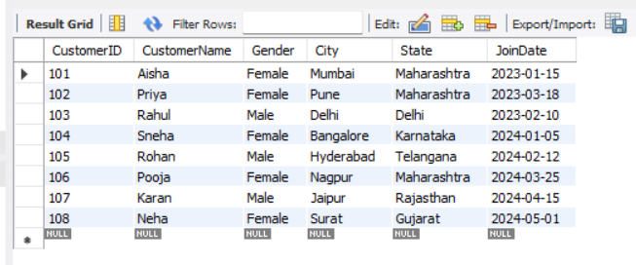
📥 Data Manipulation Language (DML)
A) Inserting Into Customers
INSERT INTO Customers VALUES
(101,'Aisha','Female','Mumbai','Maharashtra','2023-01-15'),
(102,'Priya','Female','Pune','Maharashtra','2023-03-18'),
(103,'Rahul','Male','Delhi','Delhi','2023-02-10'),
(104,'Sneha','Female','Bangalore','Karnataka','2024-01-05'),
(105,'Rohan','Male','Hyderabad','Telangana','2024-02-12'),
(106,'Pooja','Female','Nagpur','Maharashtra','2024-03-25'),
(107,'Karan','Male','Jaipur','Rajasthan','2024-04-15'),
(108,'Neha','Female','Surat','Gujarat','2024-05-01');
Select *from Customers;

Slide 13
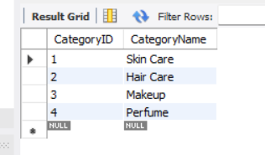
B) Inserting Into Categories
INSERT INTO Categories VALUES
(1,'Skin Care'),
(2,'Hair Care'),
(3,'Makeup'),
(4,'Perfume');
Select *from Categories;

Slide 14
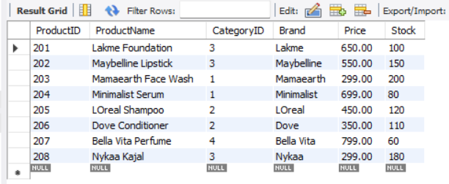
C) Inserting Into Products
INSERT INTO Products VALUES
(201,'Lakme Foundation',3,'Lakme',650,100),
(202,'Maybelline Lipstick',3,'Maybelline',550,150),
(203,'Mamaearth Face Wash',1,'Mamaearth',299,200),
(204,'Minimalist Serum',1,'Minimalist',699,80),
(205,'LOreal Shampoo',2,'LOreal',450,120),
(206,'Dove Conditioner',2,'Dove',350,110),
(207,'Bella Vita Perfume',4,'Bella Vita',799,60),
(208,'Nykaa Kajal',3,'Nykaa',299,180);
Select *from Products;

Slide 15
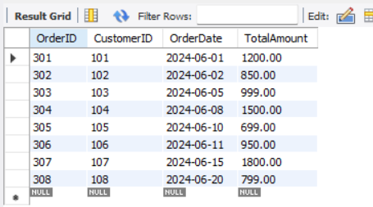
D) Inserting Into Orders
INSERT INTO Orders VALUES
(301,101,'2024-06-01',1200),
(302,102,'2024-06-02',850),
(303,103,'2024-06-05',999),
(304,104,'2024-06-08',1500),
(305,105,'2024-06-10',699),
(306,106,'2024-06-11',950),
(307,107,'2024-06-15',1800),
(308,108,'2024-06-20',799);
Select *from Orders;

Slide 16
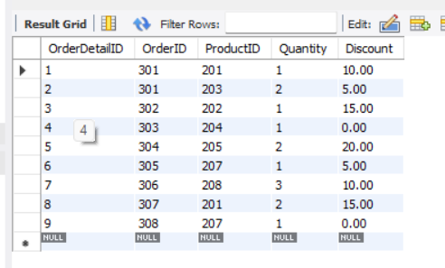
E) Inserting Into OrderDetails
INSERT INTO OrderDetails VALUES
(1,301,201,1,10),
(2,301,203,2,5),
(3,302,202,1,15),
(4,303,204,1,0),
(5,304,205,2,20),
(6,305,207,1,5),
(7,306,208,3,10),
(8,307,201,2,15),
(9,308,207,1,0);
Select *from OrderDetails;

Slide 17
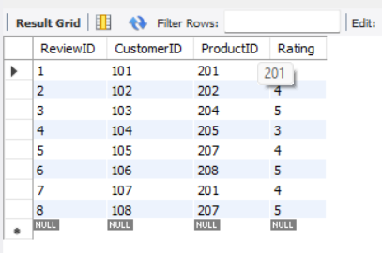
E) Inserting Into Reviews
INSERT INTO Reviews VALUES
(1,101,201,5),
(2,102,202,4),
(3,103,204,5),
(4,104,205,3),
(5,105,207,4),
(6,106,208,5),
(7,107,201,4),
(8,108,207,5);
Select *from Reviews;

Slide 18
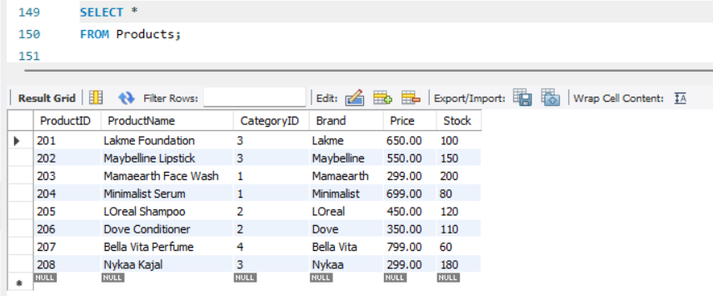
Basic SQL Queries
1). Display all details of the Customers table?

Slide 19
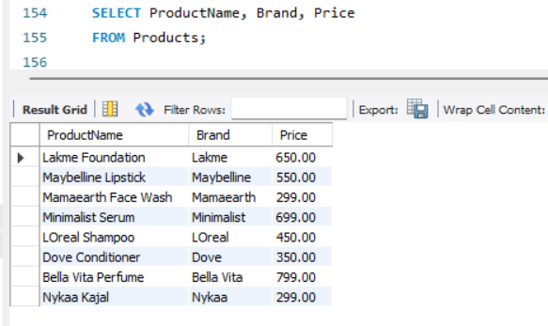
2). Display ProductName, Brand, Price from the Products table?

Slide 20
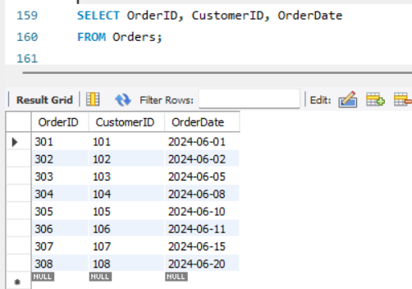
3). Display OrderID, CustomerID, OrderDate from the Orders table?

Slide 21
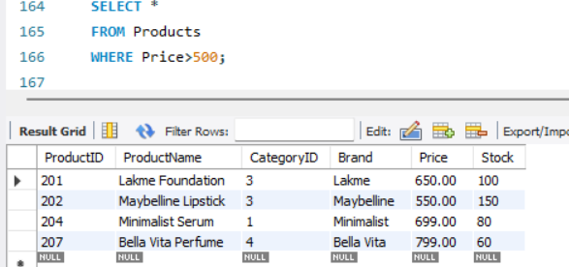
4). Show products costing more than ₹500?

Slide 22
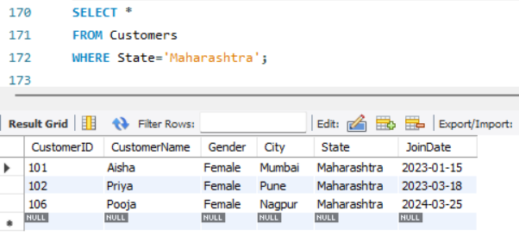
5). Show customers from Maharashtra?

Slide 23
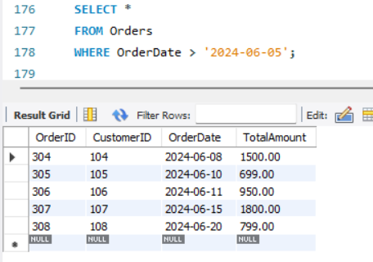
6). Display all orders placed after 2024-06-05?

Slide 24
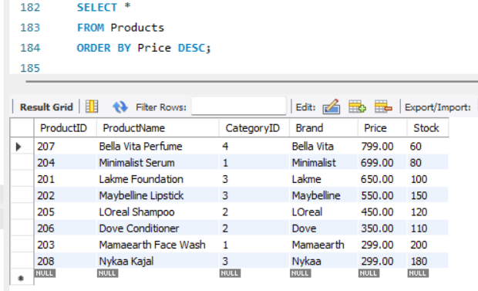
7). Display all products in descending order of price?

Slide 25
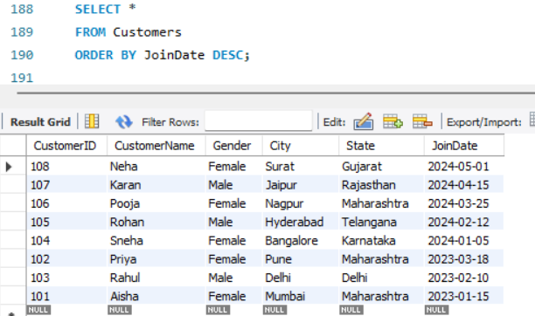
8). Display customers according to their Join Date (latest first)?

Slide 26
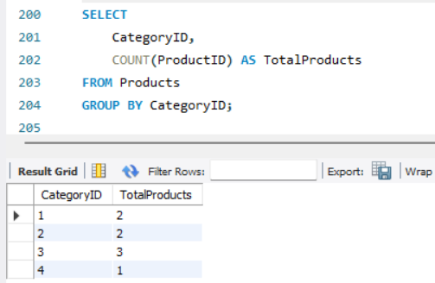
9). Find total products in each category?

Slide 27
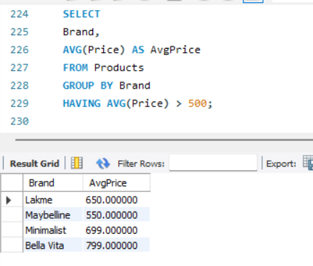
10). Display brands whose average product price is greater than ₹500?

Slide 28
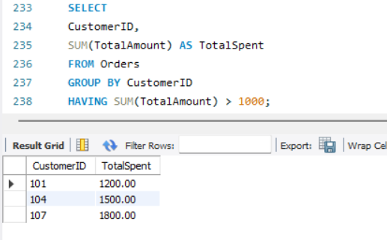
11). Display customers whose total spending is greater than ₹1000?

Slide 29
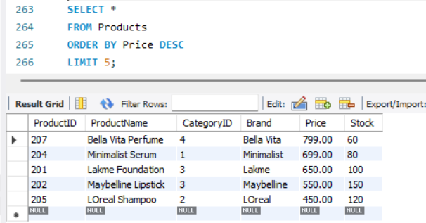
12). Display the top 5 most expensive products?

Slide 30
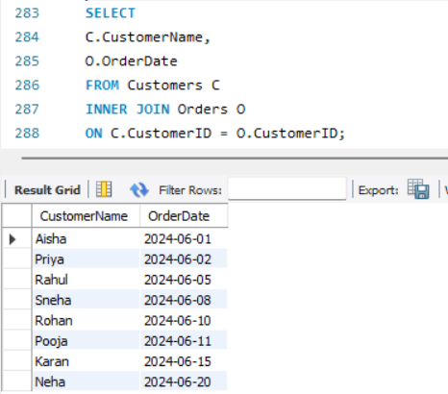
13). Display Product Name and Category Name?

Slide 31
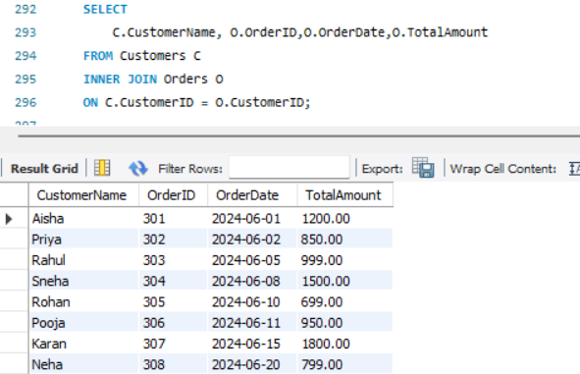
14). Display the Customer Name, Order ID, Order Date, and Total Amount of customers who have placed orders?

Slide 32
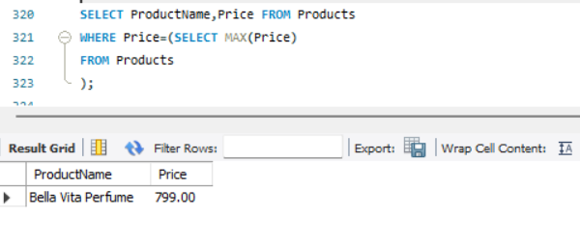
15). Find the most expensive product?

Slide 33
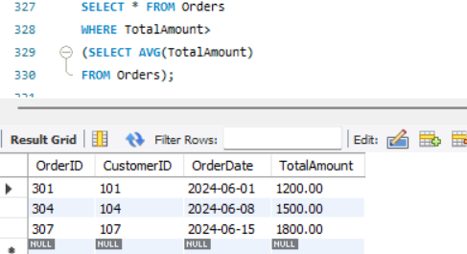
16). Find orders whose amount is greater than the average order amount?

Slide 34
Conclusion
The Nykaa Sales Analysis project demonstrates the use of SQL for managing and analyzing sales data in a structured database. The database was designed using tables for customers, categories, products, orders, order details, and reviews, making it easier to store and retrieve information efficiently.
Various SQL operations were performed to analyze customer orders, product details, sales performance, revenue, and reviews. Different SQL concepts, including DDL, DML, filtering, sorting, grouping, joins, having, aggregate functions, subqueries were used to generate meaningful information from the data.
The project highlights how SQL can be used to organize business data, simplify data analysis, and support better business decisions. The project can be further enhanced by adding more records and implementing additional SQL concepts to perform deeper business analysis.

Slide 35
Thank You

