Slide 1
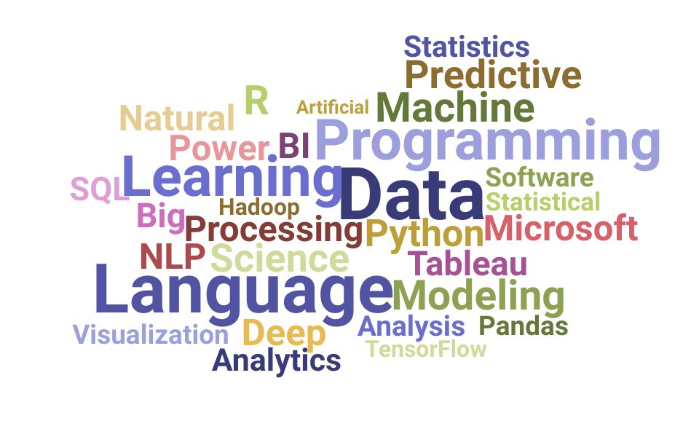
Skills for Data Scientist

Slide 2

Data Representation & Visualization
What
Why

Slide 3
What
Data
Analysis
Visualization

Slide 4
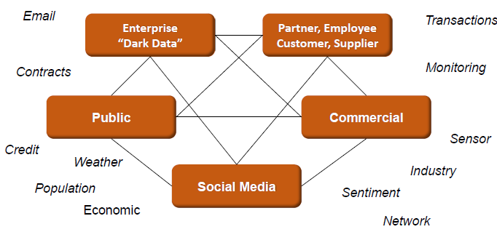
Where From Data Comes

Slide 5
Why
Easy
Quick
Effective & Efficient

Slide 6
Golden Rules
Know Your Audience
Choose the right Format
Tell a Story

Slide 7
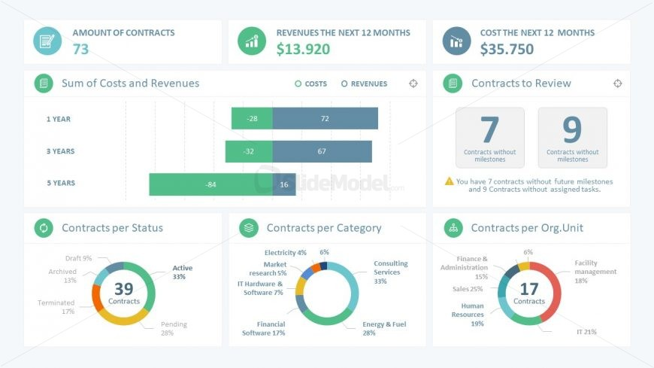
Story Telling

Slide 8
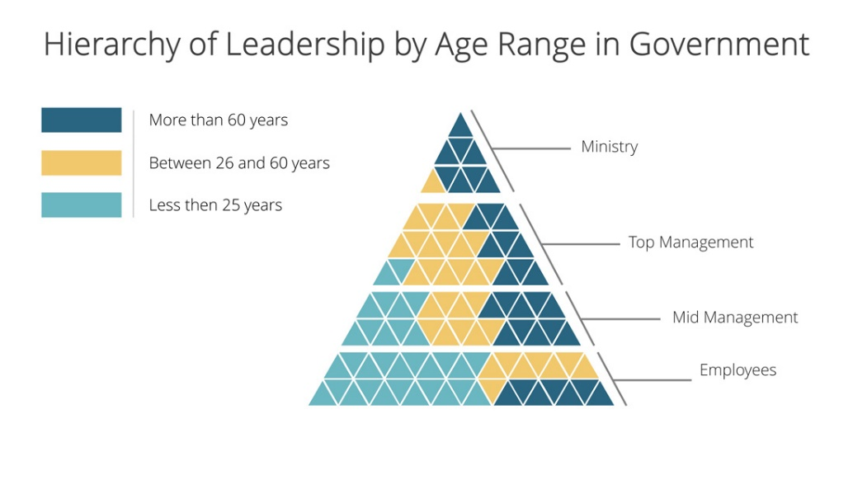
Story Telling

Slide 9
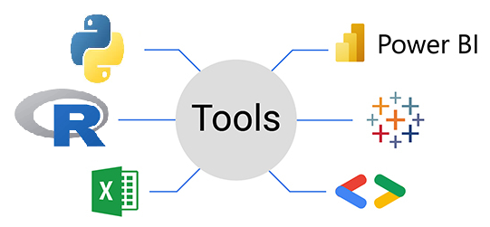
Visualization Tools

Slide 10

Visualization Tools : Python

