Slide 1

CO1-AT3-TECHNICAL PRESENTATION
CSA0504 : Database Management Systems
PRESENTED BY :
R. Pranathi(192525076)

Slide 2


Question 1: ER Diagram for
an Online Library System

Slide 3
Introduction
What is an ER Diagram?
ER stands for Entity Relationship Diagram.
It is used to design databases.
It shows entities, attributes, and relationships.
It helps organize data efficiently.

Slide 4
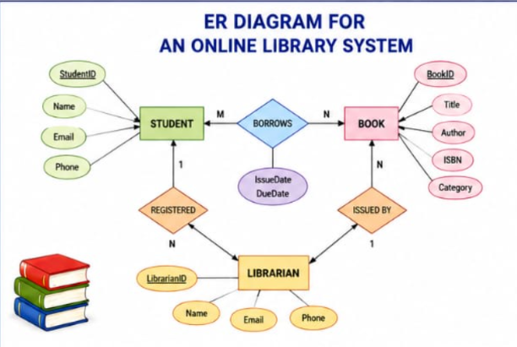
ER Diagram Components
Entities
Student
Book
Librarian
Issue
Attributes
Student ID
Book ID
Book Title
Issue Date
Relationships
Student borrows Book.
Librarian issues Book.

Slide 5
Advantages & Conclusion
Advantages:
Easy database design.
Reduces data redundancy.
Improves data organization.
Easy maintenance.
Conclusion: ER diagrams are the foundation of database design.

Slide 6
Question 2: EER Model –
University Case Study

Slide 7
Introduction
Enhanced Entity Relationship (EER) Model is an advanced version of ER (Entity-Relationship) model used for designing complex databases.
It supports inheritance, allowing subclasses to inherit attributes from a superclass.
Generalization combines similar entities into one higher-level entity.
Specialization divides a general entity into specific sub-entities.
It helps represent real-world systems more accurately and efficiently.

Slide 8
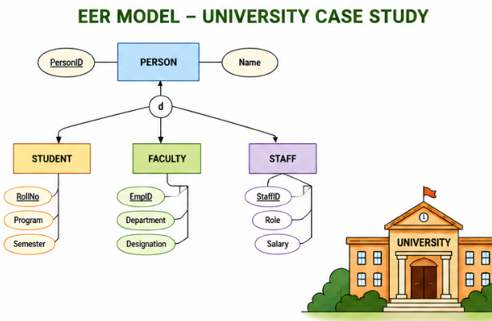
University Case Study
Superclass
Person
Subclasses
Student
Faculty
Staff
Generalization
Combines Student, Faculty, and Staff
into Person.
Specialization
Person is divided into Student, Faculty, and Staff.

Slide 9
Advantages & Conclusion
Advantages:
Represents real-world scenarios.
Supports inheritance.
Improves database flexibility.
Reduces redundancy.
Conclusion: EER models make database design more effective.

Slide 10
Question 3: Data Independence
in DBMS

Slide 11
Introduction
Data independence allows changes to the database without affecting application programs.
It makes the database flexible and easy to update.
It reduces maintenance effort and saves time.
It improves performance by enabling efficient data management.

Slide 12
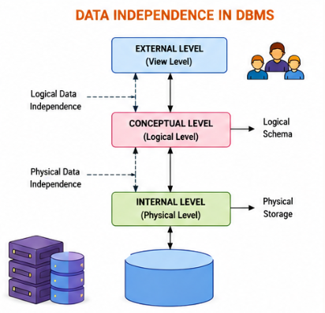
Types of Data Independence
Logical Data Independence
Changes logical schema.
No changes to applications.
Physical Data Independence
Changes physical storage.
Logical schema remains unchanged.

Slide 13
Advantages & Conclusion
Advantages:
Easy to modify the database structure.
Reduces application maintenance.
Improves database flexibility and scalability.
Enhances overall system performance.
Conclusion: Data independence enhances database efficiency by allowing changes without affecting application programs.

Slide 14
Question 4: Software Components
of DBMS

Slide 15
Query Processor
Functions:
Parses SQL Queries: Checks the syntax and converts SQL statements into an internal format.
Optimizes Queries: Selects the most efficient execution plan to improve performance.
Executes Queries: Processes the optimized query and performs the requested operations.
Retrieves Required Data: Fetches the requested data from the database and returns the results to the user.

Slide 16
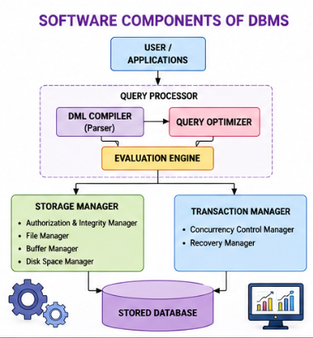
Storage Manager & Transaction Manager
Storage Manager
Stores data.
Manages files.
Handles memory.
Transaction Manager
Maintains ACID properties.
Controls concurrent transactions.
Performs recovery.

Slide 17
Conclusion
The Query Processor interprets and executes SQL queries efficiently.
The Storage Manager organizes, stores, and retrieves data securely.
The Transaction Manager ensures data consistency and maintains ACID
properties.
Together, these components ensure efficient, secure, and reliable
database management.

Slide 18
Question 5: Strong and Weak Entities

Slide 19
Strong Entity
Features
Has a Primary Key to uniquely identify each record.
Exists independently without relying on another entity.
Can be uniquely identified in the database.
Examples
Student – Student ID
Employee – Employee ID
Customer – Customer ID

Slide 20
Weak Entity
Features
Has no Primary Key and cannot be identified on its own.
Depends on a Strong Entity for its existence.
Uses a Partial Key along with the strong entity's key for identification.
Examples
Dependent – Depends on an Employee.
Order Item – Depends on an Order.
Book Copy – Depends on a Book.

Slide 21
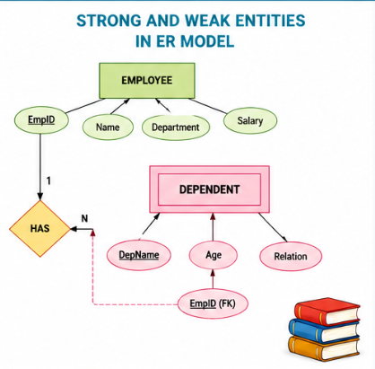

Slide 22
Comparison & Conclusion
Strong Entity | Weak Entity
Has Primary Key | No Primary Key
Independent | Dependent
Own Existence | Depends on Strong Entity
Single Rectangle | Double Rectangle
Conclusion:
Strong and weak entities help model real-world relationships accurately and improve database design.

Slide 23


