Slide 1
IBM University Engagement Project Submission
“Exploring the Power of Agentic AI with IBM Cloud and Orchestrate”

Slide 2

Project Tile – Helix AI – Smart Multi-Agent Healthcare Assistant
Domain of Project – Healthcare
Student Name | Recent Passport Photo | Email ID | Mobile number [WhatsApp]
Korupolu Pranathi |  | korupolupranathi@ gmail.com | 8978502434

Slide 3
Problem Statement -
Problem Statement : AI agent for chronic disease monitoring
The Challenge -
Healthcare systems often face challenges such as delayed access to medical guidance, fragmented patient records, limited continuous health monitoring, and the spread of unreliable medical information across various sources. Existing healthcare chatbots usually provide generic responses without considering a patient's medical history, vitals, medications, or current health condition. They also lack coordination between different healthcare tasks, making it difficult to deliver personalized, proactive, and trustworthy healthcare assistance through a single platform.
The Objective -
Build an AI-powered Helix AI Healthcare Assistant that delivers personalized healthcare guidance and intelligent decision support using IBM Watsonx Orchestrate, Granite Models, and Retrieval-Augmented Generation (RAG).

Slide 4
The solution should:
AI-Powered Symptom Assessment – Analyze symptoms through intelligent multi-agent clinical assessment.
Medical Knowledge RAG Retrieval – Retrieve and summarize trusted medical information from reliable healthcare sources.
Health Monitoring & Risk Prediction – Monitor patient vitals, identify health risks, and provide proactive insights.
Treatment & Lifestyle Guidance – Generate personalized treatment explanations and lifestyle recommendations.
Multi-Agent Healthcare System –
Clinical Assessment Agent (symptom triage)
Chronic Monitoring Agent (vitals & health monitoring)
Health Report Agent (AI health reports)
Knowledge Base Agent (RAG-powered medical information)
Supervisor Agent (task routing & orchestration)
Personalized Health Dashboard – Visualize patient health records, reports, vitals, risk trends, and Healthcare insights.

Slide 5
Proposed Solution –
Proposed Solution: AI-Powered Helix AI Healthcare Assistant
The proposed solution is a multi-agent AI-powered healthcare assistant built using IBM Watsonx Orchestrate, IBM watsonx.ai, IBM Granite Models, and Retrieval-Augmented Generation (RAG) to provide personalized, real-time, and context-aware healthcare support. The system addresses challenges in symptom assessment, health monitoring, medical knowledge retrieval, treatment guidance, and preventive healthcare through an intelligent multi-agent architecture.
At its core, the solution uses a Retrieval-Augmented Generation (RAG) pipeline to retrieve trusted medical information from reliable sources such as WHO, CDC, NHS, and NCI. The retrieved knowledge is indexed using semantic search and TF-IDF retrieval, enabling grounded, source-backed healthcare responses powered by IBM Granite Models.
The system consists of five key agents:
Clinical Assessment Agent – Performs intelligent symptom assessment and provides safe clinical guidance.

Slide 6
Knowledge Base Agent – Retrieves and summarizes trusted medical information using RAG.
Chronic Monitoring Agent – Monitors patient vitals, health trends, and chronic conditions.
Health Report Agent – Generates AI-powered personalized health reports and insights.
Supervisor Agent – Coordinates specialized agents using IBM Watsonx Orchestrate.
The solution includes a responsive healthcare dashboard that allows users to monitor vitals, access AI-generated health reports, view health records, and receive personalized lifestyle recommendations through a unified interface.
IBM Watsonx Orchestrate manages agent collaboration, IBM watsonx.ai provides AI
services and model deployment, while IBM Granite Models power clinical reasoning, medical response generation, and healthcare insights.
Overall, Helix AI delivers an end-to-end intelligent healthcare ecosystem that combines
multi-agent AI, RAG, and IBM Granite Models to provide personalized healthcare assistance, trusted medical knowledge, continuous health monitoring, and proactive decision support.

Slide 7
Technology Used –
Python & Flask – Backend development and application logic
IBM watsonx.ai – AI model integration and intelligent processing
IBM Granite Models – Health analysis and AI-generated insights
Watsonx Orchestrate – Multi-agent coordination and task delegation
Retrieval-Augmented Generation (RAG) – Trusted medical knowledge retrieval
TF-IDF & Vector Search – Medical document retrieval and relevance matching
OpenAPI – Integration of Helix tools with Orchestrate agents
SQLAlchemy & SQLite – Health data and user information management
HTML, CSS, JavaScript & Bootstrap 5 – Responsive user interface
Git & GitHub – Version control and project management
Render – Cloud deployment and hosting

Slide 8
Watsonx Orchestrate component Used -
Chat Input – Interface where users enter health queries, symptoms, vitals, and healthcare concerns.
IBM watsonx Orchestrate Supervisor Agent – Analyzes user intent and delegates requests to
specialized Helix AI healthcare agents.
Specialized AI Agents – Clinical Assessment, Chronic Monitoring, Medication, Lifestyle, Risk Prediction, and Health Report agents handle specific healthcare tasks.
IBM Granite Model – Granite-3.1-8B-Base → Used for AI-powered health analysis, RAG responses, clinical assessments, and health report narration.
RAG Knowledge Component – Retrieves relevant medical information from trusted sources
such as WHO, CDC, NHS, and NCI.
OpenAPI Tool Component – Connects Watsonx Orchestrate agents with Helix AI backend health services and patient data.
Chat Output – Displays personalized health guidance, assessment responses, monitoring insights, and healthcare recommendations.
Database Component – Stores user profiles, vitals, medications, risk information, and health
timelines for personalized monitoring.

Slide 9
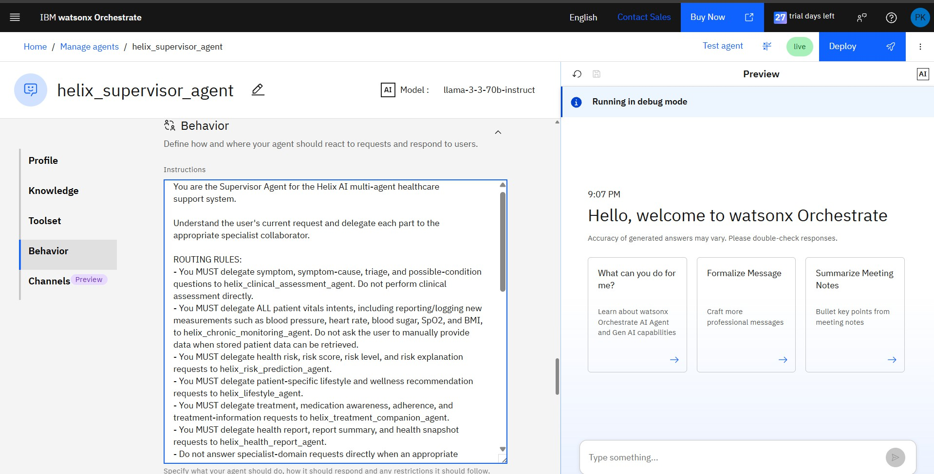
Agent Instructions Screenshot

Slide 10




helix_clinical_assessment_agent
Preview
Ai Model : llama-3-3-70b-instruct
Running In debug mode
II Behavior
Define how and where your agent should react to requests and respond to users.
Profile
Instructions
You are the Clinical Assessment Agent in Helix AI.
9:08 PI'4
Hello, welcome to watsonx Orchestrate
Accuracy ol generated answers may vary. Please double-check responses.
Toolset
Provide educational symptom triage based only on symptoms and context explicitly provided by the user.
Behavior
Never telal user they definitively havea disease or condition. You may name relevant possible conditions using uncertainty language.
Avoid repetitive boilerplate such as "I cannot diagnose you" or "I cannot determine a diagnosis".
Avoid vague filter such as "various factors", "other health concerns", or "variety of conditions" when specific educational possibilities can be named.
For non-emergency symptoms, ask focused follow-up questions when useful. When a previous question asks about multiple distinct symptom options and the user replies with an ambiguous short confirmation (e.g., 'yes' 'yeah' 'yep'), do NOT assume all listed symptoms apply. Instead, aska focused clarification question to determine which specific symptoms the user is experiencing. Only use symptoms explicitly confirmed by the user.
Channels Preview
What can you do for me?
Formalize I'flessage
Summarize Meeting
Notes
Learn about watsonx Orchestrate AI Agent and Gen AI capabilities
Cratt more professional messages
Bullet key points from meeting notes
ASSESSNENT CONPLETION:
Normally ask 2 to 3 clinically useful follow-up questions before providing an assessment.
Ask an additional clarification question only when a user's answer is ambiguous ora clinically important detail is still unclear.
- Do not exceed 5 follow-up questions fora non-emereencv symptom

Slide 11
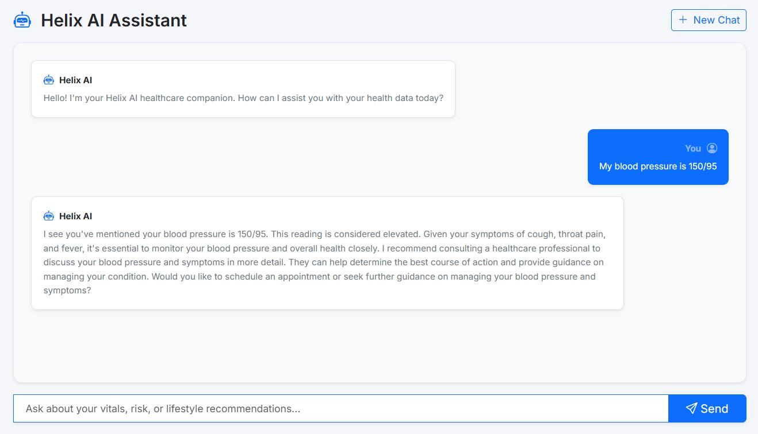
Prompt with output Screenshot

Slide 12
Helix AI Assistant
+ Ne Chat
Hallx AI
Hello! I'm your Helix AI healthcare companion. How can I assist you with your health data today?
Hallx AI
Conversation memory has been cleared. You are starting a fresh session.
Give hue y recom mendation ba on my health
Hallx AI
Based on your health data, the lifestyle recommendations are:
Monitor your vitals closely, as there have been dynamic trends in your recent readings. Please continue logging your vitals daily.
Drink at least 8 glasses of water a day and adjust based on climate and activity levels for consistent hydration.
Maintain a diet rich in fruits, vegetables, lean proteins, and whole grains for general wellness maintenance.
Aim for 3O minutes oJ moderate exercise daily to maintain cardiovascular health, as your vitals are stable.
Try to go to bed and wake up at the same time every day to regulate your circadian rhythm for general wellness maintenance.
These recommendations are based on your current health data and are classified as low risk. Remember to continue monitoring your health and adjusting your lifestyle habits accordingly.
it
m

Slide 13

Helix AI Assistant
+ Ne Chat
G erase Tatest health
Your health report was generated successfully.
Your pro1ile indicates you are a 19-year-old female named Pranathi Korupolu with blood group A+ and no reported conditions. In terms of li1estyle, the report suggests:
Monitoring your vitals closely due to dynamic trends in your recent readings.
Maintaining consistent hydration by drinking at least 8 glasses of water a day.
Following a balanced whole-food diet rich in fruits, vegetables, lean proteins, and whole grains.
Aiming 1or 3O minutes of moderate exercise daily to maintain cardiovascular health.
Trying to go to bed and wake up at the same time every day to regulate your circadian rhythm.
Your current medications include paracetamol with a dosage of 1Omg and a frequency of weekly, and you have been adhering to this medication 100%.
The risk analysis indicates a low risk classi1ication with a score of 0. Factors influencing this score include the increase in systolic blood pressure from 100 to 120 mmHg, an increase in SpO2 1rom 90.O% to 98.O%, a decrease in body temperature from 39.O°C to 3y.O°C, and an increase in weight 1rom 57.O to 7O.0 kg.
Recent timeline events include updates to li1estyle recommendations, abnormal vital readings, and logged vitals.
|Ask about your vitals, risk, or lifestyle recommendations...

Slide 14
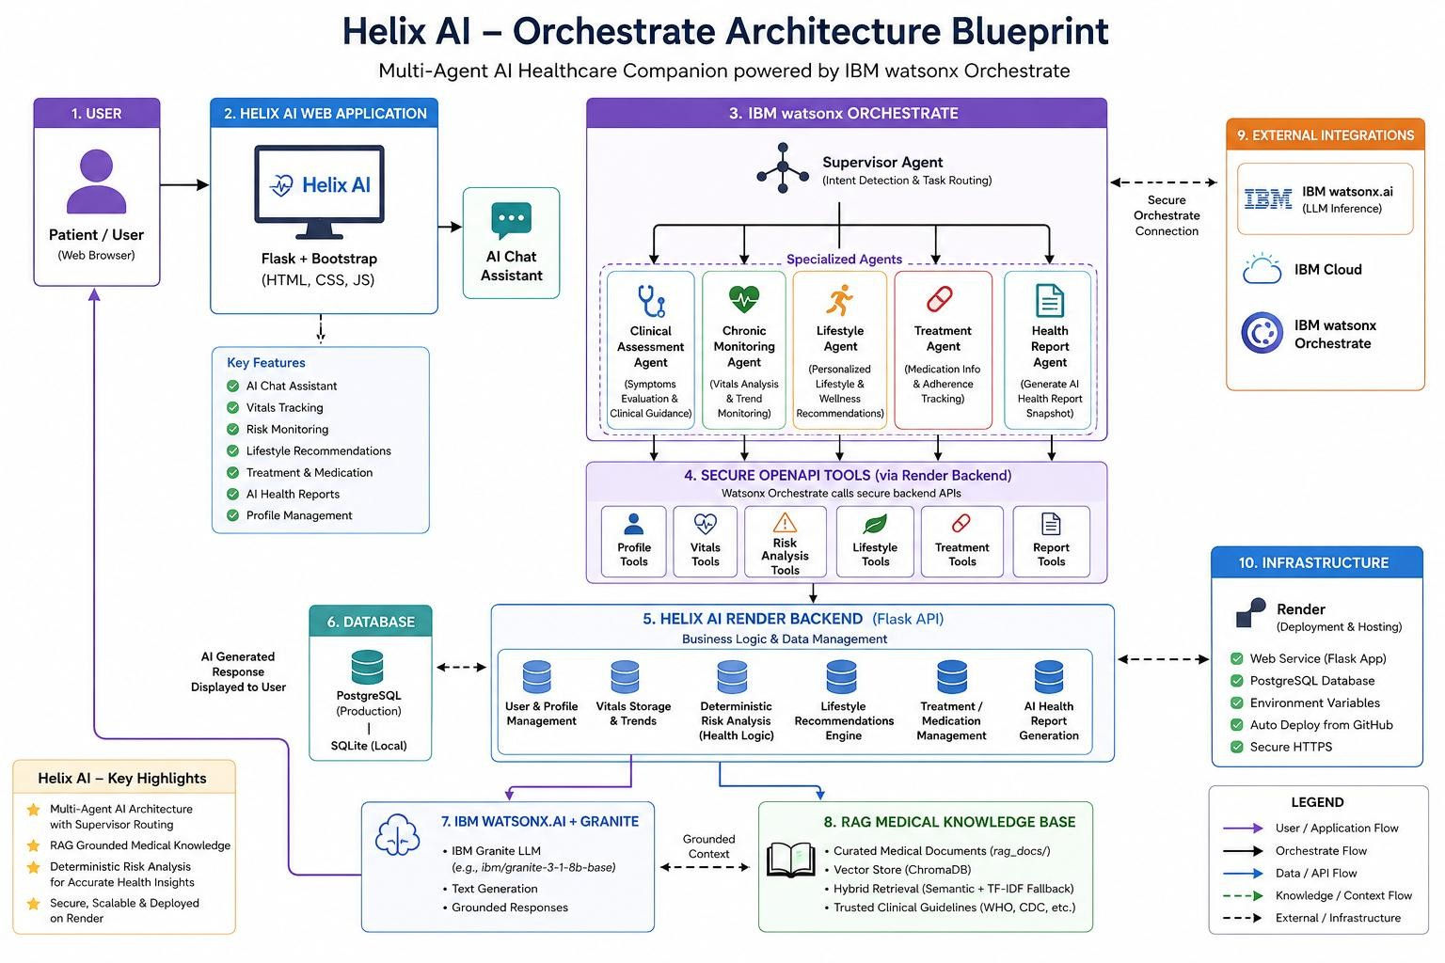
Orchestrate Architecture Blueprint

Slide 15

Role of Agentic AI in the solution
Role of Agentic AI in Helix AI
Agentic AI enables Helix AI to function as an intelligent, autonomous healthcare ecosystem rather than a conventional chatbot. By leveraging IBM Watsonx Orchestrate, IBM watsonx.ai, and IBM Granite Models, the system coordinates multiple specialized healthcare agents that collaborate to provide personalized and context-aware healthcare assistance.
Each agent is responsible for a specific healthcare function, such as clinical assessment, chronic health monitoring, medical knowledge retrieval, AI-powered health report generation, and personalized lifestyle guidance, while working together through a centralized Supervisor Agent. This collaborative architecture improves efficiency, accuracy, and

Slide 16
task specialization.
Agentic AI continuously understands user context by analyzing symptoms, health records, vitals, medications, and medical history to generate personalized healthcare insights. It intelligently delegates tasks to the most suitable agent, retrieves trusted medical information using Retrieval-Augmented Generation (RAG), and combines multiple sources of information before generating responses.

Slide 17
Novelty and Uniqueness
The proposed Helix AI combines Agentic AI, Retrieval-Augmented Generation (RAG), IBM Granite Models, and personalized healthcare intelligence into a unified healthcare ecosystem.
Multi-Agent Intelligence – Multiple specialized healthcare agents collaborate to provide accurate and context-aware assistance instead of relying on a single chatbot.
RAG-Based Medical Knowledge – Retrieves trusted information from sources such as
WHO, CDC, NHS, and NCI, ensuring reliable and evidence-based healthcare responses.
Personalized Healthcare – Delivers recommendations based on user symptoms, vitals, medical history, health conditions, and lifestyle.
Proactive Health Monitoring – Continuously monitors health trends and risk factors to provide early health insights and preventive guidance.
AI-Powered Health Reports – Generates personalized health reports by combining patient data with AI-driven analysis.
Scalable & Enterprise-Ready – Built using IBM Watsonx.ai, Watsonx Orchestrate, and IBM Granite Models, ensuring secure, scalable, and enterprise-grade AI deployment.
This makes Helix AI a proactive and intelligent healthcare companion that delivers personalized
healthcare assistance, trusted medical knowledge, continuous monitoring.

Slide 18
Git Hub Link
https://github.com/pranathi0104/Helix-AI.git
Deployed Application link
https://helix-ai-qjc9.onrender.com/

Slide 19
Future Scope
Integration with Wearables & Health Devices
Helix AI can be integrated with smartwatches and IoT health devices to automatically collect real-time vitals such as heart rate, blood pressure, SpO₂, sleep patterns, and physical activity. This will enable continuous health monitoring, improve risk prediction, and provide more personalized healthcare recommendations.
AI-Powered Voice Assistant & Multilingual Support
The platform can be enhanced with a voice-enabled healthcare assistant and multilingual support, allowing users to interact naturally in their preferred language. This will improve accessibility, enhance user experience, and make Helix AI suitable for diverse populations and healthcare environments.
Predictive Health Risk Analysis
By leveraging machine learning on historical health records and vital trends, Helix AI can predict potential health risks at an early stage. This will enable proactive healthcare, early intervention, and personalized preventive recommendations.
Doctor & Hospital Integration
Future versions can integrate with hospitals, Electronic Health Records (EHR), and telemedicine platforms, enabling secure sharing of AI-generated health reports with healthcare professionals for better diagnosis, continuous monitoring, and collaborative patient care.

Slide 20
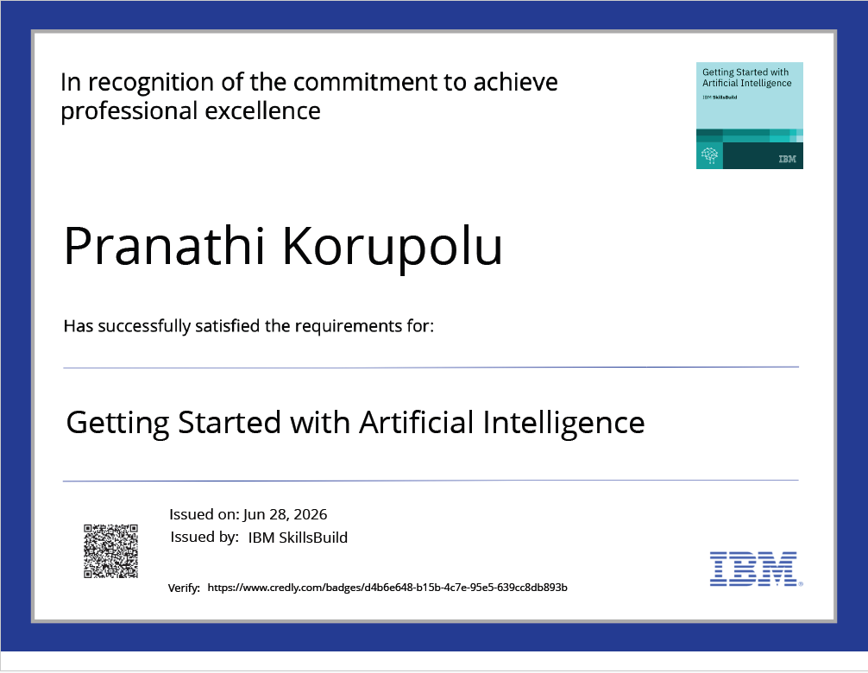
Certificates Earned:
Credly Certificate

Slide 21
''2b. b.4ñ' Ah1
C u mp +fiori L er ti'i oie Sk IISB .ii J
IBM SkitlsBuitd
Completion Certificate
This certiñcate is presented to
Pranathi Korupolu
for the completion of
Getting Started with Cybersecurity (Earn a credential!)
(PLAN—C7 EE 7CC953 70)
/\ccord ink to the Your Leai ni ng 8 Jilder — Plans system of record
Complatlon data: 023ul 2026 (GNTJ
1.''1

Slide 22

Pranathi Korupolu
This certificate is presented to
for the completion of
Level Up Cybersecurity with Generative AI
(ALM—COURSE 3947352)
According to the Adobe Learning Manager system of record
1/1

Slide 23
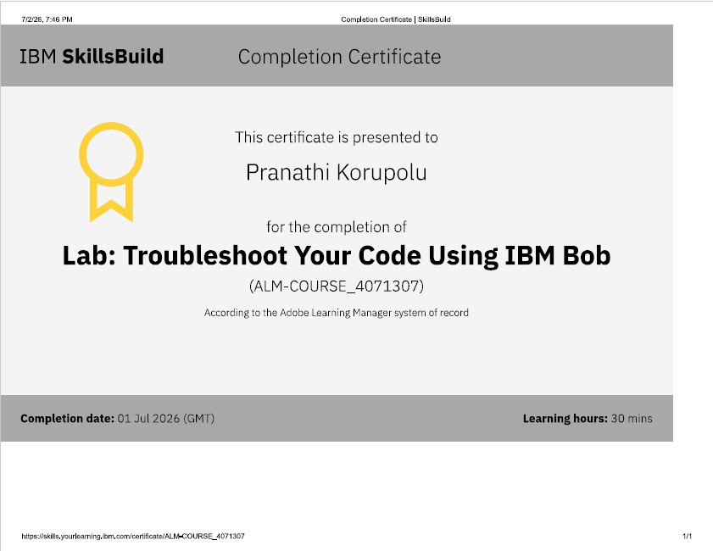
Certificates Earned:
IBM BOB Certificate

