Slide 1
"Smart Water Quality Monitoring Bottle"
Guide : Ms. P. Shilpa sri K. Pranathi(22UP1A6631)
(Asst. professor) T. Ashwitha(22UP1A6664)
DEPARTMENT OF CSE(AI & ML) K. Shveni(22UP1A6627)
R. Prathyusha(22UP1A6656)

Slide 2
Contents
Abstract
Introduction
Literature Survey
Existing system & Limitations
Problem statement
Software & Hardware Requirements
Proposed System
System Architecture
Methodology
Results
Conclusion
References

Slide 3
ABSTRACT
Access to clean drinking water is a crucial requirement, especially for travelers, outdoor enthusiasts, and individuals in areas where water quality is uncertain.
This project focuses on developing a smart water quality monitoring bottle that helps users understand the condition of their drinking water in real-time. The bottle is equipped with sensors to measure and display TDS, pH, and temperature values. These readings give users quick insights into whether the water is potentially safe to drink or needs further purification.
This system provides transparent, sensor-based water quality monitoring. It is a simple, portable, and affordable solution that encourages users to make informed decisions about the water they consume. The design is simple, efficient, and sustainable, offering a low-power, low-maintenance tool to support public health and environmental safety.

Slide 4
INTRODUCTION
Clean and safe drinking water is essential for good health, yet it is not always readily available—especially for people who travel, camp, or live in areas with uncertain water sources. Even if water looks clear, it can still contain harmful substances such as excessive dissolved solids or an unbalanced pH level, which can pose health risks if consumed.
This project presents a smart water quality monitoring bottle that helps users assess the safety of their drinking water in real-time. Instead of purifying the water, the system uses sensors to measure key parameters such as Total Dissolved Solids (TDS), pH, and temperature. These values are displayed on a digital screen attached to the bottle, providing instant feedback on water quality.
The goal is to create a portable, low-maintenance, and user-friendly tool that helps people make informed choices about their hydration. This is especially helpful in off-grid, outdoor, or emergency environments where access to tested water is limited. By increasing awareness of water quality, the project also encourages healthier habits and supports public safety.

Slide 5
LITERATURE SURVEY
TITLE | AUTHORS | METHODOLOGY USED/ ACHIEVEMENTS | LIMITATIONS/DRAWBACK
IoT based smart water quality monitoring system | Varsha Lakshmikantha, Anjitha Hiriyannagowda, dspace.aiub.edu | Sensors collect water data, microcontroller processes it, and IoT transmits to cloud for real-time monitoring and alert notifications | Sensor drift, power issues, poor connectivity, maintenance needs, high costs, limited parameters, and data security are key system limitations.
Design and Development of Multi Purpose Smart Water Bottle | NAMRATA SWARGARI www.academia.edu | Design, integrate Peltier module, sensors, microcontroller; test heating/cooling, and user interface. | High power consumption, limited battery life, slow temperature adjustment, bulkiness, and high cost due to advanced components.

Slide 6
TITLE | AUTHOR | METHODOLOGY USED/ ACHIEVEMENTS | LIMITATIONS/DRAWBACK
Photovoltaic Bottle with Multiple Features Using Solar | SUPRIYA TELSANG SWAPNIL PAWAR ieeexplore.ieee.org | Design photovoltaic bottle with transparent solar cells, test energy harvesting, and usability for sustainability. | Limited energy output, high cost, dependency on sunlight,bulkiness, and durability issues in harsh outdoor conditions.

Slide 7
EXISTING SYSTEM
Sensors collect water data, microcontroller processes it, and IoT transmits to cloud for real-time monitoring and alert notifications
Design photovoltaic bottle with transparent solar cells, test energy harvesting, and usability for sustainability.

Slide 8
LIMITATIONS
Power issues,
Poor connectivity,
High costs,
Dependency on sunlight,

Slide 9
Problem statement
Traditional water quality monitoring methods are often time-consuming, costly, and lack real-time capabilities. Therefore, there is a need for an efficient, iot-based smart water quality monitoring system that can continuously track water parameters in real time

Slide 10
SOFTWARE & HARDWARE REQUIREMENTS
Software requirements:
Embedded C/C++ (arduino IDE or platformio)
Sensor calibration algorithms
Data visualization library
Hardware Requirements:
Microcontroller
Ph sensor
TDS sensor
Temperature sensor
Battery

Slide 11
PROPOSED SYSTEM
The proposed system uses iot technology to monitor water quality in real time. It includes sensors to measure ph, temperature, and TDS. These sensors connect to a microcontroller (e.g., ESP32 or arduino) and display the water quality on lcd.

Slide 12
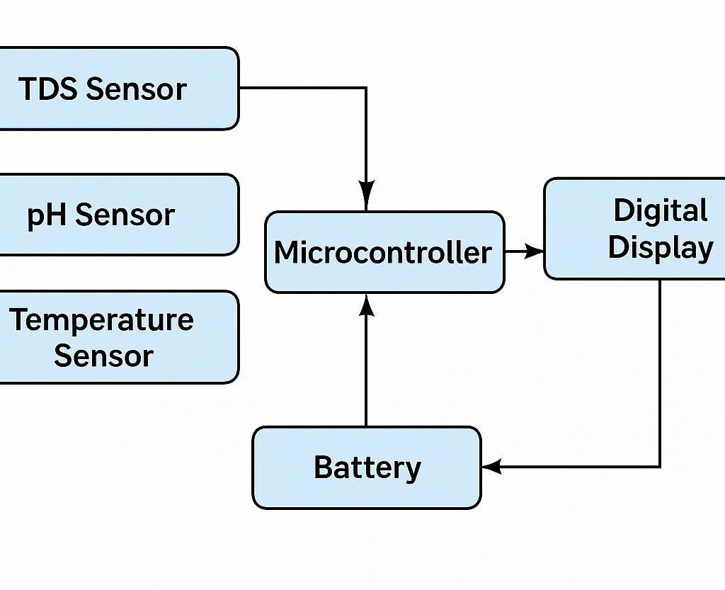
System Architecture

Slide 13
METHODOLOGY
Component Selection:
TDS Sensor to detect dissolved solids.
Ph Sensor to measure acidity or alkalinity.
Temperature Sensor to monitor water temperature.
Select a microcontroller (E.G., Arduino Or ESP32) to process sensor data.
Include a digital display (E.G., OLED Or LCD) to show real-time results.

Slide 14
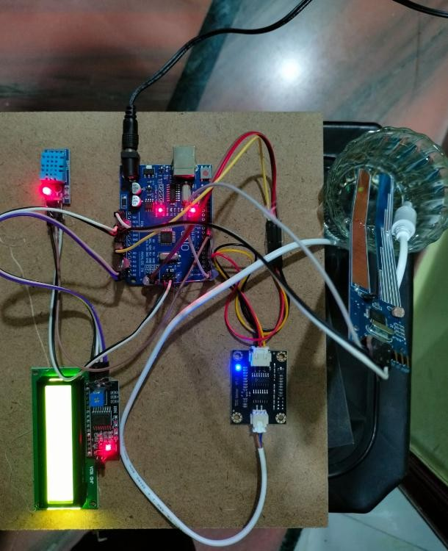
results

Slide 15
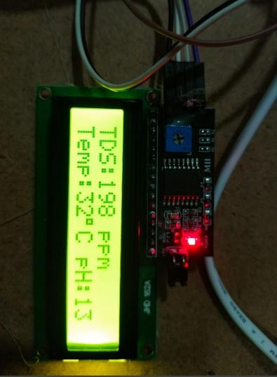

Slide 16
CONCLUSION
This smart water quality monitoring bottle provides a simple and portable way to check the safety of drinking water. By displaying real-time TDS, pH, and temperature values, it helps users make informed decisions, especially in uncertain or outdoor environments. The system is compact, easy to use, and useful for promoting safe and healthy hydration habits.

Slide 17
REFERENCES
“Iot based smart water quality monitoring system”, Varsha lakshmikantha, anjitha hiriyannagowda, international journal of engineering research & technology (IJERT).
“Design and development of multi purpose smart water bottle ”,NAMRATA SWARGARI (2020).
journal of environmental management.
"Photovoltaic bottle with multiple features using solar module" SUPRIYA TELSANG. (2021).

Slide 18
THANK YOU

