Slide 1

Sentiment Analysis on Product/Movie Reviews
DATA SCIENCE (24AD3107) Project Review-2
17-09-2026
 | Under the Guidance of Prathusha Assistant Professor, Department of Computer Science and Engineering, KLH CSE Bowrampet Campus
Team Members 2420030043-P.Pranathi 2420030093-E.Mahathi 2420030773-V.Mani MahaLakshmi

Slide 2
Outline of Project Work
Focus
Introduction
Literature Survey
Challenges
Research Objectives
Conclusion & Future Work
References
Publications Details

Slide 3
Problem Statement
Online platforms contain a large number of product and movie reviews, making it difficult and time-consuming to manually analyze customer or viewer opinions. These reviews contain useful information about satisfaction, complaints, and preferences, but understanding them at a large scale is challenging. Therefore, there is a need for an automated system that can analyze review text and classify the sentiment as Positive, Negative, or Neutral using Natural Language Processing and Machine Learning techniques.
The main problem is to automatically understand the opinion expressed in a review and determine whether it is Positive, Negative, or Neutral. Since reviews are written in natural language, computers cannot directly understand them. Therefore, Natural Language Processing techniques are required to clean and process the text and convert it into useful numerical features.
This project aims to develop a Sentiment Analysis system that uses NLP techniques such as text preprocessing, tokenization, and TF-IDF feature extraction along with Machine Learning algorithms such as Naïve Bayes and Logistic Regression to classify product or movie reviews into different sentiment categories. The performance of the models is evaluated using Accuracy, Precision, Recall, and F1-Score.

Slide 4
Objectives
Collect review data
Gather product or movie reviews from suitable datasets.
Preprocess the review text
Clean the data by removing punctuation, special characters, unnecessary words, and converting text into lowercase.
Perform text processing
Tokenize the reviews and prepare the text for machine learning.
Build machine learning models
Train classification models such as:
  Naïve Bayes
  Logistic Regression
Classify sentiments
Predict each review as:
  Positive
  Negative
  Neutral
Evaluate model performance
Compare the models using:
  Accuracy
  Precision
  Recall ,F1-Score

Slide 5
Literature Survey
Authors | Title of the Paper | Methodology | Inferences | Limitation/Future work
Pang et al. 2002 | Sentiment Classification using Machine Learning Techniques | Machine learning for movie review sentiment classification Naïve Bayes, Maximum Entropy and SVM Text-based feature extraction | Demonstrated that machine learning can classify movie reviews based on sentiment. Showed that different ML algorithms produce different classification performance. | Focused mainly on binary sentiment classification. More advanced NLP methods can be explored for contextual and neutral sentiment.
Devika et al. 2016 | Sentiment Analysis: A Comparative Study on Different Approaches | NLP-based sentiment analysis Text preprocessing Machine learning and lexicon-based approaches Feature extraction | Shows that preprocessing and feature selection have an important effect on sentiment classification. Different approaches have different strengths and weaknesses. | Traditional approaches may have difficulty understanding complex language, sarcasm, and contextual meaning. Future work can explore deep learning and advanced NLP models.
Jim et al. 2024 | Recent Advancements and Challenges of NLP-Based Sentiment Analysis: A State-of-the-Art Review | Review of NLP sentiment-analysis techniques Machine Learning and Deep Learning Preprocessing and feature extraction Evaluation metrics | Sentiment analysis is widely used for extracting positive, negative, and neutral opinions. Reviews common datasets, preprocessing methods, ML/DL models, and evaluation metrics. | Challenges remain in handling sarcasm, context, multilingual text, and complex sentiment. Future research can explore LLMs, pre-trained models, and more advanced contextual approaches.

Slide 6
Problem Gap Identification
Existing Approach | Problem / Gap | Our Project
Manual review analysis | Time-consuming and difficult for large datasets | Automates sentiment analysis
Star/rating-based analysis | Does not fully understand review text | Analyzes actual text
Raw text processing | Machine learning models cannot directly process text | Uses NLP preprocessing
Text represented as words | Difficult for ML models to use directly | Uses TF-IDF features
Single ML model | Performance may vary depending on data | Compares Naïve Bayes and Logistic Regression
Basic accuracy measurement | Accuracy alone may not show complete performance | Uses Accuracy, Precision, Recall, and F1-Score
Large number of reviews | Difficult to identify overall customer opinion quickly | Provides automated sentiment classification

Slide 7
Innovation, Creativity, and Novelty
Innovation
The innovation of our project is the combination of Natural Language Processing and Machine Learning for automated review analysis. The system uses NLP to process review text, TF-IDF to extract important features, and machine learning algorithms to classify the sentiment. It also compares different models to understand their performance.
Creativity
The creative aspect of the project is providing a simple and user-friendly way to analyze reviews. A user can enter a product or movie review, and the system can predict whether the review is Positive, Negative, or Neutral. The results can also be represented using graphs and visualizations to make the sentiment information easier to understand.
Novelty
The novelty of the project is the integration of text preprocessing, TF-IDF feature extraction, Naïve Bayes, Logistic Regression, sentiment prediction, and multiple evaluation metrics into one practical system. The same approach can be adapted to analyze both product and movie reviews and provide quick insights from large amounts of text data.

Slide 8
Feasibility and Project Plan
Technical Feasibility: Can be developed using Python, NLP, TF-IDF, and Machine Learning libraries.
Data Feasibility: Product and movie review datasets are easily available for training and testing.
Economic Feasibility: Uses free and open-source tools, so development cost is low.
Operational Feasibility: Simple system that can automatically classify reviews and display sentiment results.
Phase | Activity | Main Work
Phase 1 | Problem & Literature Survey | Identify the problem, objectives, existing methods, and research gap.
Phase 2 | Data Collection & Preprocessing | Collect review datasets and clean, tokenize, and prepare the text.
Phase 3 | Feature Extraction & Model Development | Apply TF-IDF and train Naïve Bayes and Logistic Regression models.
Phase 4 | Evaluation & Visualization | Evaluate models using Accuracy, Precision, Recall, and F1-Score and visualize results.
Phase 5 | Testing & Documentation | Test the system with new reviews, improve the model, and prepare the report and presentation.

Slide 9
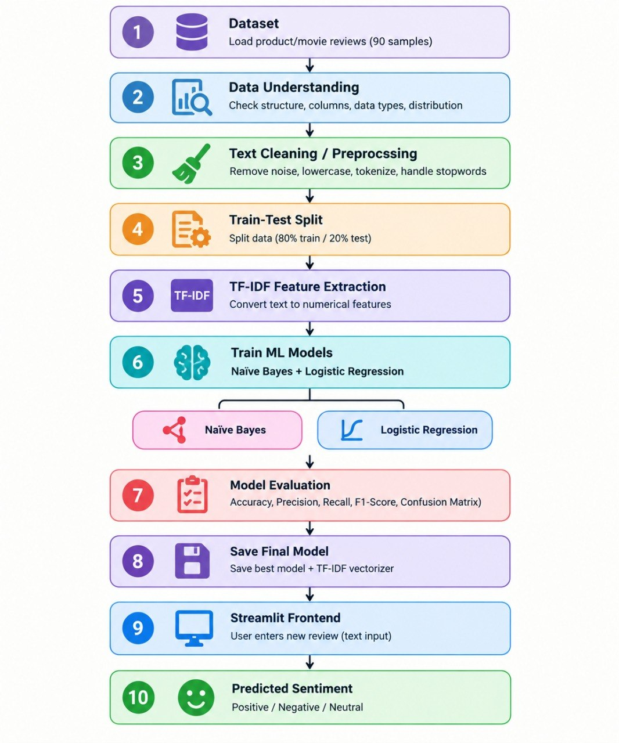
Work flow:

