Slide 1

CAMPUS IQ – Intelligent Resource Management for Smart Campuses
 | Under the Guidance of Professor Lavanya Gottumukkala Department of Computer Science and Engineering, KLH CSE Bowrampet Campus
Team Members Bhargavi Devi - 2420030588 Pranathi - 2420030043 Chaithanya - 2420090077 Mahathi - 2420030093

Slide 2
Abstract
Campus IQ is an intelligent resource management system designed to improve the utilization of resources in smart campuses. It manages resources such as classrooms, laboratories, computers, equipment, electricity, library facilities, and other infrastructure. The system collects campus data, stores it in a database, processes it using Python/Django, and analyzes resource usage using AI techniques. Based on the analysis, the system provides intelligent recommendations for better resource allocation. An admin dashboard helps administrators monitor usage and make informed decisions for efficient campus management.

Slide 3
Problem Statement
Educational institutions manage a large number of resources such as classrooms, laboratories, equipment, computers, electricity, and library facilities. Traditional resource management is often manual and may result in underutilization, overutilization, resource conflicts, and inefficient allocation.
Campus IQ aims to solve these problems by collecting and analyzing campus resource data and providing AI-based recommendations for efficient resource utilization.

Slide 4
Objectives
To develop a centralized system for managing campus resources.
To collect and store information about campus resources and their usage.
To analyze resource availability, occupancy, usage, and energy consumption.
To identify inefficient or underutilized resources.
To provide AI-based recommendations for better resource allocation.
To provide an admin dashboard for monitoring campus resources.
To support efficient and smarter campus management.

Slide 5
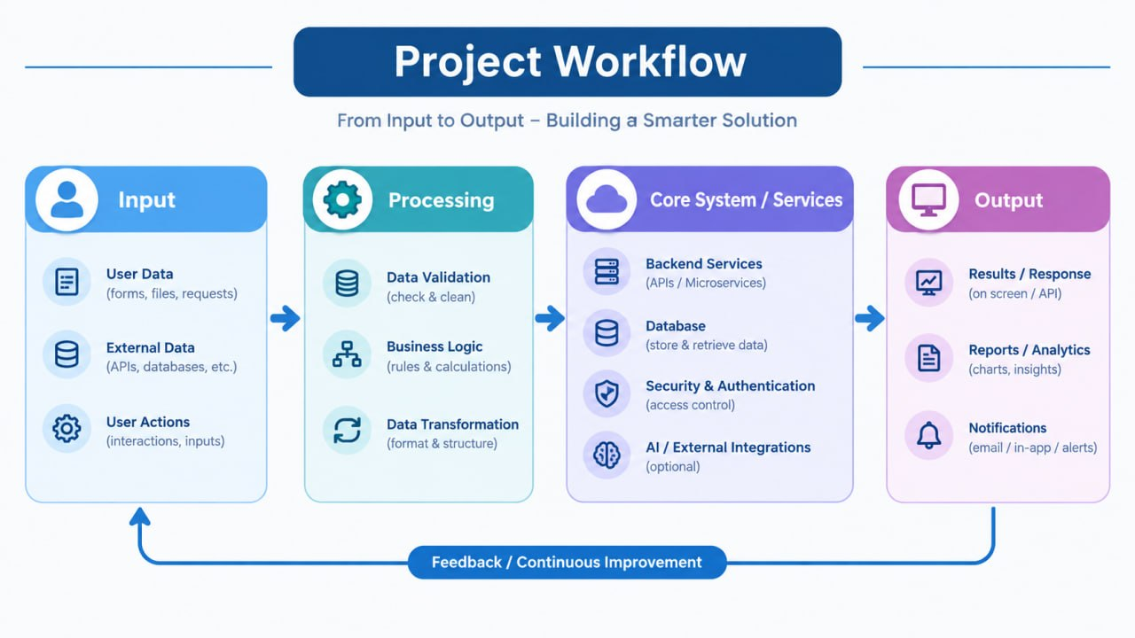
Work Flow

Slide 6
Tecnology Stack
Component | Technology
Frontend | HTML, CSS, JavaScript / React
Backend | Python – Django
Database | MySQL / PostgreSQL
Data Processing | Python
AI/ML | Python, Scikit-learn
Dashboard | Web-based Admin Dashboard
Development | VS Code / PyCharm
Version Control | Git & GitHub

Slide 7
OutCome
Output
Resource utilization information
Usage analysis
Availability status
Energy usage insights
AI recommendations
Better resource allocation decisions
Campus IQ is expected to help institutions:
Reduce inefficient resource usage.
Improve utilization of classrooms and laboratories.
Identify underutilized resources.
Improve resource allocation.
Monitor energy consumption.
Support data-driven administrative decisions.
Move toward smarter and more efficient campus management.

