Slide 1

Intrusion Detection System Using Federated Learning
by
B.PRANATHI
Roll No. 224G1A0571
T.JOSHIKA
Roll No. 234G5A0504
C.KRISHNA KOWSHIK
Roll No. 224G1A0538
Under the guidance of
Dr. S.Ravi Kumar, M.C.A., Ph.D.
Associate Professor
Department of Computer Science and Engineering
Srinivasa Ramanujan Institute of Technology
Autonomous
Rotarypuram Village, B K Samudram Mandal, Ananthapuramu – 515701.
2025-2026
B - 15
DEPT. OF COMPUTER SCIENCE AND ENGINEERING
SRINIVASA RAMANUJAN INSTITUTE OF TECHNOLOGY
1

Slide 2
Queries From Review 0
Intrusion Detection System Using Federated Learning
What is Federated Learning?
What is the main objective of your project?
What real-time problem does your project solve?
What are the algorithms used?
Why did you combine Federated Learning with IDS?
Srinivasa Ramanujan Institute of Technology

Slide 3
Title Explaination
Intrusion Detection System Using Federated learning
Intrusion Detection System (IDS) →Refers to a cybersecurity mechanism designed to monitor network or system activities and detect malicious behavior, unauthorized access, or potential security threats. The IDS analyzes traffic patterns and system data to identify anomalies or known attack signatures, helping organizations respond quickly to cyber threats.
Federated Learning (FL) →Indicates the use of a decentralized machine learning approach where multiple clients collaboratively train a global model without sharing their raw data. Instead of sending sensitive data to a central server, only model updates are shared. This ensures data privacy, security, and compliance while still improving the detection model’s performance.
Privacy-Preserving and Distributed Threat Detection →Integrates Federated Learning with IDS to enable distributed threat detection without sharing sensitive user data, ensuring privacy preservation.
Srinivasa Ramanujan Institute of Technology

Slide 4
Contents
Intrusion Detection System Using Federated learning
Abstract
Introduction
Literature Survey
Existing System
Proposed System
Planning
Design
Implementation
Research Paper
References
GitHub Link
Srinivasa Ramanujan Institute of Technology

Slide 5
Abstract
Intrusion Detection System Using Federated learning
The Intrusion Detection System with Federated Learning (IDS-FL) is a secure and intelligent platform developed to detect cyber threats in a distributed environment while preserving data privacy. The system monitors network and system activities to identify malicious behavior, unauthorized access, and potential security attacks in real time.The system replaces the traditional manual scheduling process, which is time-consuming, stressful, and prone to human errors.
Traditional intrusion detection systems rely on centralized data collection, which can raise privacy concerns and increase the risk of data breaches. To overcome this limitation, the proposed system integrates Federated Learning, enabling multiple clients or devices to collaboratively train a global threat detection model without sharing their raw data..
The primary objective of the system is to enhance cybersecurity while ensuring privacy preservation and secure model training. Model updates are aggregated centrally, improving detection accuracy without exposing sensitive information. The system also provides real-time monitoring, alert generation, and performance metrics for better security management.
Srinivasa Ramanujan Institute of Technology

Slide 6
Introduction
Intrusion Detection System Using Federated learning
This project develops a secure and intelligent Intrusion Detection System integrated with Federated Learning to enhance cybersecurity in distributed environments. It eliminates the need for centralized data collection and reduces privacy risks by allowing model training directly on local devices.
The system supports collaborative model updates from multiple clients without sharing raw data. This helps handle large-scale and real-time cyber threats efficiently while maintaining data confidentiality and compliance.
The project is unique because it combines advanced machine learning with privacy-preserving techniques to solve real-world cybersecurity challenges in a scalable and transparent manner.
It provides a centralized platform for monitoring network activities, managing threat alerts, and analyzing security metrics through an interactive dashboard. This improves detection accuracy and simplifies security administration.
The system ensures secure and unbiased model training by aggregating only encrypted model updates and preventing data leakage. This strengthens overall network resilience and enables fair, distributed threat detection across enterprise environments.
Srinivasa Ramanujan Institute of Technology

Slide 7
Literature Survey
Intrusion Detection System Using Federated learning
Literature Survey
Nguyen et al. (2022)
Proposed a federated learning–based intrusion detection framework for distributed network environments. The study demonstrated that federated learning allows multiple organizations to collaboratively train intrusion detection models without sharing sensitive network data, thereby improving privacy and detection performance.
Li et al. (2023)
Developed a privacy-preserving intrusion detection system using federated deep learning techniques. Their approach combines local model training with global aggregation to detect network attacks effectively while maintaining data confidentiality across different network nodes.
Sharma & Chen (2023)
Introduced a collaborative intrusion detection model using federated learning and deep neural networks. The research showed that decentralized learning can improve detection accuracy and reduce the risk of data leakage compared to traditional centralized IDS models.
B-15 | Department of Computer Science and Engineering | Srinivasa Ramanujan Institute of Technology | 7

Slide 8
Literature Survey
Intrusion Detection System Using Federated learning
Literature Survey
Zhang & Liu (2024)
Designed a deep learning–based federated IDS for cloud computing environments. The study showed that federated learning enhances collaborative threat detection while ensuring that sensitive cloud traffic data remains locally stored.
Patel et al. (2024)
Implemented a federated anomaly detection system using neural networks for network security monitoring. The research confirmed that federated training improves model generalization by learning from diverse network datasets distributed across multiple organizations.
Alazab et al. (2025)
Proposed a hybrid intrusion detection system combining federated learning and deep neural networks for cyber threat detection. The study demonstrated that collaborative model training significantly improves detection accuracy for complex cyber attacks while preserving privacy.
B-15 | Department of Computer Science and Engineering | Srinivasa Ramanujan Institute of Technology | 8

Slide 9
Existing System
Intrusion Detection System Using Federated learning
Existing System
In the existing approach, intrusion detection systems are typically implemented using centralized machine learning or rule-based methods where all network data is collected and analyzed at a single central server.
Centralized IDS require sharing large amounts of network traffic data from multiple organizations or devices, which may lead to privacy concerns, data leakage, and security risks.
In large-scale distributed environments such as cloud computing, IoT networks, and enterprise systems, collecting and transferring data to a central server can cause high communication overhead, delays, and scalability issues.
Some existing research focuses on improving intrusion detection accuracy using machine learning or deep learning, but they often do not address the data privacy and decentralized learning challenges in modern distributed networks.
B-15 | Department of Computer Science and Engineering | Srinivasa Ramanujan Institute of Technology | 9

Slide 10
Proposed System
Intrusion Detection System Using Federated learning
Proposed System
The proposed system is a Federated Learning-based Intrusion Detection System (IDS-FL) designed to detect network attacks while preserving data privacy. The system analyzes network traffic data to classify activities into normal and malicious categories.
A large and diverse cybersecurity dataset is collected and organized into a dedicated dataset module to overcome the limitation of limited training data. This dataset contains multiple attack types and normal traffic records from different sources.
The dataset is preprocessed and cleaned to remove noise and missing values. Feature selection and normalization techniques are applied to improve model performance and training efficiency.
The system uses Federated Learning, where multiple distributed clients train local intrusion detection models using their own data. Instead of sharing raw data, only model parameters are shared with a central server, ensuring privacy and security.
B-15 | Department of Computer Science and Engineering | Srinivasa Ramanujan Institute of Technology | 10

Slide 11
Proposed System
Intrusion Detection System Using Federated learning
Proposed System
Deep learning and machine learning models such as CNNand Random Forest can be used for feature extraction and attack classification.
The central server aggregates the local models using federated averaging to create a global IDS model. The trained model is evaluated using metrics such as accuracy, precision, recall, and F1-score, and the best performing model is used for final intrusion detection.
The final IDS-FL system can detect network intrusions in real time and can be deployed in cloud environments, enterprise networks, and IoT infrastructures to enhance cybersecurity while maintaining data privacy.
B-15 | Department of Computer Science and Engineering | Srinivasa Ramanujan Institute of Technology | 11

Slide 12
Plannin
Intrusion Detection System Using Federated learning
Planning
The first step in the project planning was to identify the problem of centralized intrusion detection systems, where sharing raw network data can cause privacy risks and security concerns.
The project objective was defined as developing a privacy-preserving intrusion detection system using Federated Learning (IDS-FL) capable of detecting normal and malicious network activities.
A plan was made to collect and prepare multiple cybersecurity datasets containing various types of network attacks and normal traffic to train the detection models.
Dataset preparation and management:
Dataset Sources:
Public cybersecurity datasets such as CICIDS, NSL-KDD, and other network traffic datasets
Preprocessing: Removing missing values, noise filtering, and feature normalization
Feature Selection: Identifying important network traffic features for intrusion detection
Data Distribution: Splitting datasets across multiple federated clients for distributed training
Privacy Preservation: Ensuring only model parameters are shared instead of raw data
B-15 | Department of Computer Science and Engineering | Srinivasa Ramanujan Institute of Technology | 12

Slide 13
Software Requirements
Intrusion Detection System Using Federated learning
Programming Languages: Python for implementing machine learning and federated learning models. JavaScript for building the desktop application interface.
Development Tools and Frameworks: TensorFlow / PyTorch for deep learning model development. Scikit-learn for machine learning algorithms and data preprocessing. Flower (Federated Learning Framework) for implementing federated learning architecture. Pandas and NumPy for data processing and analysis.
Desktop Application Framework: Electron.js for developing a cross-platform desktop application interface to monitor intrusion detection results.
Data Processing and Visualization: Matplotlib / Seaborn for visualization and performance evaluation. Jupyter Notebook / Google Colab for experimentation and model training.
Web Technologies: HTML for application layout and structure. CSS for styling the user interface. JavaScript for interactive frontend functionality.
Srinivasa Ramanujan Institute of Technology

Slide 14
Software Requirements
Intrusion Detection System Using Federated learning
Planning
Operating System : Windows / Linux
Development Environment : VS Code / Jupyter Notebook
Hardware Requirements:
Processor – Intel i3 / i5 / i7 or equivalent processor
Hard Disk – Minimum 160 GB storage
Keyboard – Standard keyboard
RAM – Minimum 8 GB
Network – Internet connection required for federated learning communication between clients and server
Srinivasa Ramanujan Institute of Technology

Slide 15
Datasets/Modules
Intrusion Detection System Using Federated learning
Authentication & Role Management Module: Handles user registration, secure login, JWT-based session management, and role-based dashboard access (Admin, Security Analyst, Client Node). Ensures secure API access and controlled system operations.
Federated Learning Module: Manages distributed model training across multiple client nodes. Supports local training, secure model update sharing, global model aggregation (e.g., FedAvg), and client participation management.
Intrusion Detection Module: Performs data preprocessing, feature extraction, attack classification, and anomaly detection. Identifies malicious activities such as DoS, Brute Force, Port Scanning, and other cyber threats.
Dashboard & Analytics Module: Displays system health, training progress, detection accuracy, attack statistics, and performance metrics through interactive charts and reports.
Datasets Used:
CIC-IDS2017 Dataset – For modern real-world attack simulation and classification.
Srinivasa Ramanujan Institute of Technology

Slide 16
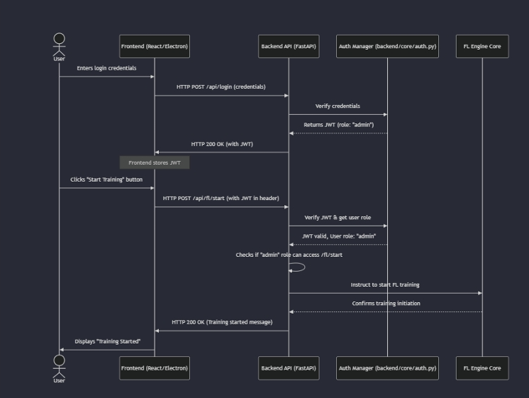
Design-Sequence Diagram
Intrusion Detection System Using Federated learning
Design-Sequence Diagram
A UML sequence diagram defines the dynamic behavior of IDS‑FL by showing how system components interact over time through ordered messages. It illustrates the end‑to‑end flow of intrusion detection, beginning with data collection from distributed nodes and progressing through preprocessing, feature extraction, and federated model training.
B-15 | Department of Computer Science and Engineering | Srinivasa Ramanujan Institute of Technology | 16

Slide 17
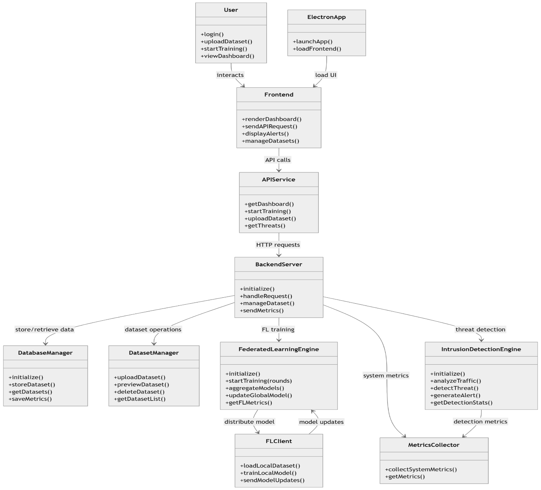
Design-Class Diagram
Intrusion Detection System Using Federated learning
Design-Class Diagram
A UML class diagram represents the static structure of a system, showing classes, their attributes, methods, and relationships.
In this project, the class diagram models key components such as dataset management, federated learning engine, FL clients, intrusion detection engine, API services, and dashboard interface that work together to perform privacy- preserving intrusion detection and real-time threat monitoring.
B-15 | Department of Computer Science and Engineering | Srinivasa Ramanujan Institute of Technology | 17

Slide 18
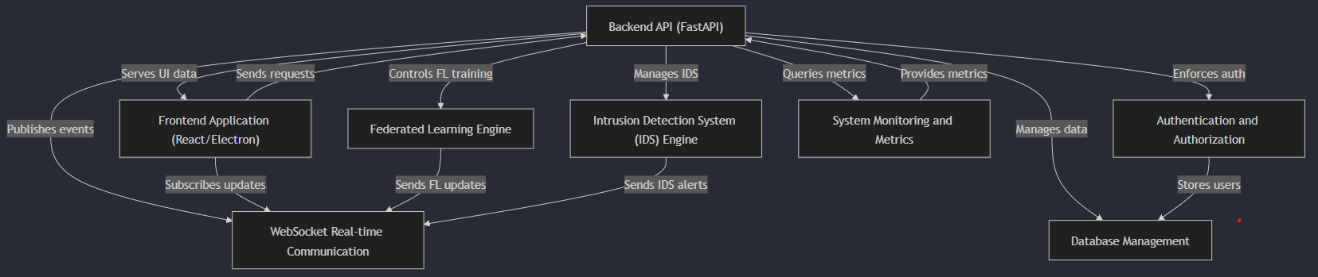
Intrusion Detection System Using Federated learning
Implementation-System Architecture
The system follows a modular, API-driven architecture centered around a FastAPI backend coordinating all components.
The Frontend (React/Electron) handles user interaction and communicates with the backend via REST APIs and WebSockets. The Backend API acts as the central controller, managing FL training, IDS operations, authentication, metrics, and database interactions
The Federated Learning Engine performs distributed model training and sends real-time updates without sharing raw data.
The Database, Monitoring, and Authentication modules ensure secure data storage, system observability, and role-based access control.
Srinivasa Ramanujan Institute of Technology

Slide 19
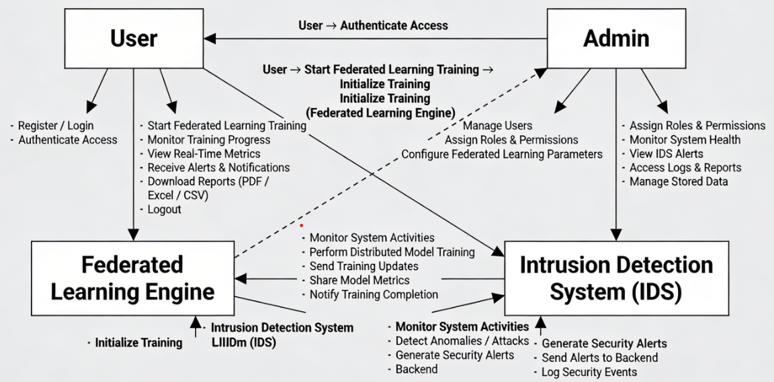
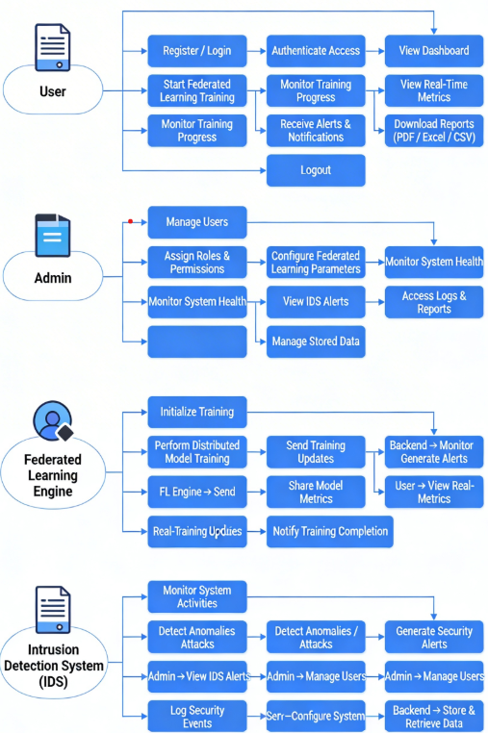
Intrusion Detection System Using Federated learning
Implementation
Integrates Federated Learning with Intrusion Detection System (IDS) for secure and privacy-preserving training.
Users can start training, monitor progress, and view real-time metrics through the system.
The Federated Learning Engine performs distributed model training without sharing raw data.
The IDS continuously monitors system activities and generates security alerts on anomalies.
Admin manages users, configures system parameters, and monitors logs and alerts.
Real-time alerts, logs, and reports help ensure continuous system monitoring and rapid security response.
Srinivasa Ramanujan Institute of Technology

Slide 20
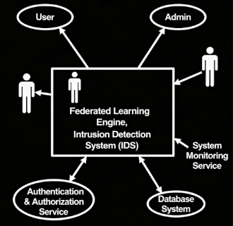
Intrusion Detection System UsingFederated Learning
Implementation - Use Case Diagram
The User logs into the system, and the Authentication & Authorization Service validates access permissions.
The User initiates federated learning training through the system interface.
The Federated Learning Engine initializes and performs distributed model training across multiple nodes.
The System Monitoring Service tracks system performance and training metrics in real time.
The Intrusion Detection System (IDS) continuously monitors system activities to detect anomalies or attacks.
When a threat is detected, the IDS generates security alerts and logs events in the Database System.
The Admin monitors system health, reviews IDS alerts, and accesses logs and reports for security analysis.
Srinivasa Ramanujan Institute of Technology

Slide 21
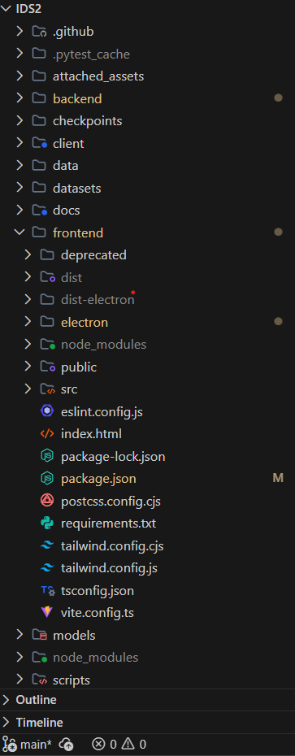
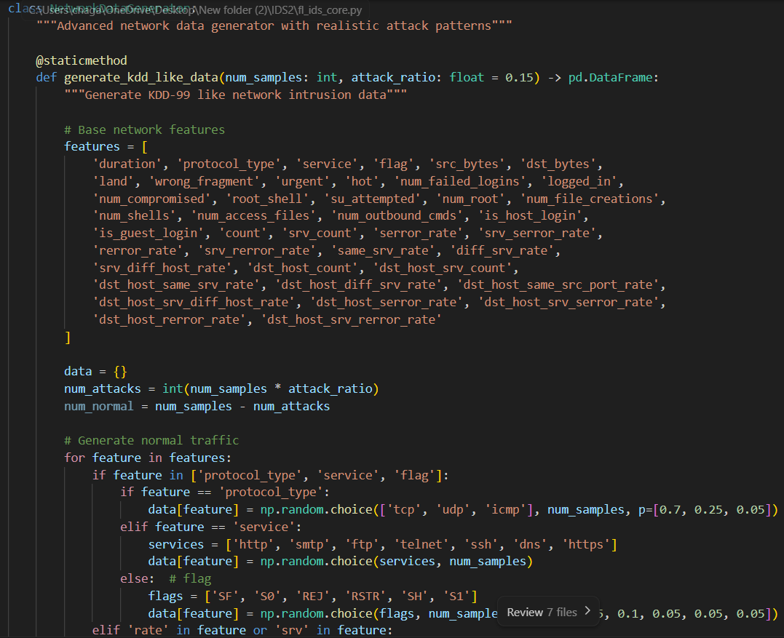
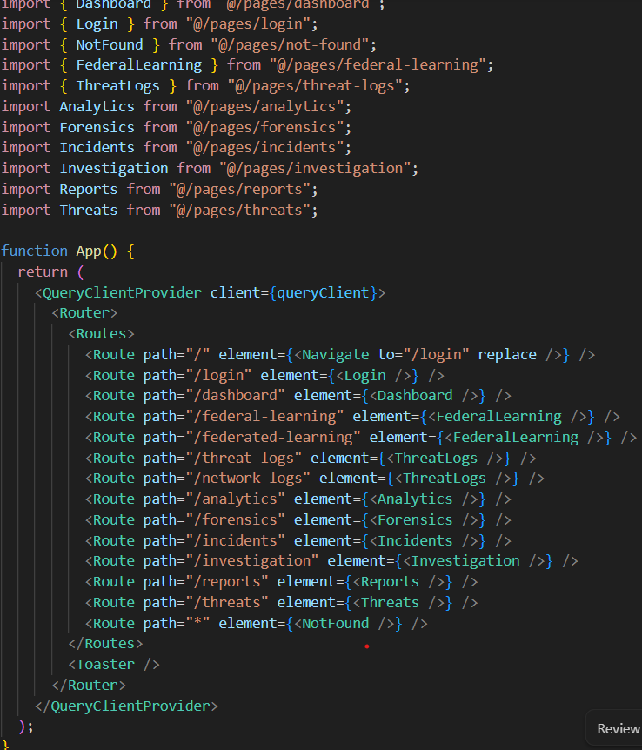
Implementation
Intrusion Detection System UsingFederated Learning
Srinivasa Ramanujan Institute of Technology

Slide 22
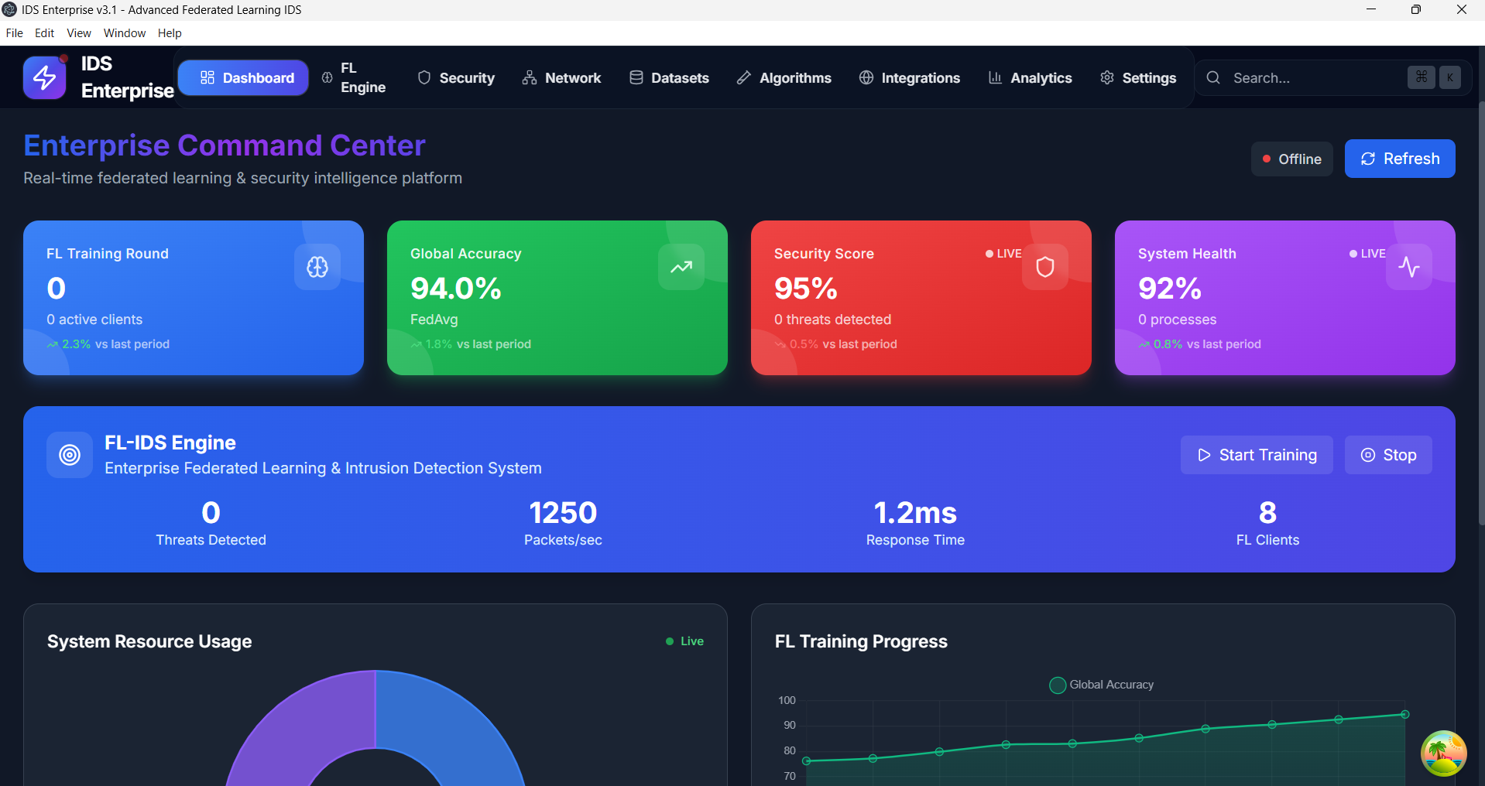
Outputs
Intrusion Detection System Using Federated Learning
Outputs
B-15 | Department of Computer Science and Engineering | Srinivasa Ramanujan Institute of Technology | 22

Slide 23
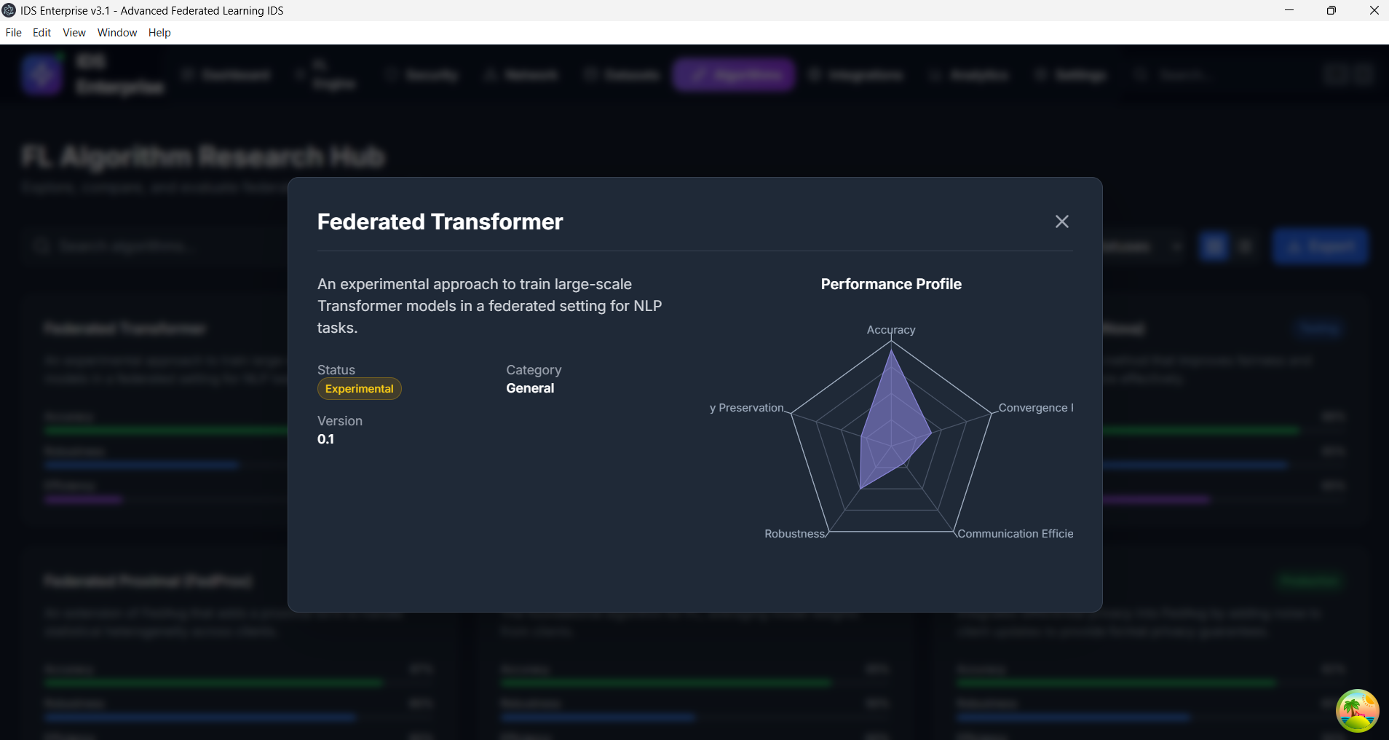
Outputs
Intrusion Detection System UsingFederated Learning
Outputs
B-15 | Department of Computer Science and Engineering | Srinivasa Ramanujan Institute of Technology | 23

Slide 24
Research paper
Intrusion Detection System UsingFederated Learning
Research paper
Cloud Security: Intrusion Detection System using Federated Learning
Intrusion Detection Systems (IDS) are essential cybersecurity tools used to monitor network traffic and identify malicious activities such as unauthorized access, malware attacks, and data breaches.
Many organizations such as enterprises, government agencies, and academic institutions depend on IDS to protect sensitive information and maintain digital security.
Traditional IDS systems mainly rely on centralized data collection and analysis, where network logs from multiple sources are stored in a central server.
This centralized approach creates several issues including:
Privacy and confidentiality risks
Limited scalability in large distributed networks
Vulnerability to single points of failure
Sharing raw security logs between organizations is often restricted because the data may contain sensitive operational or personal information.
Although Artificial Intelligence and Machine Learning have improved intrusion detection accuracy, most solutions still require centralized datasets.
Federated Learning (FL) is a distributed machine learning technique that allows multiple organizations to collaboratively train a global model without sharing their raw data.
B-15 | Department of Computer Science and Engineering | Srinivasa Ramanujan Institute of Technology | 24

Slide 25
Research paper
Intrusion Detection System UsingFederated Learning
Research paper
Problem Statement
Existing centralized intrusion detection systems provide limited visibility across distributed environments and may become ineffective as network size increases.
Traditional data-sharing approaches expose sensitive logs, leading to privacy risks and potential misuse of information.
Manual recording and monitoring of intrusion events is time-consuming, error-prone, and difficult to maintain in large organizations.
Security data is often fragmented across multiple departments or organizations, making it difficult to detect global attack patterns and emerging threats.
Lack of secure collaboration between organizations reduces the ability to develop accurate and robust intrusion detection models.
Objectives
To design a secure Federated Learning-based Intrusion Detection System (FedIDS) that enables collaborative training of machine learning models.
To ensure privacy-preserving intrusion detection by restricting the sharing of raw network data.
To provide structured intrusion detection information, including attack types, anomaly patterns, and response actions.
B-15 | Department of Computer Science and Engineering | Srinivasa Ramanujan Institute of Technology | 25

Slide 26
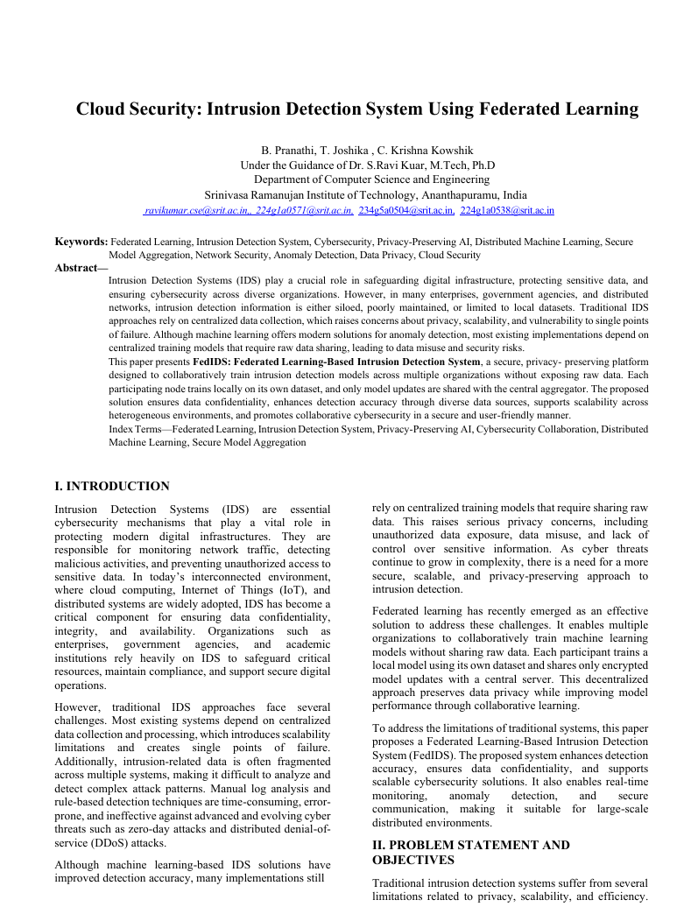
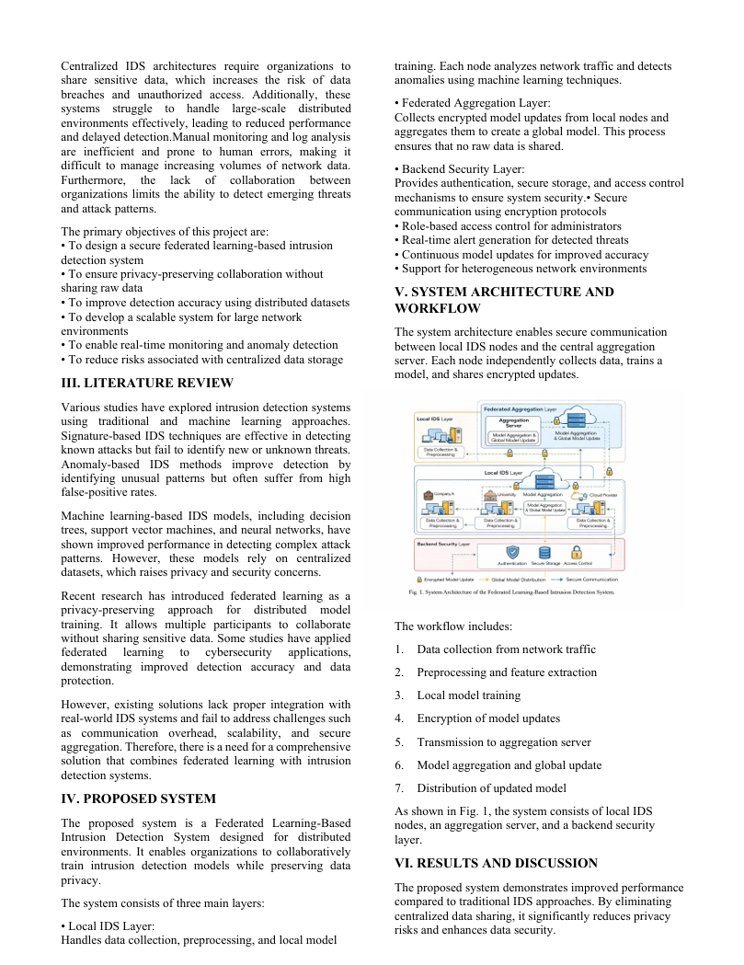
Research paper
Intrusion Detection System UsingFederated Learning
Research paper
B-15 | Department of Computer Science and Engineering | Srinivasa Ramanujan Institute of Technology | 26

Slide 27
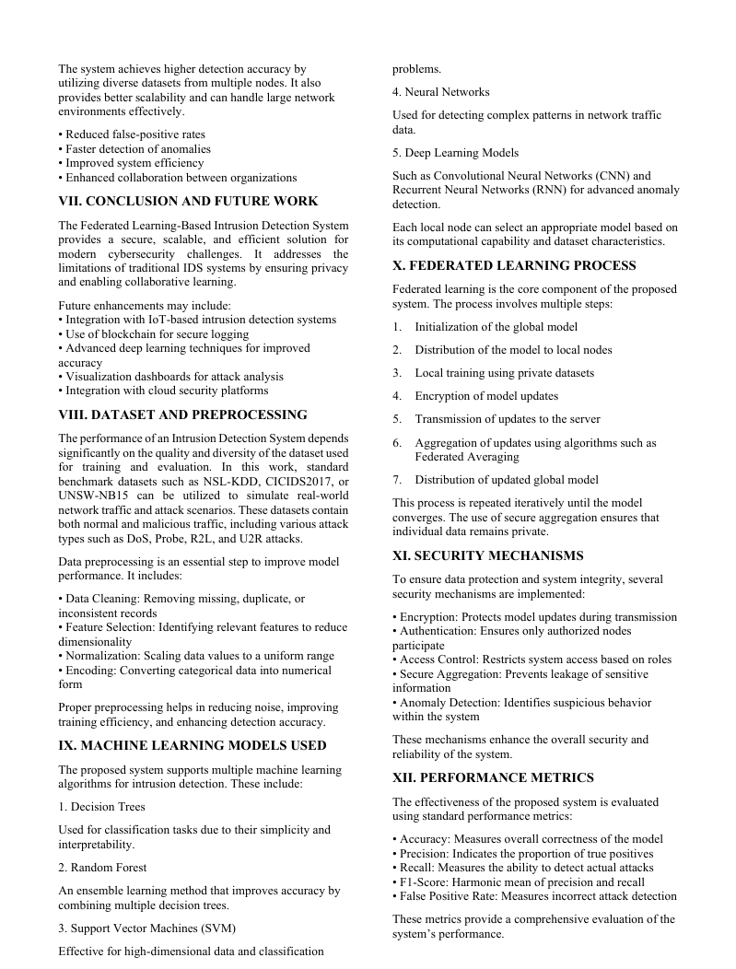
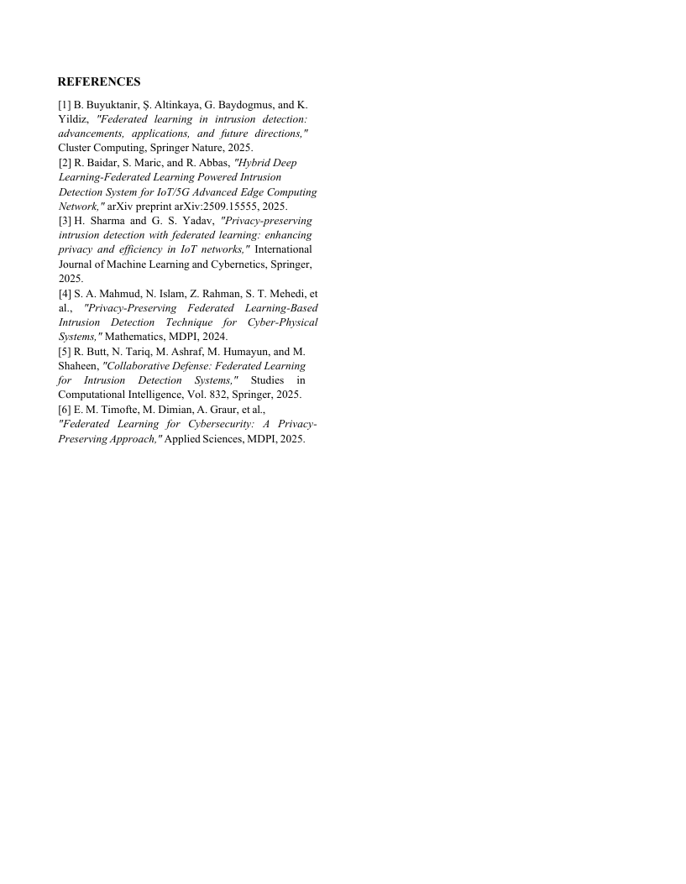
Research paper
Intrusion Detection System UsingFederated Learning
Research paper
Research Paper: https://drive.google.com/file/d/1bWr0vDKFJ5xhUB8YsBZtsShwOikuuqzn/view?usp=sharing
B-15 | Department of Computer Science and Engineering | Srinivasa Ramanujan Institute of Technology | 27

Slide 28
Conclusion
Intrusion Detection System Using Federated Learning
The system successfully integrates federated learning with intrusion detection to enhance security while preserving data privacy.
Distributed model training ensures that sensitive data is not shared across participating nodes.
Real-time monitoring and alert generation improve the system’s ability to detect and respond to security threats.
Role-based access control enables secure and efficient system management by users and administrators.
The modular architecture improves scalability, maintainability, and future system expansion.
The proposed FLIDS solution is suitable for secure, large-scale, and distributed computing environments.
The system improves threat detection accuracy by continuously updating models through federated learning.
Automated logging and reporting support effective security analysis and audit compliance.
Srinivasa Ramanujan Institute of Technology

Slide 29
References
Intrusion Detection System Using Federated Learning
H. B. McMahan, E. Moore, D. Ramage, S. Hampson, and B. A. y Arcas, “Communication-efficient learning of deep networks from decentralized data,” in Proceedings of the International Conference on Artificial Intelligence and Statistics (AISTATS), 2017.
N. Moustafa and J. Slay, “UNSW-NB15: A comprehensive data set for network intrusion detection systems,” in Military Communications and Information Systems Conference (MilCIS), IEEE, 2015.
I. Goodfellow, Y. Bengio, and A. Courville, Deep Learning, MIT Press, Cambridge, MA, USA, 2016.
Y. Liu, T. Chen, and Q. Yang, “Secure federated learning for privacy-preserving artificial intelligence,” ACM Computing Surveys, vol. 54, no. 5, pp. 1–36, 2021.
S. R. Agrawal and J. Agrawal, “Survey on anomaly detection using data mining techniques,” Procedia Computer Science, vol. 60, pp. 708–713, 2015.
Srinivasa Ramanujan Institute of Technology

Slide 30
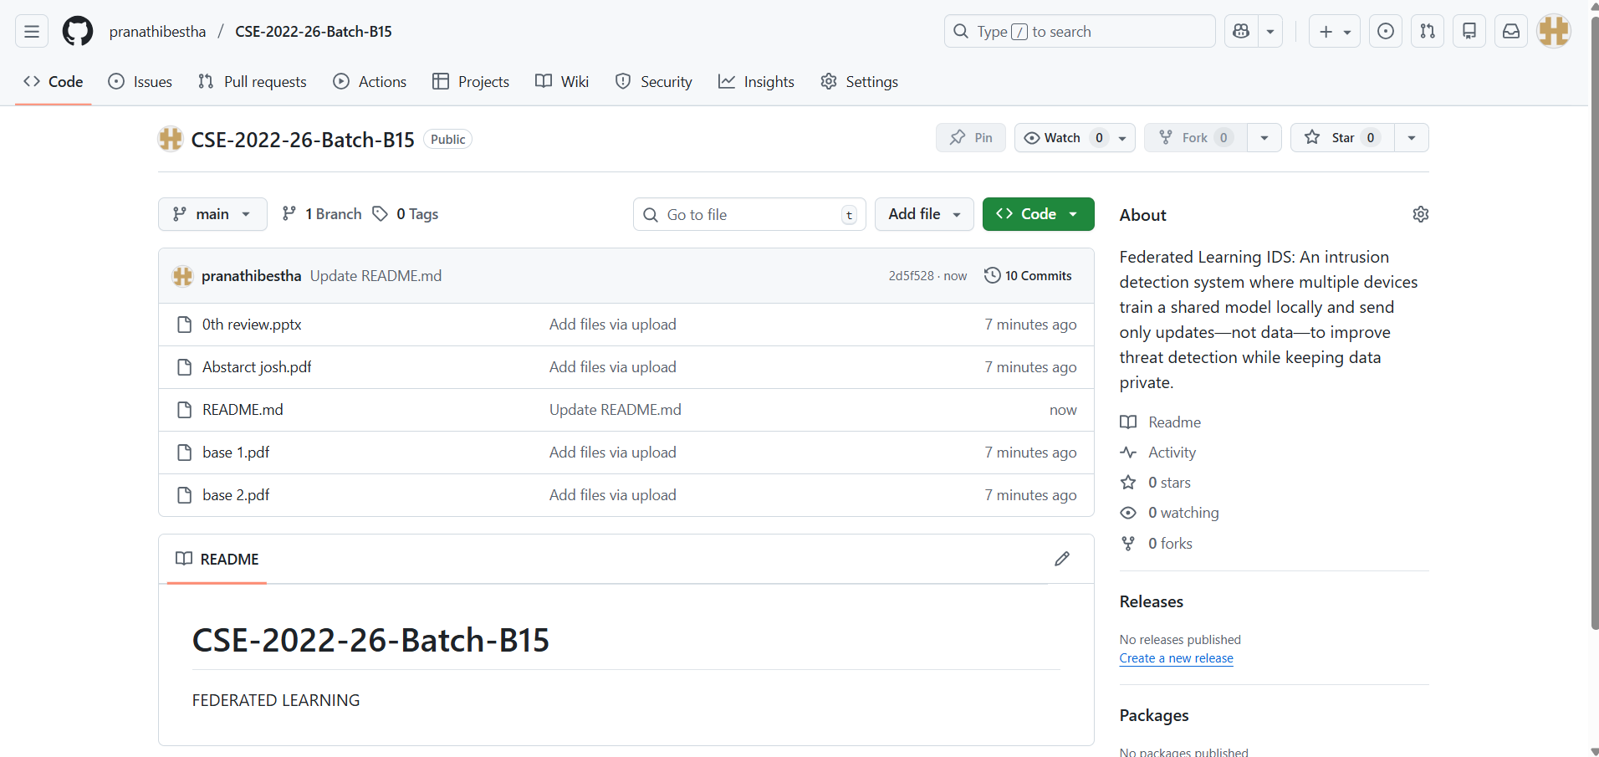
Git Hub Dashboards of each student
Intrusion Detection System Using Federated Learning
link of the Github : https://github.com/pranathibestha/CSE-2022-26-Batch-B15
Srinivasa Ramanujan Institute of Technology

Slide 31
Intrusion Detection System Using Federated Learning
Thank You!!!
B-03 | Department of Computer Science and Engineering | Srinivasa Ramanujan Institute of Technology | 31

Slide 32
Any Queries?
Intrusion Detection System Using Federated Learning
Srinivasa Ramanujan Institute of Technology

