Slide 1
Flight Delay Prediction System
Using Weather Conditions, Flight Schedules, Route Information, and Historical Aviation Data

Slide 2



PROBLEM STATEMENT
Introduction and Problem Statement
Background
The Problem
Motivation
Scope
Flight delays significantly impact airlines, airports, passengers, and logistics operations, resulting in economic losses and operational inefficiencies.
Current delay prediction systems lack integration of comprehensive data sources including real-time weather, flight schedules, route information, and historical aviation patterns.
Accurate flight delay prediction enables proactive decision-making, resource optimization, and improved passenger experience across the aviation industry.
Develop a machine learning-based system that predicts flight delays by analyzing weather conditions, departure times, airline characteristics, airport congestion, and historical delay patterns.

Slide 3


OBJECTIVES
Objectives and Proposed System Overview
1
2
Delay Prediction
Factor Analysis
Predict flight delay probability and duration using integrated aviation data sources.
Identify key factors influencing flight delays through comprehensive feature analysis.
3
4
Dual Modelling
Interactive Dashboard
Develop both regression and classification models for comprehensive delay prediction.
Create a real-time analytics dashboard delivering actionable delay insights to stakeholders.
System Scope
Expected Outcomes
Integrate weather data, flight schedules, route information, airline details, airport metrics, traffic patterns, and historical aviation records into a unified prediction framework.
Actionable delay predictions with confidence scores, route analytics, airport performance trends, and operational intelligence for all aviation stakeholders.

Slide 4

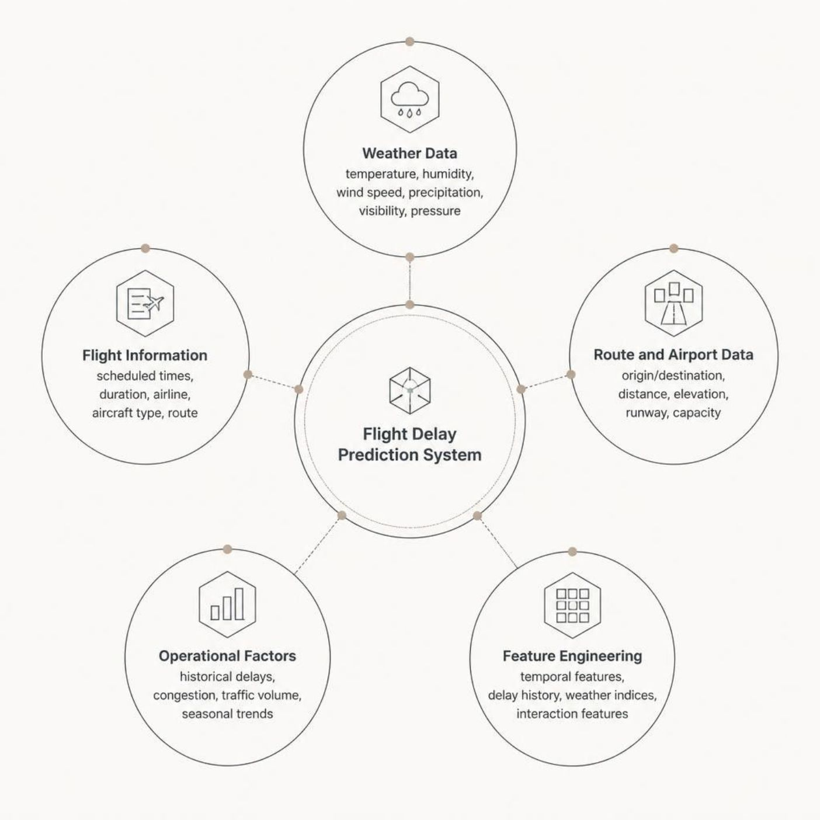
DATA SOURCES
Data Sources and Feature Engineering
Weather Data
Temperature, humidity, wind speed, precipitation, visibility, atmospheric pressure, and weather conditions (clear, cloudy, rainy, stormy).
Flight Information
Scheduled departure and arrival times, actual flight duration, airline identifier, aircraft type, and flight route.
Feature Engineering
Temporal features (day of week, month, time of day), derived metrics (delay history by airline/airport), weather indices, and interaction features capturing relationships between weather and operational factors.

Slide 5


METHODOLOGY
Data Preprocessing and Machine Learning Methodology
Preprocess
Select Model
Train
Evaluate
Classification Model
Regression Model
Predicts delay probability (delayed / on-time) using Logistic Regression, Random Forest, Gradient Boosting, or Support Vector Machines.
Predicts delay duration in minutes using Linear Regression, Decision Trees, Ensemble methods, or Neural Networks.

Slide 6


ARCHITECTURE
Key Prediction Factors and System Architecture
Critical Delay Factors
System Architecture Pipeline
Weather Conditions — precipitation, wind speed, and visibility directly correlate with flight delays.
Data Ingestion Layer
Weather, schedules, routes, historical records
Departure Time & Day of Week — influence airport congestion and delay probability.
Preprocessing & Feature Engineering
Airline Efficiency — historical operational performance patterns per carrier.
Cleaning, encoding, temporal extraction
Airport Congestion — origin and destination capacity, infrastructure, and traffic volume.
ML Models
Classification + Regression engines
Route Complexity — distance and variability affecting flight duration.
Dashboard & Analytics Interface
Interactive predictions and insights

Slide 7

RESULTS
Prediction Results, Dashboard, and Analytics
Delay Probability
Delay Duration
Percentage likelihood of delay with confidence intervals and risk classification: Low / Medium / High.
Predicted delay in minutes alongside confidence scores for operational planning.
Route Analytics
Airport Metrics
Route-specific delay patterns, trends, and historical performance comparisons.
Congestion levels, historical delay analysis, and infrastructure performance indicators.
Dashboard Capabilities
User Interface
Real-time flight delay predictions with confidence intervals
Airline operational performance comparison and efficiency trends
Weather impact visualization and correlation analysis
Interactive visualizations with filtering by airline, airport, and route. Supports historical trend analysis and exportable reports for operational decision-making.

Slide 8





APPLICATIONS
Advantages and Applications
System Advantages
Stakeholder Applications
Multi-Source Integration
Comprehensive fusion of weather, schedule, route, and historical data for superior prediction accuracy.
Airlines
Airports
Crew scheduling, fuel planning, and passenger communication.
Gate management, ground handling, and congestion mitigation.
Dual Prediction Approach
Classification and regression models together deliver complete delay intelligence — both probability and duration.
Scalable & Interpretable
Authorities
Logistics
Architecture supports real-time and batch modes; interpretable models enable stakeholder trust and understanding.
Airspace management and traffic flow optimization.
Cargo scheduling and supply chain optimization.

Slide 9


CONCLUSION
Conclusion
The Flight Delay Prediction System successfully integrates weather conditions, flight schedules, route information, and historical aviation data to provide accurate, actionable delay predictions for the aviation industry.
Unified Framework
Dual ML Models
Combines multiple data sources for comprehensive delay analysis in a single integrated pipeline.
Classification and regression models enabling both delay probability and duration prediction.
Operational Dashboard
Critical Factor Insights
Interactive intelligence platform serving stakeholders across the entire aviation ecosystem.
Identification of key delay drivers and their quantified relationships with flight performance.
Enables proactive decision-making, reduces operational inefficiencies, improves passenger experience, and optimizes resource allocation across airlines, airports, and aviation authorities.

Slide 10

FUTURE SCOPE
Future Scope and Enhancements
Real-Time Integration
Intelligent Decision Support
Aviation System APIs
Live weather feeds, real-time flight tracking, and dynamic prediction updates as flights progress.
Automated recommendations for crew scheduling, gate assignments, and resource allocation based on predicted delays.
Connectivity with airline reservation systems, airport management platforms, and air traffic control networks.
1
2
3
4
5
Advanced Deep Learning
Cloud-Scale Deployment
LSTM, GRU, and Transformer networks for temporal sequence prediction and complex pattern recognition.
Distributed cloud infrastructure for large-scale data processing and multi-region deployment.
Cascading Delay Analysis
Route Optimization
Enhanced modelling of cascading delay impacts across connected routes and hub airports for network-wide operational intelligence.
Improved algorithms leveraging predicted delay data to recommend optimal routing, scheduling adjustments, and proactive mitigation strategies.

