Slide 1
Measuring Advertising in Gaming Environments
MSBX 5320 · Digital Advertising
A Comparative Analysis of Anzu.io and Integral Ad Science (IAS)
Presented By:
Chinmayi Chavan
Jinal Mehta
Pranathi Manthri
Supria Deka

Slide 2
Why Gaming Industry Matters
Market Size: Gaming projected to reach $312 billion by 2027.
Audience: Over 3.2 billion active gamers globally, diverse & highly engaged.
Advertising Opportunity: High user engagement offers potential for powerful brand-building, but traditional digital advertising methods struggle to effectively measure true impact.

Slide 3
Project Objective
Primary Goal: Analyze and compare how Anzu.io and IAS measure advertising effectiveness within immersive gaming environments.
Key Metrics Analyzed: Engagement, Viewability, Brand Safety, ROI, Fraud Detection.
Purpose: Provide insights for advertisers on selecting the best platform and approach to measure and optimize gaming-related advertising investments.

Slide 4
Key Challenges in Gaming Ad Measurement
Limitations of CTR & Impressions: These traditional metrics are ineffective in player-controlled, interactive gaming environments.
Specialized Needs: Measurement of viewability in 3D spaces, passive user attention, brand safety in interactive scenarios, ad fraud risks unique to gaming platforms.

Slide 5
Anzu.io Company Overview
About Anzu: Leader in native, immersive in-game advertising integrated directly within game worlds.
Ad Formats: Blended Display Ads, Blended Video Ads, Custom Native Formats (virtual billboards, game environment integration).
Programmatic Advertising: Integration with 40+ demand-side platforms (DSPs), including Xbox, Unity, Magnite.

Slide 6
Anzu.io – Measurement & Targeting Capabilities
Patented 3D Ad Tracking Technology: Measures intrinsic ads through screen coverage, occlusions, positioning, and session analytics.
Advanced Targeting: Contextual targeting leveraging geolocation, census data, user opt-in identifiers—without relying on personal data.
Compliance & Verification: GDPR, CCPA, COPPA compliant, partnered with IAS, Comscore, Oracle MOAT for third-party verification

Slide 7
Case Study – Tommy Hilfiger Campaign
Campaign Objective: Promote Tommy Hilfiger's "Classics Reborn Spring '23" collection within gaming environments to boost brand visibility and drive consumer action.
Strategy: Non-intrusive native ads tailored for mobile & PC gamers; regularly refreshed creatives to maintain engagement.
Measurement Partners: Comscore (brand lift), Oracle MOAT (viewability), IAS (fraud detection).
Key Results:
+14 pts Ad Recall
+20 pts Brand Favorability
+23 pts Purchase Intent
+24 pts Recommendation Intent

Slide 8
Integral Ad Science (IAS) Overview
Company Profile: Global leader in ad verification, media quality, and fraud prevention.
Core Offerings: Viewability measurement, fraud detection, brand safety, contextual targeting across multiple digital channels (web, mobile, Connected TV).
Client Base: Advertisers, advertising agencies, publishers, platforms (YouTube, TikTok, Meta).

Slide 9
IAS Technology & Methods
AI & Machine Learning: Real-time fraud detection, classification, predictive analytics.
Natural Language Processing (NLP) & Computer Vision: Contextual and sentiment analysis of text, images, and video content for brand suitability.
Real-Time Analytics: Dashboards providing immediate insights, enabling rapid campaign optimization and adjustments.

Slide 10
Case Study – IAS & Major CPG Brand
Campaign Goal: Investigate if increased ad viewability leads to measurable in-store sales growth and improved ROAS.
Study Methodology:
14.6 million households: Segmented into "In-View" vs. "Not-In-View" groups based on IAS viewability standards.
Key Findings:
+180% Incremental ROAS for the In-view group
74% of incremental sales driven by viewable ads
Optimal ad view duration: 3 to 10 seconds for maximum conversion effectiveness.

Slide 11
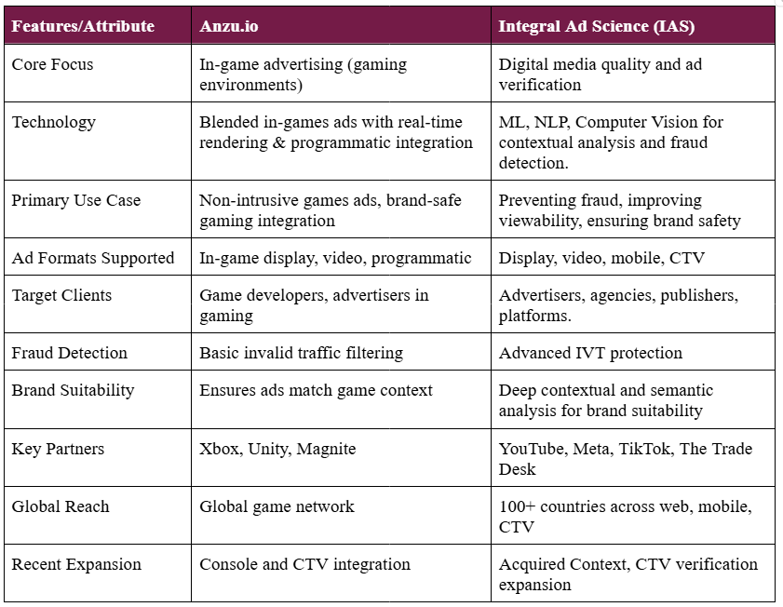
Anzu vs. IAS Comparative Analysis

Slide 12
Conclusion
The analysis revealed that the in-view ad group achieved a 180% higher incremental ROAS compared to ads not verified for viewability.
74% of incremental sales from the test campaign were directly attributable to ads that met viewability standards.
Optimal ad exposure duration, or the "sweet spot," was identified as 3 to 10 seconds, which yielded the highest incremental sales.

Slide 13
Recommendations
Prioritize and consistently implement ad viewability metrics, ensuring digital advertisements meet robust viewability standards.
Optimize campaigns by focusing on ads with 3–10 seconds of viewability, leveraging this duration to maximize consumer engagement and conversion.
Adopt precise measurement methodologies, such as those offered by IAS, to enhance overall media quality, directly influencing consumer behavior and significantly improving Return on Advertising Spend (ROAS).
Recognize the strategic importance of media quality as a fundamental factor driving tangible business outcomes in digital advertising—particularly within dynamic and immersive channels like gaming.
.

