Slide 1

Team 4
Talent Management Model
and Workable Solution

Slide 2

Meet team 4
Rafael Cintron
Supria Deka
Pranathi Manthri
Murali Prateek Manthri
Jinal Mehta
rafael.cintron@colorado.edu
supria.deka@colorado.edu
pranathi.manthri@colorado.edu
murali.manthri@colorado.edu
jinal.mehta@colorado.edu

Slide 3
Overview
Opportunity Statement
Rapid Expansion
Fine-Tune how to better
Attract Top Talent
Train Prospective Employees
Retain Workers with Proven Success
Objectives
Analyze Workforce Trends
Summary Data Analysis
Predict Talent Retention
Predictive Model
Optimize Employee Experience
Feature Importance
Display all in Live Dashboard

Slide 4


Voluntary Churn
Model
Automatically
Updating Dashboard

Slide 5
Data Preparation
Cleaning
Standardized Naming and Data Types
PK → ee_#
Id’s → Integers
Imputing Missing Data
Job Descriptions
FLSA Status
Analytics Preparation
Merging Datasets
Feature Engineering
Days Since
Transfer In
Transfer Out
Demotion
Rehire
Promotion
Termination
Voluntary Vs. Involuntary Termination

Slide 6
Model: XGBoost
Binary Classifier to Forecast Voluntary Churn
Did or Did Not Leave
Gradient Boosting: Ideal for Subtle Behavior Driven Patterns
Accuracy: 82%
Precision: 84%
Area Under the Curve: 87%

Slide 7
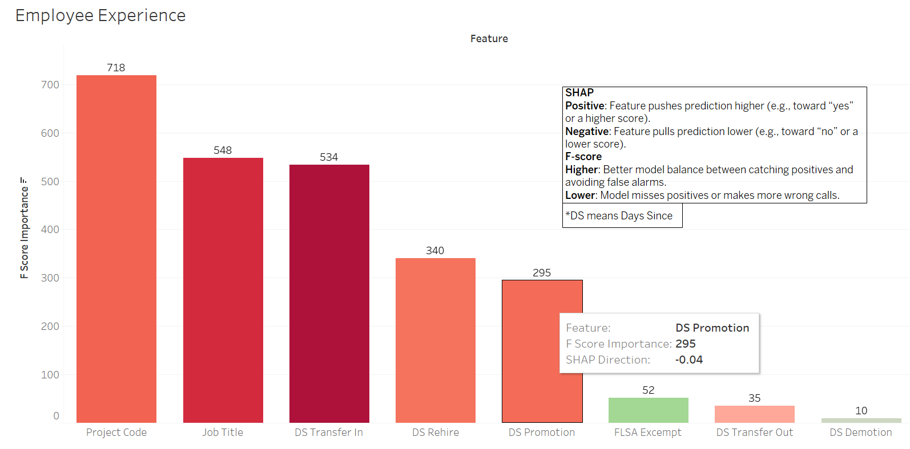

Slide 8
Workable Solution:
Automatically Updating Tableau
Utilize threading.py module to rerun model every specified interval
Code saves
to the Existing .csv Connected Tableau Dashboard
Tableau Visuals will Automatically Update in Live Mode

Slide 9
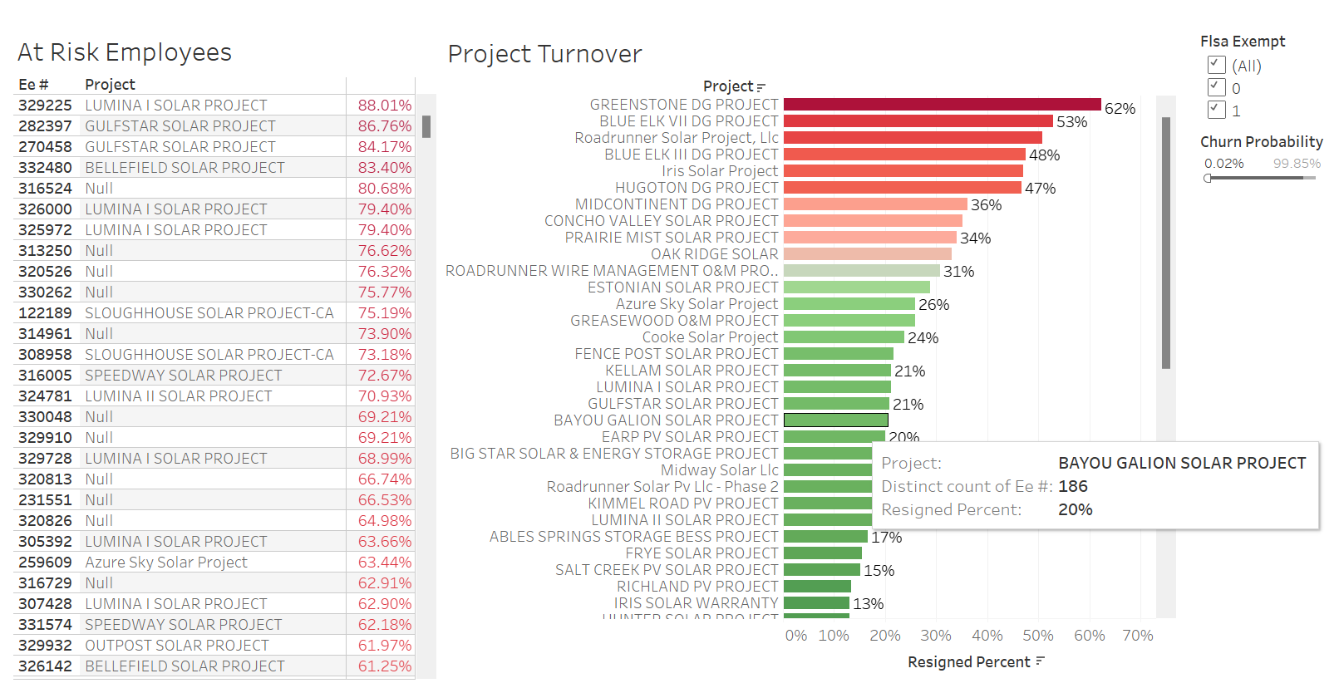

Slide 10
Business Insights
Turnover exceeds 167%
2,472 rehires: Gaps in Retention Strategy
Promotion Bottleneck at Junior Levels
Spike in Demotions in 2024
Operations shows Above Average Talent Mobility
Admin/Finance shows Below Average Talent Mobility
Internal Transfers Accelerate Advancement

Slide 11
Recommendations
XGBoost
Utilize the XGBoost Model Feature Importance to Prioritize HR Decisions to Improve Employee Experience
Auto-Refreshing Tableau
Monitor Employee Shift in Retention Risk and Contact if Needed
Locate which Projects have High Retention Rates to Identify Differentiators to improve sites with lower retention rate

Slide 12
Group 4
Thanks You.
If you have any Questions feel free to reach out!

