Slide 1
Enhancing Model Performance with Optimization Algorithms and Regularization Techniques
S.Lakshmi Pranathi
192124046

Slide 2
OBJECTIVE
The study aims to investigate the efficacy of diverse optimization algorithms, particularly gradient descent variants, in a specific machine learning task.
Compare the performance of different optimization algorithms on a specific machine learning task to identify the most effective approach in terms of convergence speed and final performance metrics.
Investigate the impact of various regularization techniques, including L1, L2, and dropout, on model generalization in regression or classification problems.
Evaluate the generalization performance of models trained with different regularization techniques to understand their effectiveness in preventing overfitting and improving model robustness.
Draw insights from the comparison of optimization algorithms and regularization techniques to inform best practices for model optimization and regularization in machine learning tasks.

Slide 3
INTRODUCTION
Model enhancement involves leveraging optimization algorithms and regularization techniques to improve the performance and generalization ability of machine learning models.
Optimization algorithms like gradient descent variants (e.g., stochastic gradient descent, Adam) are essential for refining model parameters and minimizing loss functions.
Regularization methods such as L1/L2 regularization and dropout mitigate overfitting by penalizing complex models.
Optimization algorithms refine models to fit training data better, while regularization techniques control model complexity to improve generalization.
Performance metrics like MSE,accuracy, loss, and validation scores empirically evaluate the effectiveness of optimization algorithms and regularization techniques.

Slide 4
LITERATURE SURVEY
Ruder, Sebastian. "An overview of gradient descent optimization algorithms." arXiv preprint arXiv:1609.04747 (2016).
Kingma, Diederik P., and Jimmy Ba. "Adam: A method for stochastic optimization." arXiv preprint arXiv:1412.6980 (2014).
Nesterov, Yurii. "Gradient methods for minimizing composite objective function." Mathematical Programming 140.1 (2013): 125-161.
Bengio, Yoshua, et al. "Deep learning of representations: Looking forward." Deep learning, 2013. Link

Slide 5
LITERATURE SURVEY
Glorot, Xavier, and Yoshua Bengio. "Understanding the difficulty of training deep feedforward neural networks." Proceedings of the thirteenth international conference on artificial intelligence and statistics. 2010.
Hinton, Geoffrey E., and Ruslan R. Salakhutdinov. "Reducing the dimensionality of data with neural networks." Science 313.5786 (2006): 504-507.
Loshchilov, Ilya, and Frank Hutter. "SGDR: Stochastic Gradient Descent with Warm Restarts." arXiv preprint arXiv:1608.03983 (2016).

Slide 6
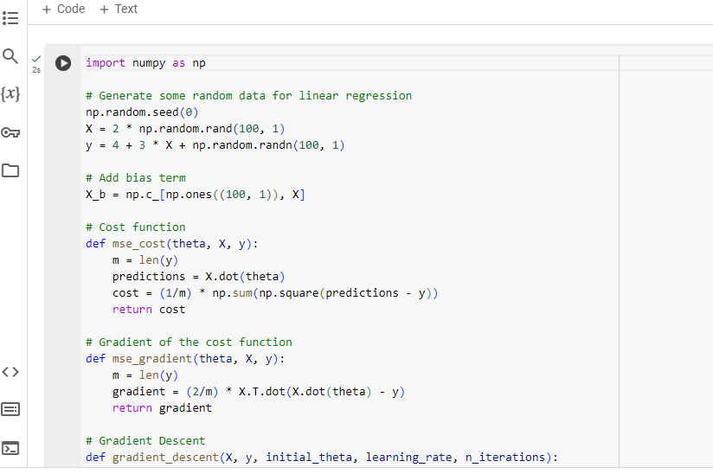
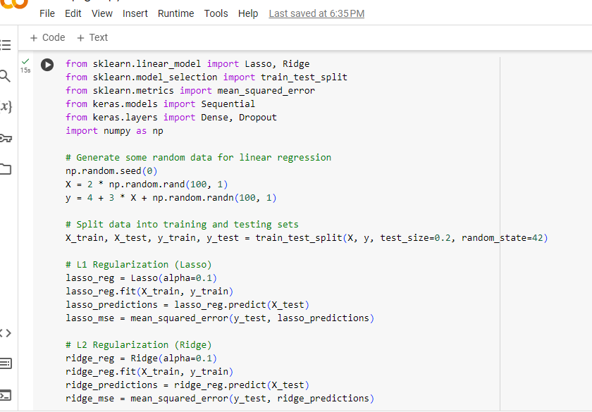
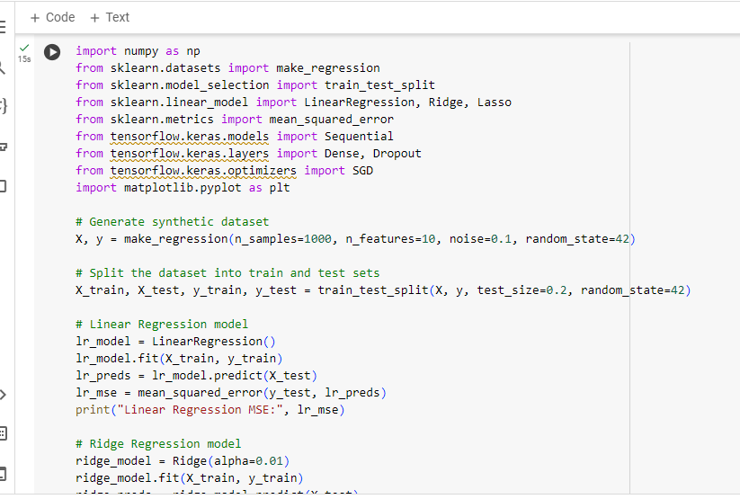
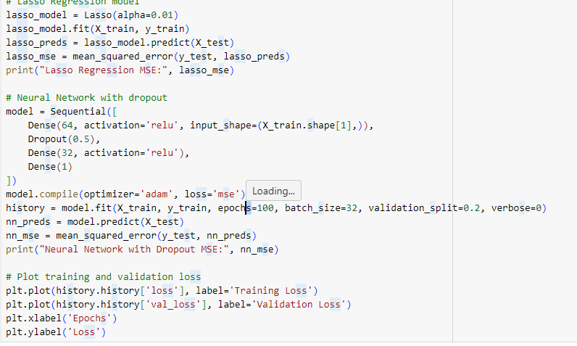
CODE

Slide 7
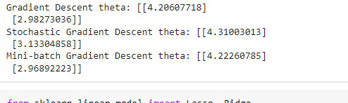
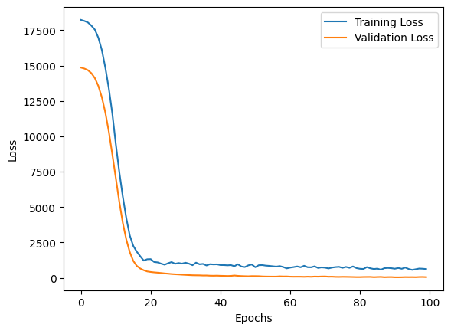
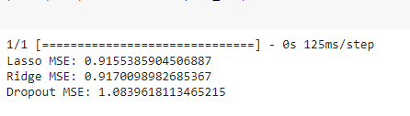
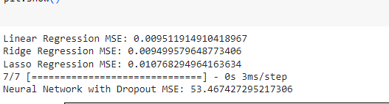
OUTPUT

Slide 8
CONCLUSION
Optimization algorithms and regularization techniques are fundamental for enhancing model performance in machine learning and deep learning.
They help minimize errors and prevent overfitting by iteratively refining model parameters and controlling model complexity.
Empirical evaluation through metrics like accuracy, loss, and convergence speed guides the selection and tuning of these techniques.
Ongoing advancements introduce new algorithms and techniques, driving continuous improvement in model performance.
By leveraging these methodologies effectively, researchers can develop robust models with superior generalization capabilities, advancing applications across various domains.

Slide 9


