Slide 1
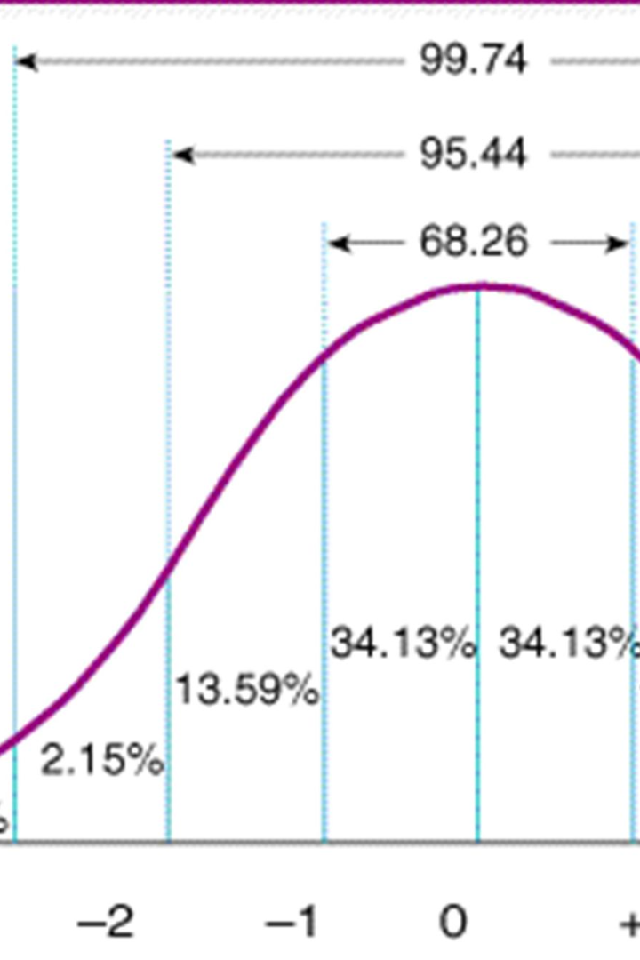

Discovering the Magic of the Normal Distribution
The normal distribution, or Gaussian distribution, is a type of continuous probability distribution that is widely used in statistics, probability theory, and other fields. Let's dive deeper.

Slide 2
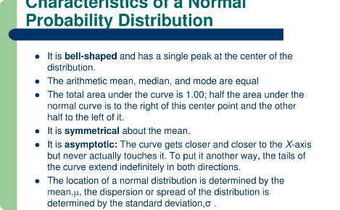
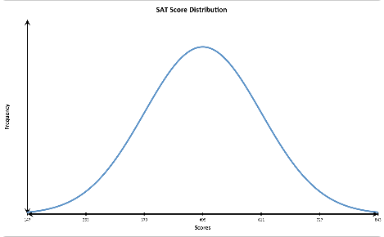
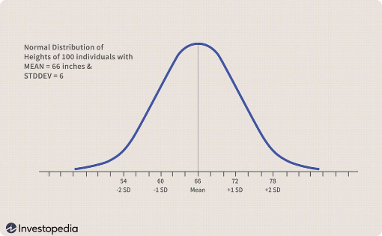
The Definition and Characteristics of Normal Distribution
Definition
Characteristics
The normal distribution describes a symmetrical bell-shaped curve that represents the distribution of a large population.
The normal distribution is continuous, unimodal, and asymptotic. It is characterized by its mean and standard deviation.The formula for the normal distribution is:
P(x) = (1 / σ√(2π)) * e^(-((x-μ)^2) / (2σ^2)
Applications
The normal distribution is used to model many real-life phenomena, such as IQ scores, height, weight, and test scores.

Slide 3

The Bell Curve and Symmetry of Normal Distribution
Bell Curve
The normal distribution curve is shaped like a bell, with most data points clustered around the mean and fewer points farther away.
Symmetry
The normal distribution is symmetrical around the mean. This means that the areas under the curve on either side of the mean are equal.
Relevance
The bell curve and symmetry of normal distribution are essential concepts in statistics, economics, and science.

Slide 4
Standard Deviation and Mean as Measures of Central Tendency
1
Mean
The mean, or average, is a measure of central tendency that is calculated by adding up all the data points and dividing by the total number of data points.
Standard Deviation
2
The standard deviation is a measure of the amount of variability or spread in a data set. It tells us how much the data deviate from the mean.
3
Interpretation
The mean and standard deviation are important in interpreting the normal distribution curve and understanding the data.

Slide 5
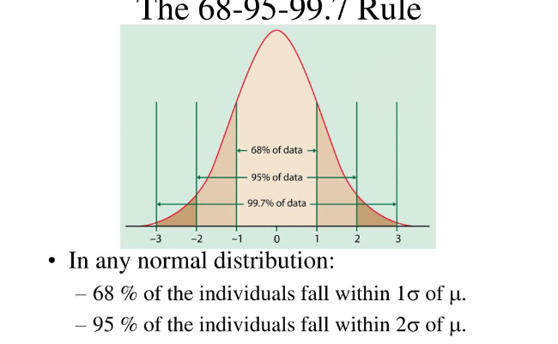
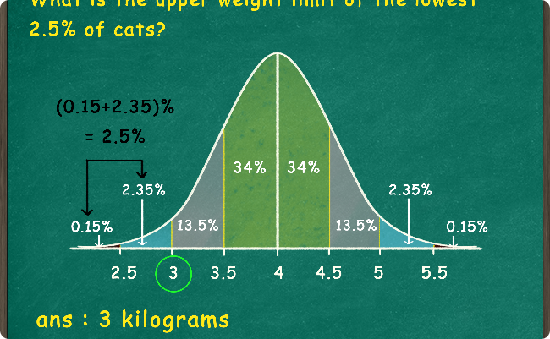
68-95-99.7 Rule and Empirical Rule
68-95-99.7 Rule
Empirical Rule
This rule states that, in a normal distribution, about 68% of the data falls within one standard deviation of the mean, 95% of the data falls within two standard deviations, and 99.7% of the data falls within three standard deviations.
The Empirical Rule is another way of stating the 68-95-99.7 Rule. It says that about 68% of the data falls within one standard deviation of the mean, about 95% falls within two standard deviations, and almost all (99.7%) falls within three standard deviations.

Slide 6
Z-Scores and the Standard Normal Distribution
Z-Scores
A z-score measures the number of standard deviations that a value in a data set is from the mean. Z-scores are used to standardize data.
Standard Normal Distribution
The standard normal distribution is a special case of the normal distribution with a mean of 0 and a standard deviation of 1. It is used to standardize data so that it can be compared with other data sets.
Applications
Z-scores and the standard normal distribution are used in hypothesis testing, quality control, and other statistical analyses.

Slide 7

Sampling Distributions and the Central Limit Theorem
1
Sampling Distributions
A sampling distribution is the distribution of a statistic obtained from multiple samples of the same size from a population. It helps estimate the parameters of a population.
2
Central Limit Theorem
The central limit theorem states that the sampling distribution of the mean is normally distributed, regardless of the population distribution, if the sample size is large enough.
3
Importance
The central limit theorem is one of the foundational concepts of statistics and enables many statistical analyses.

