Slide 1


MAJOR PROJECT 2024-2025
IDENTITY RECOGNITION USING TETROLET TRANSFORMS IN SURVEILLANCE APPLICATIONS
CBIT/IT/2024-25/IT1/106
Team Memebers:
Dama Pranati Sreya (160121737006)
Tanguturi Poojitha (160121737021)
Guide:
Mrs. E. Ramalakshmi
Assistant Professor
Department of Information Technology,
Chaitanya Bharathi Institute of Technology,
Date of Presentation : 29th April, 2025

Slide 2
ABSTRACT
1
Facial recognition has become a cornerstone technology in modern biometric systems, evolving significantly beyond traditional methods. This project explores the use of wavelet-based neural networks to enhance the accuracy and efficiency of face detection and recognition. Unlike conventional convolutional neural networks (CNNs) that focus on pixel-level image processing, wavelet transforms enable multiresolution analysis, capturing both spatial and frequency components of facial features. To further boost feature extraction, Tetrolet transforms—an advanced variant of wavelets—are employed for their ability to adaptively capture local geometric structures in facial images. This dual-level insight helps the model better handle variations in lighting, facial pose, and occlusion. By focusing on essential features and minimizing noise, the system achieves more reliable and robust performance. The integration of wavelet techniques with deep learning not only improves precision but also offers scalability for real-time applications such as security, surveillance, and identity verification. The project demonstrates the advantages of Tetrolet-based feature extraction over traditional methods, offering a flexible and high-performing solution for face recognition challenges.
Keywords: Facial Recognition, Tetrolet Transform, Wavelet Neural Networks, Multiresolution Analysis, Real-Time Applications
CBIT/IT/2024-25/IT1/106

Slide 3
2
AGENDA
Methodology
Dataset
Tetrolet Transforms
Evaluation
Results
Conclusion
References
Introduction
Problem Statement
Research Papers
Literature Review
Existing System
Proposed System
Requirements
CBIT/IT/2024-25/IT1/106

Slide 4
3
INTRODUCTION
Wavelet neural networks enhance facial recognition accuracy by capturing both spatial and frequency features from facial images. This multi-resolution approach allows for improved detection in challenging conditions, such as varied lighting and occlusions.
This compact design supports the scalability needed for surveillance systems, providing reliable and precise recognition capabilities.
CBIT/IT/2024-25/IT1/106

Slide 5
4
PROBLEM STATEMENT
OBJECTIVE
This project is vital for improving real-time face recognition in security and surveillance, offering a solution with enhanced accuracy through wavelet transforms, advancing research in biometric systems beyond traditional CNN methods.
Develop a real-time face recognition system
CBIT/IT/2024-25/IT1/106
SCOPE OF PROJECT
Tetrolet Transformations feature extraction for real-time face recognition.

Slide 6
RESEARCH PAPERS
5
s. no. | Year | Authors | Title | Journal | Insights
1 | 2023 | Houda Meddeb, Zouhaira Abdellaoui, and Firas Houaidi. | Development of surveillance robot based on face recognition using Raspberry-PI and IOT | Microprocessors and Microsystems | Surveillance system, 93.33% accuracy for 15 faces, HAAR Classifier, LBPH Algorithm
2 | 2022 | Bhavyalakshmi R , B. P. Harish | Surveillance Robot with Face Recognition using Raspberry Pi | INTERNATIONAL JOURNAL OF ENGINEERING RESEARCH & TECHNOLOGY (IJERT) | HaarClassifier, LBPH, SSD, Mobilenet Base Network
CBIT/IT/2024-25/IT1/106

Slide 7
RESEARCH PAPERS
6
s. no. | year | Authors | Title | Journal | Insights
3 | 2022 | T. Guo, T. Zhang, E. Lim, M. López-Benítez, F. Ma and L. Yu, | A Review of Wavelet Analysis and Its Applications:Challenges and Opportunities | IEEE Access | Rational Wavelet Transform (RWT), Wavelet Neural Networks (WNN), Complex Wavelet Transform (CWT).
4 | 2020 | Subpixel Computer Vision Detection Based on Wavelet Transform | Subpixel Computer Vision Detection Based on Wavelet Transform | IEEE Access | Dual-tree dual-density wavelet transform,Quantum denoising algorithm
5 | 2022 | D. Ali, I. Touqir, A. M. Siddiqui, J. Malik and M. Imran, | Face Recognition System Based on Four State Hidden Markov Model | IEEE Access | Four Sate HMM,Discrete Wavelet Transform
CBIT/IT/2024-25/IT1/106

Slide 8
7
LITERARY REVIEW
Current implementations of IoT-based facial recognition systems, while leveraging deep learning techniques, encounter significant challenges in terms of accuracy and scalability, particularly when integrated with devices like the Raspberry Pi.
1
Accuracy Issues: Existing models often struggle to deliver real-time, high-accuracy face recognition on resource-constrained devices such as Raspberry Pi.
Wavelet Neural Networks: There is a notable lack of research focused on optimizing wavelet-based neural networks for efficient operation on edge devices.
Scalability Challenges: Scaling IoT systems to support secure and efficient identity recognition remains a pressing concern.
Integration: There is insufficient practical implementation i IoT technologies that effectively support real-time face recognition.
CBIT/IT/2024-25/IT1/106

Slide 9
8
EXISTING SYSTEM
The existing system focuses on real-time facial recognition in a mobile surveillance system
Algorithms:
Haar Cascade Classifier: Detects faces by identifying patterns in images.
LBPH(Local Binary Pattern Histogram): Recognizes faces by comparing local binary patterns in image histograms
Drawbacks
Haar Cascade Classifier can struggle with varied conditions.
Low LBPH may falter with lighting changes and facial variations.
CBIT/IT/2024-25/IT1/106

Slide 10
9
9
PROPOSED SYSTEM
The proposed system leverages wavelet neural networks to enhance face detection and recognition, utilizing wavelet transforms to capture both spatial and frequency information for improved accuracy and robustness.
Better detection and recognition under varying conditions like lighting and pose changes.
Wavelet transforms decompose images into different frequency components, allowing for more effective filtering of noise and irrelevant data.
Possible Algorithms:
The system applies wavelet-based transformations (O, T, L, I) to grayscale images, selecting the best transformation using L1 normalization.
Extracted features can be used for prediction using SSIM and LBPH
CBIT/IT/2024-25/IT1/106

Slide 11
10
REQUIREMENTS
Libraries:
OpenCV – Image processing
MediaPipe – Face landmarks
NumPy, Pandas – Data handling
Scikit-learn – Evaluation
Matplotlib – Visualization
Software
Language: Python 3
IDE: VS Code / Google Colab
CBIT/IT/2024-25/IT1/106

Slide 12
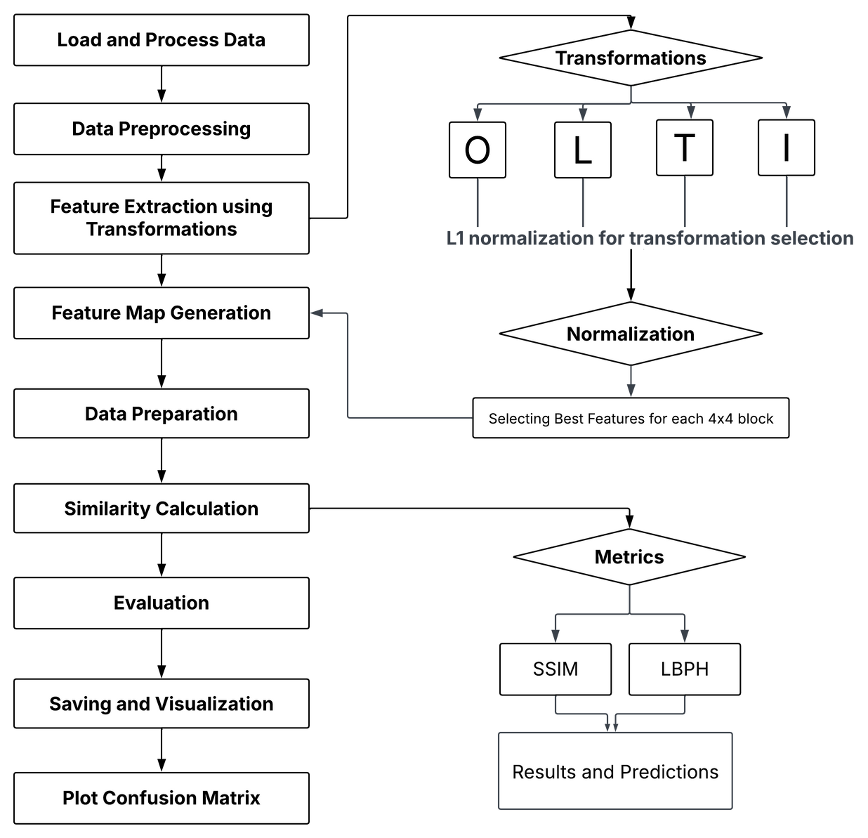
11
METHODOLOGY
256×256 Image
⬇
Divide into 4×4 Blocks
⬇
Apply Tetrolet Transform
(Rearrange pixels in 4×4 block)
⬇
Split 4×4 into four 2×2 Sub-Blocks
⬇
Feature Extraction (4 values per sub-block)
⬇
Generate Final Feature Matrix
CBIT/IT/2024-25/IT1/106

Slide 13
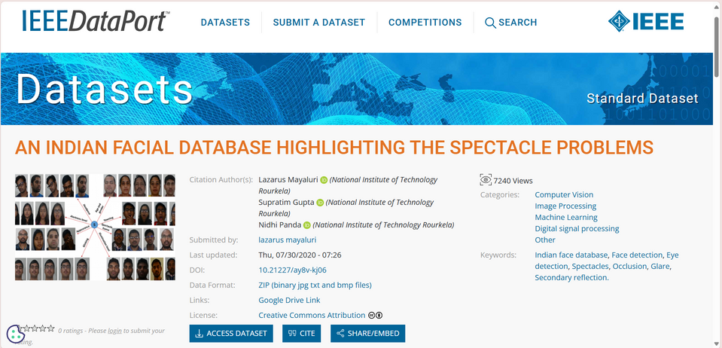
12
DATASET
1. Spectacle Problem: Issues like occlusion, glare, and reflections from spectacles hinder accurate eye/face detection and recognition.
2. Indian Facial Image Database: A new database was created to address these issues, with Version 1 containing 271 images and Version 2 expanding to 1,23,213 images from 58 subjects.
https://ieee-dataport.org/documents/indian-facial-database-highlighting-spectacle-problems#files
CBIT/IT/2024-25/IT1/106

Slide 14
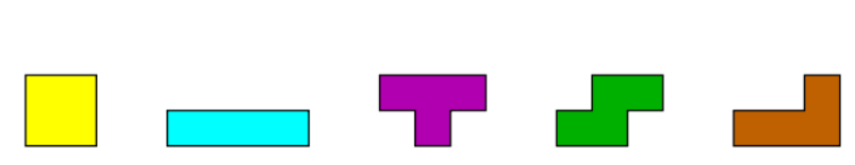
13
TETROLET TRANSFORMS
Wavelet transformation is independently applied to the rows and columns of an image
DWT fails to achieve optimal results with images that contain geometric structures in other directions.
Instead of choosing a priori a basis or a frame one may try to adapt the function system depending on the local image structures.
We divide the image into 4x4 blocks, then we determine in each block a tetromino partition which is adapted to the image geometry in this block
CBIT/IT/2024-25/IT1/106

Slide 15



14
TETROLET TRANSFORMS
CBIT/IT/2024-25/IT1/106

Slide 16
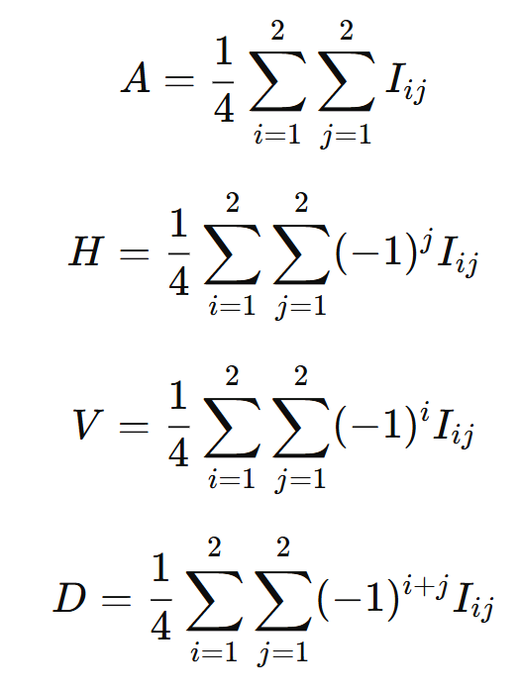
9
15
TETROLET TRANSFORMATIONS
Computation
Tetrolet wavelet transform, an extension of Haar transformation, is used for efficient image feature extraction. It decomposes an image into four components:
LL (Approximation) – Captures the main structure.
LH (Horizontal) – Captures horizontal edges.
HL (Vertical) – Captures vertical edges.
HH (Diagonal) – Captures diagonal edges.
For a 2×2 image block, Haar wavelet feature extraction is computed as:
CBIT/IT/2024-25/IT1/106

Slide 17
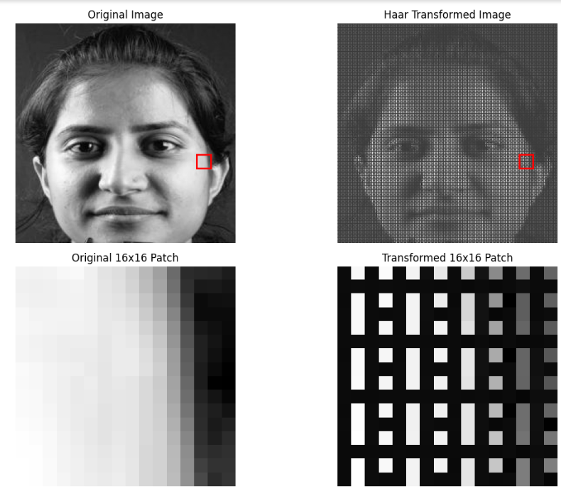
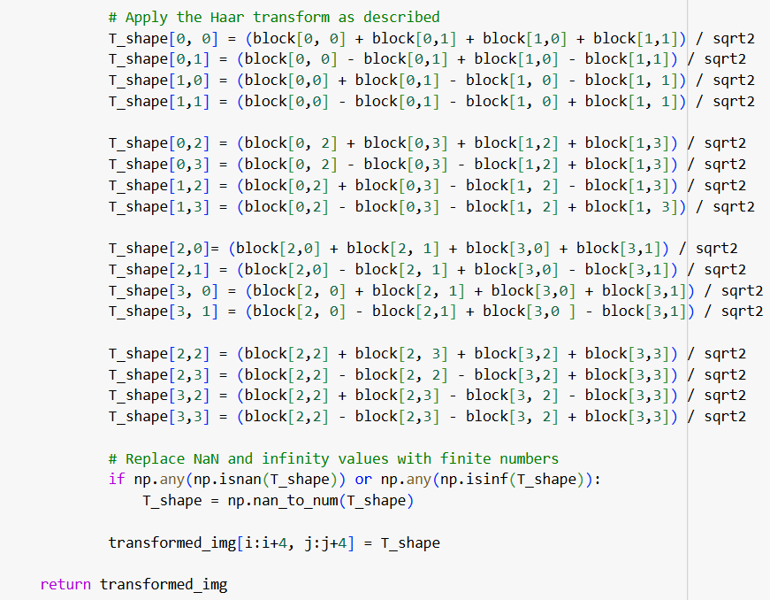
17
O-TRANSFORMATION
CBIT/IT/2024-25/IT1/106

Slide 18
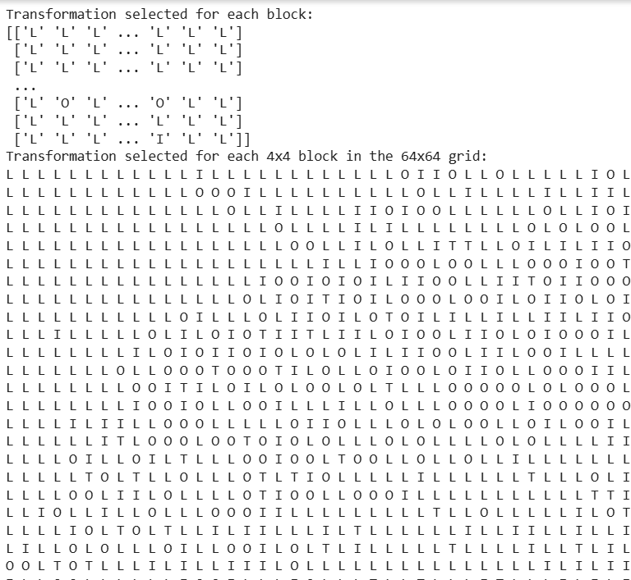
18
TRANSFORMATION OPTIMIZATION
CBIT/IT/2024-25/IT1/106

Slide 19
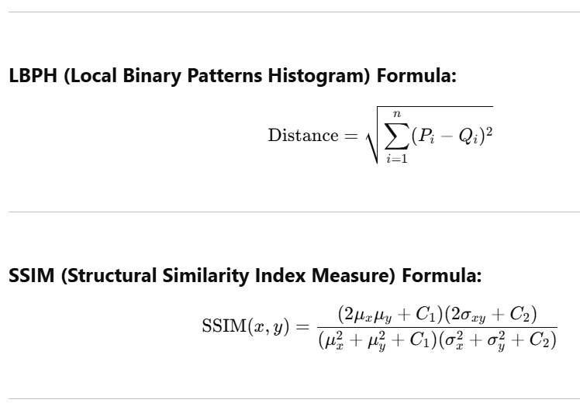
9
19
EVALUATION
Formula
LBPH (Local Binary Patterns Histogram)
LBPH extracts texture features for face recognition.
It compares local patterns (edges/textures) between images.
SSIM (Structural Similarity Index Measure)
SSIM measures image similarity based on luminance, contrast, and structure.
It ranges from -1 to 1, with 1 indicating identical images.
LBPH (Local Binary Patterns Histogram)
(Euclidean distance between histograms)
CBIT/IT/2024-25/IT1/106
SSIM (Structural Similarity Index Measure)

Slide 20
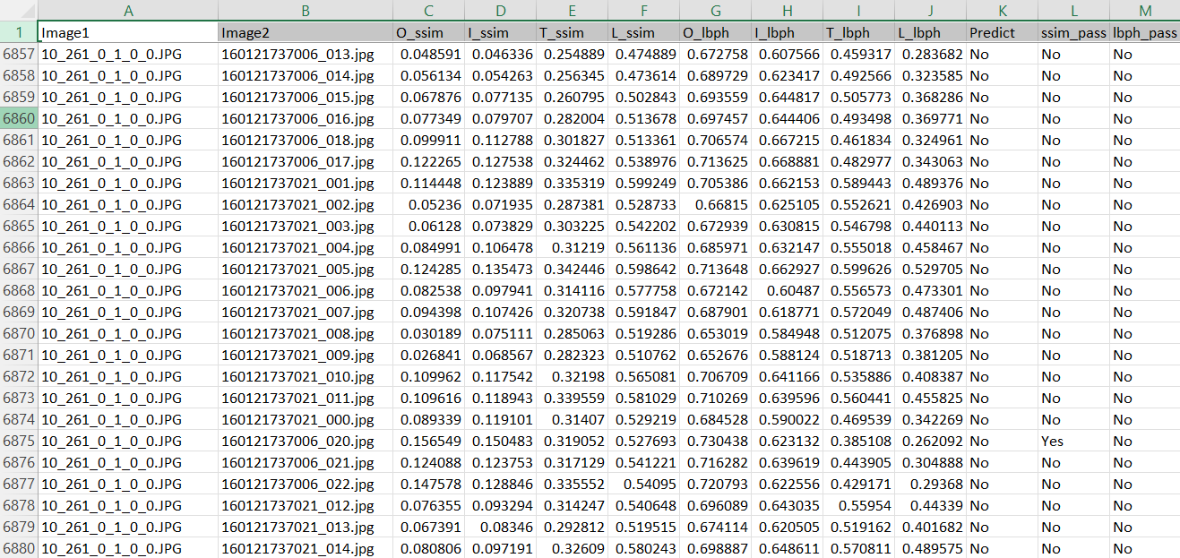
20
EVALUATION
CBIT/IT/2024-25/IT1/106

Slide 21
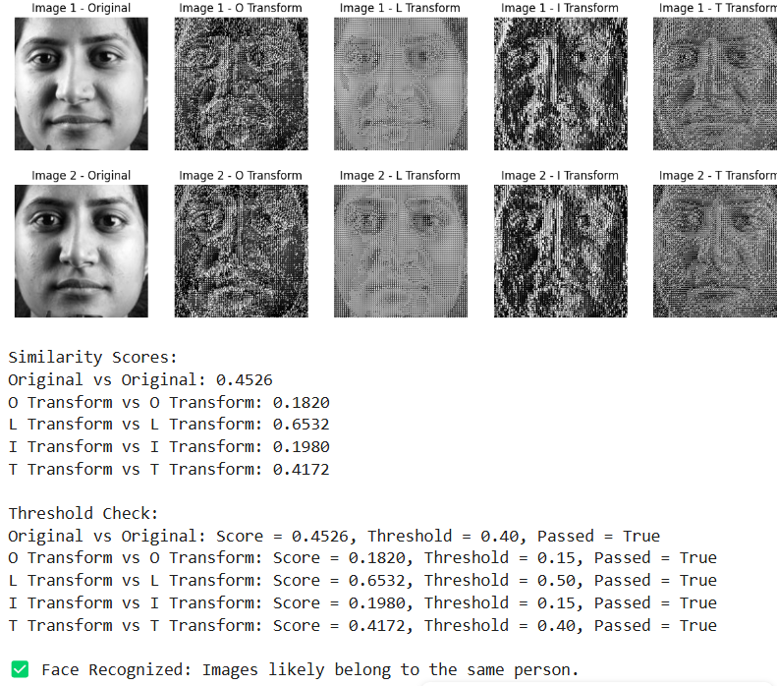
RESULTS
21
CBIT/IT/2024-25/IT1/106

Slide 22
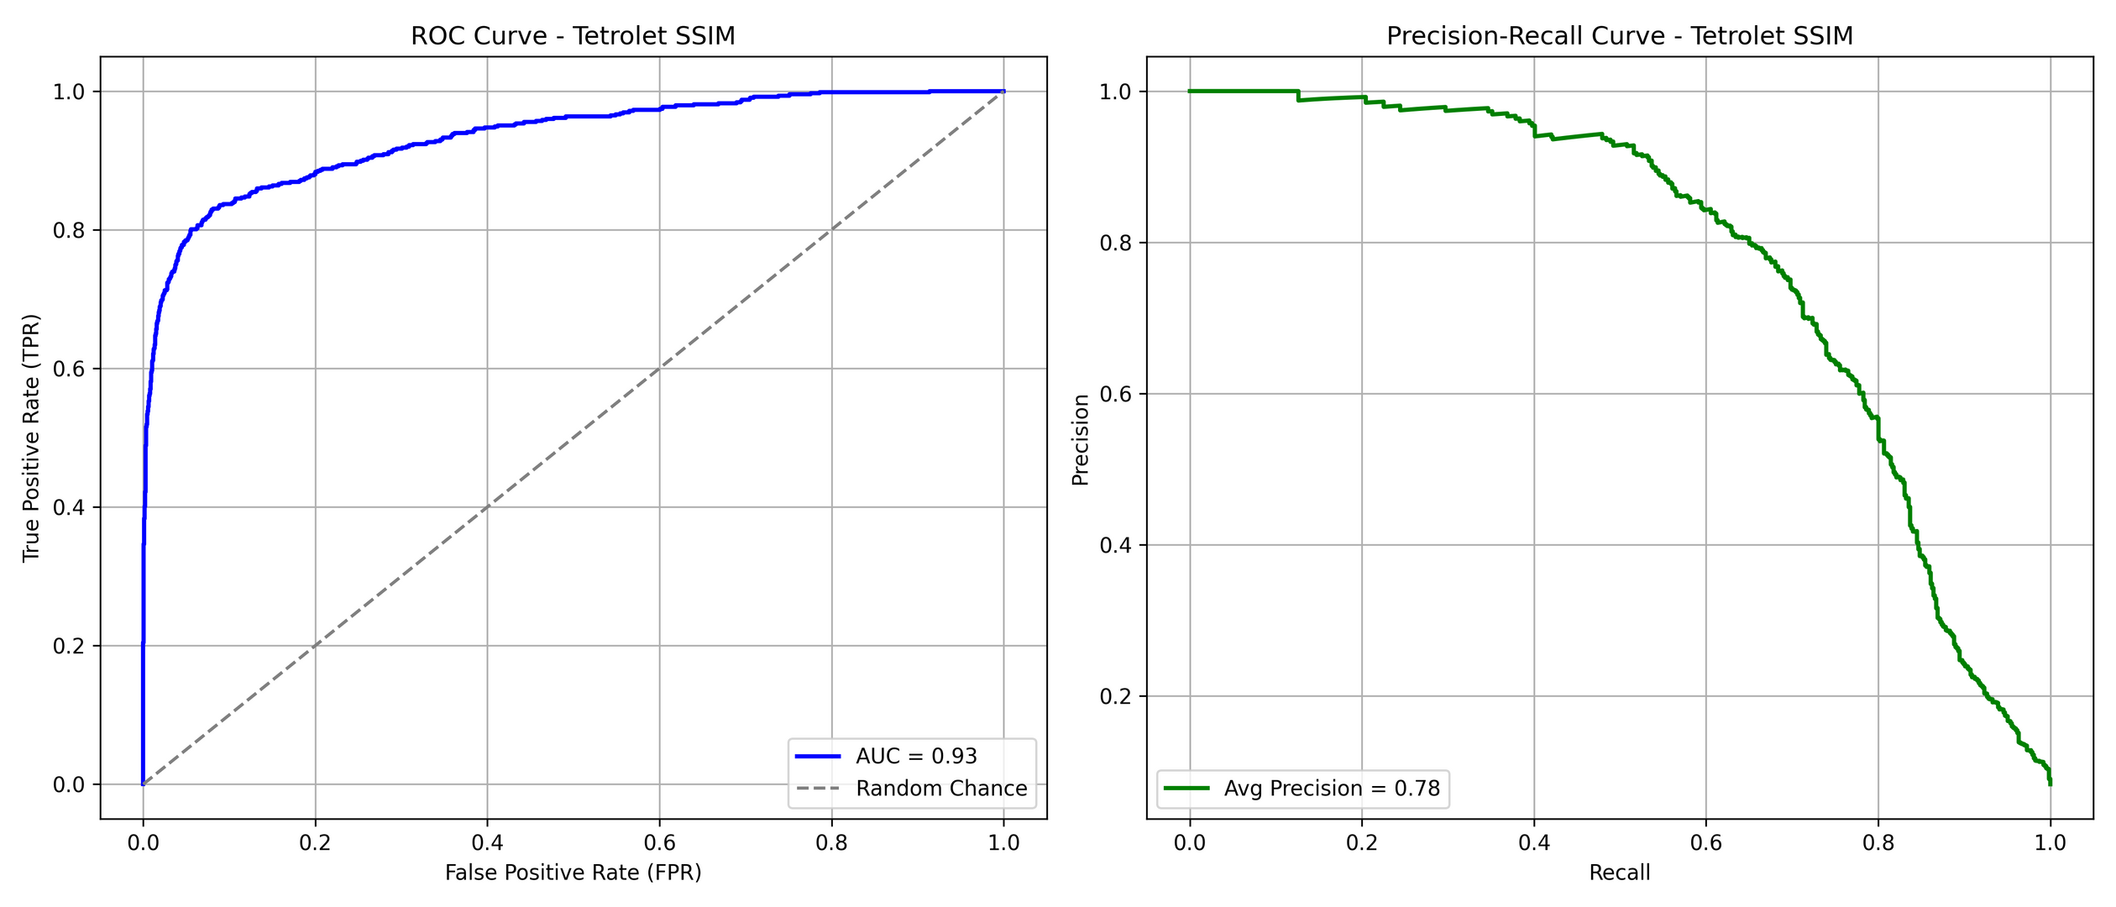
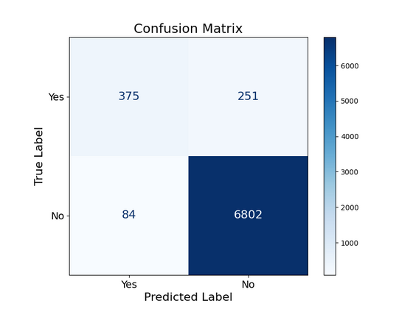

RESULTS
22
Tetrolet with SSIM
CBIT/IT/2024-25/IT1/106
Haar Classifier with LBPH

Slide 23
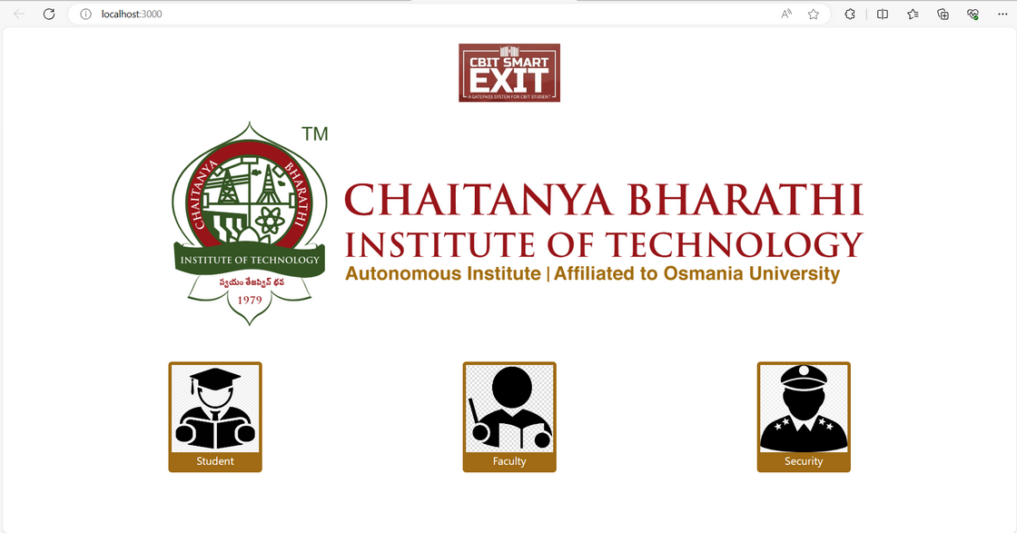
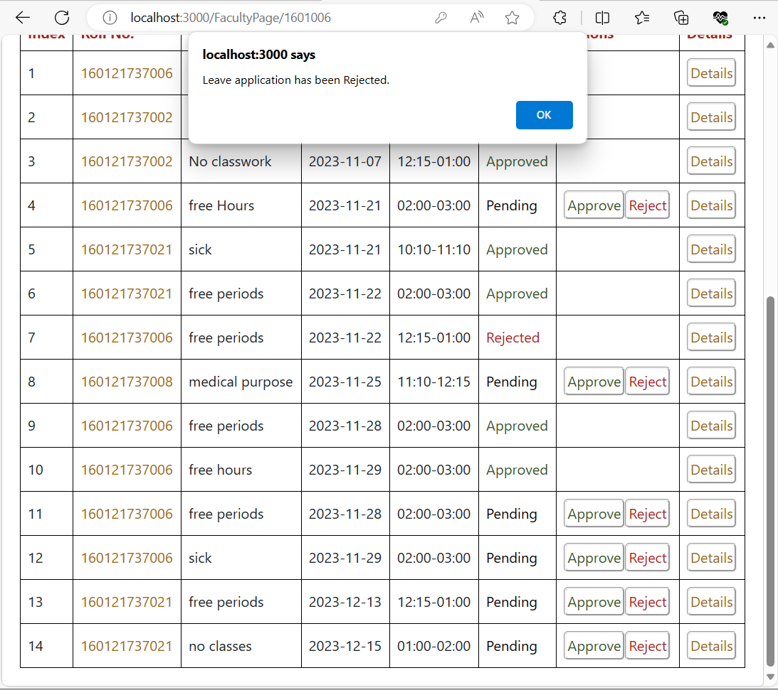
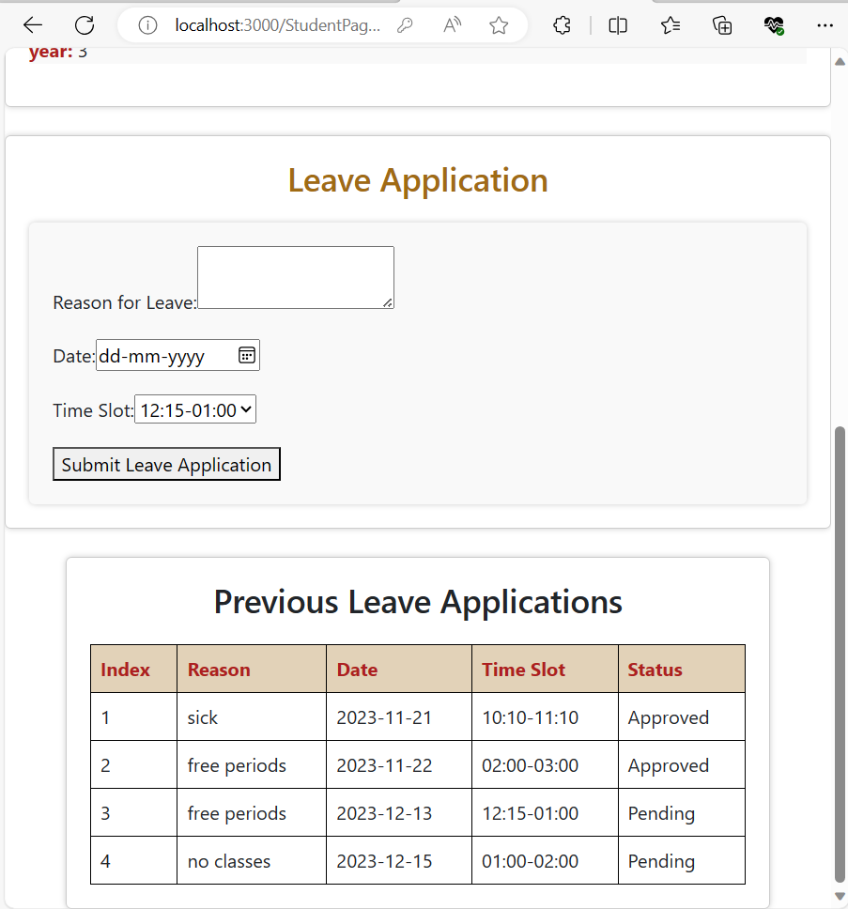
23
RESULTS
CBIT/IT/2024-25/IT1/106

Slide 24
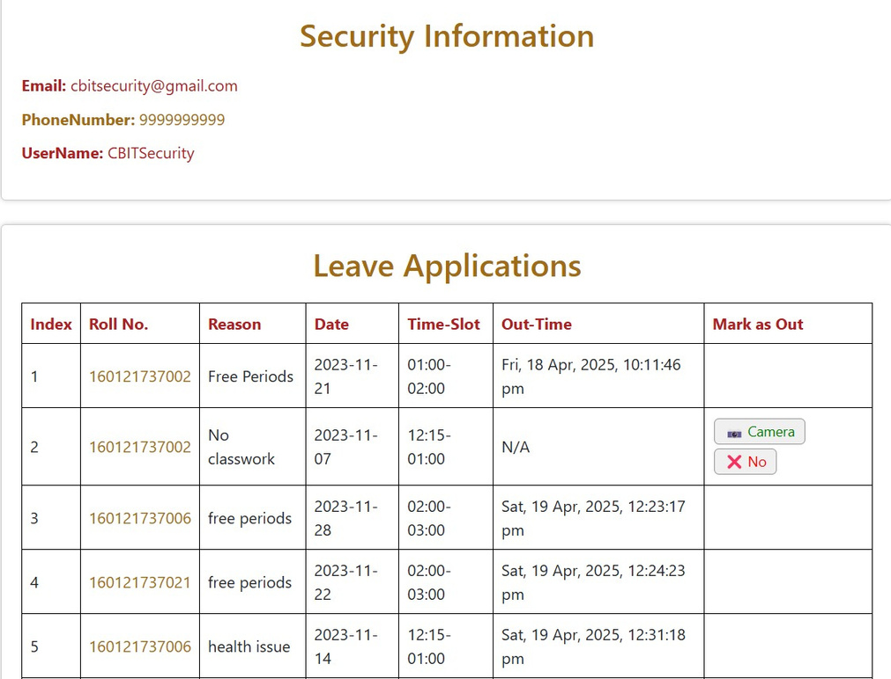
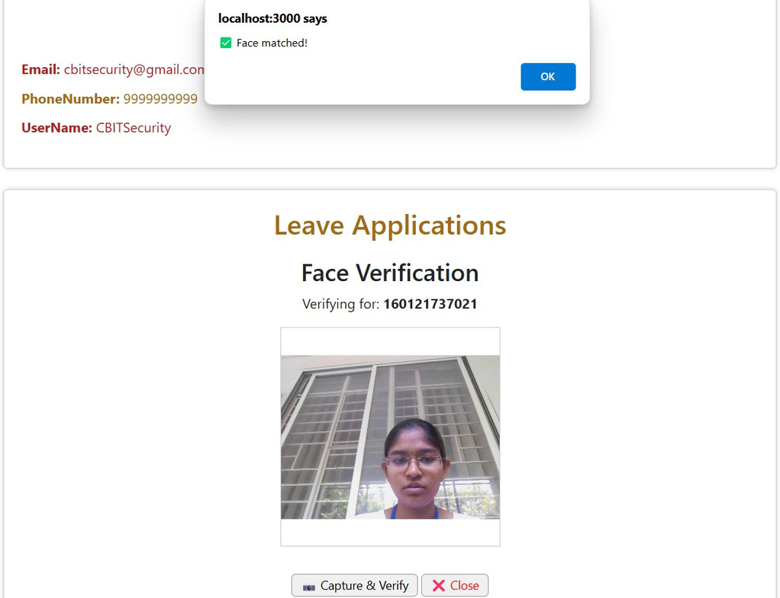
24
RESULTS
CBIT/IT/2024-25/IT1/106

Slide 25
25
CONCLUSION
We conclude that Tetrolet Transforms enhance facial recognition accuracy and robustness compared to Haar Cascade and LBPH, improving feature extraction and reducing false identification rates, thereby strengthening the surveillance system's reliability and effectiveness.
CBIT/IT/2024-25/IT1/106

Slide 26
26
REFERENCES
Dataset https://ieee-dataport.org/documents/indian-facial-database-highlighting-spectacle-problems#files
Base Paper https://doi.org/10.1016/j.micpro.2022.104728
CBIT/IT/2024-25/IT1/106

Slide 27
CBIT/IT/2024-25/IT1/106
THANK YOU

