Slide 1
AI-POWERED BEHAVIOURAL ANOMALY DETECTION FOR CYBERSECURITY
Problem Statement Number – 4
Problem Statement Title – AI-Powered Behavioral Anomaly Detection for Cybersecurity
Student Name – Pranati
WHAT THE DETECTOR SEES — ONE ENTITY, 42 DAYS
MEASURED ON FIVE HELD-OUT SEEDS, HASH-FROZEN CONFIG
0.613
0.837
0.43
PR-AUC
37× random
incident
recall
leakage gate
≤0.60 to pass

Slide 2
PROPOSED SOLUTION
Per-entity behavioural baselines → 21 named signals → correlation-corrected fusion → typed, explainable alerts at a fixed analyst budget.
HOW IT ADDRESSES THE PROBLEM — three detection levels, never pooled
ENTITY
13 signals
SOURCE IP
3 signals
LONG WINDOW
5 signals
Habitual hours, known IPs, geo-velocity, device fingerprint, resource novelty.
Entity fan-out and failure rate per IP over rolling windows.
7-day footprint growth, off-hours share, sensitive-access volume.
Catches lateral movement, spoofing, impossible travel
Credential stuffing exists ONLY here — many entities, few IPs
Low-and-slow is unremarkable per event; only days reveal it
A per-event, per-entity detector misses two of six attack classes by construction — no matter how good the model is.
INNOVATION — THE BENCHMARK POLICES ITSELF
6
4
2
A synthetic benchmark can be solved without doing detection at all.
An adversarial audit hands a classifier only features that carry no behavioural information — row position, string lengths, field-presence flags — and must score ≤ 0.60. It failed at 0.9963 and exposed four leaks.
leaks caught
full regenerations
introduced by our
own correct fixes

Slide 3
TECHNICAL APPROACH
TECHNOLOGIES
Python 3
NumPy / pandas
LightGBM
Streamlit
Parquet
scikit-learn
Matplotlib
METHODOLOGY — layered pipeline, every signal a named unit-ed quantity
L0
L1
L2
L3
L4
L5
L6
Deterministic
Baseline
Sequence
Graph
Fusion
Type
Explain
Geo-velocity, failed-auth
rate, fingerprint mismatch
›
Per-entity profile,
cold-start shrinkage
›
n-gram surprisal over
a typed token stream
›
Entity–resource edges,
cohort corroboration
›
Correlation-corrected
Stouffer → risk score
›
Rule-based attribution
over the evidence vector
›
Ranked signals →
analyst-facing text
KEY METHODS
Correlation-corrected Stouffer
Size-calibrated alert scoring
Weights never learned from labels
Z = (w·z)/√(wᵀΣw). Geo-velocity and country-novelty both fire on impossible travel — a plain sum counts one event as three alarms.
A 200-event window gets 200 chances at a high score. Calibrating against same-size alerts cut corr(score, size) from 0.263 to 0.042.
Analyst priors ÷ an unsupervised reliability term. Learning them would be learning the generator’s wiring diagram.
STREAMING
3,281
0.27 ms
0.75 ms
1.3 kB
O(1)
events / sec
p50 latency
p99 latency
state per entity
state per event

Slide 4
FEASIBILITY AND VIABILITY
FEASIBILITY — built, measured, and validated on seeds never used for fitting
0.837
0.613
0.570
0.042
3,281
incident recall
holdout, 5 seeds
PR-AUC
37× random baseline
R-Precision
no ceiling artefact
corr(score, size)
was 0.263
events / sec
p99 0.75 ms
GRACEFUL DEGRADATION UNDER ATTACKER STEALTH (δ)
CHALLENGES → STRATEGY
A benchmark we wrote ourselves can be gamed
Adversarial leakage gate must pass before any result counts. Config hash-frozen before the holdout seeds were generated.
“Unusual” and “malicious” become synonyms
Benign confounders injected at 4× the attack rate — business travel, OS patches, on-call rotations, office NAT.
0.5–3% prevalence makes accuracy meaningless
Every metric reported with its alert budget and its ceiling. R-Precision headlined because it has no prevalence artefact.
Both metrics fall monotonically. Incident recall is deliberately not plotted — prevalence falls across the sweep, so at low δ more campaigns compete for the same fixed budget and recall saturates against the budget, not the detector.
One number says as much about the generator as the detector
δ-sweep from blatant to benign-overlapping; 17 limitations published, including three negative results.

Slide 5
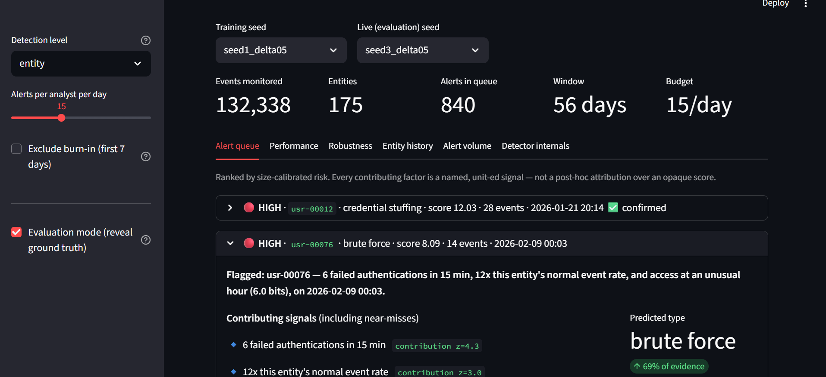
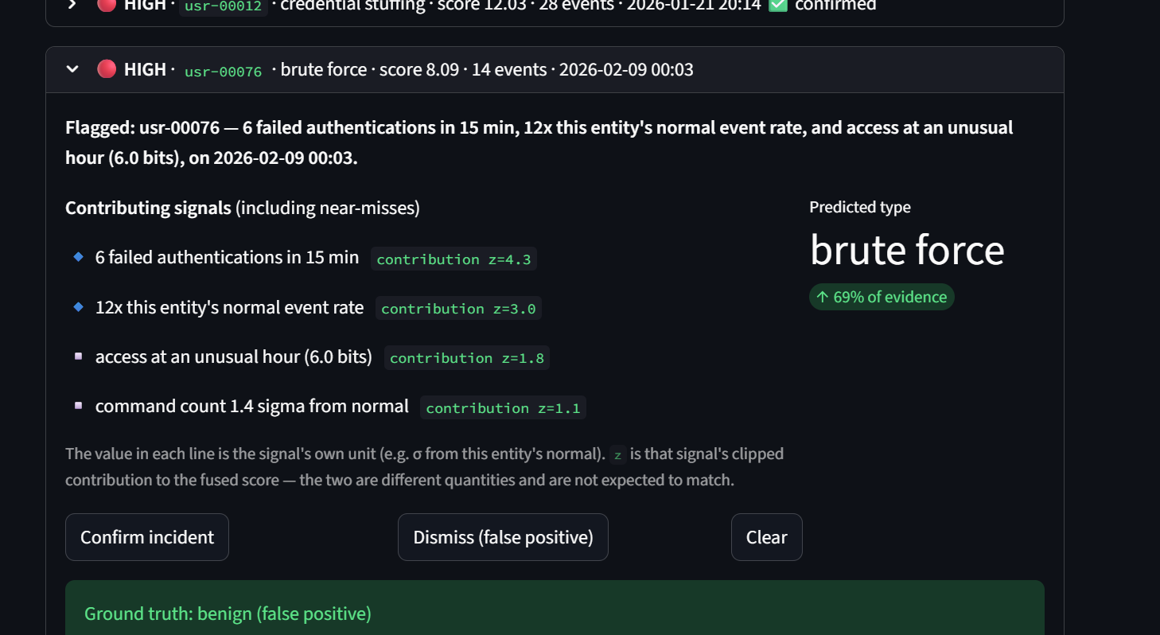
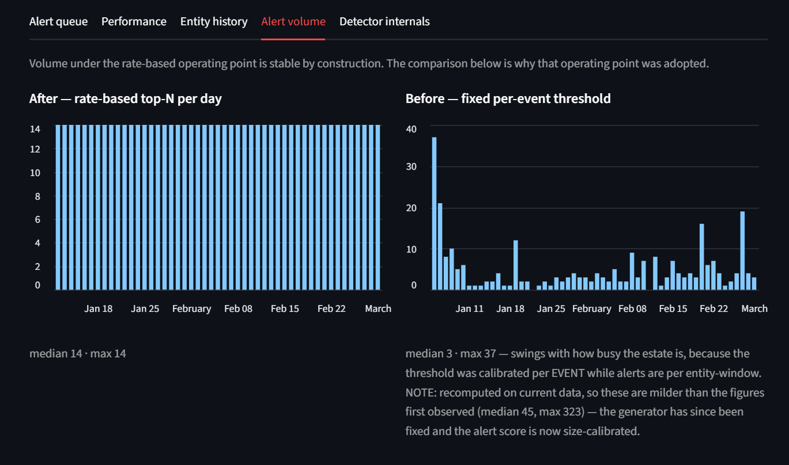
ARTIFACTS
ANALYST CONSOLE — SIX TABS, BUILT ON STREAMLIT
Live: anomaly-detection-gdahlrwllymdpfnxax86y5.streamlit.app
Ranked alert queue
Alert detail — why it fired
Alert volume, before and after
Severity, entity, predicted attack type and score. Ranked by size-calibrated risk, not raw score.
Plain-English sentence, contributing signals with values, predicted type, and analyst confirm / dismiss.
A fixed threshold swung 12× day to day. A rate-based operating point makes workload predictable.
CODE — 13 MODULES, 13 HAND-COMPUTED METRIC TESTS
REPRODUCIBILITY
generator.py synthetic log generator + attack injection
audit.py adversarial leakage gate — runs first
Config hash-frozen to 10284ea8d70452c5 before the holdout seeds were generated, and re-verified at scoring time.
“We did not tune on the holdout” is checkable, not asserted. Every dataset regenerates byte-identically from its seed.
features.py / sequence.py L0–L2 signals, bounded streaming state
detector.py fusion, calibration, type rules, explanation
ablation.py / drift.py / experiments.py layer ablation, poisoning arms, δ-sweep + holdout

Slide 6
RESEARCH AND REFERENCES
PROJECT ARTEFACTS
Live analyst console - https://anomaly-detection-gdahlrwllymdpfnxax86y5.streamlit.app/
Repository - https://github.com/pranatisri/anomaly-detection Documentation
METHODS AND STANDARDS REFERENCED
Stouffer’s Z with correlated tests
Behavioural analytics / UEBA framing
Stouffer et al. (1949); Whitlock, J. Evol. Biol. (2005) — weighted meta-analytic combination and the √(wᵀΣw) correction.
Gartner UEBA market definition; MITRE ATT&CK techniques T1110 Brute Force, T1078 Valid Accounts, T1021 Remote Services.
Precision–recall under extreme imbalance
Public intrusion-detection benchmarks
Saito & Rehmsmeier, PLOS ONE (2015) — why ROC-AUC is optimistic and PR curves are the honest view at low prevalence.
CICIDS2017 (Sharafaldin et al.) and UNSW-NB15 (Moustafa & Slay) — surveyed; both motivated generating labelled campaign-level data instead.
Empirical-Bayes shrinkage for cold start
Dataset artefacts and leakage
Efron & Morris (1975) — pooling a new entity toward its cohort prior with weight n/(n+k).
Arp et al., “Dos and Don’ts of Machine Learning in Computer Security”, USENIX Security (2022) — the direct motivation for the audit gate.
Tooling Python 3 · NumPy · pandas · LightGBM · scikit-learn · Matplotlib · Streamlit · Parquet. All data synthetic; labels held physically separate from every path the detector can read.

