Slide 1


#DPL2026
DATA PREMIER LEAGUE 2026
Decode the Game. Build the Analytics.
PRELIMINARY ROUND — QUESTION 1 SUBMISSION
TEAM / PARTICIPANT NAME
Pranav Ramanathan Swaminathan
QUESTION ATTEMPTED
Question 1 — Franchise Report: scouting, performance and strategic review
SELECTED IPL TEAM(S) / SEASONS
Rajasthan Royals · IPL 2023 and 2024 · 34,967 deliveries, 145 matches, all 10 teams as context
SUBMISSION DATE
16 / 10 / 2026
Data Premier League · An INSMA Hackathon · info@insma.in

Slide 2

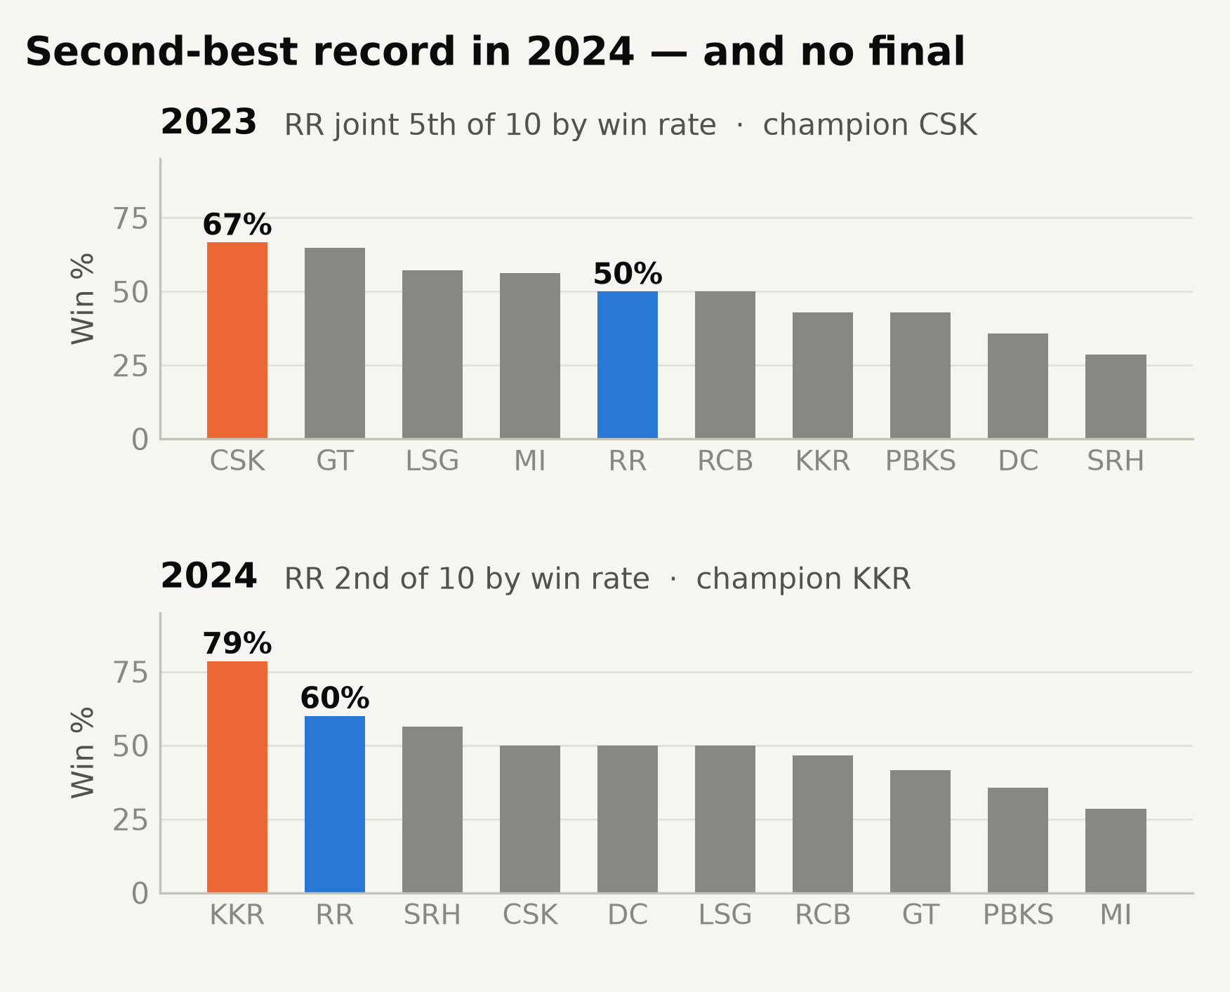

SECTION 1
Context & Analytical Objective
Objective and scope
Question 1 — a scouting, performance and strategic review of one IPL franchise.
Team: Rajasthan Royals, IPL 2023 and 2024 — both seasons in the dataset.
Lens: a franchise analyst briefing RR ahead of the 2025 mega-auction, when retention and recruitment are decided.
Objective: find where RR lose ground to champions, establish whether it is a squad problem or a method problem, and recommend what to keep, change and buy.
Why RR: the 2nd-best record in 2024 and no final — a strong side with a specific, diagnosable ceiling.
Scope: 34,967 deliveries and the organisers' auction file, all 10 teams as context. Two seasons only.
DATA PREMIER LEAGUE 2026 · PRELIMINARY ROUND
2

Slide 3
SECTION 2
Data & Methodology
Data Sources
Cleaning & Prep
Analytical Methods
Organisers' dataset: 34,967 deliveries from 145 IPL 2023–24 matches, all 10 teams.
Every ball tagged for line, length, delivery type, shot, batter control and wagon wheel.
Organisers' auction file: both seasons' squads, with price, nationality and role.
The supplied wprob model is used only as a benchmark, never as an input.
Squad table: 28 players from the auction file; Keshav Maharaj from RR's announcement. No scraped data.
RCB is spelled two ways: a naive join shows 0 RCB wins in 2023, not 7.
110 run outs and other non-bowler dismissals removed from bowling figures.
14 no-ball errors corrected; all 289 innings now reconcile.
Abandoned and rain-shortened matches handled; every comparison is per ball.
Auction prices converted to crore and names matched: 28 of 29 RR players found.
Powerplay 1–6, middle 7–15, death 16–20.
Bootstrap by match, 10,000 resamples, for significance tests.
Permutation tests for post-hoc splits; shrinkage for player rankings.
Win-probability model, cross-validated by match, against the supplied one.
Reproducibility: code, data dictionary and cleaning log in the project repository (link on the appendix slide). Scripts run in order; random seed 42 throughout.
DATA PREMIER LEAGUE 2026 · PRELIMINARY ROUND
3

Slide 4
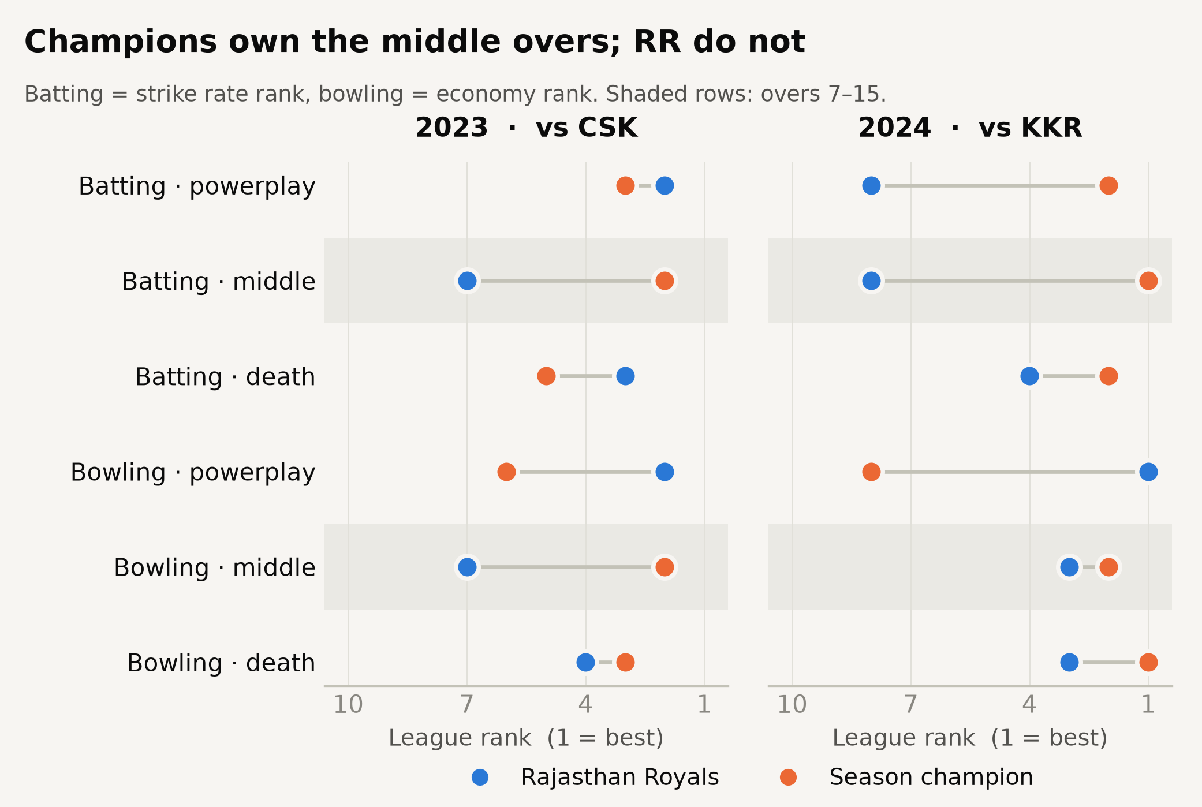
SECTION 3
Performance Overview
0.558
Correlation of middle-overs edge with season win % (p = 0.010) — the strongest of any phase
7 of 7
Quality metrics on which RR ranked bottom-half in the 2023 middle overs
18.2%
RR's attacking-shot share in the middle overs — last of all ten teams
DATA PREMIER LEAGUE 2026 · PRELIMINARY ROUND
4

Slide 5
SECTION 4
Detailed Analytical Findings
1
Champions are built in the middle overs — RR are not
Across 20 team-seasons, edge in overs 7–15 tracks season win % more closely than any other phase (Spearman 0.558, p = 0.010); the death overs, despite the widest spread, show no significant link. Both champions ranked 1st in the middle overs. RR's 2023 middle overs were bottom-half on all 7 quality metrics.
2
The data point to passivity in the middle overs, not being outbowled
In 2024 RR had the league's second-highest middle-overs control (80.1%; +3.7 points, p = 0.027) but the second-lowest return from it (1.53 runs per controlled ball, p = 0.042); champions KKR were the reverse (71.4%, 1.87). RR play attacking shots (sweeps, pulls, hooks, slogs, ramps, upper cuts, reverses) on 18.2% of middle-overs balls, last of ten, yet score 2.29 runs per ball when they do, the league's best.
3
The mechanism is full deliveries — and shot choice could close the gap
Off full balls RR score 24–28 strike-rate points below the league, yet beat it off back-of-a-length balls at the stumps. At the league's attacking share, RR's own returns would lift middle-overs strike rate from 132.5 to 137.5 (league 137.7): an illustrative, likely optimistic scenario.
DATA PREMIER LEAGUE 2026 · PRELIMINARY ROUND
5

Slide 6
SECTION 5
Strengths & Weaknesses of Chosen Methodology
STRENGTHS
LIMITATIONS
Tested, not asserted. Significance tests resample whole matches, 10,000 times.
A circular trap, avoided. Predicting results from runs scored and conceded only rebuilds the scoreboard; our model forecasts from the state at each ball.
No leakage. Cross-validation is grouped by match, so no match is in both training and test.
A real baseline. Lower observed log-loss than the dataset's own model (0.551 vs 0.572), though not significant; gradient boosting overfit and was dropped.
Small samples. 14–15 matches a season, fewer per venue or opponent: no single-season RR gap is significant, so the argument rests on patterns.
Two claims rejected. ‘RR struggle against spin’ (p = 0.569) and a late-2024 ‘collapse’ (p = 0.118 once corrected).
Control looks like style. Higher control goes with slower scoring, so it stays out of quality rankings.
A scenario, not a forecast. The shot-mix estimate assumes RR's attacking return holds.
Missing data. No fielding or injury records; prices are 2023–24 contracts, not 2025 auction values.
DATA PREMIER LEAGUE 2026 · PRELIMINARY ROUND
6

Slide 7
SECTION 6
Interpretation & Practical Significance
Cricket interpretation
Practical relevance to the franchise
Phases. Champions win overs 7–15 with bat and ball; RR's 2023 middle overs were bottom-half on all 7 metrics.
Tactics. The pattern points to passivity, not being beaten: second for control in 2024, second-lowest for runs per controlled ball. RR stall against full balls.
Roles. No RR batter with 50+ balls strikes above 150 in overs 7–15; Hetmyer, Samson and Parag attack less than the league median.
Venue and opposition. Even at home in Jaipur RR trail visiting sides; Chennai and Punjab held them below 120.
The first lever is free. RR attack least but score best when they do; the league's shot mix would lift them to about the league average.
Overseas slots. 12 overseas players for 4 slots, five with under 60 deliveries. The churn was cheap: settle them for role clarity.
Role balance and recruitment. The 2024 bowling was top-three for economy in every phase; spend on one middle-overs batter who scores off full balls. 13 of the 20 who fit are Indian, so no overseas slot is needed.
Availability. Prasidh Krishna, retained at ₹10 Cr, bowled no balls in either season; in 2024, players with no balls faced or bowled held ₹14.5 Cr of contracts.
Risk and ambition. A blunt ‘attack more’ order risks the wickets RR learned to protect. Without a middle-overs engine, Qualifier 2 is the ceiling.
DATA PREMIER LEAGUE 2026 · PRELIMINARY ROUND
7

Slide 8
SECTION 7
Conclusion & Key Takeaways
Champions are built in overs 7–15 — and RR's batting there has been below average for two seasons
Action: make middle-overs run rate the squad's primary planning metric — in selection, match plans and player reviews.
RR look passive, not outbowled — the league's best attacking return, its lowest attacking share
Action: set and test a minimum attacking-shot share for overs 7–15; on RR's own returns it could close the gap.
The 2024 bowling was top-three for economy in every phase; the middle-order batting and overseas slots were not
Action: buy one middle-overs accelerator who scores off full balls (13 of the 20 who fit are Indian),
and consolidate twelve overseas players into four slots.
DATA PREMIER LEAGUE 2026 · PRELIMINARY ROUND
8

Slide 9
APPENDIX — NOT COUNTED IN SLIDE LIMIT
References & Code Repository
References
Dataset. Data Premier League 2026, Preliminary Round (organisers): IPL 2023–24 ball-by-ball, 34,967 deliveries, 61 columns.
Auction file. Data Premier League 2026 (organisers): IPL 2023 and 2024 squads with price, nationality and role.
Squad reference. data/reference/rr_squad_reference.csv — nationality and keeper roles from the auction file (28 players).
Documentation. docs/DATA_DICTIONARY.md and docs/CLEANING_LOG.md, written for this submission — no data dictionary was supplied with the dataset.
Figures. Every analysis chart, including those not shown on these slides, is in reports/figures/.
Code, Reproducibility & Video Explanation Links
Repository: https://github.com/pranav-0217/DPL Video: https://drive.google.com/file/d/1jLL0KZS9EmJdwQcU8pXXAaGpCZJvD62B/view?usp=share_link
Reproduce: put the organisers' dataset and auction file in the repository root, pip install -r requirements.txt, then run src/01 to src/10. Seed 42.
Environment: Python 3.12 · pandas 3.0.5 · numpy 2.4.6 · scikit-learn 1.9.0 · scipy 1.18.0 · matplotlib 3.11.1 · pyarrow 24.0.0 · openpyxl 3.1.5
DATA PREMIER LEAGUE 2026 · PRELIMINARY ROUND
9

