Slide 1
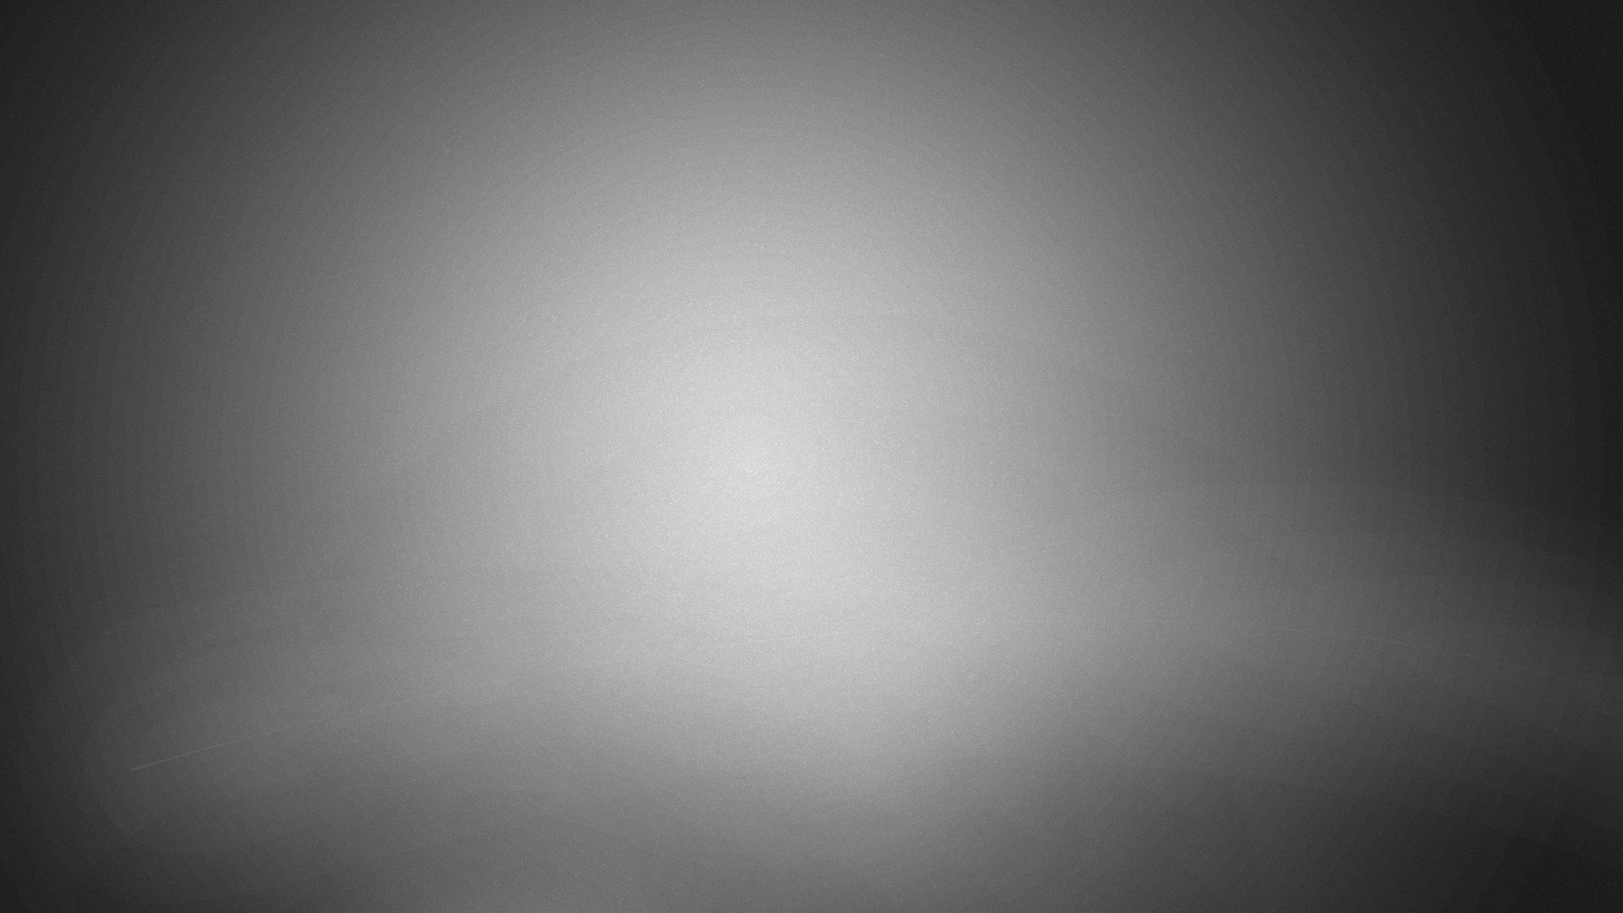
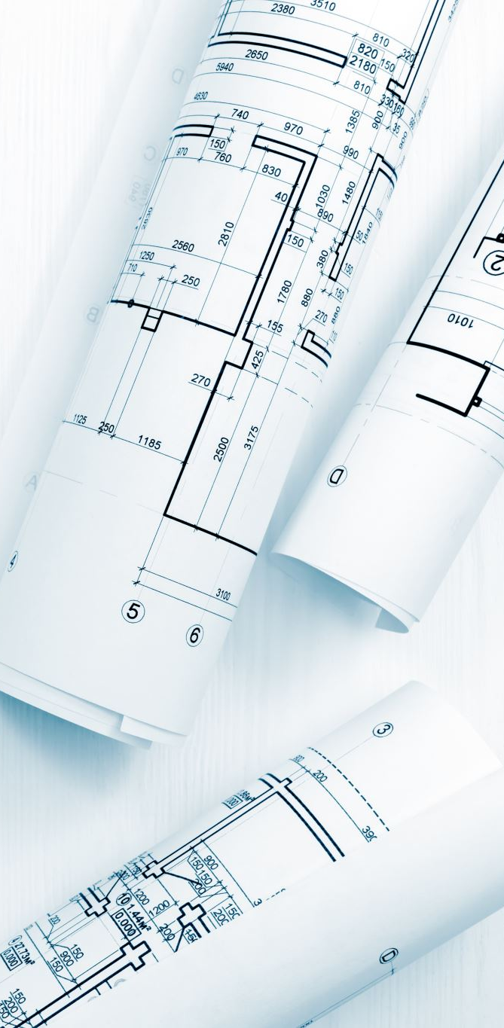
ID1054 Project
Stereographic projection model

Slide 2
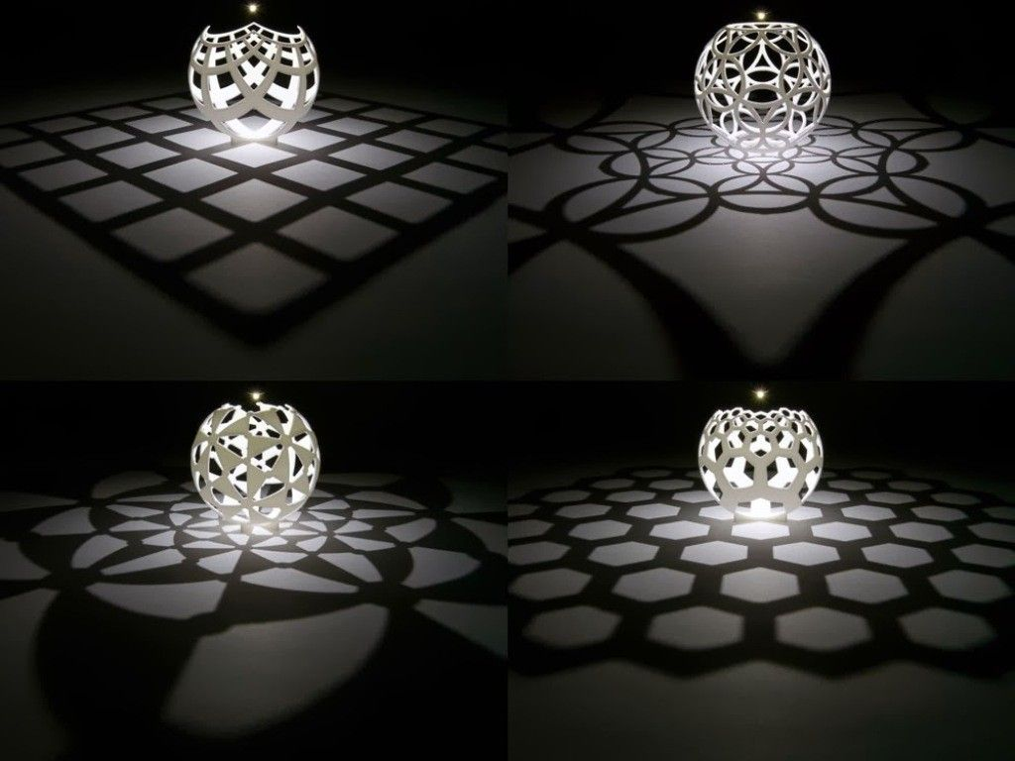
About Project
Our model is inspired from Henry segerman's lamp related stereographic projections of floor patterns on the sphere as show in the picture.
We tried to make a model with floor pattern of a 4 x 4 square grid
We made the model by creating the planes containing light source and the line on the floor then cutting the sphere appropriately.
We checked the accuracy of the model by creating an artificial lightning environment in keyShot.
Henry Segerman's lamp related orthographic projections of different floor patterns.(BG)

Slide 3

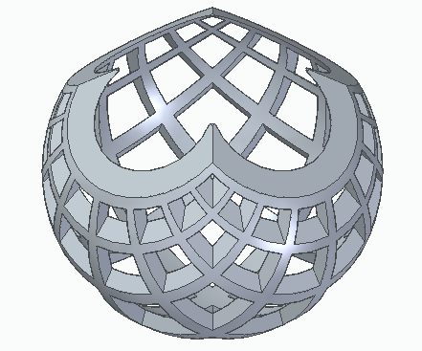



Screenshot of the CAD Model

Slide 4
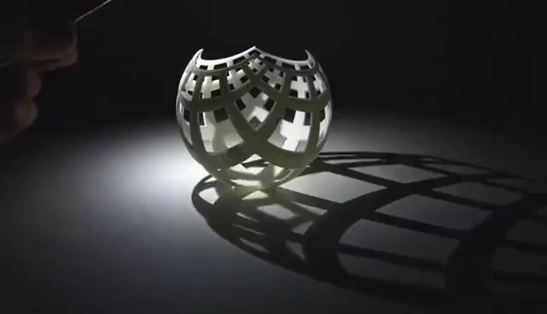
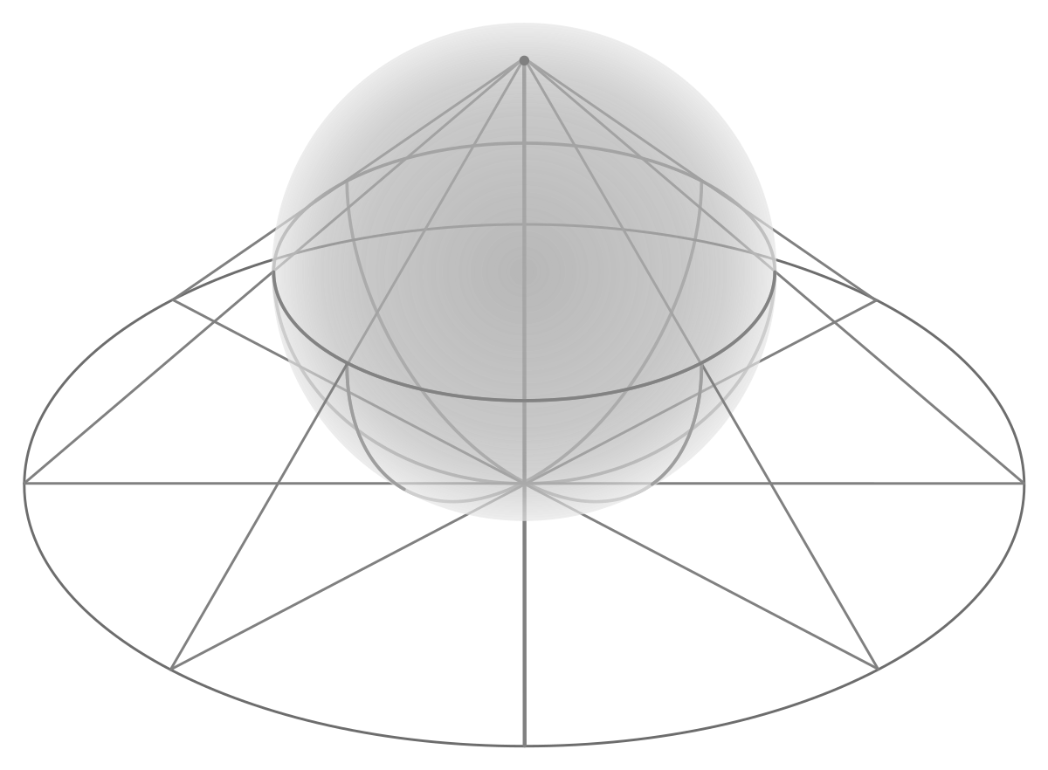
EXAMPLES
Above video shows how shadow projections change with the position of source of light.
Projection of a hemisphere onto the tangent plane of bottom most point

Slide 5
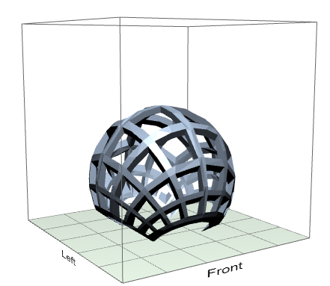
3D Printing Related Data
We can print the model in Mojo 3d printer
Orientation of the model which is efficient and suitable for better 3d printing is show in the image right.
Model dimensions :
3.54" x 3.54" x 3.06"
STL units : inches
Scale : 1.5
Support : SMART
Part Interior : Solid
Slice Height : 0.007 in
Build Estimates
Time : 12 hrs 58 min
Model Material: 1.83 in³
Support Material: 3.14 in³

Slide 6
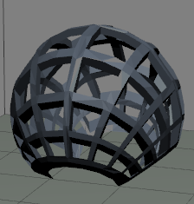
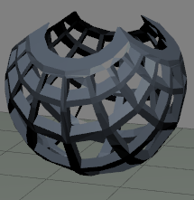
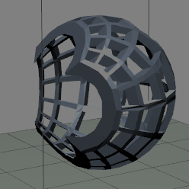
Comparisions of models based on orientations
Bottom Face Up(best orientation)
Bottom Face Down
Bottom Face Sideways
Time : 12 hours and 36 min
Model Material : 30 cm3
Support Material : 48.9cm3
Time : 14 hours and 34 min
Model Material : 29.3 cm3
Support Material : 58.9cm3
Time : 13 hours and 48 min
Model Material : 29.5 cm3
Support Material : 60.95cm3

Slide 7
3D printing Optimizations
In regarding material usage ,downward orientation is most efficient of the above orientations because we can save a quite a bit of support material in the downward orientation as compared to others and the model material required is almost same in all orientations
In regarding time of construction, as we require less support constructions in downward orientation that in others time taken to construct the model is also less in downward orientation.
Therefore, downward orientation is the best of the above orientations when we consider material and time constraints.

