Slide 1

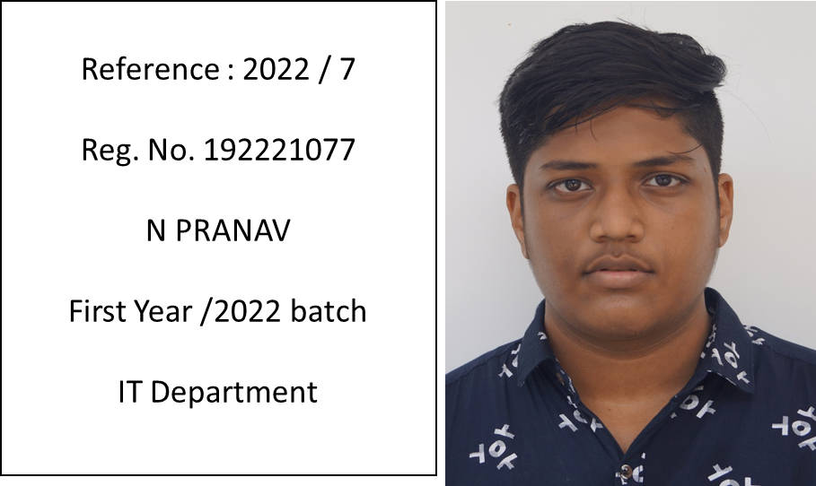

Slide 2

EXAM RESULTS
Slot B | Total Marks | Marks Obtained | Class Average Mark
Model Exam A Slot | Engineering Chemistry | UBA4954
Test 1 ( B Slot) | 100 | 90 | NG
Test 2 ( B Slot) | 100 | 85 | NG
Test 3 ( B Slot) | 100 | 96 | NG
Test 4 ( B Slot) | 100 | 90 | NG
Test 5 ( B Slot)

Slide 3
Dear parents,
PRANAV is showing good performance in his academics. He is studying well at present.
He is attending all classes regularly. BUT VERY RARE IN MENTOR MEETING.
He passed three subjects that has been registered in the last semester.
In this semester, he registered for three subjects.
Last week (before Pongal) he got excellent marks in the class tests for Engineering Chemistry.
He needs to keep up his studies to get good grades in the semester exam.
Next week he is A slot practical exam and B slot practicals.
No other complaints were received about him.
His overall performance is good.
Thank you

Slide 4
MENTEE RESPONSE
PARENT’S RESPONSE
I will make sure my performance will be definitely above 80% in all subjects
I will make in mind sure that my ward will score A grades in all academics

