Slide 1
Anchor Selection for Node
Localization Using Deep Reinforcement Learning
Sai Pranav Madupu
CS22B1027
Dr. Preeth R
Dept. of CSE, IIITDM Kancheepuram

Slide 2
Table of Contents
Introduction
Problem Definition
Literature Survey
Proposed Methodology
Training Setup
Results
Observations
Future Work / Conclusion

Slide 3
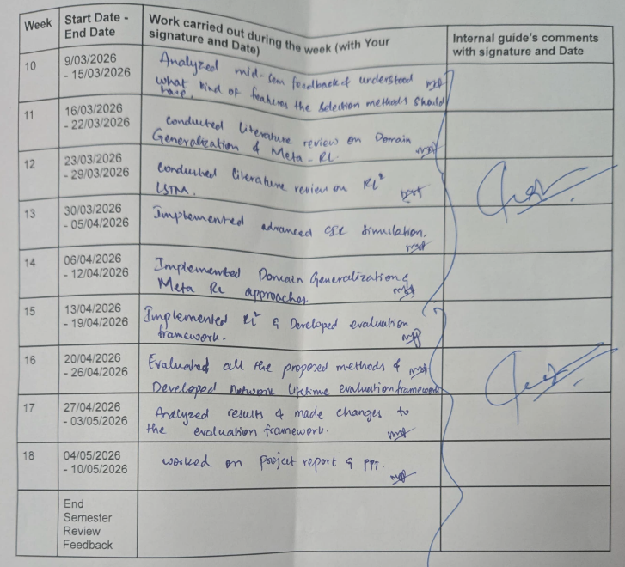
Weekly Review Report

Slide 4
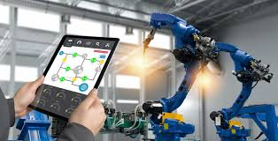
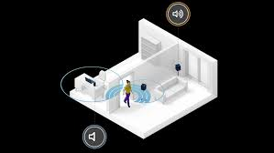
Introduction
Indoor node localization used in:
Industrial automation
Robotics & smart factories
GPS fails indoors
UWB Node Localization:
Anchor Deployment
UWB Ranging
Distance Estimation
Position Estimation
Localization Algorithm

Slide 5
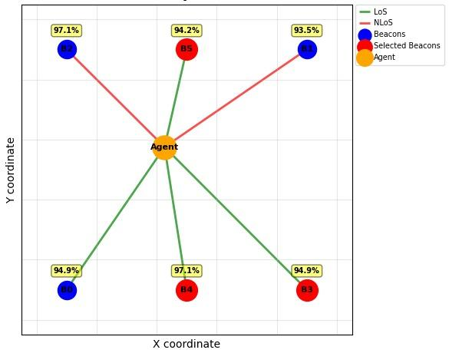
Problem Definition
N = total anchors
A_{t} ⊆ {1, …, N}
I/P: {(x_{i} , y_{i})} → optimal anchor subset
O/P: (x_{est} , y_{est}) → est. tag position
Objective:
Min⁡ E_{t} and Min⁡ D_{energy} for multiple envs
Multi-objective optimization → sequential decision problem

Slide 6
Literature Survey
Paper | Implementation / Contribution | Challenges / Gaps
Finn et al. (MAML) [3] “Model-Agnostic Meta-Learning for Fast Adaptation of Deep Networks”, 2017 | Learns initialization parameters adaptable to new tasks Requires only a few gradient updates for adaptation | Computationally expensive Limited exploration in UWB localization applications
Duan et al. (RL²) [4] “RL²: Fast Reinforcement Learning via Slow Reinforcement Learning”, 2016 | Uses LSTM-based recurrent policy learning Enables implicit adaptation without explicit retraining | Requires large training data and long training time Generalization across highly diverse environments remains challenging

Slide 7
Paper | Implementation / Contribution | Challenges / Gaps
Hajiakhondi et al. (DQLEL) [1]“Deep Q-Learning for Energy-Optimized LoS/NLoS UWB Node Selection”, 2022 | Deep Q-Learning for anchor selection Uses TDOA-based localization with Nakagami-m fading Demonstrates balanced energy consumption | Requires strict time synchronization(TDOA) Higher infrastructure complexity Scalability challenges in large deployments
Nosrati et al. [2]“Improving Indoor Localization Using Mobile UWB Sensor and DRL”, 2024 | DRL-based adaptive anchor placement PPO-based policy optimization Achieves MAE ≈ 0.09 m under dynamic conditions | Focuses on anchor placement rather than selection Limited emphasis on long-term energy balancing

Slide 8
Proposed Methodology
Localization
(TWR Ranging and Trilateration)
Environment State (Battery, LoS/NLoS, Distances)
RL Agent
(Meta RL, RL²)
Anchor Subset Selection
Policy Update
Reward Calculation
RL Anchor Selection Approaches:
Domain Generalization DQN
Meta-RL (MAML)
RL² (LSTM-based)

Slide 9
Meta-RL (MAML)
RL² (LSTM-based)
Core Idea: Learn a model initialization that can quickly adapt to a new environment
Explanation:
Train on different indoor environments
Learn common patterns across environments
When a new environment appears:
Perform small gradient updates
Quickly adapt policy
Relevance:
Indoor environments
Core Idea: The agent adapts using memory stored inside an LSTM hidden state.
Explanation:
Input: Current state, Previous action, Previous reward
LSTM Memory captures: Channel conditions, Battery trends, Previous localization performance
Relevance:
The model can:
Remember past observations
Infer environment behavior
Adapt dynamically during execution
without explicit retraining changes.
Different anchor layouts
Different LoS/NLoS
Goal: Improve generalization across unseen indoor environments

Slide 10
Training Setup
Environment Generation
Training Configuration
Reward Function
Random Environments
Random anchor, obstacle, and battery configurations
Used for diverse and unpredictable training scenarios
Normalized Environments
Normally distributed anchor and obstacle placement
Used for stable and standardized evaluation
Number of Training envs: 40
Number of Testing envs (unseen): 10
State Information:
Anchor battery levels
Estimated distances
LoS/NLoS status
Previous localization error
Action Space:
Select subset of anchors:
A_{t} ⊆ {1, …, N}
The reward balances:
Localization accuracy
Energy efficiency
Link quality
Reward Function:
R=0.6G−0.3B−0.1L−0.1D
G: Geometry Quality
B: Battery Imbalance
L: NLoS Penalty
D: GDOP Penalty

Slide 11
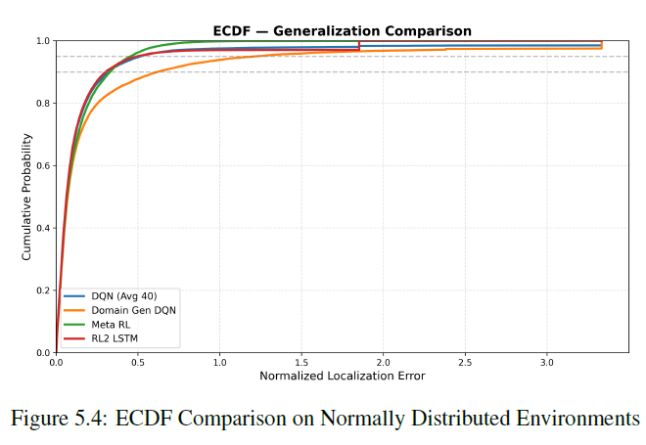
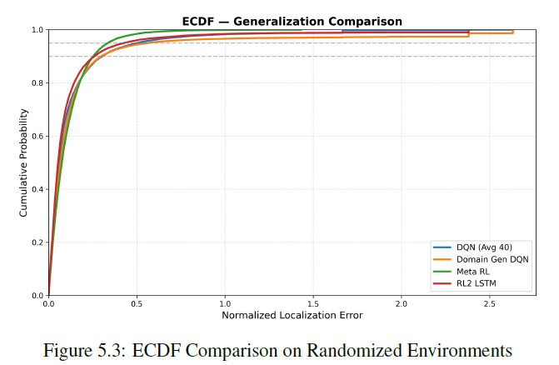
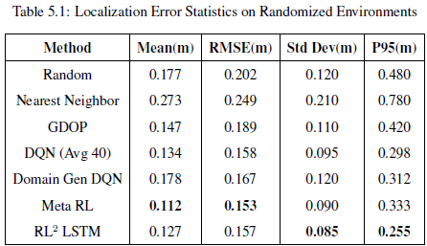
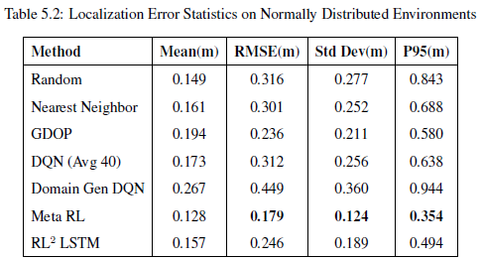
Results

Slide 12
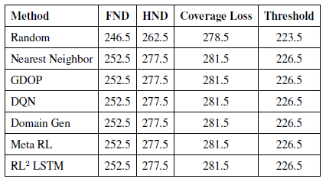
Observations
Important Findings
Meta-learning improves generalization
RL methods adapt better to dynamic environments
Domain Generalization alone is insufficient
Network Lifetime Analysis
Key Insight:
Localization accuracy improved significantly while maintaining energy consumption levels comparable to other anchor selection methods.
Similar FND/HND across methods for both the training setups

Slide 13
Conclusion
Future Work
RL-based anchor selection improves localization performance
Meta-RL generalizes best to unseen environments
RL² provides stable localization behavior
Real-world UWB deployment
Improved reward design
Stronger energy optimization
Advanced Meta-RL techniques

Slide 14
References
Z. Hajiakhondi-Meybodi, A. Mohammadi, M. Hou, and K. N. Plataniotis, “Dqlel: Deep q-learning for energy-optimized los/nlos uwb node selection,” IEEE Transactions on Signal Processing, vol. 70, pp. 2532–2543, 2022.
L. Nosrati, S. H. Semnani, M. S. Fazel, S. Rakhshani, and M. Ghavami, “Improving indoor localization using mobile uwb sensor and deep reinforcement learning,” IEEE Sensors Journal, vol. 24, no. 20, pp. 32 546–32 552, 2024.
C. Finn, P. Abbeel, and S. Levine, “Model-agnostic meta-learning for fast adaptation of deep networks,” Proceedings of the 34th International Conference on Machine Learning (ICML), 2017.
Duan, J. Schulman, X. Chen, P. L. Bartlett, I. Sutskever, and P. Abbeel, “Rl2: Fast reinforcement learning via slow reinforcement learning,” arXiv preprint arXiv:1611.02779, 2016
F. Mazhar, M. G. Khan, and B. Sällberg, “Precise indoor positioning using uwb: A review of methods, algorithms and implementations,” Wireless Personal Communications, vol. 97, pp. 4467–4491, 2017.

Slide 15
Thank You Any Questions?

