Slide 1
Deep Fake Detection
Deep Learning CS3008
Jan-May 2025
KMVR Madhava Krishna – CS22B1005
Sai Pranav – CS22B1027

Slide 2
Dataset
Celeb-DF Stats:
5168 training videos
742 real, 4426 fake
Note: Balanced subset used for training and evaluation by dropping fake videos uniformly.

Slide 3
Model Architectures
Frame-Based Models:
ResNet152
Vision Transformer (ViT-B/16)
XceptionNet
Temporal Model:
Optical Flow + 3D CNN

Slide 4
Metrics Used
Accuracy
Precision
Recall
F1 score
ROC AUC
Confusion Matrix
PR Curve

Slide 5
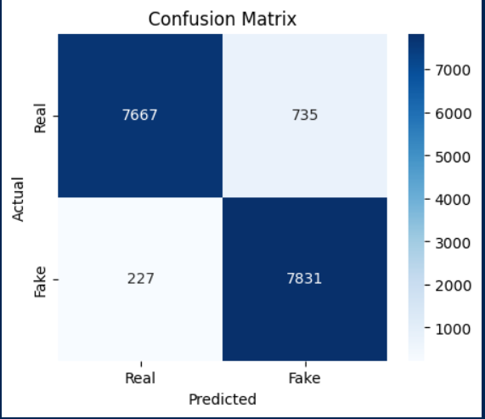
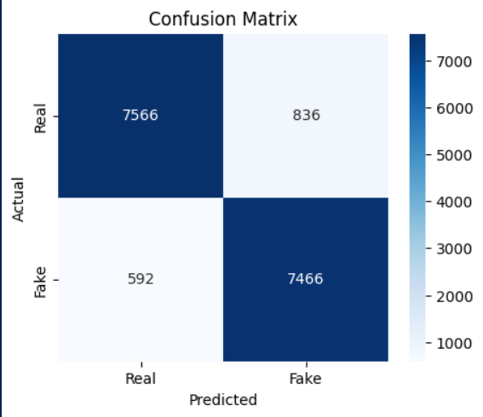
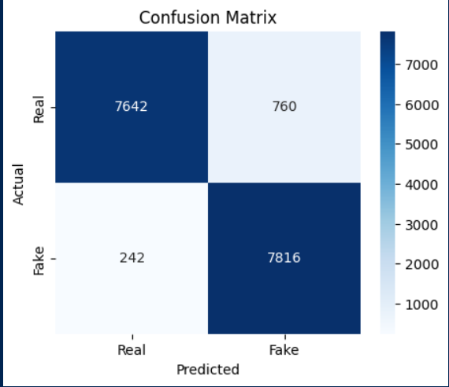
Confusion Matrices
Fig2: Vison Transformer
Fig3: XceptionNet
Fig1: Resnet152

Slide 6
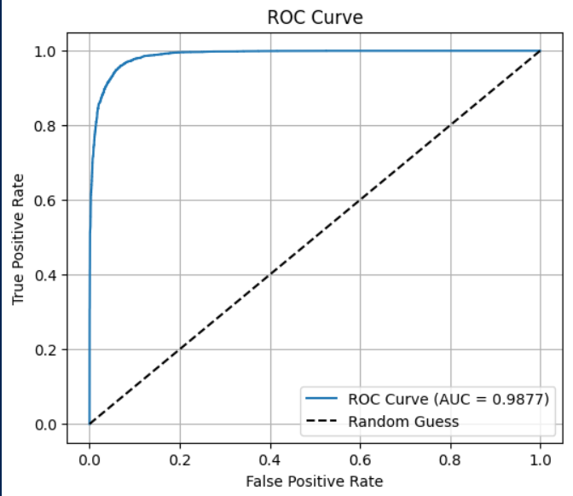
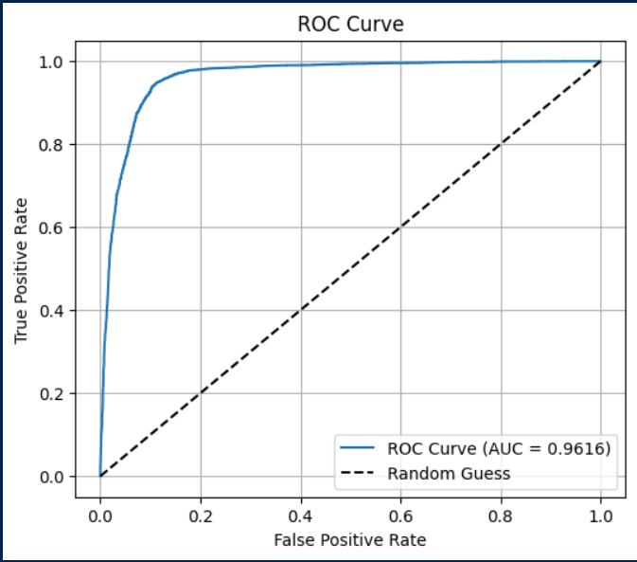
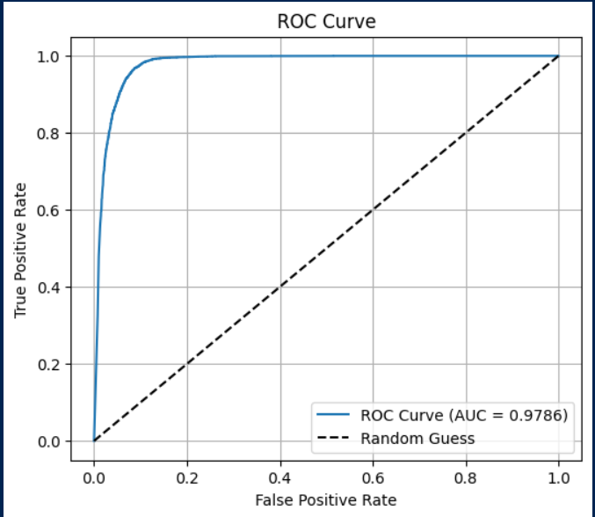
ROC Curves
Fig2: Vison Transformer
Fig3: XceptionNet
Fig1: Resnet152

Slide 7
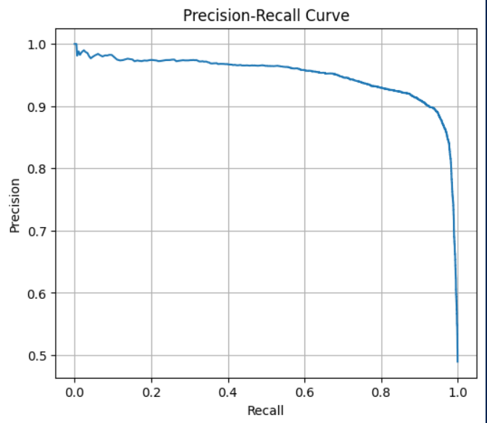
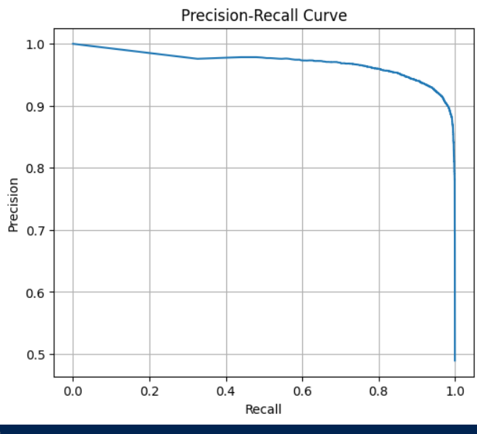
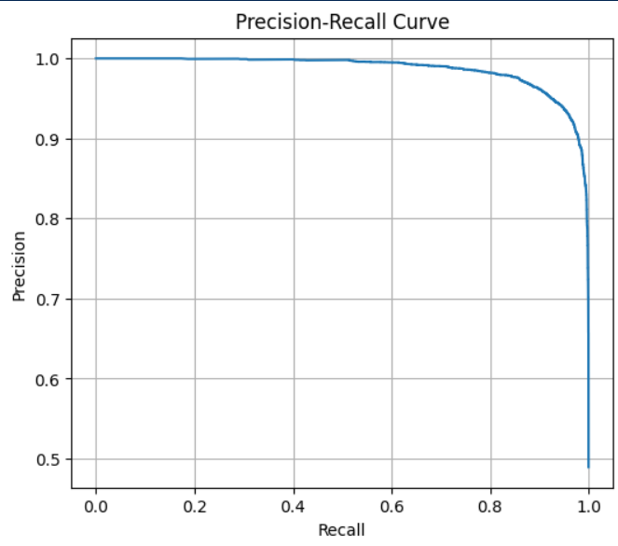
Precision Vs Recall Curves
Fig1: Resnet152
Fig2: Vison Transformer
Fig3: XceptionNet

Slide 8
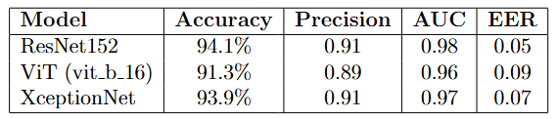
Results

Slide 9
Conclusion
ResNet152 achieved the best performance across all metrics, with 94.1% accuracy and AUC of 0.98.
XceptionNet followed closely with 93.9% accuracy and solid precision.
ViT-B/16, while effective, showed slightly lower precision and higher EER.
Conclusion:CNN-based architectures, particularly ResNet152 and XceptionNet, are highly effective in frame-level deepfake detection.

Slide 10
Thank You

