Slide 1
Mushroom Classification Project

Slide 2
The Mushroom Classification Project presents a machine learning solution for predicting the edibility of mushrooms based on their attributes. This project aims to develop a sophisticated web application that provides users with accurate predictions regarding whether a mushroom is poisonous or not. Leveraging advanced machine learning techniques and frameworks such as DVC, MLflow, and Docker, the application ensures efficient model development, management, and deployment. By integrating a user-friendly interface powered by Flask, users can easily input mushroom characteristics and receive immediate predictions. The project also emphasizes transparency and scalability, with detailed model insights available through the Model Management Interface. Through this project, we demonstrate the effectiveness of machine learning in addressing real-world challenges and provide a valuable tool for mushroom enthusiasts, researchers, and beyond.
Abstract

Slide 3
Objective:
The primary objective of the Mushroom Classification Project is to develop a machine learning-based web application capable of accurately predicting the edibility of mushrooms. By leveraging advanced MLOps frameworks such as DVC, MLflow, and Docker, the project aims to streamline the entire machine learning lifecycle, from data management to model deployment. The application's dual-port functionality provides users with a user-friendly interface for submitting mushroom attributes and receiving immediate predictions, as well as a detailed model management interface for insights into model lifecycle and performance.
Benefits:
Prevents food poisoning incidents
Preserves biodiversity and ecosystems
Facilitates medical research advancements
Ensures legal food standards

Slide 4
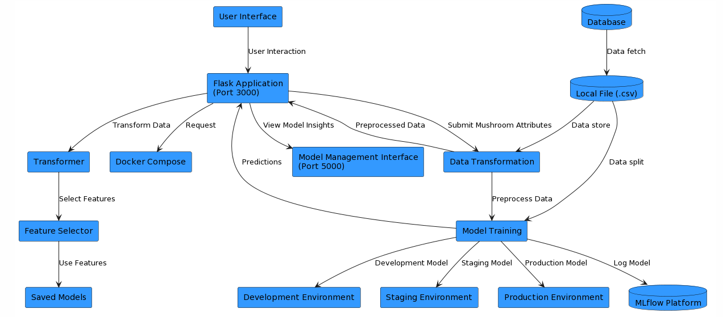
Architecture

Slide 5
Data Fetch from Astra DB :-
The "Data Fetch from Astra DB" phase involves retrieving mushroom data from the Astra DB, a database management system designed to handle large-scale data sets efficiently. This phase serves as the initial step in the training pipeline of the Mushroom Classification System, where raw data is sourced from the Astra DB to be used for model training and evaluation. In this phase, a Python script (data_fetch_astra_db.py) is executed to interact with the Astra DB and extract relevant mushroom data. The script is configured with parameters specified in the params.yaml file, ensuring flexibility and configurability in data retrieval.

Slide 6
Model Training Pipeline
Data Loading: Retrieve mushroom dataset from local file, ensuring completeness and integrity, readying it for preprocessing.
Data Preprocessing: Clean, transform, and standardize mushroom data, handling missing values and outliers for improved model performance.
Data Splitting: Partition preprocessed data into training and testing subsets to assess model generalization and prevent overfitting.
Model Training: Employ training data to build machine learning models, optimizing parameters to capture underlying patterns in mushroom characteristics.
Model Evaluation: Assess trained models' performance using testing data, employing metrics like accuracy and precision to gauge effectiveness and identify potential improvements.
Model Logging: Record trained models, along with relevant metadata and performance metrics, facilitating model tracking, reproducibility, and future iterations.

Slide 7
Model Prediction Pipeline:
Data Transformation: Transform user-input mushroom attributes using saved preprocessing model file.
Feature Selection: Select relevant features for model prediction from transformed data using Saved selector object file.
Model Prediction: Utilize trained models to predict mushroom edibility based on selected features.
Result Presentation: Present prediction results to the user through the Flask web application for user interaction and interpretation.

Slide 8
Model Deployment Pipeline
Docker Setup: Configure Docker Compose file to orchestrate deployment, ensuring parallel execution of Flask app and MLflow platform containers.
Flask App Deployment: Deploy Flask application on port 3000, providing user interface for mushroom prediction submission and interaction.
MLflow Deployment: Deploy MLflow platform on port 5000, facilitating model tracking, experimentation, and management for efficient machine learning operations.

Slide 9
Q & A:
Q1) What’s the source of data?
The data for training is provided by the client in Astra Db Database
Q 2) What was the type of data?
The data was the set of Categorical values.
Q 3) What’s the complete flow you followed in this Project?
Refer slide 4th for better Understanding

Slide 10
Q 4) How logs are managed?
We are using different logs inside the logs folder and the custom logs are generated for each step and phase of training and prediction pipeline.
Q 5) What techniques were you using for data pre-processing?
Handle Missing values in data
Visualizing relation of independent variables with each other and output variables
Removing outliers
Encoding categorical data into numeric values.
Selecting best features for model training phase

Slide 11
Thank You !!!

