Slide 1

Machine Learning Based Detection of DDoS Flooding Attacks in SDNs
C. Pranav 1602-22-733-031

Slide 2
CONTENT
Abstract
Introduction
Traditional Methods
Proposed System
System Architecture
Machine Learning Algorithms
Evaluation Metrics
Implementation Details & Results
Expected Outcomes
Conclusion

Slide 3

ABSTRACT
Software Defined Networks (SDNs) are changing how we manage and operate networks, offering flexibility and efficiency. However, they also face significant threats from Distributed Denial of Service (DDoS) attacks, which can disrupt services by overwhelming network resources.
Traditional methods for detecting DDoS attacks often rely on fixed rules and may struggle to adapt to new attack patterns. As cyber threats continue to evolve, there is a pressing need for smarter solutions.
The proposed RNN model leverages sequential patterns in student interactions with educational materials, such as online learning platforms, to automatically predict and quantify engagement levels.

Slide 4
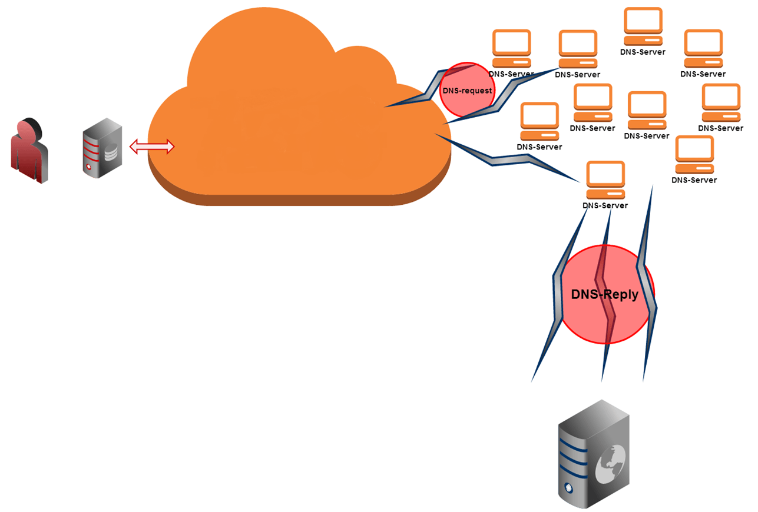
INTRODUCTION
In today’s digital landscape, securing networks is essential. A significant threat is Distributed Denial of Service (DDoS) attacks, which disrupt services by overwhelming systems with harmful traffic. As organizations adopt Software Defined Networking (SDN), protecting these networks from DDoS attacks becomes more complex.
Traditional detection methods, like threshold-based and signature-based techniques, often fail to identify advanced DDoS patterns. Our research explores using machine learning to enhance the detection and classification of DDoS flooding attacks in SDN environments.
By employing advanced algorithms, we aim to improve the accuracy and speed of attack detection, leading to stronger network security. This presentation will outline our methodology and key findings.

Slide 5
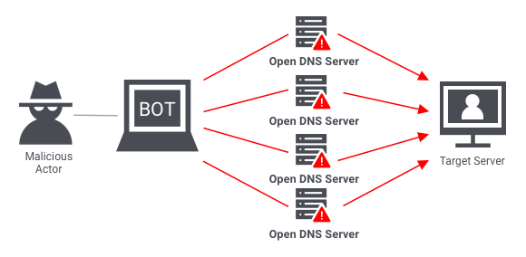
Cloud DDoS (Distributed Denial of Service) Attack Definition: Attacks that target cloud services by overwhelming them with traffic from multiple sources. Attack Types: Volume-based: Floods bandwidth with excessive traffic. Protocol: Exploits network protocol weaknesses. Application Layer: Targets specific applications with legitimate-looking requests. Impact: Causes service outages, financial losses, and reputational damage. Mitigation Strategies: Traffic filtering to block malicious traffic. Rate limiting to manage request volume. Use of cloud-based DDoS protection services.

Slide 6
Traditional Methods
Threshold-Based Detection: This approach sets predefined thresholds for normal network behavior (e.g., traffic volume, connection rates). If traffic exceeds these thresholds, an alert is triggered, indicating a potential DDoS attack.
Signature-Based Detection: Signature-based systems rely on known attack patterns or signatures to identify threats. This method requires a database of signatures and is effective against known attacks but struggles with new or unknown attack vectors.
Rate Limiting: Rate limiting restricts the number of requests a user can make to a server within a specific timeframe. This helps mitigate the impact of DDoS attacks but can also affect legitimate users.
Access Control Lists (ACLs): ACLs are used to block or allow traffic based on specific criteria, such as IP addresses. While effective in some cases, they can be difficult to manage and may not scale well against large-scale DDoS attacks.

Slide 7
Intrusion Detection Systems (IDS): IDS solutions monitor network traffic for suspicious activity. They can use a combination of signature and anomaly detection but often require manual intervention and may not provide real-time responses.
Firewalls: Traditional firewalls can provide some protection against DDoS attacks by filtering traffic. However, they are often not sufficient to handle sophisticated or volumetric attacks.
Traffic Analysis: Analyzing network traffic patterns can help identify unusual behavior that may indicate a DDoS attack. However, this method may not be timely enough to prevent damage.

Slide 8
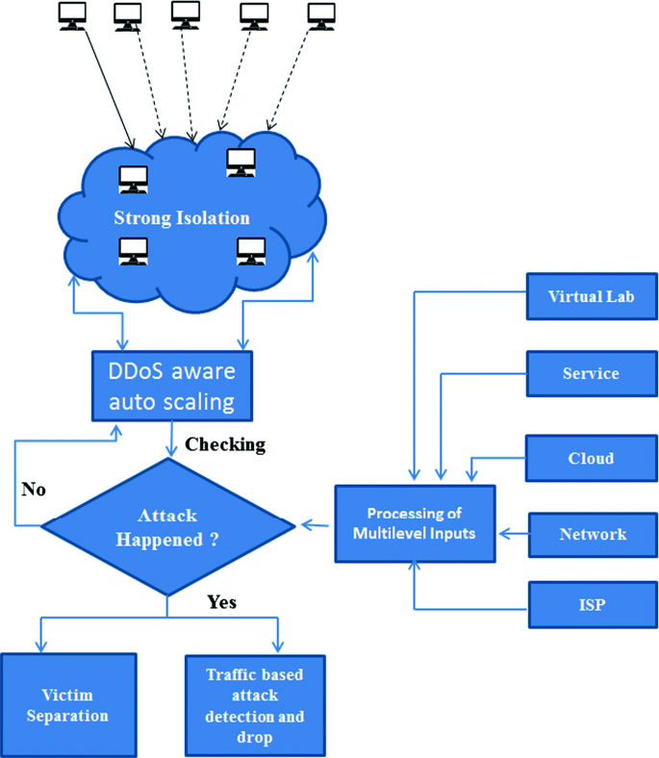
To enhance the detection and classification of DDoS flooding attacks in Software Defined Networks (SDN) using machine learning techniques.
Proposed System

Slide 9
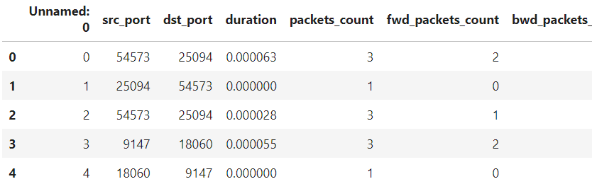
System Architecture
Data Collection and Feature Extraction:
Gather real-time network traffic data from SDN controllers and switches.
For this case study, I brought the dataset from Kaggle:
https://www.kaggle.com/datasets/dhoogla/bccc-cpacket-cloud-ddos-2024/code
Then I performed following to clean the dataset:
Remove the incomplete rows
Checked for consistency of all values
Remove unnecessary features
Removed duplicate data rows
And more..
Final Cleaned Dataset is of size: (700452, 320)

Slide 10
Machine Learning Algorithms for Prediction
Supervised vs. Unsupervised Learning
Machine learning algorithms can be categorized into supervised and unsupervised learning methods. Supervised learning requires labeled training data, whereas unsupervised learning does not require any labels.
In the context of DDoS detection, supervised learning algorithms is not more suitable. Unsupervised learning algorithms can be utilized for clustering or detecting patterns in the data.
Classification and Regression Techniques
Classification techniques can be employed to predict the attack. Various classifiers, such as decision trees, and neural networks can be utilized for this purpose. Algorithms like K-Nearest Neighbors, random forest regression, and gradient boosting can be employed to perform regression-based prediction.

Slide 11
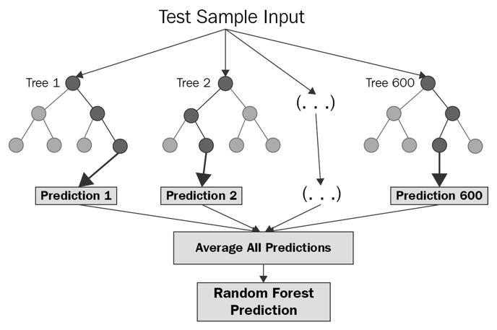

Random Forest
Naive Bayes

Slide 12
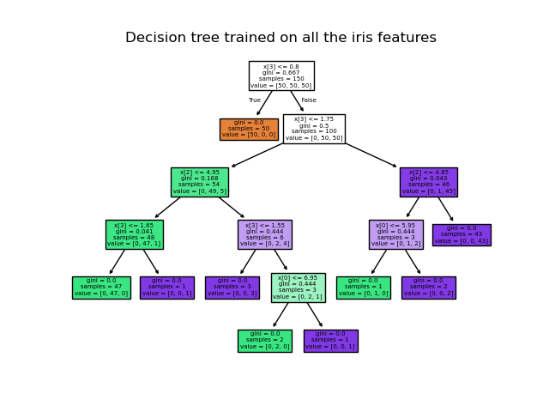
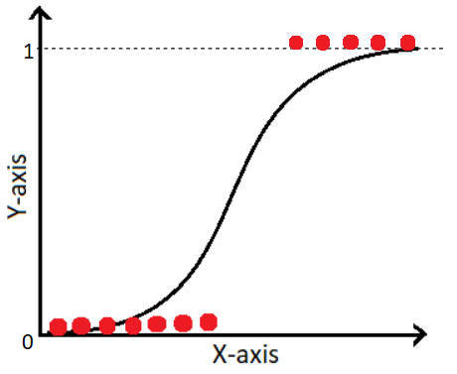
Decision Tree
Logistic Regression

Slide 13
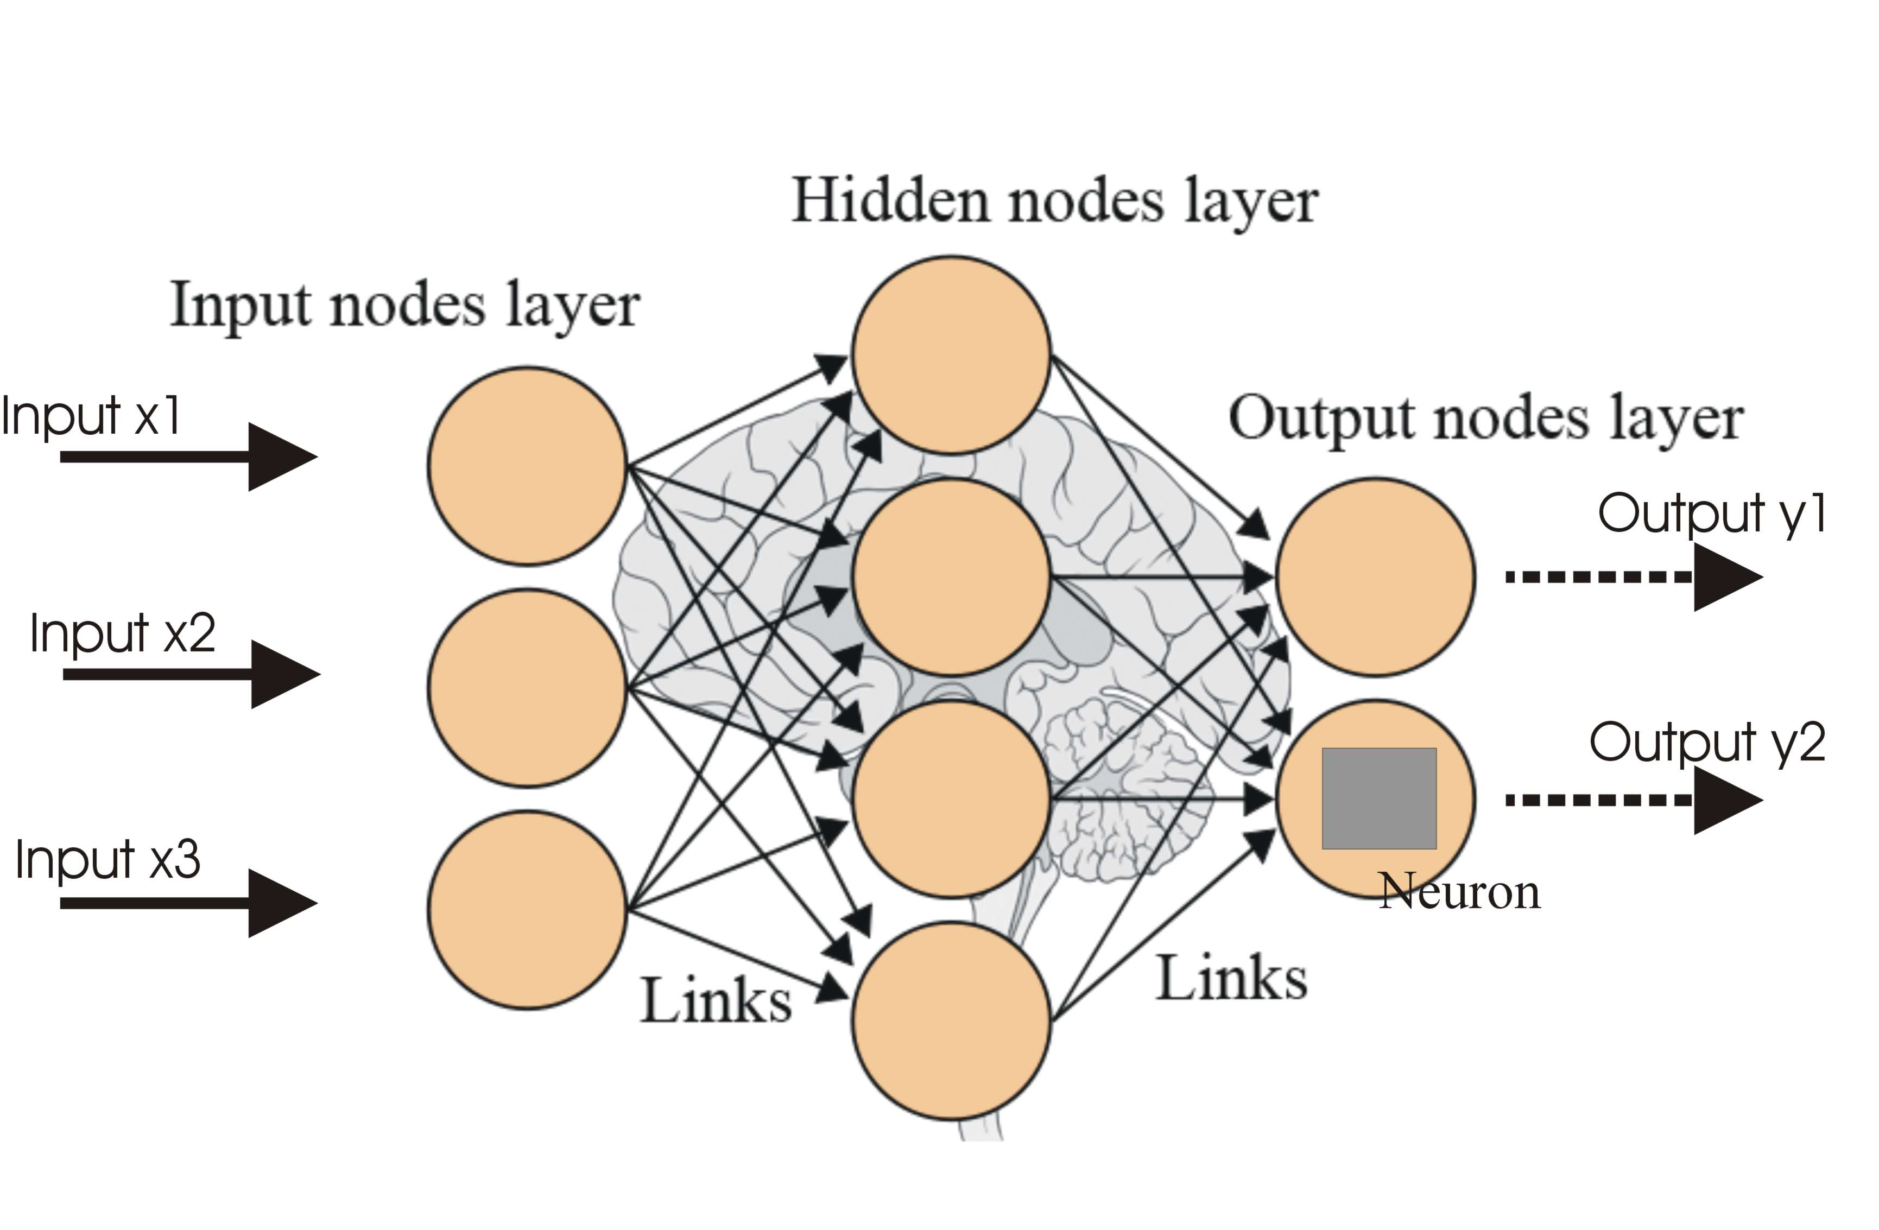
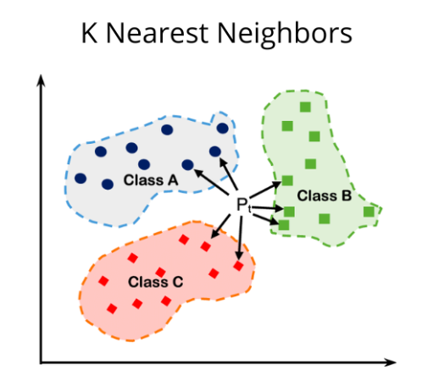
Neural Network
K-Nearest Neighbors

Slide 14





Evaluation Metrics
1) Error Rate : Ratio of incorrectly predicted instances to the total instances.
Specificity : Ratio of true negative predictions to the total actual negatives
Precision : Ratio of true positive predictions to the total predicted positives.
Sensitivity/Recall(s) : Ratio of true positive predictions to the total actual positives.
F1-Score : Harmonic mean of Precision and Recall

Slide 15
2) Receiver Operating Characteristic (ROC) Curve The Receiver Operating Characteristic (ROC) curve is a graphical representation of the true positive rate ag ainst the false positive rate at various classification thresholds. ROC curves help compare different models and select the one with the best trade- off between true positiv e and false positive rates. }

Slide 16
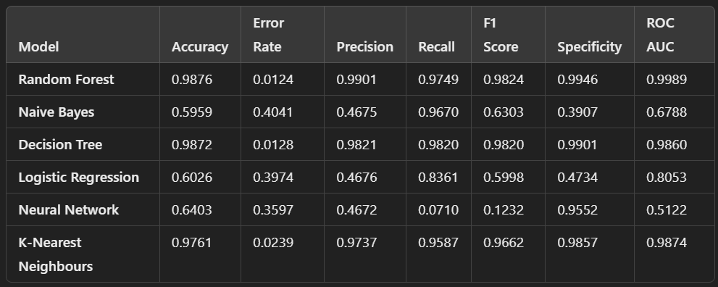
RESULTS

Slide 17
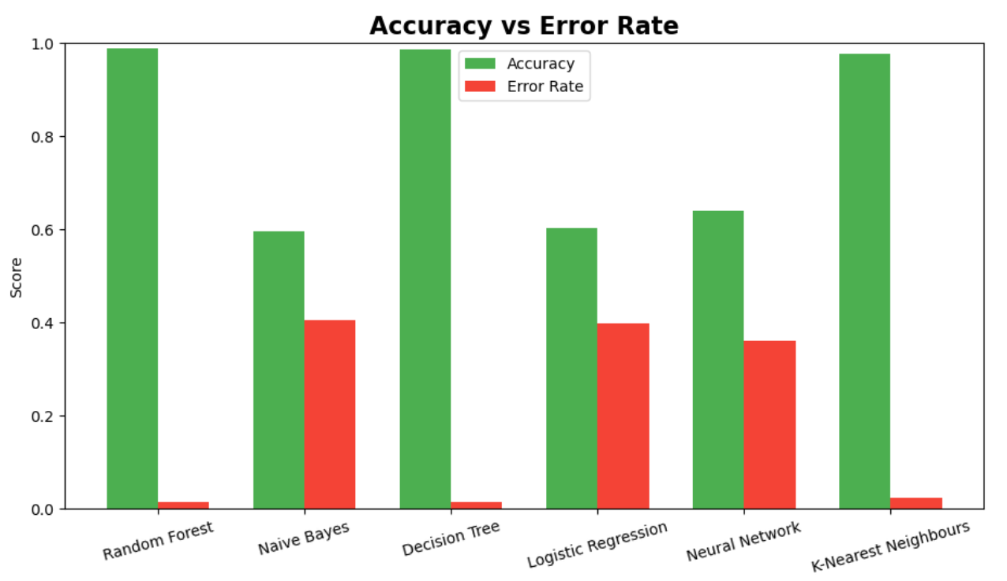

Slide 18
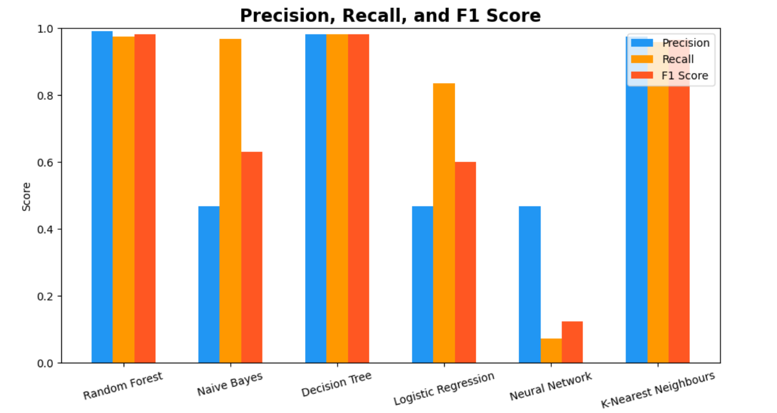

Slide 19
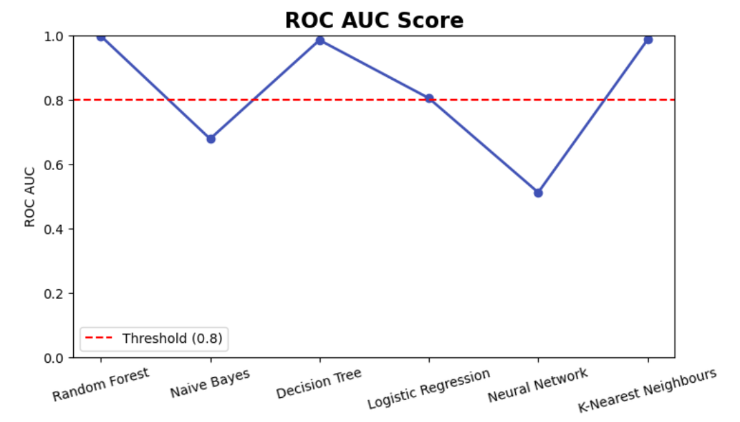

Slide 20
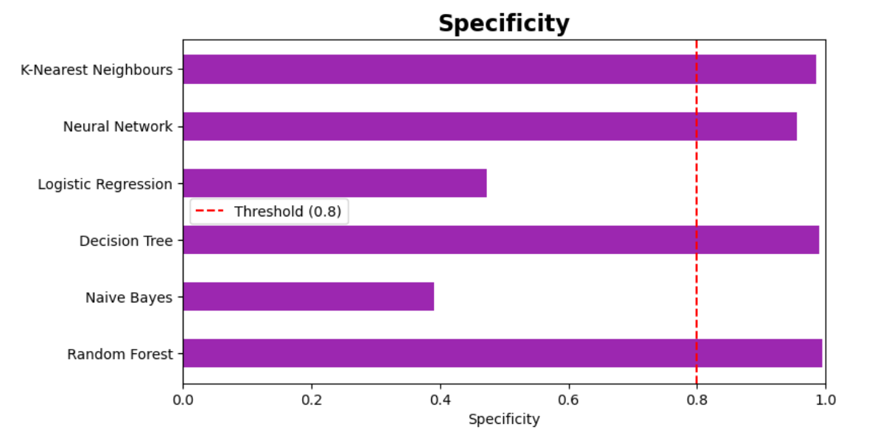

Slide 21
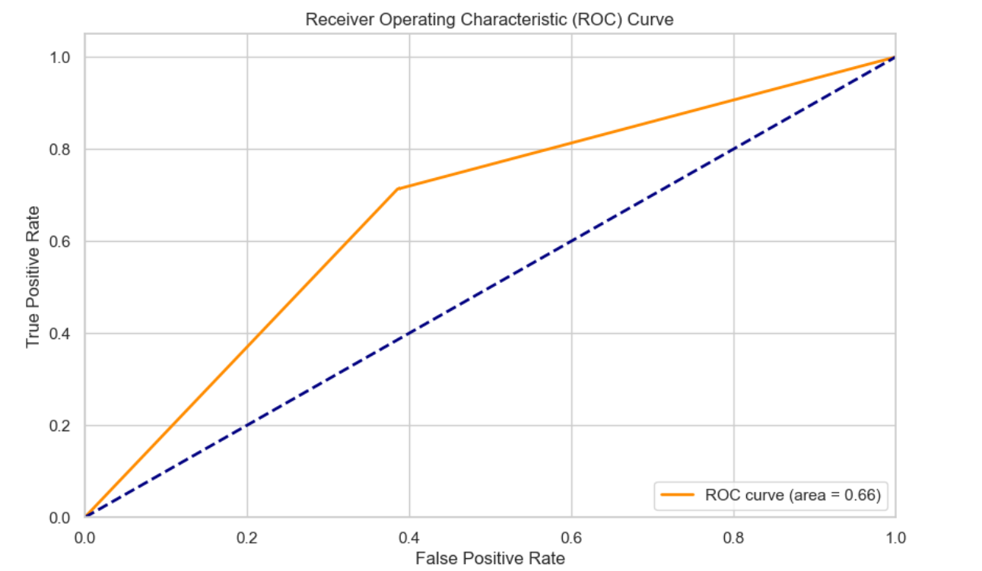
ROC for Neural Networks

Slide 22

Expected Outcomes
Improved detection rates of DDoS attacks.
Reduced false positives compared to traditional methods.
Faster response times to mitigate attacks.

Slide 23
Addressing Privacy and Ethical Concerns
To ensure data privacy, we implement robust security measures and obtain informed consent from participants. Clear guidelines will govern data monitoring practices, promoting transparency. Additionally, we actively assess and mitigate biases in machine learning models, ensuring ethical standards and responsible use of technology in combating DDoS attacks.

Slide 24
HARDWARE SOFTWARE REQUIREMENTS
HARDWARE REQUIREMENTS:
•SYSTEM: PENTIUM 13 PROCESSOR.
HARD DISK: 500 GB.
•MONITOR: 15" LED
•INPUT DEVICES: KEYBOARD, MOUSE
RAM: 4 GB
SOFTWARE REQUIREMENTS:
•OPERATING SYSTEM: WINDOWS 10 PRO. CODING LANGUAGE: PYTHON 3.10.9

Slide 25
CONCLUSION
In conclusion, this study delves into the innovative realm of Machine learning,whose usage enhances the ability to detect and classify DDoS attacks in Software Defined Networks.
By automating the analysis of network traffic, machine learning models facilitate faster response times to attacks, minimizing downtime and potential service disruptions for organizations.
This research underscores the need for continued innovation in cybersecurity approaches, advocating for machine learning as a vital component in securing SDN environments against sophisticated DDoS attacks.

Slide 26
Thank you

