Slide 1



Networking of Healthcare Services
By Team Techie Lifesavers

Slide 2
TEAM DETAILS
Team Name : Techie Lifesavers
Team Leader Name : C.Pranav
College Name : Vasavi College of Engineering
Team Member 1 Name : G.Sai Rathan
Team Member 2 Name : K.Srihari Sakshith
Team Member 3 Name : S.Sriraj

Slide 3
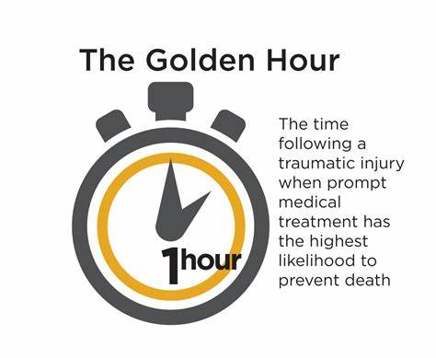

Our Vision
We want to design an app(MedForAll) to get medical services available to the needy person as soon as possible without having to worry about the hospital having required medical facilities or not.
The platform will note the persons medical condition and select ambulance available nearest to him and it will take him to the nearest hospital which can best treat his medical condition based on blood type, equipment required, surgeons availability etc.
We will try to make it inter-hospital platform i.e, a hospital can get a patient from another hospital’s ambulance, making it more safe and fast for patients treatment.
Also, we want to help the NGO’s and organizations reach out to the needy more easily with the help of our platform.
If a person is treated within 1 hour of injury, the probability of survival will increase. We want to get patients treated within golden hour time by the help of our app.

Slide 4
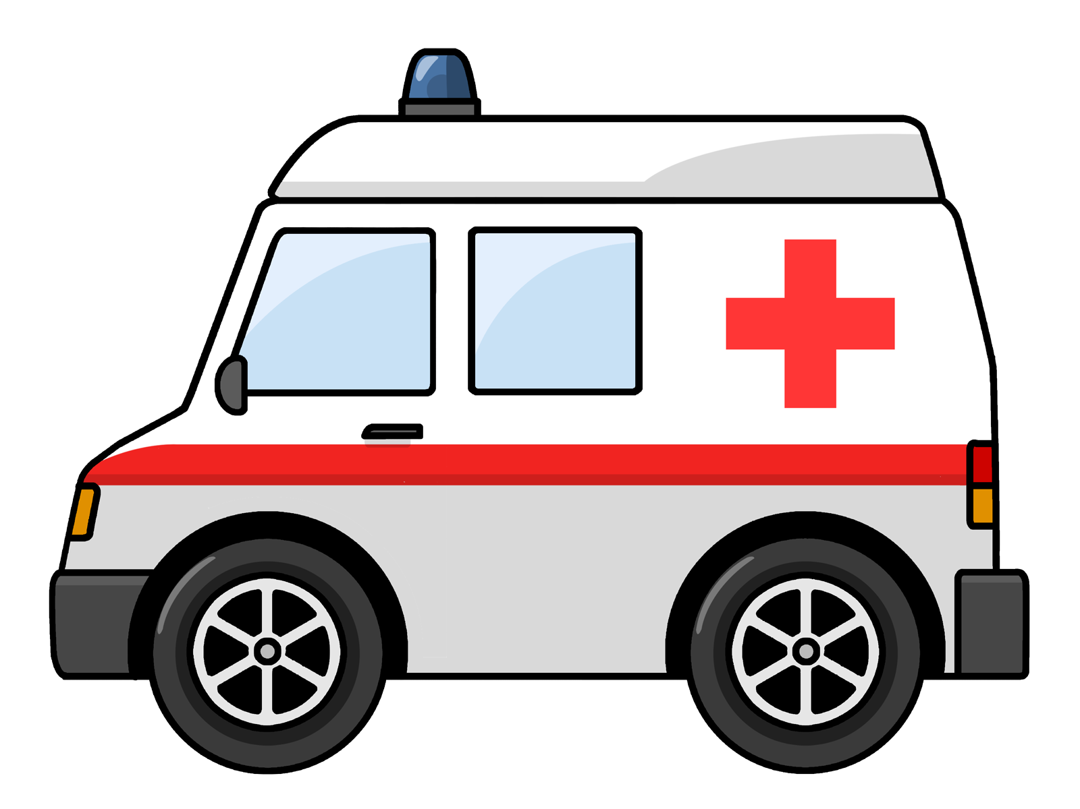
Our Approach
One of the main problem of our country’s healthcare system is lack of proper emergency services network among hospitals.
As the hospitals doesn’t have a common roof under which they can serve the public, most of the common people are not getting proper critical emergency services.
As we saw during Covid times, Some hospitals have beds vacant, but they don’t have vacant ambulances and vice versa.
Our approach is to design a platform(MedForAll) under which hospitals can register themselves, so that real-time ambulances location, vacant beds count, equipment available and surgeons availability are available to handle patients without any hassles.
The ambulances are shared among several registered hospitals in emergency cases.
We also have the idea to share these real-time data with government so that whenever 108 or 112 is dialed, the nearest ambulance driver which is detected should get notified & called and the patient is taken to the nearest hospital available which has required equipment to treat him.

Slide 5
What makes our solution unique
Till now, Healthcare has been a business only. Many of the hospitals have one or other problem. By making a common platform between them, many of the nursing homes and mid-tier hospitals as well as citizens get benefitted.
Not only the real-time locations of the ambulances, but details of blood available and anti-venoms available are also should be shared in real-time on the app(MedForAll).
Whenever a person dials the emergency numbers, the ambulances should know which suitable place to take the person in the first place. Example, if patient loses a lot of blood, he is taken to the hospital which have reserves of required blood and which is nearer. Our solution to this problem can solve this and decrease the chance of mortality.
There are some NGOs which want to give ambulance services, but they are not able to reach out to the patients. Our platform can be help to them, as soon as they contact emergency numbers, then if NGO ambulances are available nearby, they are asked for help.

Slide 6


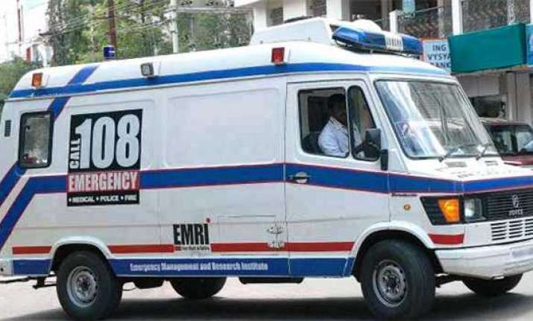
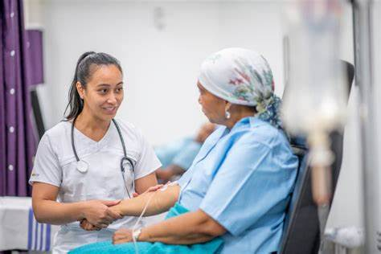
Product Roadmap
Q1
Q2
Q3
Q4
Healthcare officers notified
Fastest & fine Treatment
Hospitals Registering
Patient dials 108
Hospitals registering on our platform for better reach to patients.
The patient or other person dials 108 and gives their location and give information about their condition.
Instead of taking patient only to govt hospital, He is taken to the nearest hospital available which better suits for his medical condition.
Patient gets treated well as soon as possible.

Slide 7
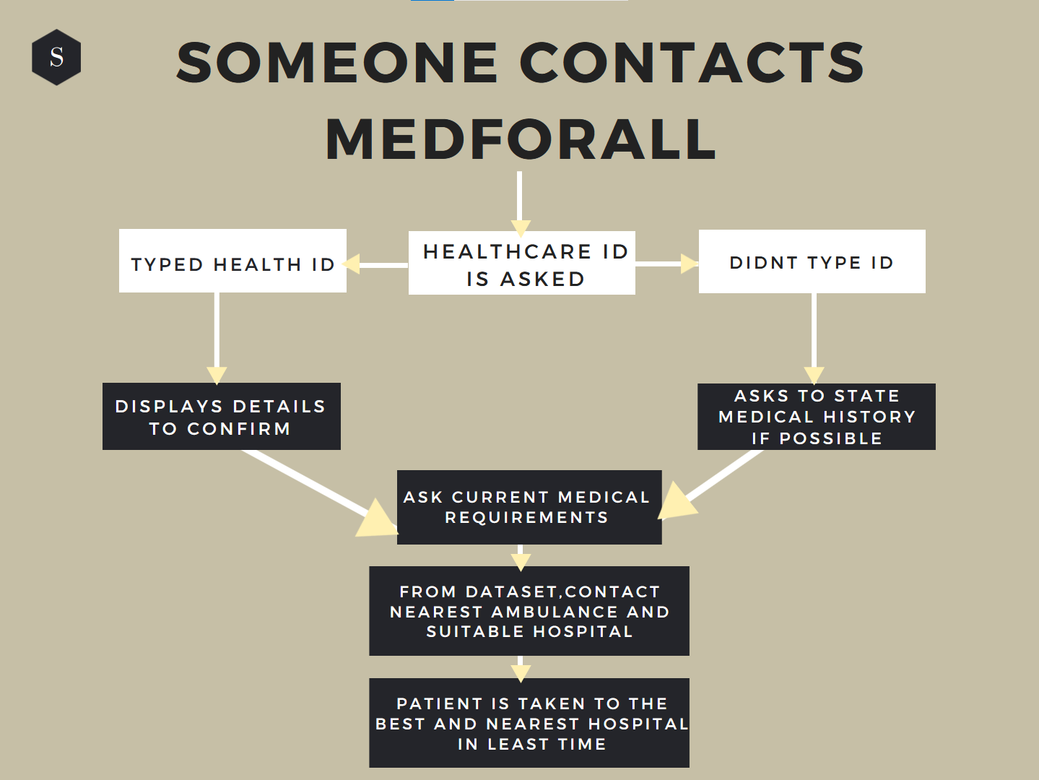
Flowchart

Slide 8
Solution Architecture
Source code | User Interface | Backend
The main code for the application can be developed using Java or C++. Java is perhaps more preferrable since it is more suitable for application development and encryption. | We can also develop a website with the same functionalities using HTML,CSS and Javascript. The website makes MedforAll more accessible for all devices. | Care should be taken such that the backend servers will not get any issues in real-time. Distributed computing environment should be set up to avoid single point failure.

Slide 9

Healthcare is a Right, not a privilege.

Slide 10

By Team Techie Lifesavers
Thank you

