Slide 1

“PERSONAL FINANCE TRACKER”
Sanjivani Rural Education Society’s
Sanjivani College of Engineering, Kopargaon 423 603
(Affiliated to Savitribai Phule Pune University, Pune )
Department of Computer Engineering
Prepared By,
Mr. Deokar Pranav[UCS23M1028]
Mr. Giri abhishek[UCS23M1046]
Guided By,
Prof. S. S. Gawali

Slide 2

Contents
Sanjivani Rural Education Society’s
Sanjivani College of Engineering, Kopargaon 423 603
(Affiliated to Savitribai Phule Pune University, Pune )
Department of Computer Engineering Research Center
Introduction of project
Functionality of project
Details about Data types used in project
Details about predefine module/libraries used in project
Details about user-defined function.
Output of Code.

Slide 3
Introduction
Sanjivani Rural Education Society’s
Sanjivani College of Engineering, Kopargaon 423 603
(Affiliated to Savitribai Phule Pune University, Pune )
In today's fast-paced world, managing personal finances efficiently is crucial for achieving financial stability and meeting long-term goals. The Personal Finance Tracker is a comprehensive software solution designed to empower users in effectively managing their expenses, tracking budgets, and gaining insights into spending patterns. Leveraging Python programming language and a user-friendly interface, this tracker offers a seamless experience for individuals seeking greater control over their financial health.
OBJECTIVES
STREAMLINED FINANCIAL MANAGEMENT
BUDGET CONTROL AND ANALYSIS
ENHANCED USER EXPERIENCE
CUSTOMIZABLE AND INFORMATIVE REPORTS

Slide 4
Functionality of Project
Sanjivani Rural Education Society’s
Sanjivani College of Engineering, Kopargaon 423 603
(Affiliated to Savitribai Phule Pune University, Pune )
USER INPUTS: It accepts the input from user like budgets and actual expenses
CALCULATE SAVINGS: Secondly the savings are calculated and condition for goal achievement is checked
REPORT GENERATIONS: After calculating savings it generate an individual report for each expense category.
DATA EXPORTATION: The generated reports for individual expenses and goal achievement status is appended in excel file
FINAL OUTPUT: Lastly graphical representation of expenses and generated report is displayed

Slide 5
DATA TYPES USED
Sanjivani Rural Education Society’s
Sanjivani College of Engineering, Kopargaon 423 603
(Affiliated to Savitribai Phule Pune University, Pune )
Strings: Strings are used for labels, messages, and user inputs
Integers: Integers are employed for storing numerical data such as income, expenses, budget goals, and month.
Lists: Lists are used to organize and manage financial transactions and budget categories. They store data in a structured format, allowing for easy access and manipulation
File Paths (Strings): File paths are represented as strings and used for specifying the location where the expense report Excel file is saved.
Global Variables: Global variables are used to store references to entry fields for user inputs and labels for displaying savings.

Slide 6
Predefine module/libraries used
Sanjivani Rural Education Society’s
Sanjivani College of Engineering, Kopargaon 423 603
(Affiliated to Savitribai Phule Pune University, Pune )
tkinter: tkinter is a standard GUI (Graphical User Interface) toolkit for Python. It is used for creating the graphical user interface of the Personal Finance Tracker application
openpyxl: openpyxl is a library for reading and writing Excel files (XLSX). In this project, it is used to generate and manage expense reports by writing data to Excel workbooks.
matplotlib: matplotlib is a comprehensive library for creating static, animated, and interactive visualizations in Python. In this project, matplotlib is used to generate graphical representations of financial data, including bar charts and pie charts
os: The os module provides a portable way of using operating system-dependent functionality in Python. In this project, it is used to handle file paths and check for the existence of the expense report Excel file.

Slide 7
Details about USER DEFINE function
Sanjivani Rural Education Society’s
Sanjivani College of Engineering, Kopargaon 423 603
(Affiliated to Savitribai Phule Pune University, Pune )
add_expenses(user_name, income, month):This function is responsible for creating a new window where users can input their expenses.
calculate_savings(expenses, income):This function calculates savings based on the difference between budgeted and actual expenses for various categories.
generate_report(user_name, income, expenses, total_savings, month, filename):This function generates an expense report based on the user's input and calculated savings.It creates a new window to display the report, including user summary, expense categories, total savings, and goal achievement message.
generate_graphs(report_window, expenses):This function generates graphical representations (bar chart and pie chart) of expense comparison and distribution.

Slide 8
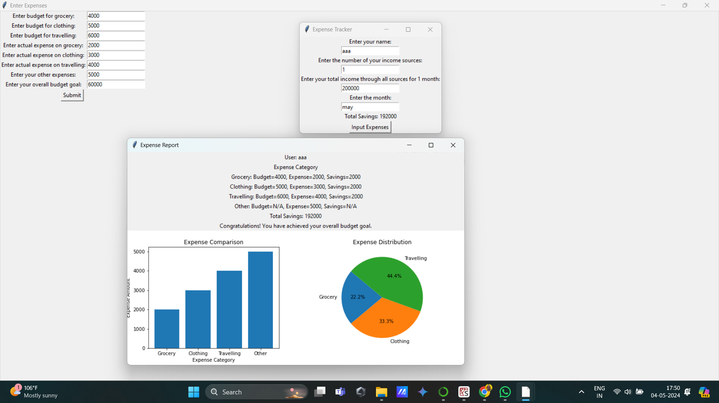
Output
Sanjivani Rural Education Society’s
Sanjivani College of Engineering, Kopargaon 423 603
(Affiliated to Savitribai Phule Pune University, Pune )

Slide 9

THANK YOU
Sanjivani Rural Education Society’s
Sanjivani College of Engineering, Kopargaon 423 603
(Affiliated to Savitribai Phule Pune University, Pune )

