Slide 1
VAARI
Crop Water Footprint Information App
An Android Application for Agricultural Water Awareness
Pranav Bhagwat | Mohanish Lowanshi | Neha Agrawal

Slide 2
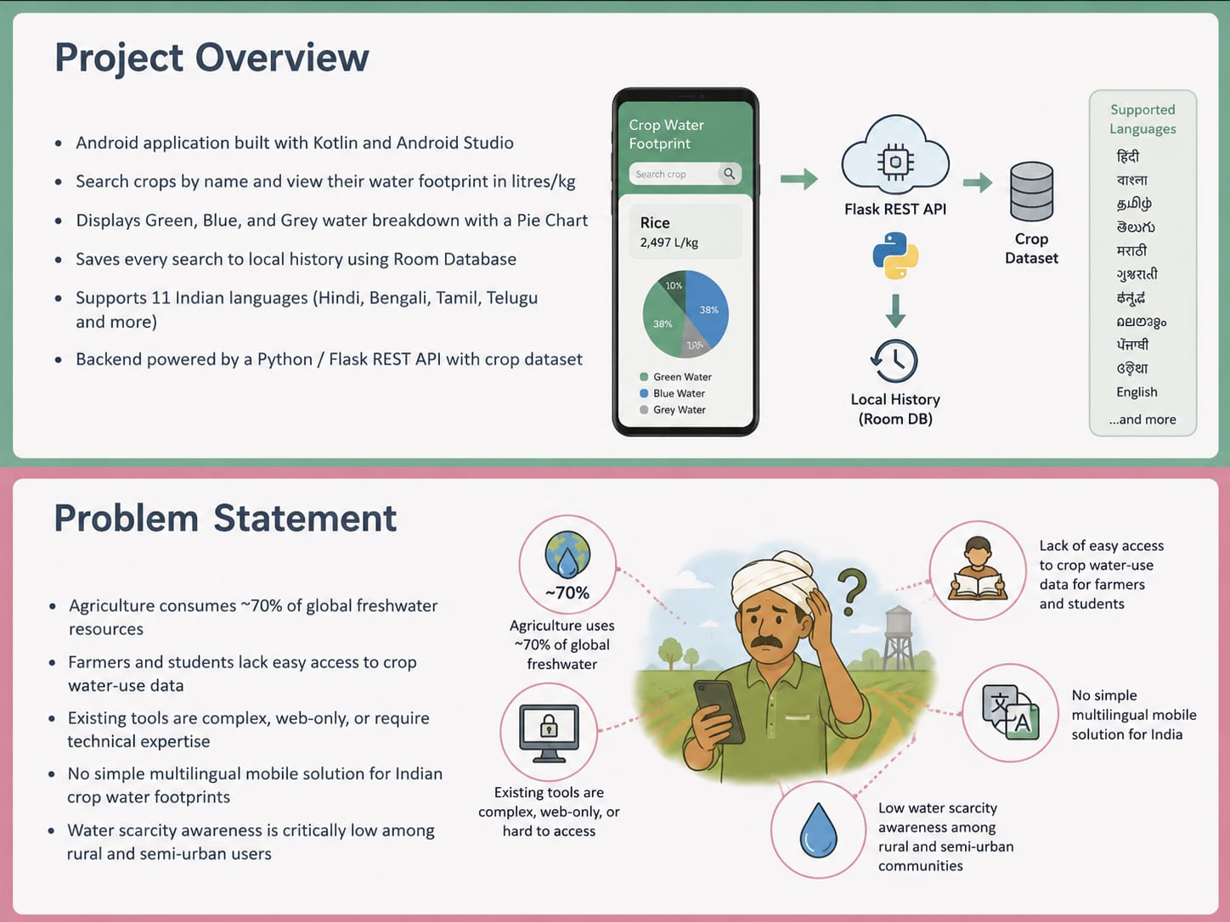
Project Overview
• Android application built with Kotlin and Android Studio
• Search crops by name and view their water footprint in litres/kg
• Displays Green, Blue, and Grey water breakdown with a Pie Chart
• Saves every search to local history using Room Database
• Supports 11 Indian languages (Hindi, Bengali, Tamil, Telugu and more)
• Backend powered by a Python / Flask REST API with crop dataset

Slide 3
Problem Statement
• Agriculture consumes ~70% of global freshwater resources
• Farmers and students lack easy access to crop water- use data
• Existing tools are complex, web-only, or require technical expertise
• No simple multilingual mobile solution for Indian crop water footprints
• Water scarcity awareness is critically low among rural and semi-urban users

Slide 4
Key Features
🔍 Crop Search
🕓 Search History
Search by name with autocomplete suggestions from backend
All searches saved locally with crop name and timestamp
📊 Water Footprint
🌍 11 Languages
Green, Blue, Grey water breakdown with interactive Pie Chart
Switch from Hindi to Malayalam — app reloads in chosen lang
💡 Water Tips
🌾 Crop Details
Crop-specific water-saving tips and scarcity risk level
Climate, irrigation type, harvest season, water scarcity info

Slide 5
System Architecture
📱 Android App
🔗 REST API
🗄️ Crop Database
Kotlin + Jetpack Navigation Room DB, Retrofit MPAndroidChart, ViewBinding
Python / Flask JSON Endpoints /search, /suggestions
JSON / flat dataset Crop water footprint values Green, Blue, Grey per crop
🌐 Localization
📦 Local Storage
🌿 Result Screen
11 Language Strings LocaleHelper utility SharedPreferences persist
Room Database HistoryEntity + DAO Searches with timestamps
Pie chart breakdown Water-saving tips Climate & irrigation info

Slide 6
Technology Stack
Frontend
Backend
Kotlin, Jetpack Navigation Android Studio, Gradle MPAndroidChart, ViewBinding
Python, Flask REST API JSON crop dataset /search, /suggestions endpoints
Local DB
HTTP Client
Room Database (SQLite) HistoryEntity + DAO SharedPreferences
Retrofit 2 OkHttp JSON response parsing

Slide 7
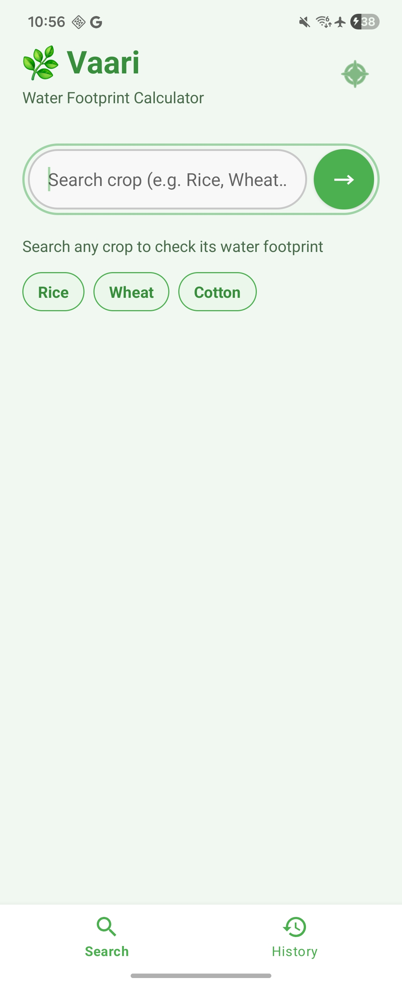
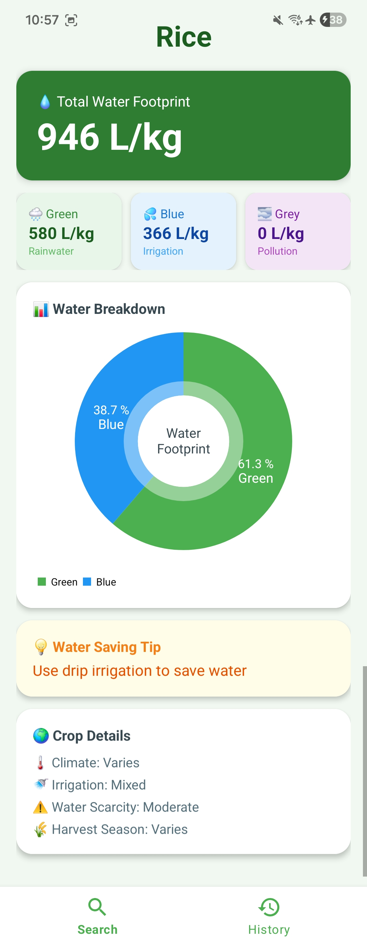
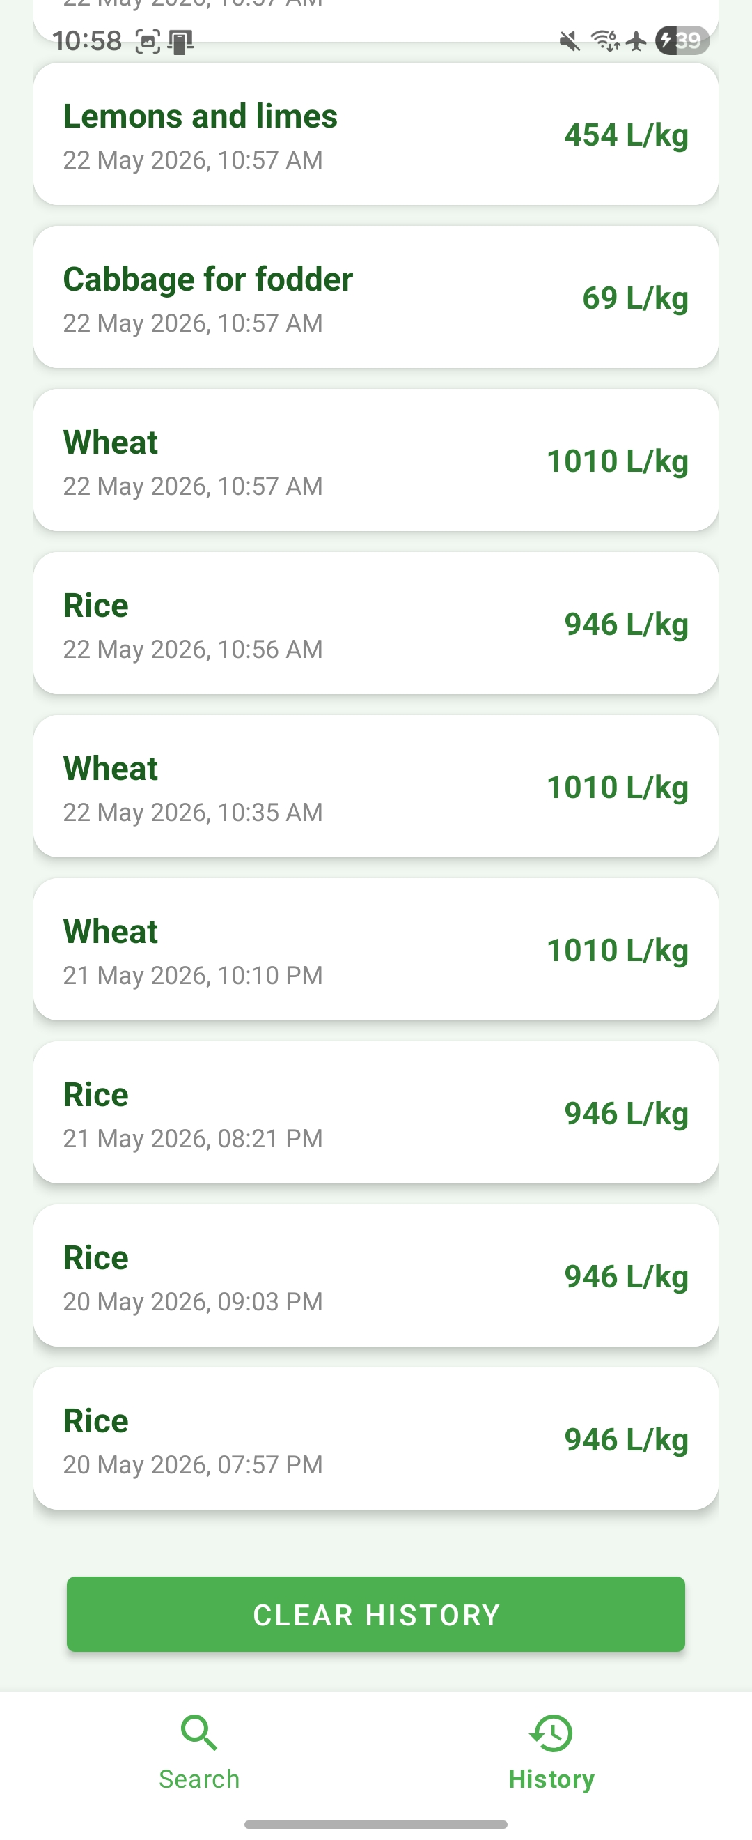
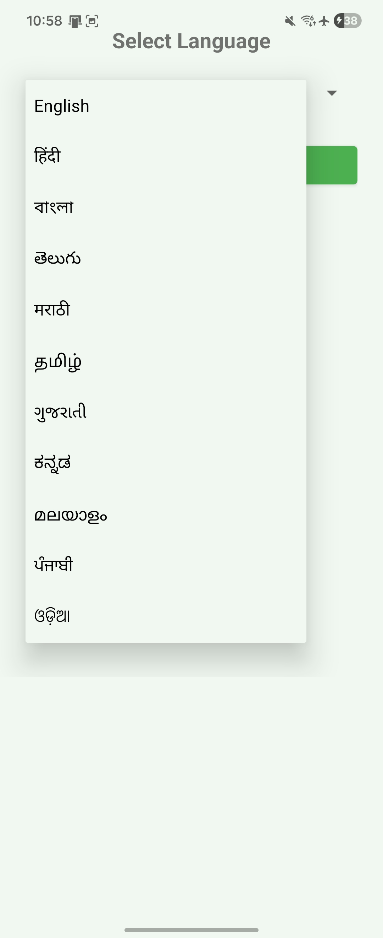
App Screens & Navigation
🏠 Home
Search bar with autocomplete Search button Loading + error states
Crop name Total water Green/Blue/Grey Pie chart + tip
📋 Result
Past searches list Timestamps Water values Scrollable view
🕓 History
11 language options Spinner selection App recreation on change
🌍 Language

Slide 8
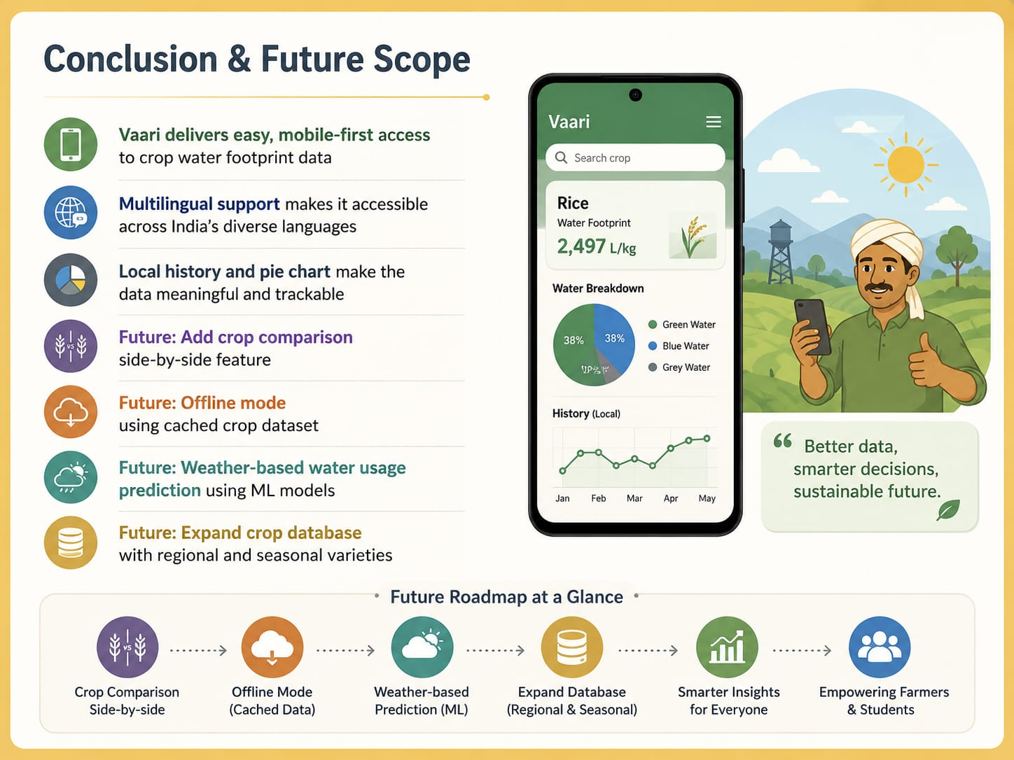
Conclusion & Future Scope
• Vaari delivers easy, mobile-first access to crop water footprint data
• Multilingual support makes it accessible across India's diverse languages
• Local history and pie chart make the data meaningful and trackable
• Future: Add crop comparison side-by-side feature
• Future: Offline mode using cached crop dataset
• Future: Weather-based water usage prediction using ML models
• Future: Expand crop database with regional and seasonal varieties
Thank You 🌿

