Slide 1
7) n8n

Slide 2
n8n Basics
n8n: Open source automation tool to connect different applications and services
Name
‘n’ -> Stands for node, because n8n is built with Node.js
‘8n’ -> Shorthand for automation
n + 8n = nodemation -> node automation -> n8n
Why n8n?
No coding needed
Open source and free
Many tool connections available out of the box
Using n8n (https://n8n.io/pricing/)
Hosting our applications on the cloud: Paid
Hosting them on our local machine: Free

Slide 3
Using/Installing n8n
Option | Description | Where it Runs | Prerequisites | License / Cost
Cloud | Sign up at app.n8n.cloud for a 14-day free trial of the hosted n8n service | n8n Cloud (hosted by n8n team) | Just a browser and internet connection | Requires registration; subscription after trial
Docker | Run n8n Community Edition in a Docker container on our machine (https://docs.n8n.io/hosting/installation/docker/) | Our local machine (Dockerized) | Docker installed | Free (CE, no license key required)
npm | Install n8n Community Edition using npm and run it directly from Node.js (https://docs.n8n.io/hosting/installation/npm/) | Our local machine (Node.js runtime) | Node.js + npm installed | Free (CE, no license key required)

Slide 4
n8n Using Docker
Install Docker: https://docs.docker.com/get-started/get-docker/
docker volume create n8n_data
docker run -it --rm --name n8n -p 5678:5678 -e GENERIC_TIMEZONE="Asia/Calcutta" -e TZ="Asia/Calcutta" -e N8N_ENFORCE_SETTINGS_FILE_PERMISSIONS=true -e N8N_RUNNERS_ENABLED=true -v n8n_data:/home/node/.n8n -v C:/Users/akaha/myfiles:/files docker.n8n.io/n8nio/n8n
To update it to the latest image: Once it starts running, open Docker Desktop -> Images -> docker.n8n.io … -> Actions -> pull
Browser: localhost:5678
Email: Dummy (root@root.com)
First Name: Dummy (Atul)
Last Name: Dummy (Kahate)
Password: Dummy (Root@1234)
After the first screen -> Send me a free licensed key -> Enter our real email id to receive it -> Get the key -> Usage and plan -> Paste key
Production hosting: n8n cloud, hostinger VPS/cloud, render/railway, etc

Slide 5
n8n Examples
Example | Details
1_basic_chatbot* | Add a Google Gemini AI LLM to respond to user’s chat questions
2_chatbot_with_tool_and_memory | Add a Wikipedia tool and memory to the chatbot
3_webhook_search_amazon* | Use a Webhook, Postman, Serp Search to allow the user to search for something in Amazon
4_form_sheet_email | Create a form for users and save data in Google Sheets and send an acknowledgement to the user over email
5_read_cheque* | Fetch a cheque image from Google Drive and read its contents, extract in JSON format and store in an Airtable table

Slide 6
1_basic_chatbot
Create workflow
Add first step-> + Symbol -> On chat message
Click + symbol after On chat message component
AI -> AI Agent -> Chat Model: Gemini
Configure Gemini API Key
Test

Slide 7
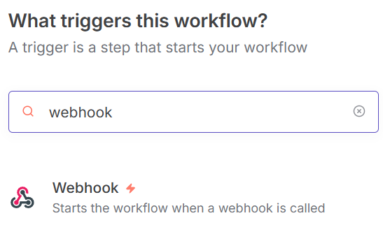
3_webhook_search_amazon
In a new workflow, add Webhook
HTTP Method: POST
Click on Production URL and copy it and save it somewhere
Add + to attach a node to the Webhook and type “search”
Select “Google Search Console” and install
Now in the search box, SerpAPI Official should appear -> Select it
Actions -> Search Amazon
Search query -> Keep blank
Domain: amazon.in
Open Postman (We would need local download, since for localhost, the web version does not work) … See next slide

Slide 8
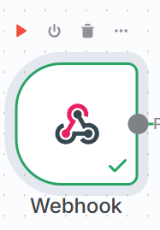
3_webhook_search_amazon
Click the run button on the Webhook
It will say Waiting for the trigger event
Double click on the Webhook and copy the URL where it is listening
Open Postman (We would need local download, since for localhost, the web version does not work)
In a new workspace, create POST and paste the URL
Body-Raw-JSON->JSON and paste this:
{
"book": "Geoffrey Hinton"
}
Try sending
If it succeeds, come back to n8n … See next slide

Slide 9
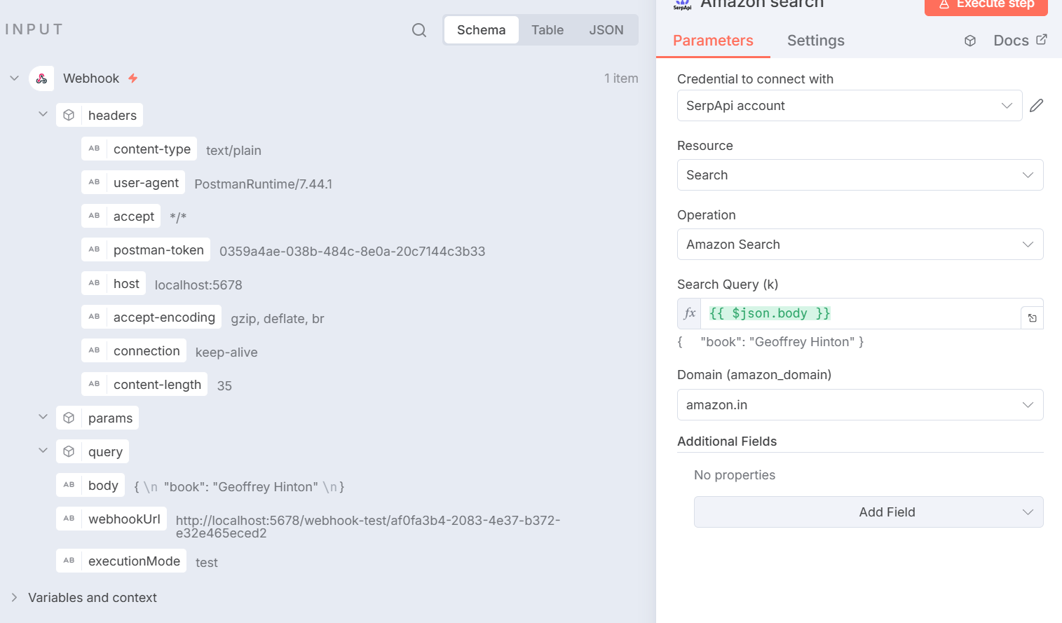
3_webhook_search_amazon
Now drag the body of Webhook to Amazon Search and do a test

Slide 10
5_read_cheque
Sign up on airtable
Create a new workspace and name it as n8n
Create a new base (like Database) named cheques_data
Open cheques_data and create a table named cheque: Columns id, payer, payee, cheque_date, amount, bank, raw
On the n8n Screen, click on your account icon (bottom left) -> Builder hub -> Create token -> name as n8n -> Scopes: data.records:write and schema.bases:read -> Access: n8n-cheques_data
Copy the token -> Come back to n8n -> Select n8n -> Create a record -> Add details
See next slide for all screens

Slide 11
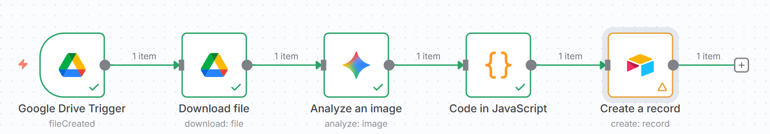
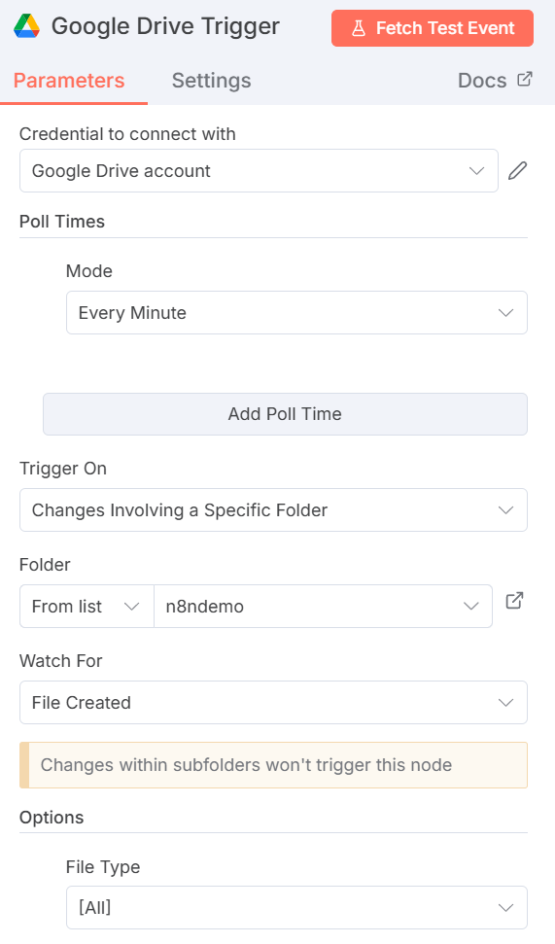
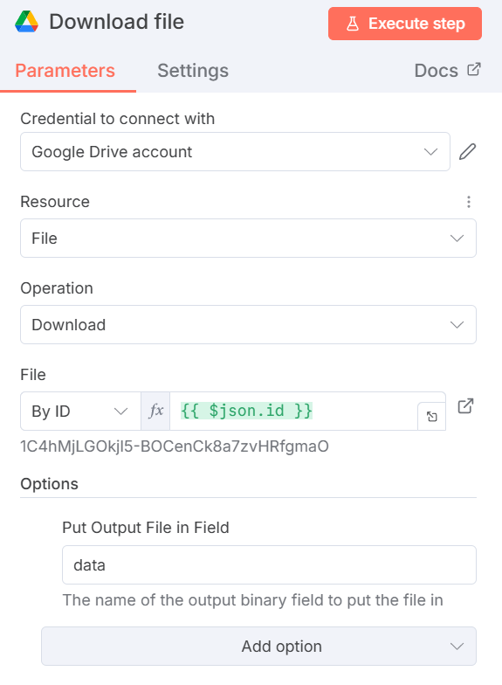
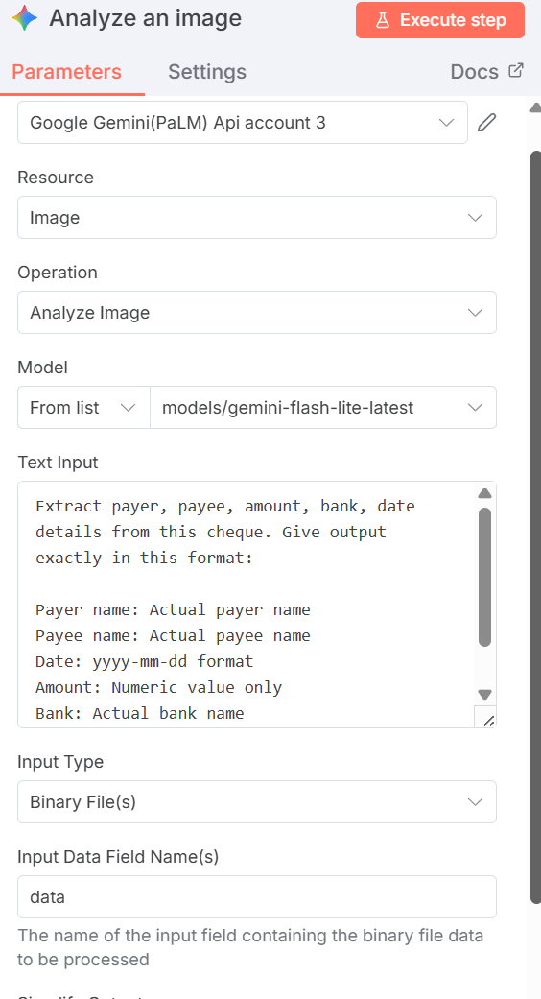
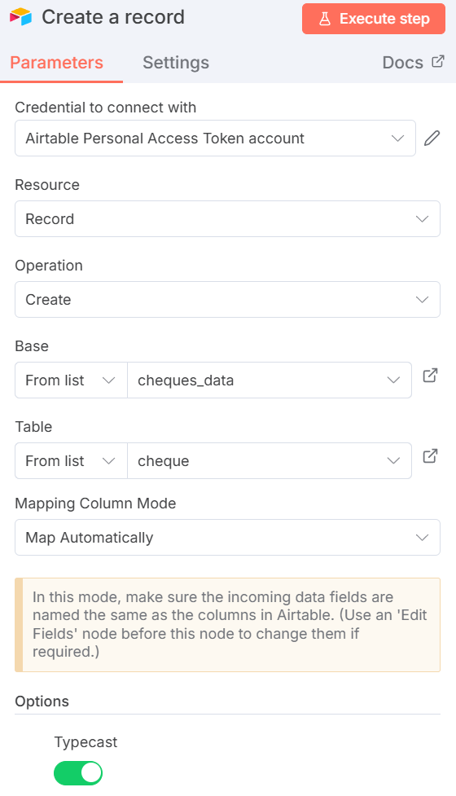
5_read_cheque (JavaScript Code – Next Slide)

Slide 12
5_cheque
// -------------------------------------------
// 1. READ TEXT FROM YOUR JSON STRUCTURE
// -------------------------------------------
const text =
item.json?.candidates?.[0]?.content?.parts?.[0]?.text || "";
// -------------------------------------------
// 2. SPLIT INTO LINES
// -------------------------------------------
const lines = text.split("\n");
function getValue(label) {
const line = lines.find(
l => l.toLowerCase().startsWith(label.toLowerCase())
);
if (!line) return "";
return line.split(":")[1].trim();
}
// -------------------------------------------
// 3. EXTRACT FIELDS
// -------------------------------------------
const payer = getValue("Payer name");
const payee = getValue("Payee name");
// Amount
let amountRaw = getValue("Amount");
let amount = null;
if (amountRaw) {
amount = parseFloat(amountRaw.replace(/,/g, "").trim());
}
// -------------------------------------------
// 4. DATE FORMAT FIX
// -------------------------------------------
function formatDate(d) {
if (!d) return null;
// Already ISO YYYY-MM-DD
if (/^\d{4}-\d{2}-\d{2}$/.test(d)) return d;
// DD/MM/YYYY or DD-MM-YYYY
const m = d.match(/(\d{1,2})[\/-](\d{1,2})[\/-](\d{4})/);
if (m) {
const [_, dd, mm, yy] = m;
return `${yy}-${mm.padStart(2, "0")}-${dd.padStart(2, "0")}`;
}
return null;
}
const cheque_date = formatDate(getValue("Date"));
const bank = getValue("Bank");
// -------------------------------------------
// 5. RETURN CLEAN JSON (ALL FIELDS AT TOP LEVEL)
// -------------------------------------------
return {
json: {
payer,
payee,
amount,
bank,
cheque_date, // date at top level
raw: text
}
};

Slide 13
Google Credentials Setup
In n8n, on a new workflow screen, search for google drive select Triggers -> On changes involving a specific folder
Credentials to connect with -> Create new credential
In the browser: console.cloud.google.com -> API and services -> Click on My first project -> New project -> Project name: n8ndemo -> Location: Do not change -> Create
Select n8ndemo -> Enable APIs and services -> Google Drive API -> Enable
Credentials -> Create credentials -> OAuth Client ID -> Configure consent screen -> Get started
App name: n8n-app -> Email: Our email id -> Next -> Audience: External -> Next -> Contact information -> Our email id -> Next -> Agree -> Continue -> Create
Audience -> Add users -> Our email id
Clients -> Create client -> Application type: Web application -> Authorized Redirect URIs -> Copy paste from n8n screen -> Create -> Copy client id and Client secret and paste in n8n screen
On the google page -> Search for gmail -> Enable … Repeat for Sheets, Calendar
Now n8n screen again -> Save and test connection

Slide 14
Discord Setup (If Needed)
Create a new account on Discord, or log in
Create a new channel named n8n
Click the edit channel button next to the channel name
Integrations -> Webhooks -> New Webhook -> Spidey Bot -> Copy Webhook URL
In n8n integration for Discord, Connection type: Webhook -> Create new credentials -> Paste the above Webhook URL from Discord
Operation -> Send a message

Slide 15
n8n and LLM
To connect n8n to an LLM
First add a chat trigger node
Then add an agent node
For using local Ollama with n8n running as a Docker container
For the Ollama account setup on n8n
Create new credential -> Base URL: http://host.docker.internal:11434 -> API key: ollama -> Model: llama 3.2 (Or whatever we have downloaded on our machine)

