Slide 1
Annotating MLTDs using Large Disagreement Modelling
By : Pranav Nair Advisor: Dr. Mohamed Wiem Mkaouer

Slide 2
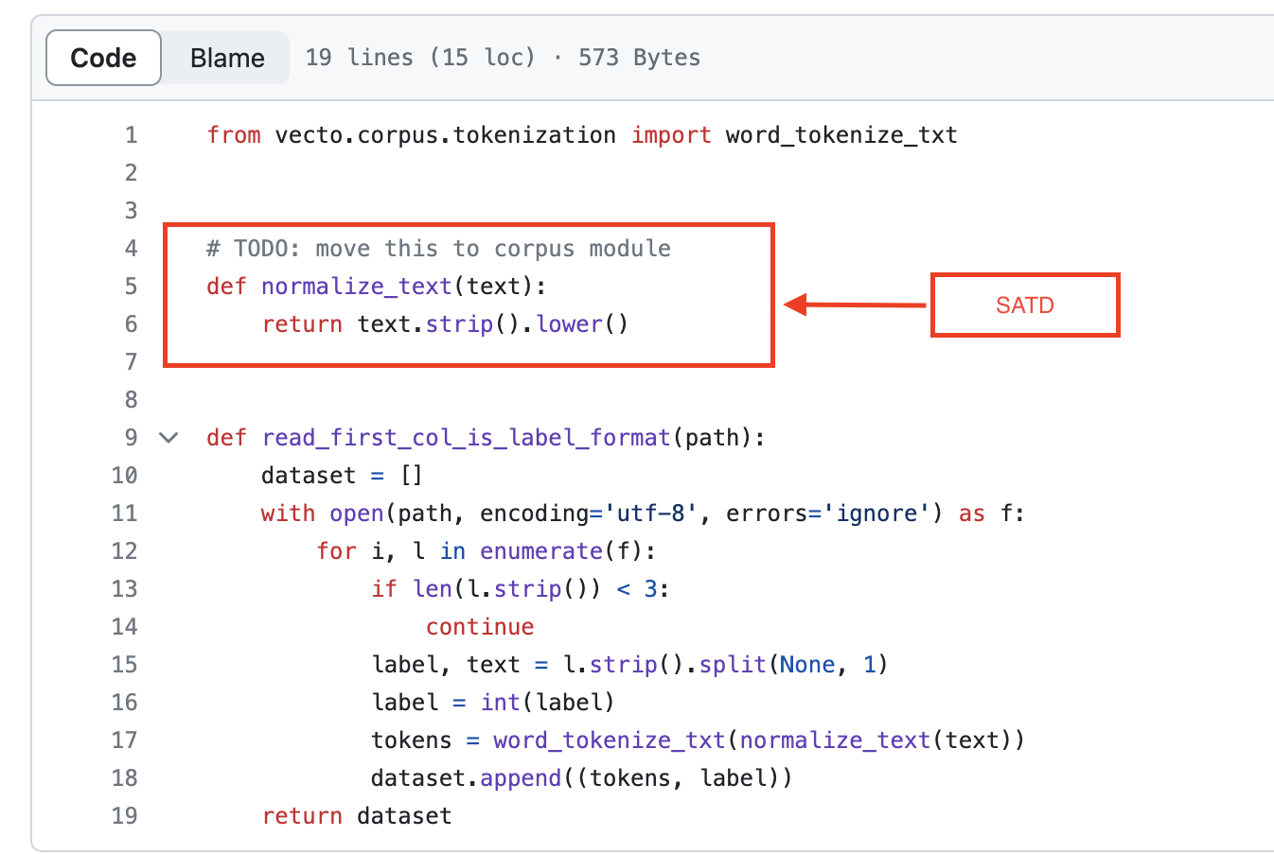
Introduction – What are Technical Debts?
Self-Admitted Technical Debt (SATD) in code refers to instances where developers knowingly introduce or leave documentation about code that they acknowledge to be suboptimal, problematic, or in need of improvement.
“Release Now, Fix it later”
Manual detection of TDs especially in large code-bases can be tedious and this can be automated using ML and rule-based techniques.
In this capstone, we focus in particular on MLTDs i.e. Technical Debt present in Machine Learning tools and applications.
The dataset used is taken from OBrien, David, et al. [1].
Fig 1: Example of MLTD

Slide 3
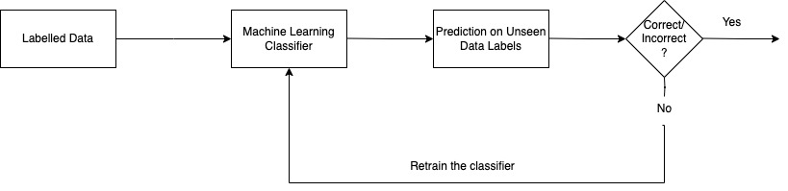
Introduction – What is Active Learning?
According to Wikipedia, Active Learning is a branch of Machine Learning in which a learning algorithm can interactively query a user (or some other information source) to label new data points with the desired outputs.
In simple terms, it means that we use an ML model trained on labelled data and perform predictions on unseen data and retrain the ML model with these datapoints depending on the predicted results.
Active Learning is useful when we have large amounts of un-labelled datasets for which manual labelling is expensive, time-consuming or is not an option due to limited labor.
For our experiment, we use the spaCy module in Python to build a custom model trained from scratch for binary text-categorization
Fig 2: Active Learning Pipeline

Slide 4
Introduction – What is Zero-Shot Classification?
Zero-Shot Learning means performing classification or any other form of prediction using Machine Learning without having to train any model on labelled data, all by the means of proper prompt learning.
Thankfully, this has been made possible due to the advent of Large Language Models.
For our experiment we use the GPT-4.0 API to perform a binary textual classification of MLTDs and Non-MLTDs, just by the means of the below prompt:
‘’’” You are supposed to behave as a binary text classification machine learning algorithm capable of identifying whether a particular code comment is a Techincal Debt or not. All the code comments given to you would be from code bases belonging to machine learning tools and applications mostly written in Python. Your answer should be either of just two words 'Yes' or 'No'. 'Yes' would mean that you have classified the given example as a Technical Debt whereas 'No' would mean otherwise. Kindly do not include any other textual commentaries in your answer and just output a 'Yes' or a 'No'
“””

Slide 5

Problem Statement – Large Disagreement Modelling
The dataset that we have used from OBrien, David, et al. [1], contains ~68k samples of code documentation comments of which around 200 data samples have been annotated as MLTDs and Non-MLTDs.
Our aim for this capstone was to perform the annotation of the remaining data points using an approach that combines Active Learning and Zero-shot learning, called Large Disagreement Modelling.
Essentially, we would classify every code sample using GPT-4.0 and the custom spaCy model and then only use those code samples to retrain the custom classifier where the predictions of both the classifiers have been contradictory
GPT-4.0 Pred | spaCy Pred | Actual Label | Annotate
Yes | No | Yes
No | Yes | Yes
Yes | No | No
No | Yes | No
Table 1: Disagreed Labels for Binary Classification

Slide 6
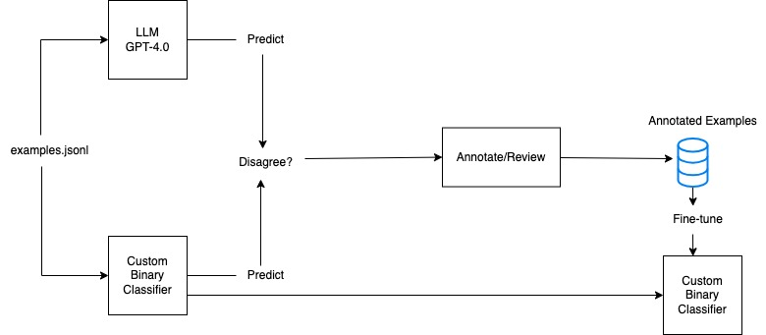
Solution Design
Fig 3: Large Disagreement Modelling pipeline

Slide 7
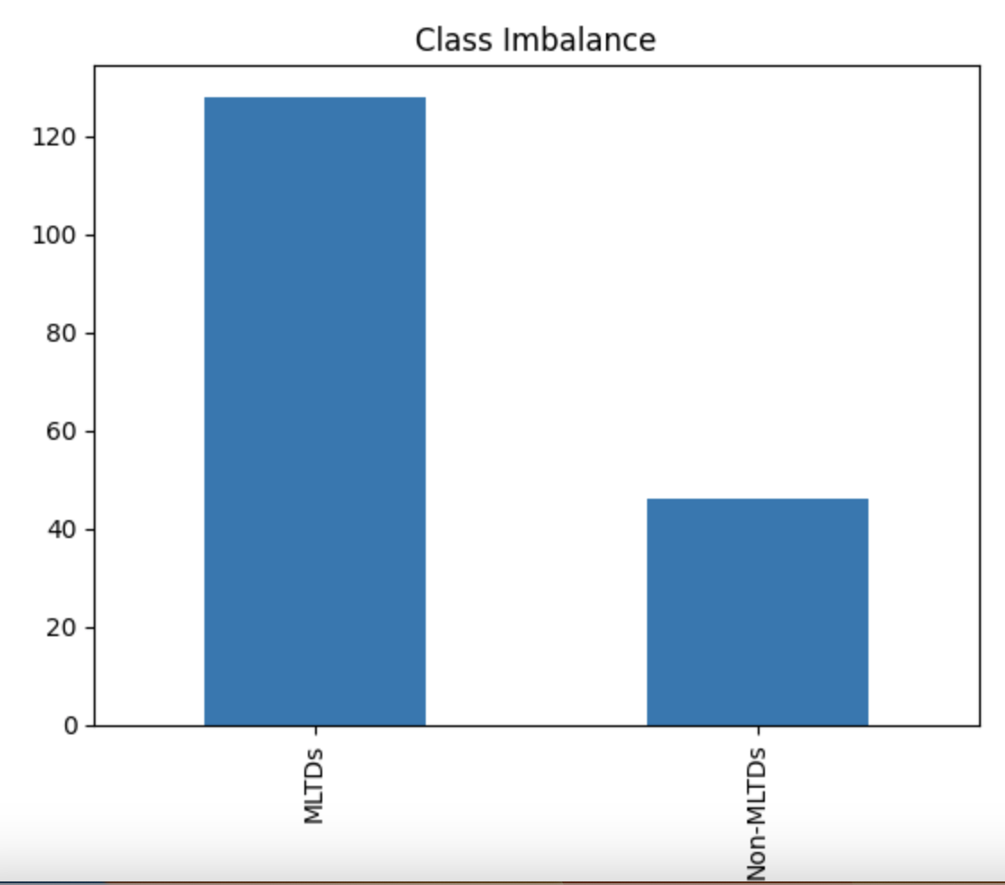
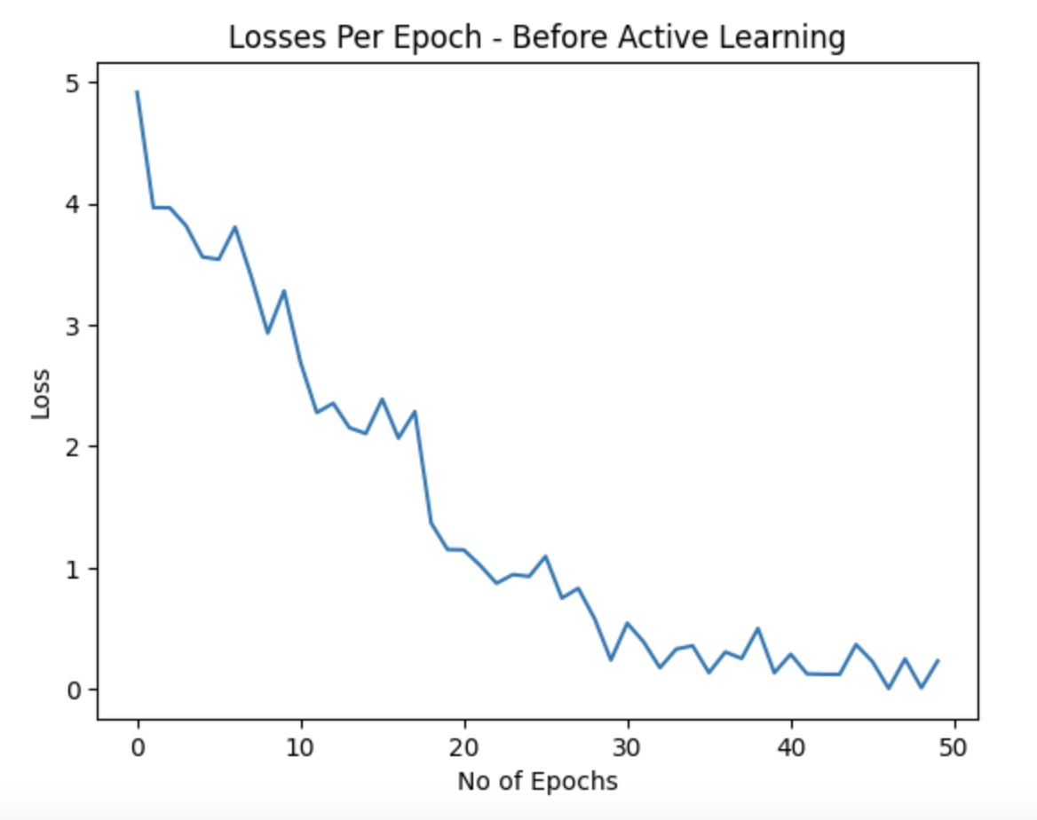
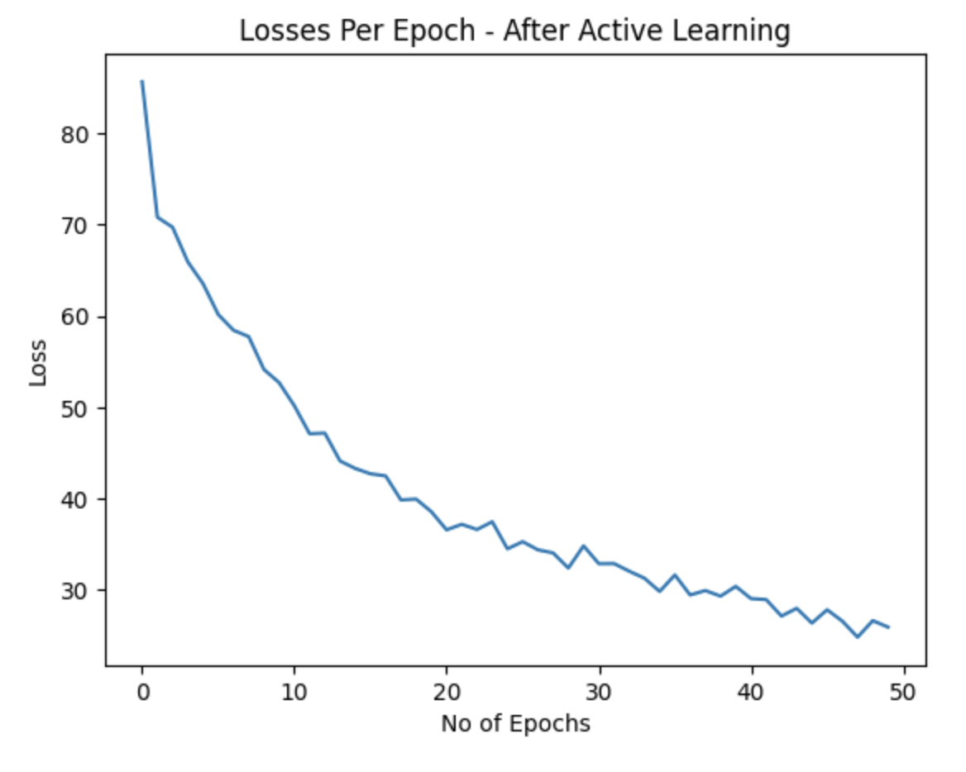
Experiments – Training Custom Model
Initially, the class imbalance ratio present in the ~200 annotated datapoints with a class imbalance as shown aside.
Text normalization was performed by:
Removing Stopwords
Removing Punctuation
Converting all words to lower case
Next we trained a text classifier using the spaCy framework in Python, which under the hood uses a deep learning library called thinc.
The model was trained for 50 epochs with a batch size of 8 and 50% dropout having the losses/epoch as shown below.
Fig 4: Class imbalance of original data
Fig 5: Model loss on 200 data points
Fig 6: Model loss on 13326 points after Active Learning

Slide 8
Experiments – Zero Shot GPT-4.0 Classification
Due to economical reasons, we calculated the results for the binary text classification using the GPT-4.0 API for only 13326 datapoints.
In order to make sure that this experiment is scientifically sound, we need to make sure that the classification report scores for the cases where both the model predictions agree, are high enough.
GPT – 4.0 Pred | Custom model Pred | Actual Label | GPT-4.0 Precision | spaCy Precision | GPT-4.0 Recall | spaCy Recall | GPT-4.0 F1-score | spaCy F1-score | Support # of examples
Yes | Yes | Yes | 0.95 | 0.95 | 1.0 | 1.0 | 0.97 | 0.97 | 5906
No | No | No | 0.94 | 0.94 | 1.0 | 1.0 | 0.97 | 0.97 | 1334
Table 2: Model confidence on Agreement

Slide 9
Experiments – Results.
After Performing Active Learning on data points annotated using LDM
Before Active Learning
 | Precision | Recall | F1-score | Support
No | 0.4 | 0.17 | 0.24 | 12
Yes | 0.89 | 0.97 | 0.93 | 88
 | Precision | Recall | F1-score | Support
No | 0.29 | 0.17 | 0.21 | 12
Yes | 0.89 | 0.94 | 0.92 | 88
Table 3: Classification Report prior to Active Learning
Table 4: Classification Report post Active Learning

Slide 10
Experiments
As seen from the previous slide, the custom model trained on 200 data points was used to make predictions on a set of 100 unannotated data points and the classification report values calculated were reported in the table on the left.
The right hand table indicates the scores of the classification report values for the same 100 unannotated data points, but after training the custom classifier on the 13326 data points annotated using Large Disagreement Modelling
As we could see, the model performance in both the cases remains almost same.
The main advantage is that of the 13326 data points chosen,
5906 (Predicted Yes both by GPT-4.0 and spaCy model) + 1334 (Predicted No both by GPT-4.0 and spaCy model)
= 7040 ~ 53% of 13326
So only remaining 47% of the data points had to be annotated, thereby bringing about a substantial reduction in the time taken for manual annotation
Hence, this experiment was successful.

Slide 11
References
[1]. OBrien, David, et al. "23 shades of self-admitted technical debt: an empirical study on machine learning software." Proceedings of the 30th ACM Joint European Software Engineering Conference and Symposium on the Foundations of Software Engineering. 2022.

Slide 12
THANKS

