Slide 1


Project Title -Seasonal Agriculture Performance Analysis.
Name: PRANAV SUNIL RAYPELLI
College name: VIDYALANKAR INSTITUTE OF TECHNOLOGY
AICTE STU ID :STU6a4393e9efe661782813673
9/2/2026
Annual Review
‹#›

Slide 2

PROBLEM STATEMENT
Agricultural activities are influenced by seasonal variations in environmental conditions, farming practices, resource availability and market conditions. As a result, agricultural performance may differ from one season to another. However, raw agricultural data does not clearly explain how agricultural performance changes across seasons or what patterns can be observed in different seasonal conditions. The problem is to analyze the given agricultural dataset and investigate seasonal differences in agricultural performance by identifying meaningful patterns, trends, relationships and variations within the available data.
9/2/2026
Annual Review
‹#›

Slide 3
Project Description
The Seasonal Agriculture Performance Analysis project focuses on analyzing agricultural activities across different seasons, geographical regions and farming conditions. The project uses a structured agricultural dataset containing information related to crop production, environmental conditions, resource utilization, irrigation practices, costs, revenue, profitability and disease/pest risk.
Using Python, Pandas, NumPy, Matplotlib, Seaborn and SciPy in Google Colab, the project performs data cleaning, exploratory data analysis, statistical analysis and visualization to identify meaningful seasonal patterns and variations.
The analysis compares Kharif, Rabi and Zaid seasons based on agricultural productivity, crop performance, water efficiency, environmental conditions, irrigation methods and economic outcomes. It also investigates relationships between agricultural variables, identifies regional differences and examines unusual observations using correlation, statistical testing and outlier analysis.
The objective is to transform raw agricultural data into evidence-based insights that can support better seasonal planning, resource management, crop selection, risk assessment and agricultural decision-making.
9/2/2026
Annual Review
‹#›

Slide 4

WHO ARE THE END USERS?
Farmers – To make better decisions about crop selection, irrigation and seasonal planning.
Agricultural Planners – To compare seasonal and regional agricultural performance.
Government & Policy Makers – To support data-driven agricultural policies and resource planning.
Agribusinesses – To understand crop performance, costs, profitability and market opportunities.
Agricultural Researchers – To study seasonal patterns, environmental factors and farming outcomes.
9/2/2026
Annual Review
‹#›

Slide 5

Technology Used
Python
Google Colab
Pandas
NumPy
Matplotlib
Seaborn
SciPy
Statistical Analysis
Data Visualization
9/2/2026
Annual Review
‹#›
Notes:
5

Slide 6
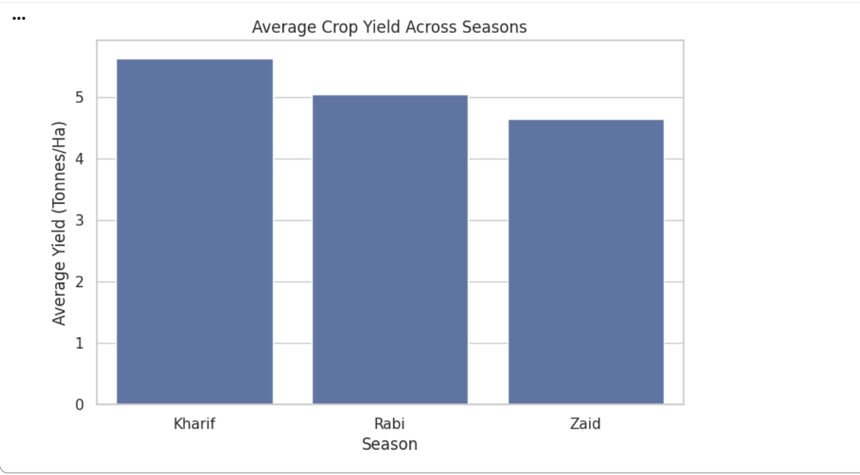
RESULTS
The graph compares the average yield in tonnes per hectare for Kharif, Rabi and Zaid seasons.
Kharif recorded the highest average yield at 5.63 tonnes/ha, followed by Rabi at 5.04 tonnes/ha and Zaid at 4.64 tonnes/ha. This indicates that agricultural productivity varies across seasons, with Kharif showing the strongest overall yield performance.
9/2/2026
Annual Review
‹#›

Slide 7
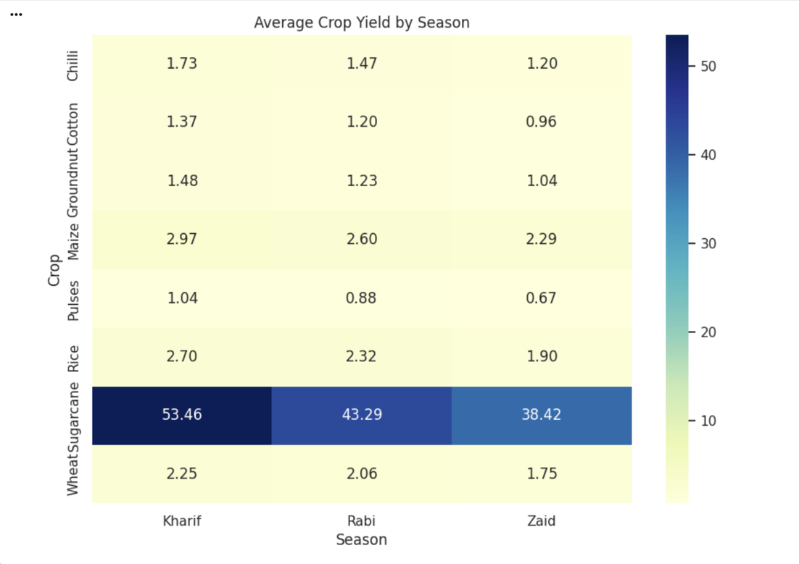
RESULTS
This heatmap compares the average yield of each crop across Kharif, Rabi and Zaid.
The crop-season heatmap shows clear differences in crop performance across seasons. Sugarcane recorded the highest average yield at 46.64 tonnes/ha, while other crops showed lower and more varied performance. This highlights the importance of considering both crop type and season when planning agricultural production.
9/2/2026
Annual Review
‹#›

Slide 8
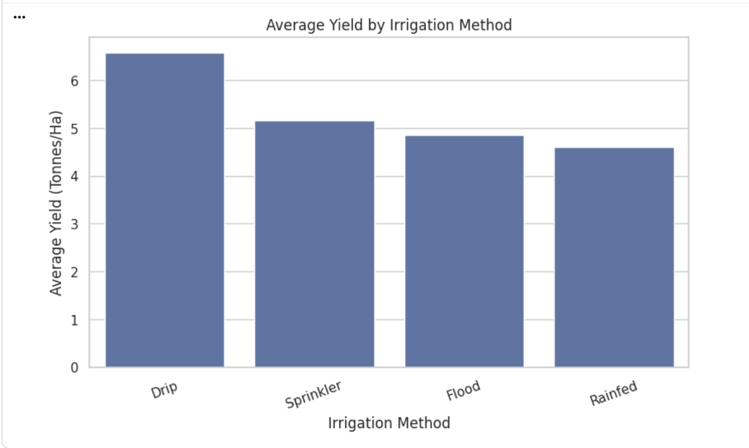
RESULTS
The graph compares the average yield achieved using Drip, Sprinkler, Rainfed and Flood irrigation.
Among the irrigation methods, Drip irrigation recorded the highest average yield of 6.58 tonnes/ha. Sprinkler, Flood and Rainfed methods recorded lower average yields. The result shows a strong association between irrigation method and observed agricultural productivity.
9/2/2026
Annual Review
‹#›

Slide 9
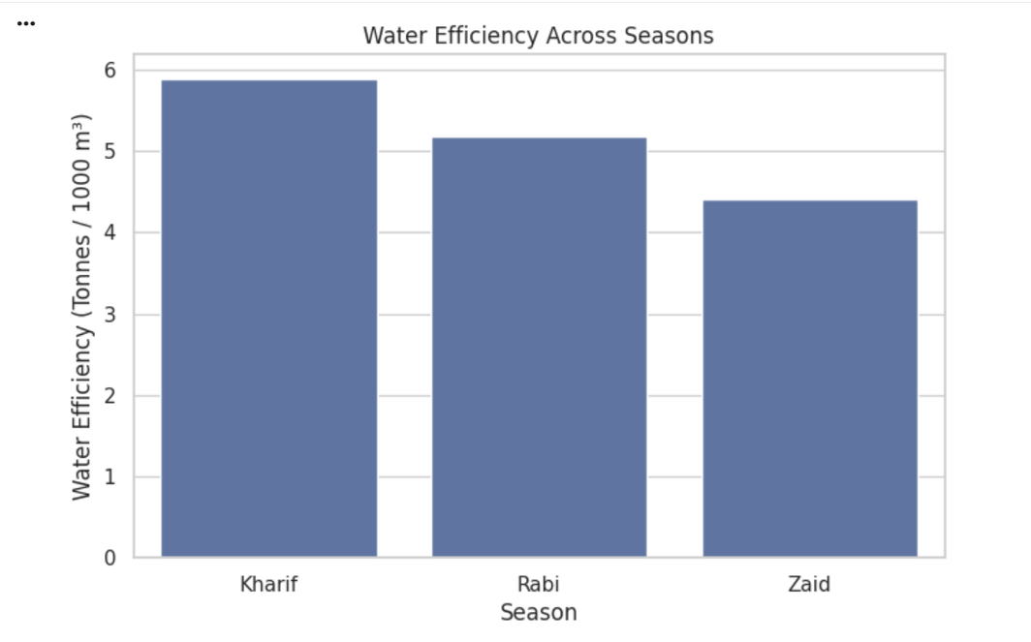
RESULTS
The graph compares water efficiency across the three seasons.
Kharif showed the highest average water efficiency of 5.89, followed by Rabi at 5.19 and Zaid at 4.41. This indicates that water utilization efficiency varies by season, making seasonal resource planning important for improving agricultural performance.
9/2/2026
Annual Review
‹#›

Slide 10
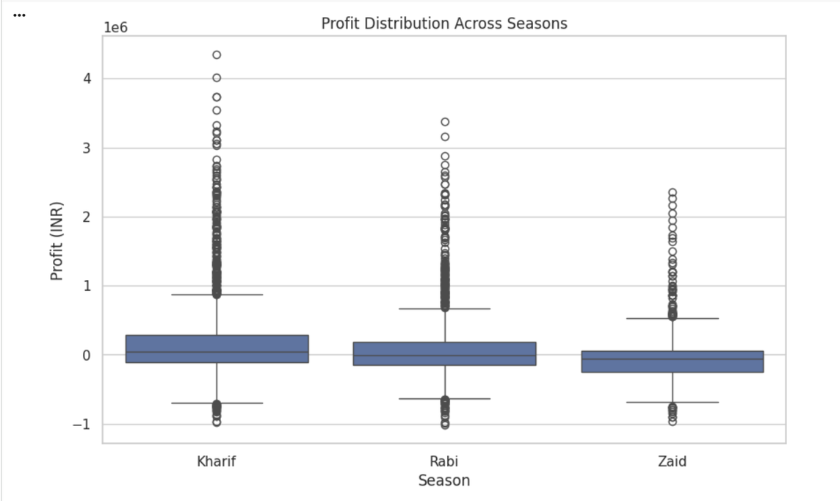
RESULTS
The profit distribution graph compares the spread of farm profits across Kharif, Rabi and Zaid seasons. Kharif shows the strongest overall profit performance, while Zaid has a wider concentration of lower and negative profits. This highlights significant differences in the economic performance of farming across seasons.
9/2/2026
Annual Review
‹#›

Slide 11
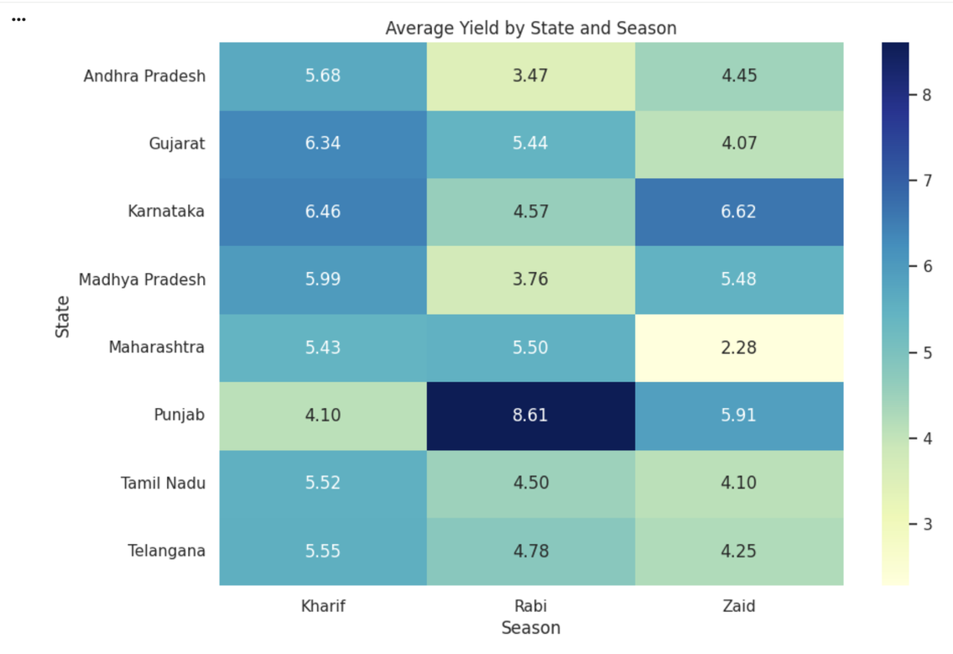
RESULTS
The heatmap compares average yield across different states and seasons.
The state-season heatmap reveals regional variation in agricultural yield across Kharif, Rabi and Zaid. The results show that seasonal performance is not identical across all states, highlighting the importance of region-specific agricultural planning and resource management.
9/2/2026
Annual Review
‹#›

Slide 12
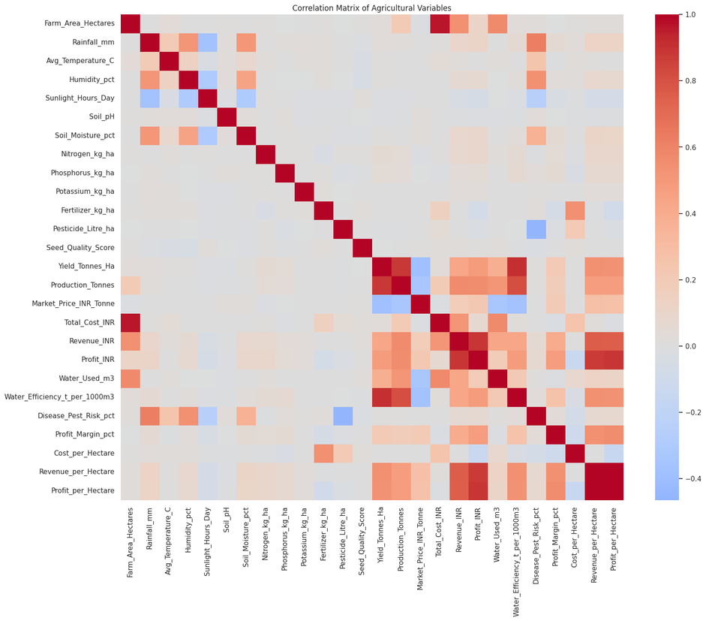
RESULTS
The correlation heatmap displays relationships between major agricultural variables.
The correlation analysis shows that water efficiency has the strongest positive relationship with yield (r = 0.913), followed by production (r = 0.883). Revenue and profit per hectare also show positive relationships with yield. These results help identify the variables most closely associated with agricultural productivity.
9/2/2026
Annual Review
‹#›

Slide 13
Future scope
Real-Time Data Integration: Incorporate real-time weather, rainfall and environmental data to improve seasonal agricultural analysis.
Predictive Analysis: Apply machine learning techniques to predict crop yield, profitability and potential agricultural risks.
Advanced Resource Management: Analyze water, fertilizer and pesticide usage to identify more efficient farming practices.
Regional-Level Analysis: Develop region-specific insights and recommendations based on soil, climate and crop conditions.
Decision Support System: Extend the project into an interactive dashboard or application for practical agricultural planning and decision-making.
Crop Recommendation: Develop a recommendation system to identify suitable crops and irrigation methods for different seasonal and environmental conditions.
9/2/2026
Annual Review
‹#›

Slide 14
GitHub Link
Git hub link:
https://github.com/pranav-raypelli06/Seasonal-Agriculture-Performance-Analysis..git
9/2/2026
Annual Review
‹#›

Slide 15
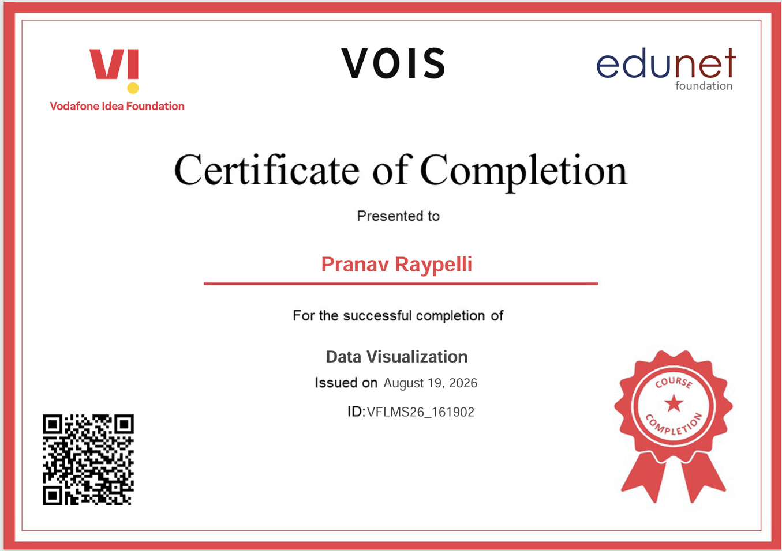
VOIS Course completion certificate -
Course name- Data Visualization
9/2/2026
Annual Review
‹#›

Slide 16
Thank you
.
.
9/2/2026
Annual Review
‹#›

