Slide 1
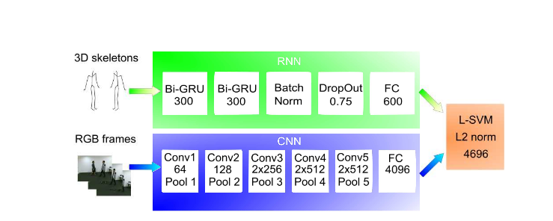
Model Architecture
A two-streamed RNN/CNN. - The gated-recurrent-unit-based neural networks are particularly well-suited to distinguish actions based on long-term information from optical tracking data
- The 3D-CNNs focus more on detailed, recent information from video data.
- The resulting features are merged in an SVM which then classifies the movement.
Image courtesy : https://arxiv.org/pdf/1703.09783.pdf

Slide 2
A Major Challenge in this approach
-Small data leads to problems like overfitting and outliers.
Size(Model) ∝ Size(Data) ∝ Complexity(Problem)
Since we have limited data, we need to modify the architecture and use something called as transient learning.

Slide 3
Transient Learning
If Deep Learning is the holy grail and data is the gate keeper, transfer learning is the key.
Models trained on one task capture relations in the data type and can easily be reused for different problems in the same domain.
- With transfer learning, we can take a pretrained model, which was trained on a large readily available dataset (trained on a completely different task, with the same input but different output). - Then try to find layers which output reusable features. We use the output of that layer as input features to train a much smaller network that requires a smaller number of parameters. - This smaller network only needs to learn the relations for your specific problem having already learnt about patterns in the data from the pretrained model. - Prisma Example

Slide 4
Techniques to overcome small data problems
Data Preprocessing [Cleaning up]
Regularization
Model Averaging
Reducing Model Complexity:
Clustering markers and mapping motion data

Slide 5
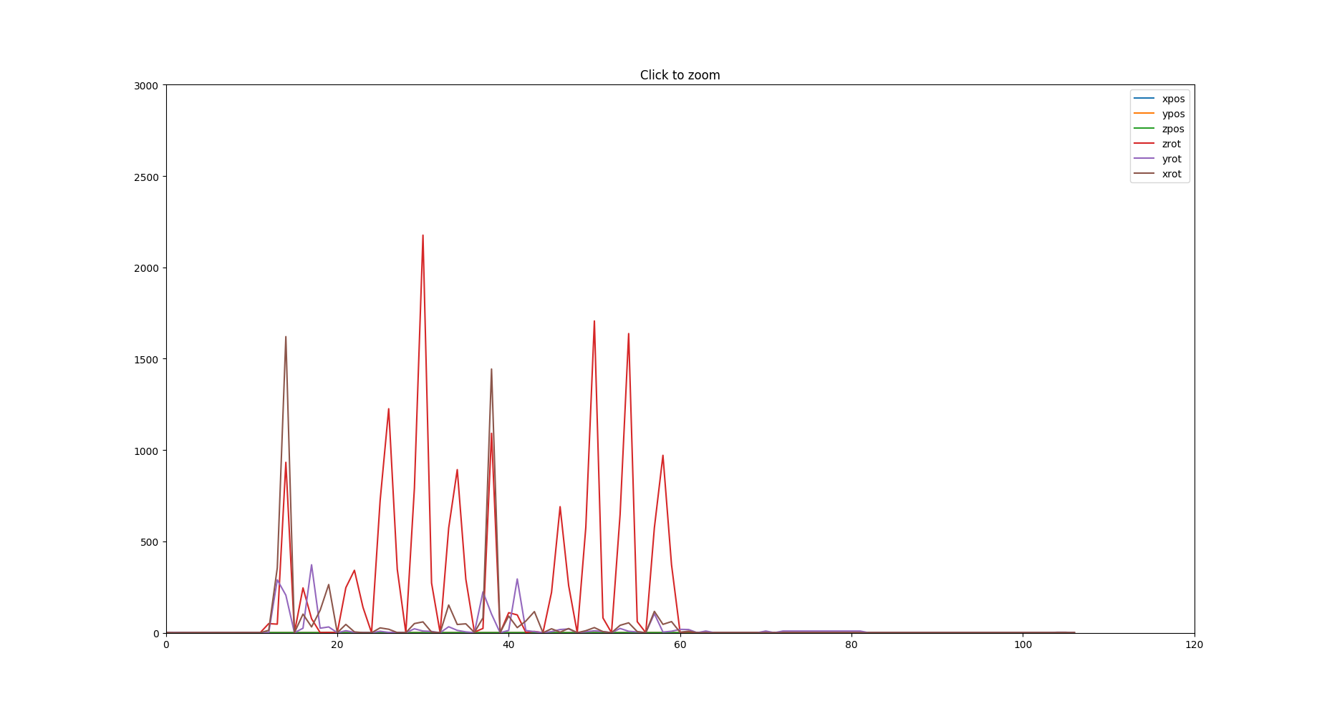
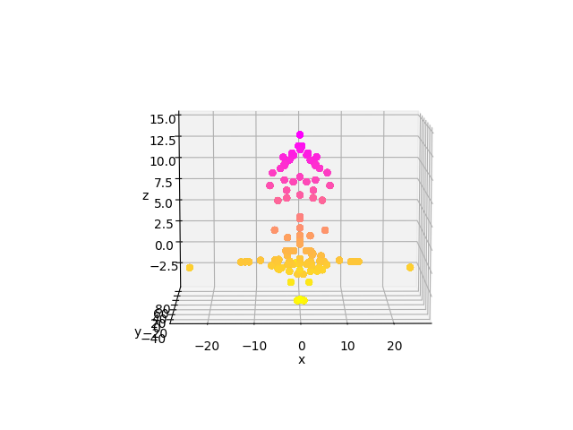
Data Preprocessing
Variance based analysis
Scatter plot of position data

Slide 6
References
https://medium.com/nanonets/nanonets-how-to-use-deep-learning-when-you-have-limited-data-f68c0b512cab
https://medium.com/rants-on-machine-learning/what-to-do-with-small-data-d253254d1a89
https://arxiv.org/pdf/1703.09783.pdf

