Slide 1
Interview Trainer ai agent (PrepSaathi)
IBM AICTE PROJECT
Presented By : Pranav Rajesh Gaikwad
Department : Artificial Intelligence And Data Science .
College Name : K. K. Wagh Institute of Engineering , Education And Research , Nashik.

Slide 2
OUTLINE
Problem Statement
Technology used
Wow factor
End users
Result
Conclusion
Git-hub Link
Future scope
IBM Certifications

Slide 3
Problem Statement
Problem Statement: Job seekers struggle to find role-specific interview questions due to lack of tailored guidance for technical, HR, and behavioral prep and existing solutions are generic and don’t leverage real-world company insights.
Proposed Solution : An AI-powered Interview Trainer Agent using
Retrieval-Augmented Generation (RAG) & IBM Granite that Generates custom interview questions based on role & experience and provides model answers & improvement tips.

Slide 4
Technology used
IBM Cloud Lite Services
Retrieval-Augmented Generation (RAG)
Natural Language Processing (NLP)
IBM Granite LLM
Lang Chain

Slide 5
IBM cloud services used
IBM Watsonx.ai Studio
IBM Watsonx.ai Runtime
IBM Cloud Object Storage
Watson Discovery
Agent Lab

Slide 6
Wow factors
Personalized Interview Prep: Generates tailored Q&A based on resume/job role.
Comprehensive Coverage: Technical, HR, and behavioral questions with model answers.
Improvement: Provides improvement tips.
Industry-Specific Prep: Retrieves real-world company & role-specific content.

Slide 7
End users
Job Seekers & Students preparing for placements
Working Professionals aiming for role transitions
Colleges & Career Centers assisting students in interview preparation
Coaching Institutes providing guided interview training

Slide 8
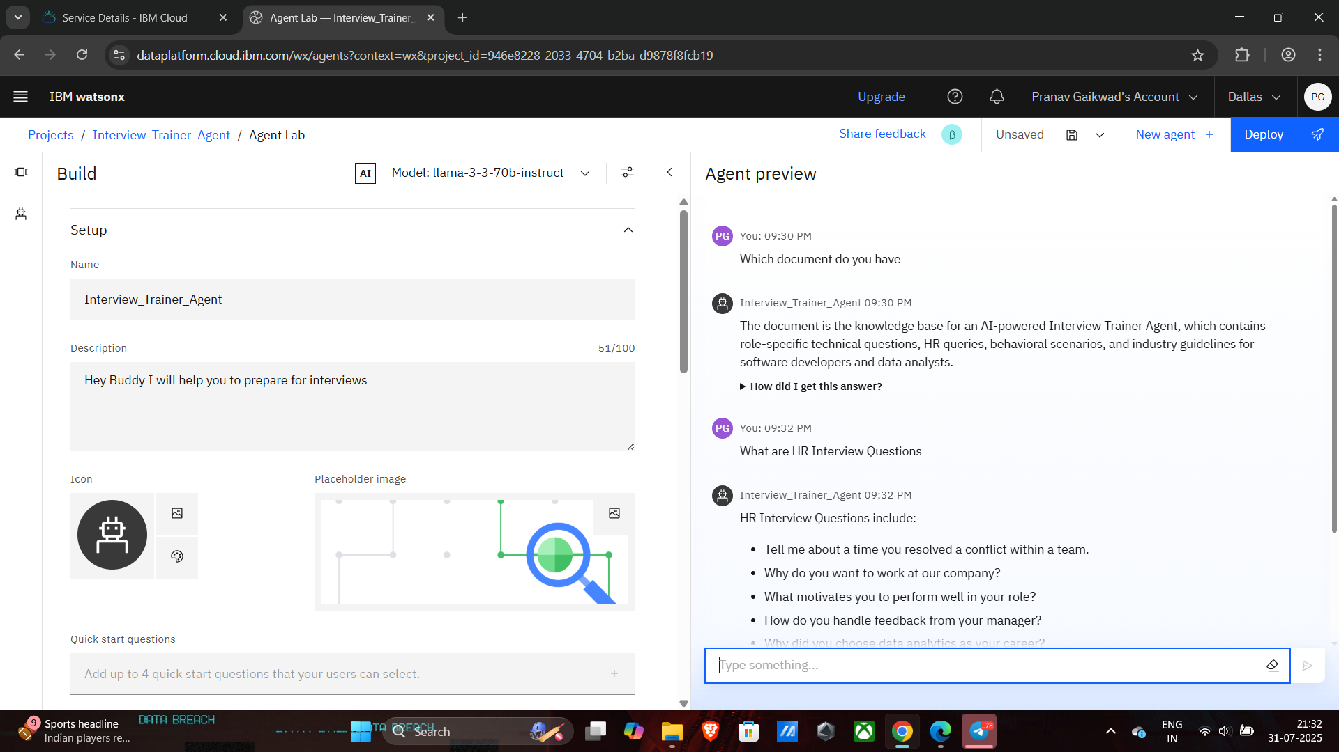
Results

Slide 9
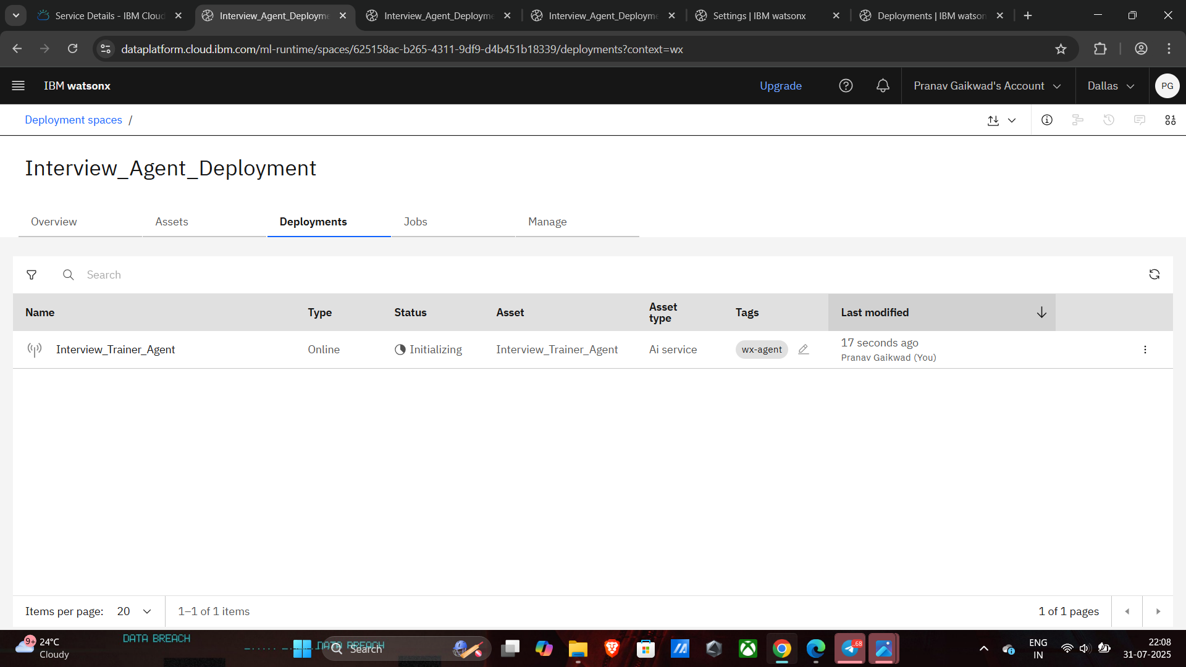
Results

Slide 10
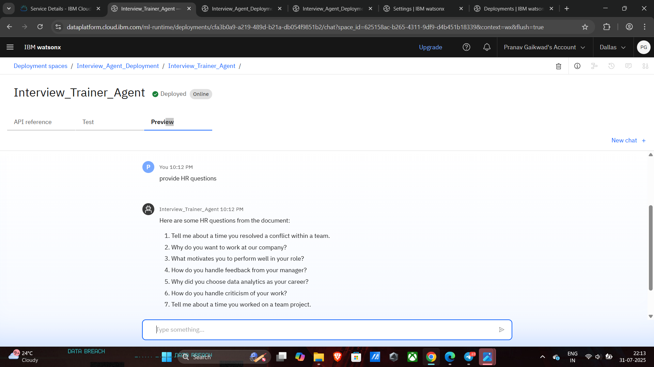
Results

Slide 11
Conclusion
The Interview Trainer Agent :
Helps users prepare smarter with tailored Q&A & answers
Leverages IBM Granite & RAG to provide realistic, role-based preparation

Slide 12
Future scope
Voice-based Mock Interviews with speech feedback
Gamified preparation for engaging practice
Company-specific Q&A sets
Multilingual Support for wider accessibility

Slide 13
GitHub Link
GitHub Link:-https://github.com/pranav0218/PrepSaathi-Interview_Agent

Slide 14
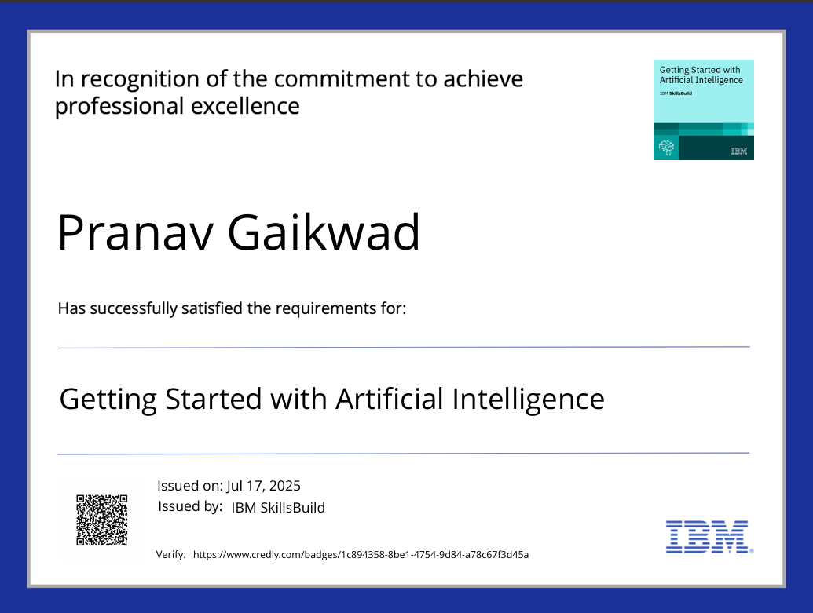
IBM Certifications

Slide 15
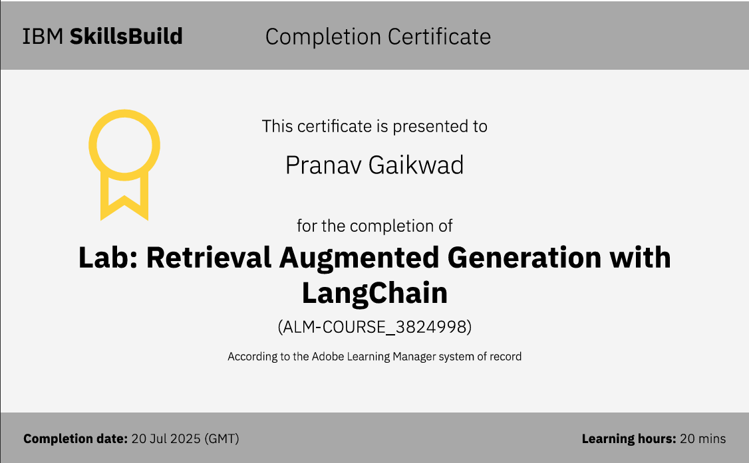

Slide 16
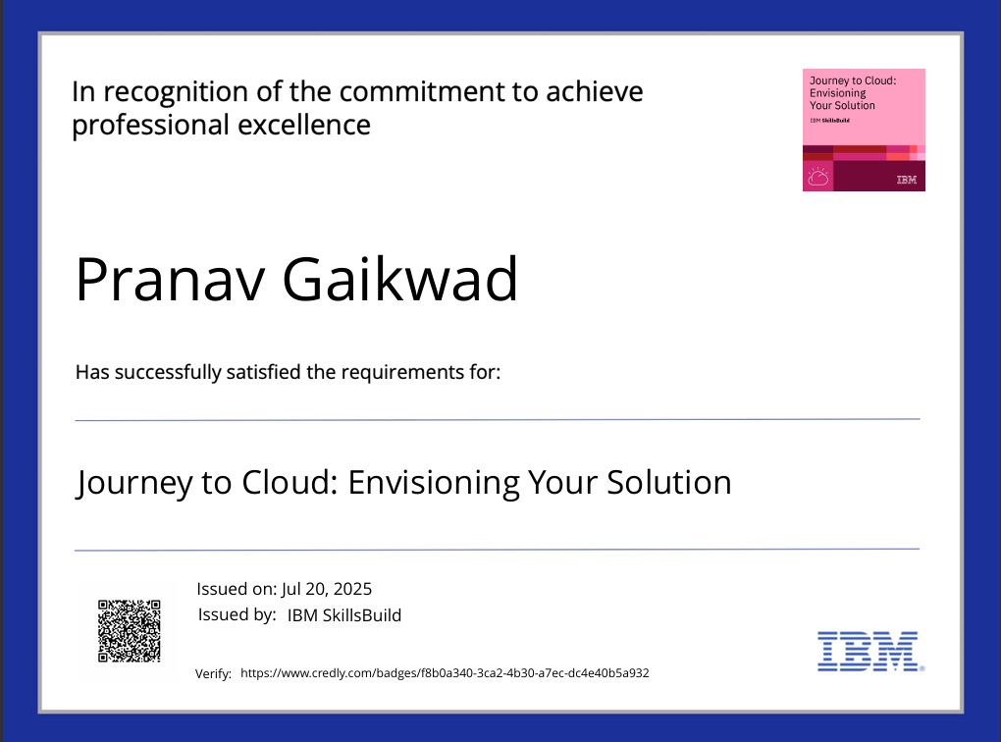

Slide 17
THANK YOU

