Slide 1
By Pranav GS
AIDS

Slide 2
Outline
Introduction to SIFT
Overview of Algorithm
Construction of Scale space
DoG (Difference of Gaussian Images)
Finding Keypoint
Getting Rid of Bad Keypoint
Assigning an orientation to keypoints
Generate SIFT features

Slide 3
Introduction to SIFT
Scale-invariant feature transform (or SIFT) is an algorithm in computer vision to detect and describe local features in images.
This algorithm was published by David Lowe.

Slide 4
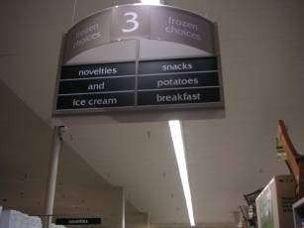
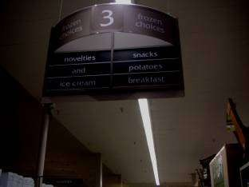
Types of invariance
Illumination

Slide 5
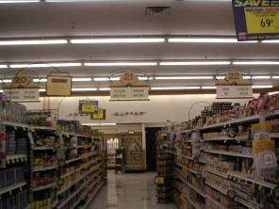
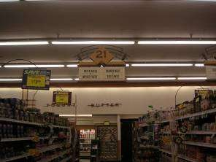
Types of invariance
Illumination
Scale

Slide 6
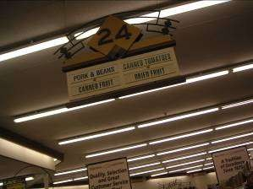
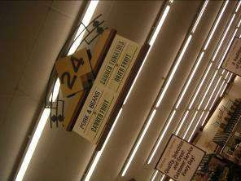
Types of invariance
Illumination
Scale
Rotation

Slide 7
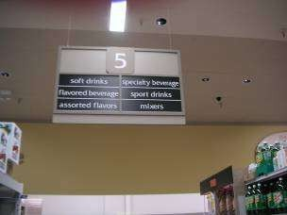

Types of invariance
Illumination
Scale
Rotation
Full perspective

Slide 8
SIFT Algorithm

Slide 9
1. Constructing Scale space
In scale Space we take the image and generate progressively blurred out images, then resize the original image to half and generate blurred images.
Images that are of same size but different scale are called octaves.

Slide 10


How Blurring is performed?
Mathematically blurring is defined as convolution of Gaussian operator and image.
where G= Gaussian Blur operator

Slide 11
L is a blurred image
G is the Gaussian Blur operator
I is an image
x, y are the location coordinates
σ is the “scale” parameter. The amount of blur. Greater the value, greater the blur.
The * is the convolution operation in x and y. It applies Gaussian blur G onto the image I

Slide 12
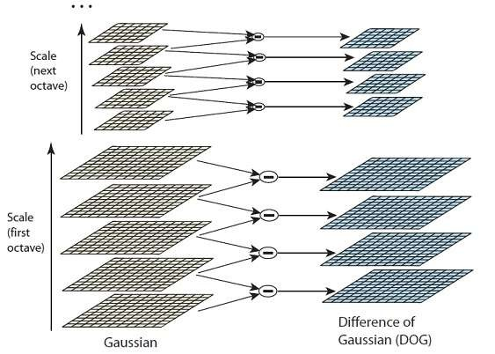
2. Difference of Gaussian(DoG)

Slide 13

LoG are obtained by taking second order derivative.
DoG images are equivalent to Laplacian of Gaussian image. Moreover DoG are scale invariant.
In other word when we do difference of gaussian images, it is multiplied with σ² which is present in gaussian blur operator G.

Slide 14
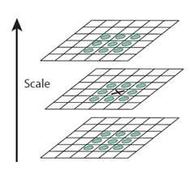
3. Finding Keypoint
Finding keypoint is a two step process:
Locate maxima/minima in DoG images
Find subpixel maxima/minima

Slide 15
Locate maxima/minima
In the image X is current pixel, while green circles are its neighbors, X is marked as Keypoint if it is greatest or east of all 26 neighboring pixels.
First and last scale are not checked for keypoints as there are not enough neighbors to compare.

Slide 16

Find subpixel maxima/minima
Sub-pixel value are generated using Taylor expansion of image around the keypoint found.
The extreme points of this equation can be found by differentiating and equating to zero. On solving, we’ll get subpixel key point locations. These subpixel values increase chances of matching and stability of the algorithm.

Slide 17
4. Eliminating bad keypoints
Removing Low Contrast features
If magnitude of intensity at current pixel is less than certain value then it is rejected.
Removing edges
For poorly defined peaks in the DoG
function, the principal curvature across the edge would be much larger than the principal curvature along it
To determine edges Hessian matrix is used.

Slide 18
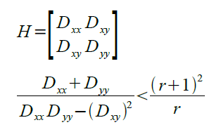
Tr (H) = Dxx + Dyy
Det(H) = DxxDyy - (Dxy )2
If the value of R is greater for a candidate keypoint, then that keypoint is poorly localized and hence rejected.

Slide 19
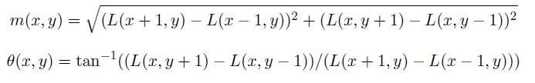
5. Assigning Orientation
Gradient direction and magnitude around keypoints are collected, and prominent orientations are assigned to keypoints.
Calculations are done relative to this orientation, hence it ensure rotation invariance.

Slide 20
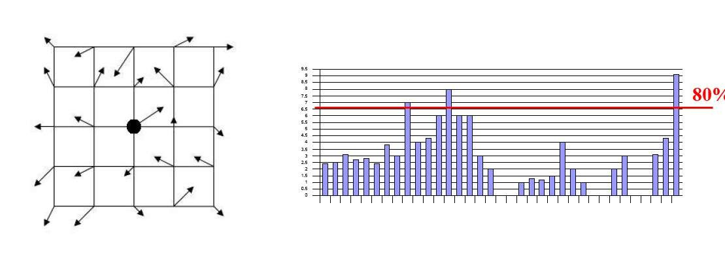
The magnitude and orientation is calculated for all pixels around the keypoint.
Then, A histogram is created for this.
So, orientation can split up one keypoint into multiple keypoints

Slide 21
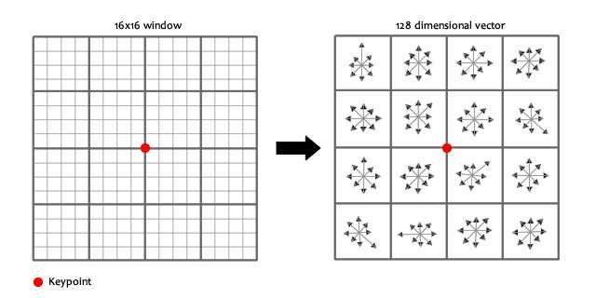
6. Generating SIFT Features
Creating fingerprint for each keypoint, so that we can distinguish between different keypoints.
A 16 x 16 window is taken around keypoint, and it is divided into 16 4 x 4 windows.

Slide 22
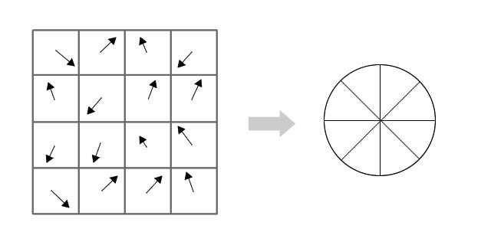
Generating SIFT Features
Within each 4×4 window, gradient magnitudes and orientations are calculated. These orientations are put into an 8
bin histogram, depending on gradient directions.

Slide 23
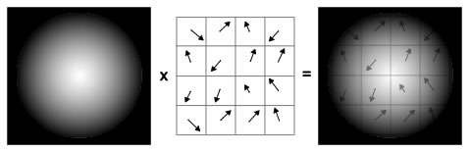
Generating SIFT Features
The value added to bin also depend upon distance from keypoint ,so gradients which are far are less in magnitude.
This is achieved by using Gaussian weighting function.

Slide 24
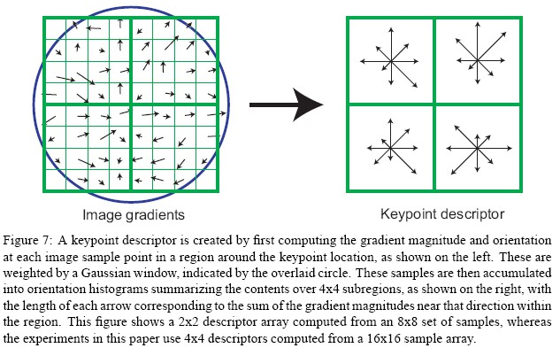

Slide 25
This has to be repeated for all 16 4x4 regions so we will get total 16x8=128 numbers. These 128 numbers are normalized and resultant 128 numbers form feature vector which determine a keypoint uniquely.

Slide 26
Problem associated with feature vector
Rotation Dependence
If we rotate the image all the gradient orientation will get change. So to avoid this keypoint’s rotation is subtracted from each gradient orientation. Hence
each gradient orientation is relative to keypoint’s orientation.
2. Illumination Dependence
If we threshold numbers that are big, we can achieve illumination independence. So, any number (of the 128) greater than 0.2 is changed to 0.2. This resultant feature vector is normalized again. And now we have an illumination independent feature vector.

Slide 27
Application
Application of SIFT include object recognition, gesture recognition, image stitching, 3D modeling.

Slide 28

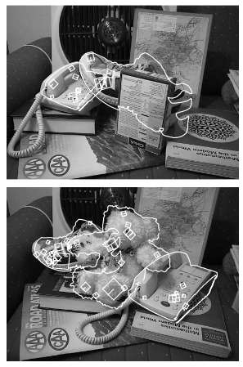
Object recognition

Slide 29
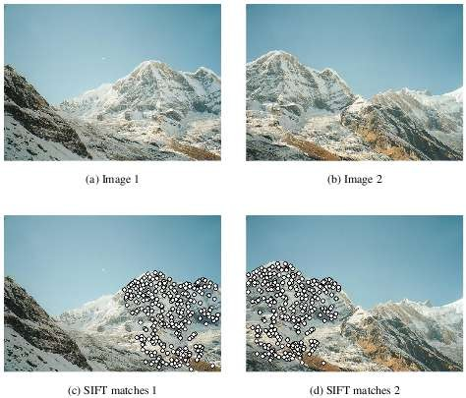
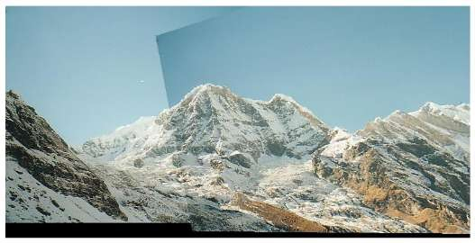
Image Stitching

Slide 30
References
http://www.aishack.in/2010/05/sift-scale-invariant- feature-transform
http://en.wikipedia.org/wiki/Scale-invariant feature transform
yumeng-SIFTreport-5.18_bpt.pdf
Paper on SIFT by Harri Auvinen, Tapio Lepp¨alampi, Joni Taipale and Maria Teplykh.
David G. Lowe, Distinctive Image Features from Scale-Invariant Keypoints, International Journal of Computer Vision, 2004

