Slide 1
Homework 2 Problems
Pranav Nadimpalli

Slide 2
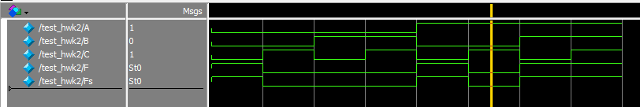
Problem 1
A | B | C | F | Fs
0 | 0 | 0 | 1 | 1
0 | 0 | 1 | 0 | 0
0 | 1 | 0 | 0 | 0
0 | 1 | 1 | 0 | 0
1 | 0 | 0 | 1 | 1
1 | 0 | 1 | 0 | 0
1 | 1 | 0 | 1 | 1
1 | 1 | 1 | 1 | 1

Slide 3
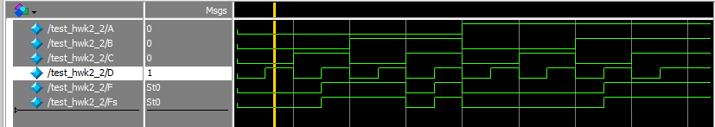
Problem 2
A | B | C | D | F | Fs
0 | 0 | 0 | 0 | 0 | 0
0 | 0 | 0 | 1 | 0 | 0
0 | 0 | 1 | 0 | 0 | 0
0 | 0 | 1 | 1 | 1 | 1
0 | 1 | 0 | 0 | 1 | 1
0 | 1 | 0 | 1 | 1 | 1
0 | 1 | 1 | 0 | 0 | 0
0 | 1 | 1 | 1 | 1 | 1
1 | 0 | 0 | 0 | 0 | 0
1 | 0 | 0 | 1 | 0 | 0
1 | 0 | 1 | 0 | 0 | 0
1 | 0 | 1 | 1 | 0 | 0
1 | 1 | 0 | 0 | 0 | 0
1 | 1 | 0 | 1 | 1 | 1
1 | 1 | 1 | 0 | 1 | 1
1 | 1 | 1 | 1 | 1 | 1

Slide 4
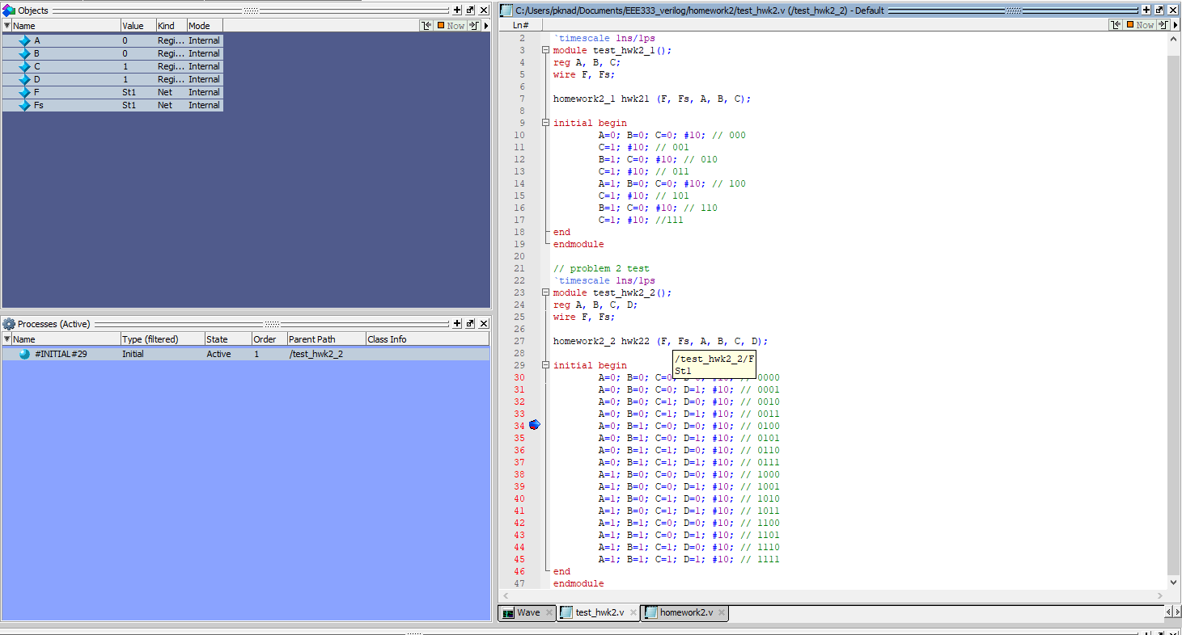
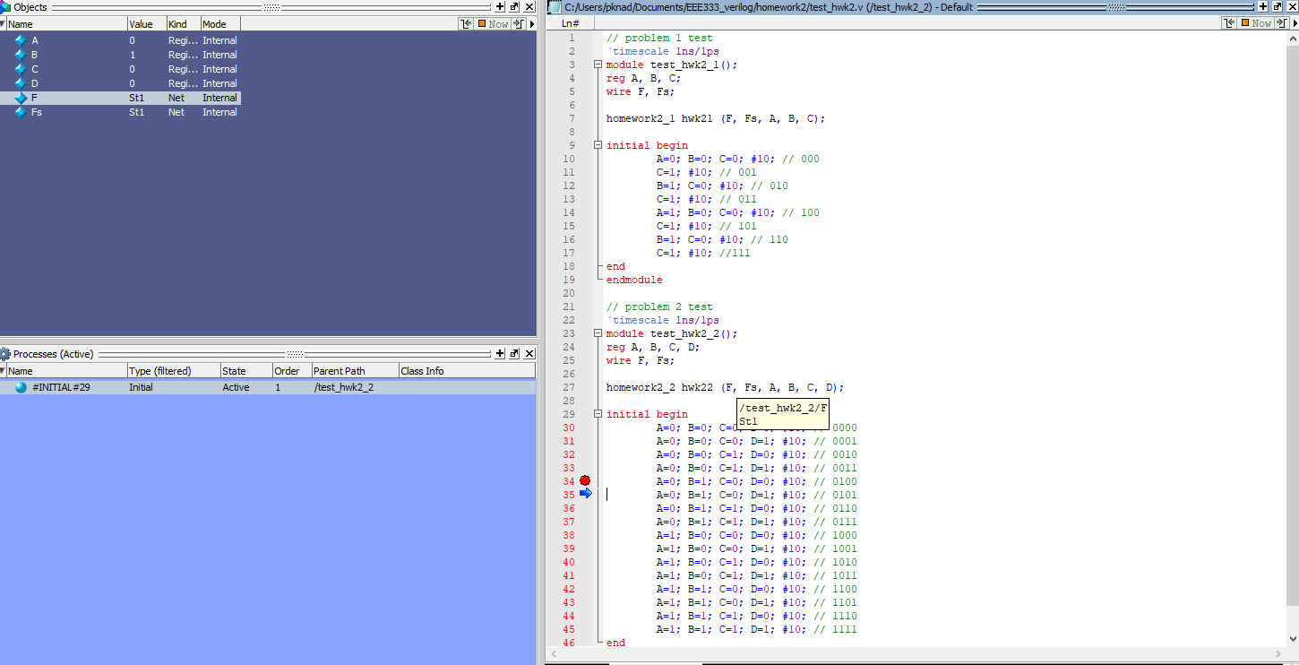
Problem 3

Slide 5
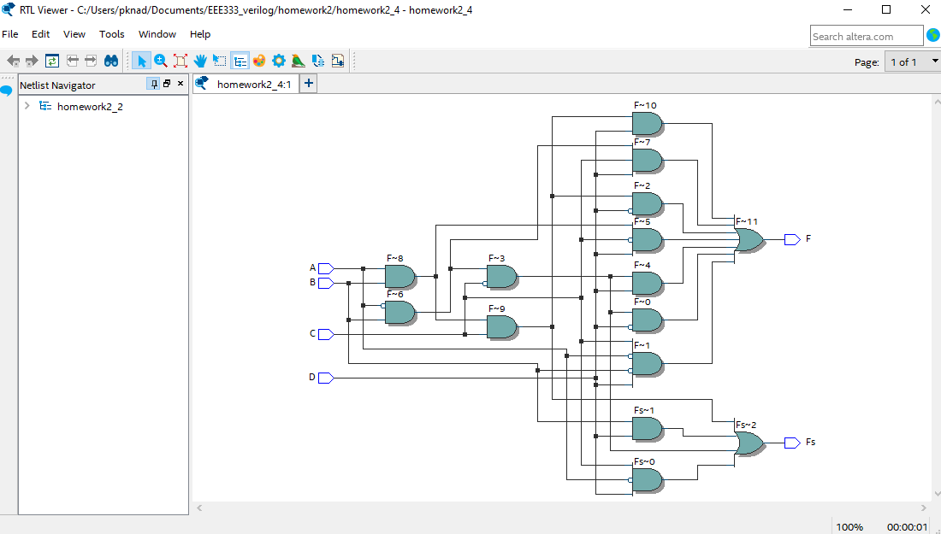
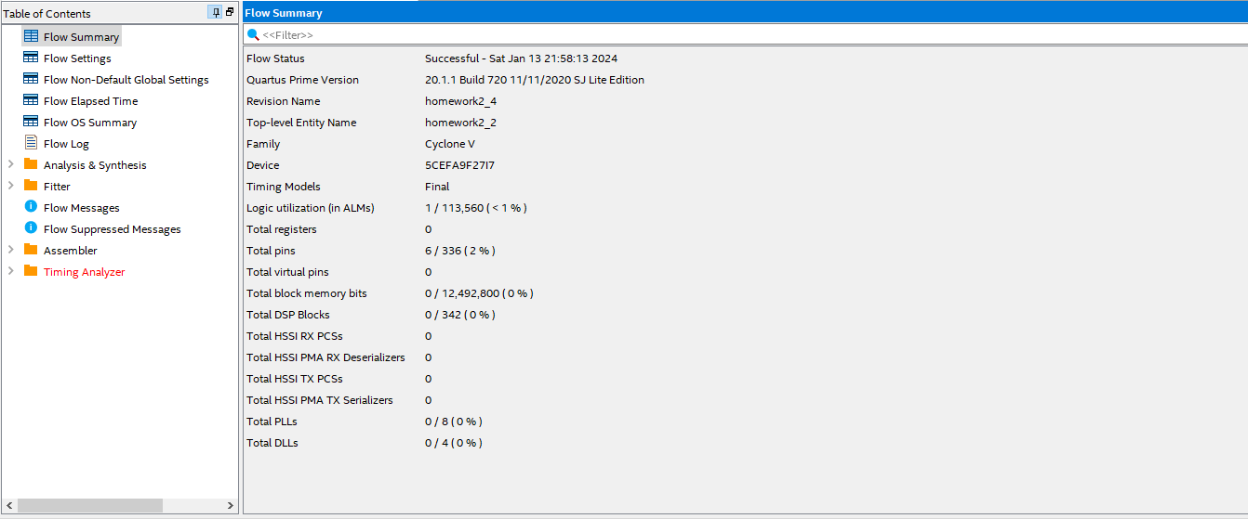
Problem 4

