Slide 1

Predicting Heart Failure: A Machine Learning Approach
Pranav Anthireddy
Vignan Kasam
Kvs Rohith

Slide 2

INTRODUCTION
Heart failure is a widespread and urgent health issue that affects a large proportion of the global population. The capacity to recognize and anticipate heart failure episodes in real time is critical for providing effective therapy and improving patient outcomes.
Accurate categorization is critical in the field of cardiovascular health. It enables us to classify patients depending on their risk of developing heart failure episodes, allowing for focused therapies and tailored treatment programs.
In this project, We performed a thorough Exploratory Data Analysis (EDA) to get deep insights into the "heart_failure_clinical_records" dataset.
Following that, we applied four machine-learning models to do classification.

Slide 3
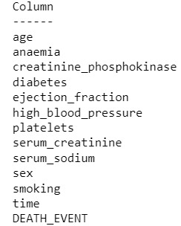
DATASET OVERVIEW
The dataset "heart_failure_clinical_records" was utilized. This patient-rich dataset serves as the foundation for training and assessing our classification model. Age, gender, and medical history are all important factors in our prediction analysis.

Slide 4
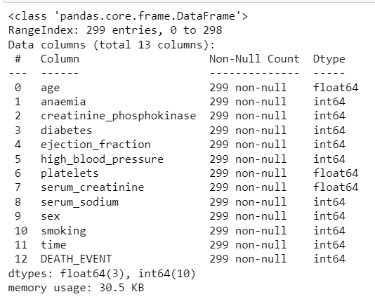
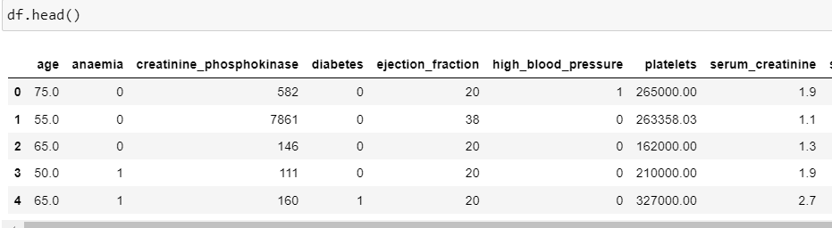
STEPS INVOLVED IN DATA PREPROCESSING
Data Loading and Initial Exploration:
(i) Load the dataset from a CSV file into a Pandas DataFrame. (ii) Use df.info() to get basic information about the DataFrame, including data types and missing values. (iii) Use df.head() to display the first few rows of the dataset to get a sense of its structure

Slide 5
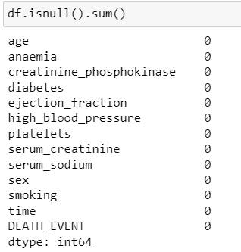
Checking for missing values:
Found no missing values in the dataset.

Slide 6
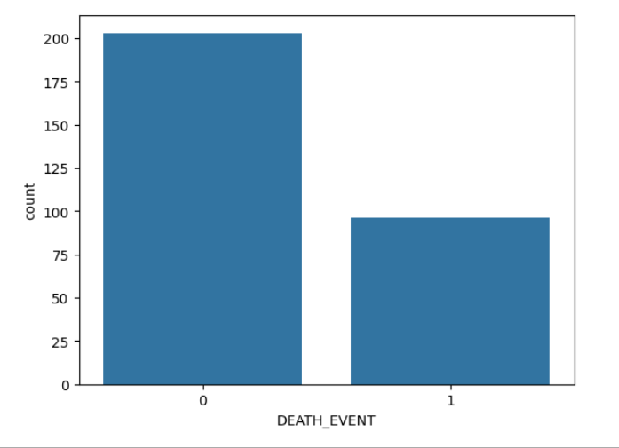
Exploratory Data Analysis
Count plot of the Target Variable(death_event):

Slide 7
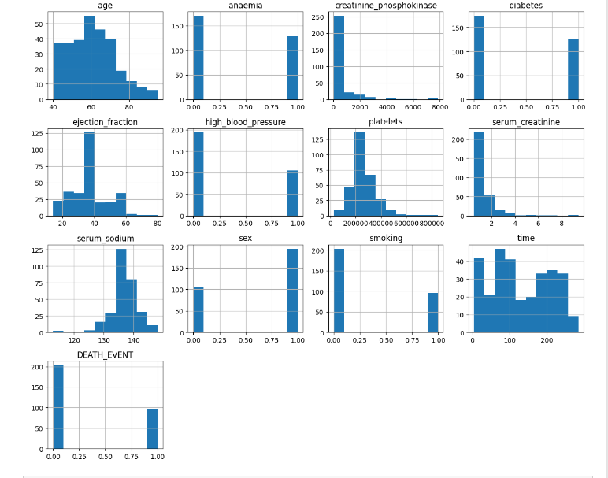
Histplot of all features:

Slide 8
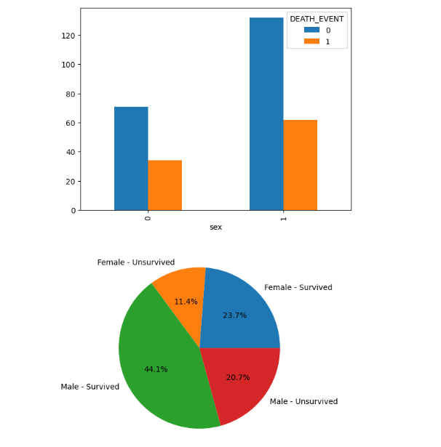
Distribution of Death Events by Gender

Slide 9
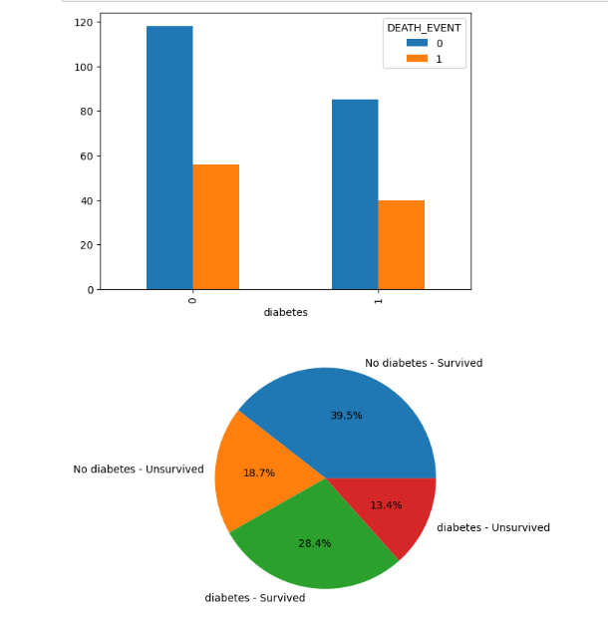
Distribution of Death Events by Diabetes

Slide 10
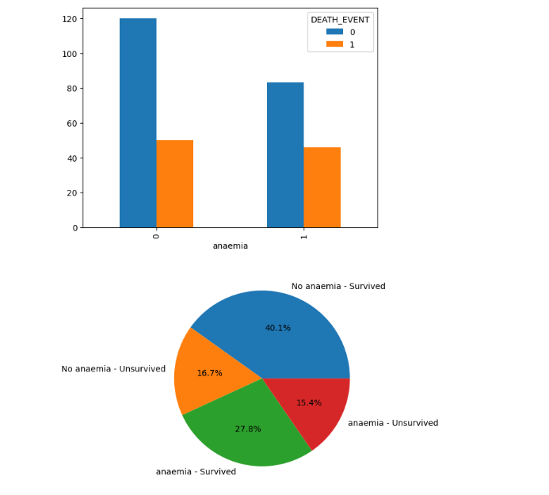
Distribution of Death Events by anaemia

Slide 11
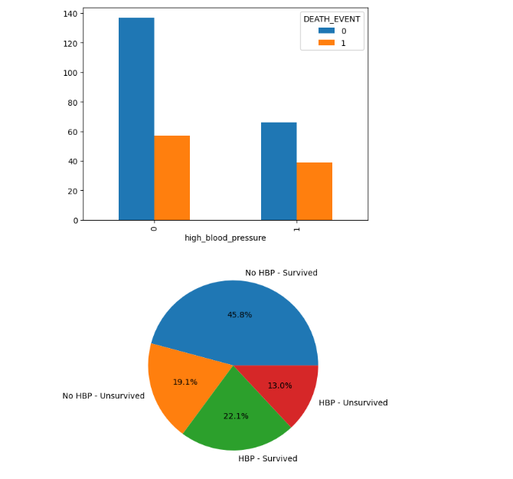
Distribution of Death Events by high_blood_pressure

Slide 12
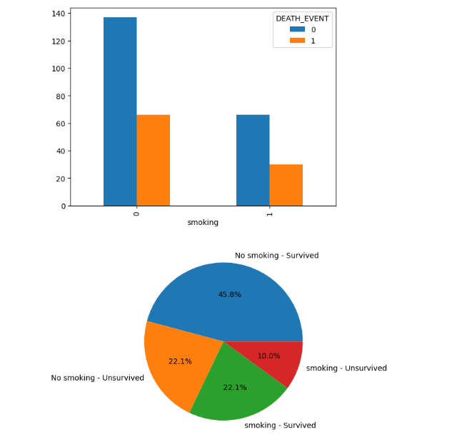
Distribution of Death Events by smoking

Slide 13
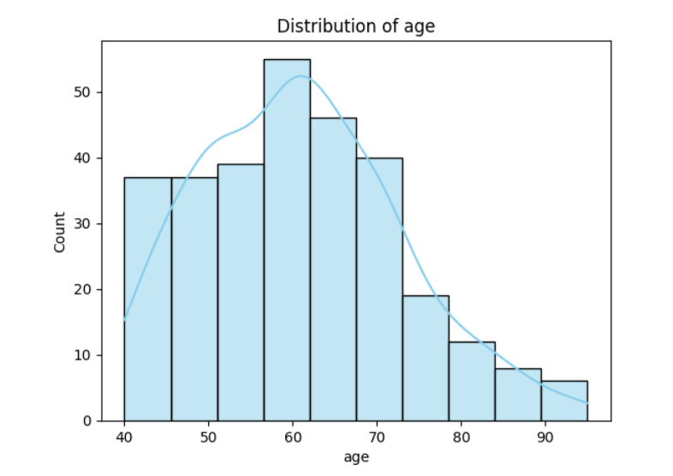
Distribution of Age

Slide 14
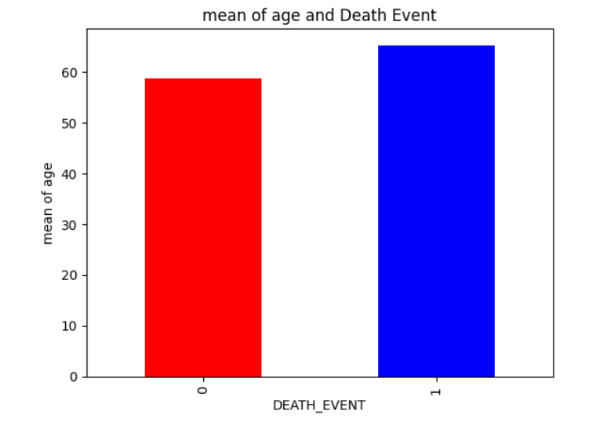
Mean Age by Death Event

Slide 15
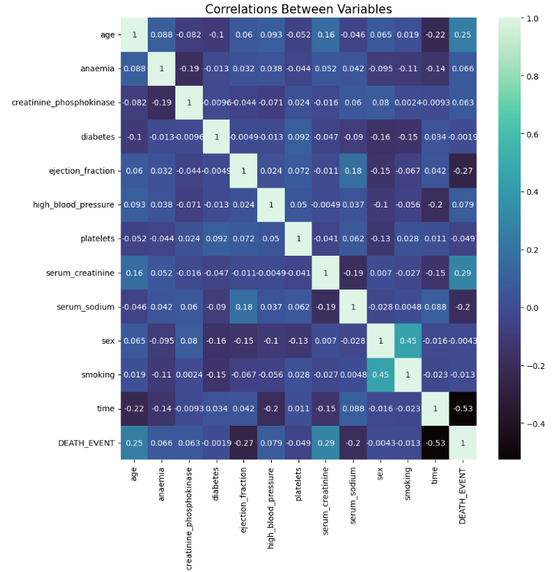
HEATMAP
Correlations between variables.

Slide 16
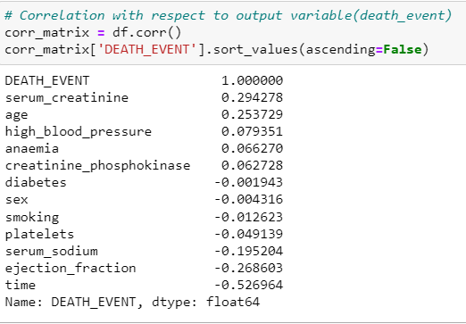
Correlation with respect to output variable(Death_event)

Slide 17
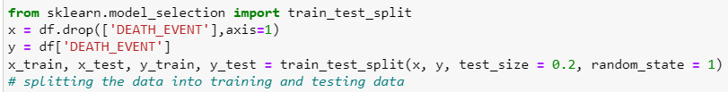
Splitting the Dataset
After performing data preprocessing and EDA, we then split the dataset into training and testing datasets so that, we can use the training dataset to train the data and the testing dataset to evaluate the model performance.

Slide 18

Scaling:
We used Min-Max scaling to normalize the values of our feature variables before applying Machine Learning Models.

Slide 19
Machine Learning Models
After performing data preprocessing and doing exploratory data analysis, we then applied four machine learning, they are Logistic Regression, Decision Tree, Random Forest, and Xgboost.

Slide 20
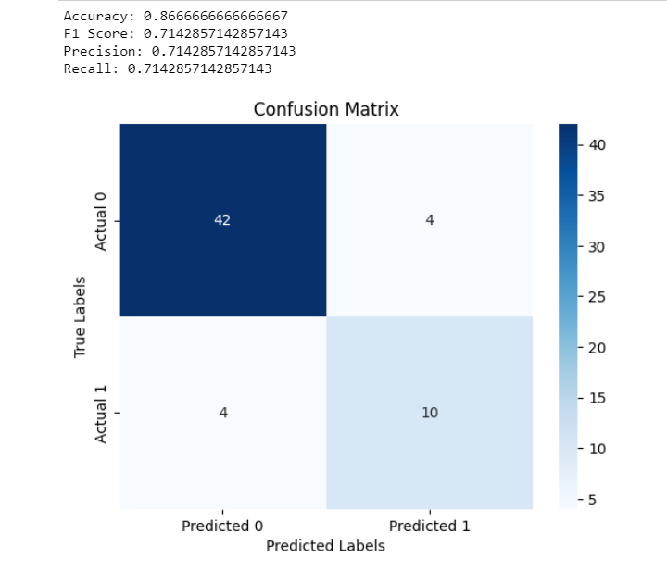
Logistic Regression
RESULTS:
For binary classification issues, logistic regression is utilized. It estimates the likelihood that an instance belongs to a specific class and uses a logistic function to convert expected values to probabilities.

Slide 21
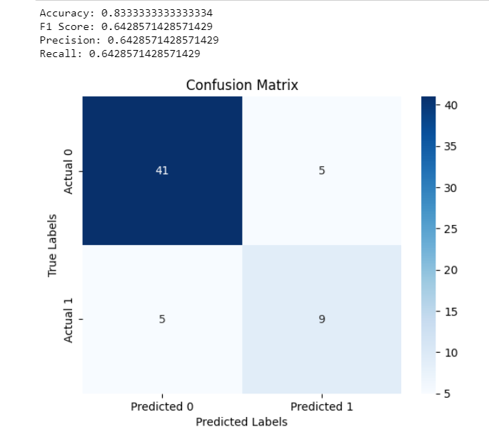
Decision Tree
A tree-like model in which each node indicates a feature-based decision that leads to future nodes or leaves with class labels. Decision trees can handle both classification and regression tasks and are interpretable.

Slide 22
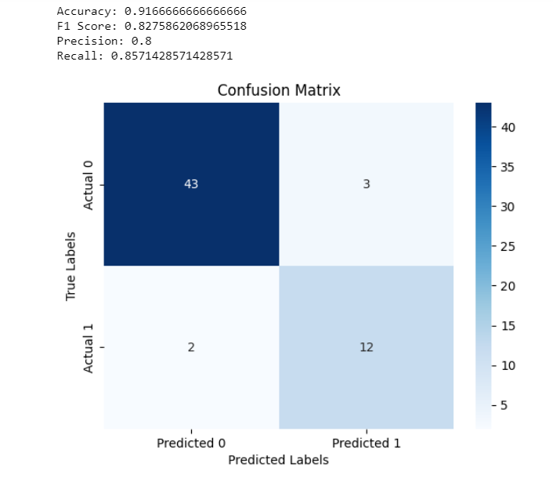
Random Forest
An ensemble learning approach that integrates the predictions of many decision trees. It boosts accuracy and resilience by avoiding overfitting and capturing more complicated data connections.

Slide 23
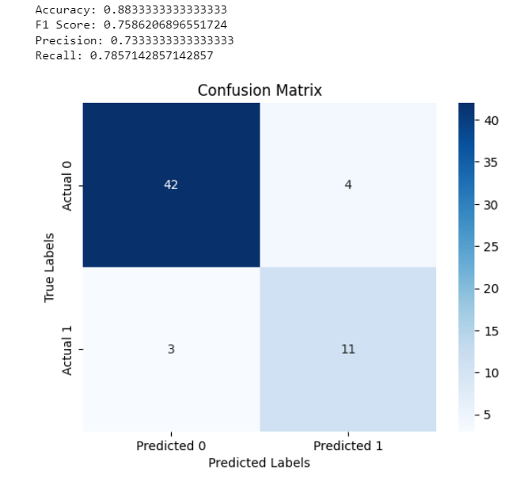
XGBoost
XGBoost is an ML model most commonly used for classification and regression problems. It creates an ensemble of weak learners, often decision trees, progressively, maximizing their contributions for accuracy and resilience.

Slide 24
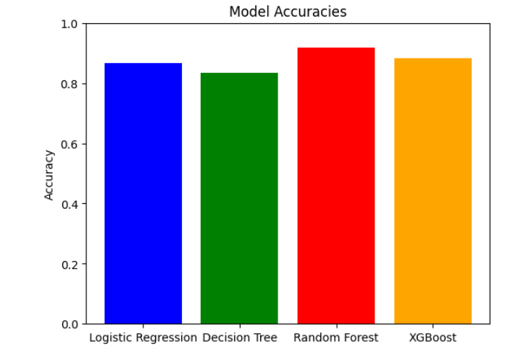
CONCLUSION:
Logistic Regression:Accuracy: 86.67%
.Decision Tree:Accuracy: 83.33%.
Random Forest:Accuracy: 91.67%.
XGBoost:Accuracy: 88.33%
The random forest model stands out for its high accuracy and robust performance.

