Slide 1

MSPM’S Deogiri Institute Of Engineering And Management Studies, Aurangabad Academic Year 2019-20 Department Of Computer Science And Engineering Subject:-Theory Of Computation Topic:-To Convert NFA to DFA by Epsilon Closure Submitted By Pranav Neel (36123) Under The Guidance Of Dr. S. M. Chavan Asst. Prof. Department Of CSE (Deogiri Institute Of Engineering And Management Studies) https://github.com/Pranav192neel/toc

Slide 2
Theory Of Computation
Subject : -To Convert NFA to DFA by Epsilon Closure
Presented By : -
Pranav Neel(36123)

Slide 3
Contents :-
N o n – Deterministic Finite Automata (NFA)
N F A V / S D F A
DFA To Minimal DFA
Epsilon Closure
Code For Conversion from NFA To DFA
Applications of Finite Automata (FA)
Conclusion

Slide 4
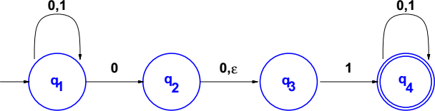
Non-Deterministic Finite Automata (NFA)
an NFA may have more than one transition labeled with a certain symbol an NFA may have no transitions labeled with a certain symbol
transitions may be labeled with ε, the empty string.
NFAs are usually easier to design than equivalent DFAs
Every DFA is also a non-deterministic finite automata (NFA)

Slide 5
NFA
Q = {q₁, q₂, q₃, q₄}, Σ = {0, 1},
 | 0 | 1 | ε
q₁ | {q₁, q₂} | {q₁} | Ø
q₂ | {q₃} | Ø | {q₃}
q₃ | Ø | {q₄} | Ø
q₄ | {q₄} | {q₄} | Ø
δ is
q₁ is the start state, and F = {q₄}.

Slide 6
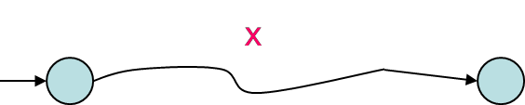
N FA v/s D FA
DFA: For every string x, there is a unique path from initial state and associated with x. x is accepted if and only if this path ends at a final state.
NFA: For any string x, there may exist none or more than one path from initial state and associated with x.

Slide 7
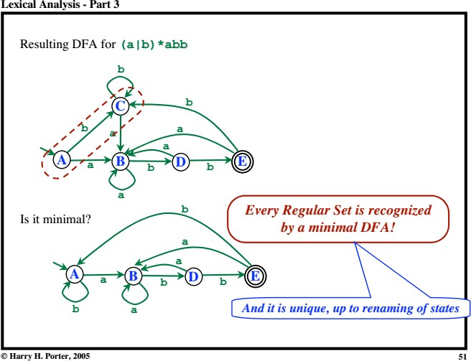
D FA to Minimal D FA

Slide 8
Epsilon Closure
Epsilon closure of a state is simply the set of all states we can reach by following the transition function from the given state that are labeled ε.
Example:
ε-closure(q) = { q }
ε-closure(r) = { r, s}

Slide 9
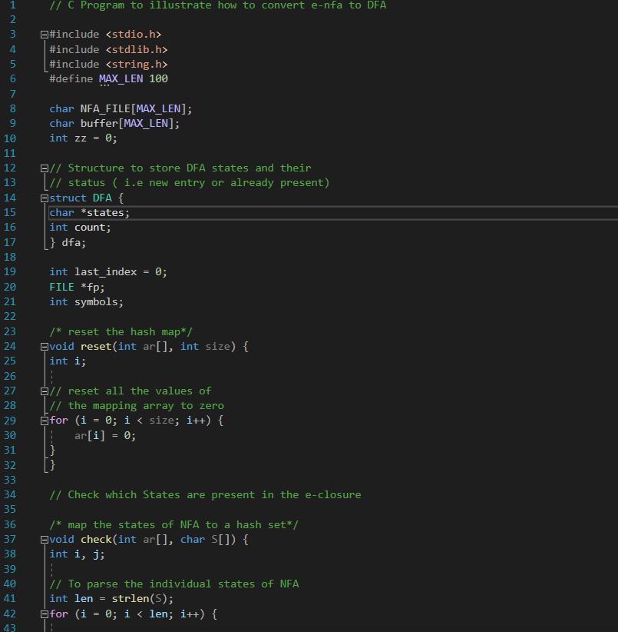
Code For Conversion from NFA To DFA

Slide 10
Applications of Finite Automata (FA):
A finite automata is highly useful to design Lexical Analyzers.
A finite automata is useful to design text editors.
A finite automata is highly useful to design spell checkers.
A finite automata is useful to design sequential circuit design (Transducer).

Slide 11
Conclusion :-
1. Every DFA is NFA but not vice versa. 2. Both NFA and DFA have same power and each NFA can be translated into a DFA. 3. There can be multiple final states in both DFA and NFA. 4. NFA is more of a theoretical concept. 5. DFA is used in Lexical Analysis in Compiler.

