Slide 1

SCHOOL OF ARTIFICIAL INTELLIGENCE​
23AID201
Modelling, Simulation & Analysis
Curse control in Cars
GROUP - 01
1.Pranav Kumar Reddy – CB.AI.U4AID24069
2.Rajesh Kumar Reddy – CB.AI.U4AID24067
3.Dheeraj kumar – CB.AI.U4AID24015
4.Lalith Sagar – CB.AI.U4AID24009
1

Slide 2
Introduction
Cruise control is a fundamental automotive technology that allows vehicles to maintain a constant speed without continuous driver input.
It improves driver comfort on highways, enhances fuel efficiency and reduces fatigue.
The evolution of cruise control demonstrates the growing importance of automation in transportation.
2

Slide 3
Objectives
To design and simulate a closed-loop cruise control system in MATLAB Simulink.
To demonstrate how feedback control (PID/PI) can regulate vehicle speed under varying road and load conditions.
To simulate and analyze system response under different driving conditions, such as slopes, resistive forces, and load variations.
Simulating these in MATLAB/Simulink allows testing of controller robustness before implementation in hardware.
3

Slide 4
Methodology
The vehicle is modeled as a dynamic system using Newton’s laws of motion.
A controller compares the actual vehicle speed with the desired speed (reference) and adjusts the throttle force accordingly.
Implemented in MATLAB Simulink, which allows block-based modeling of plant dynamics, controller design and closed-loop simulation.
Disturbances such as road slope or drag force can be added to test system robustness.
4

Slide 5
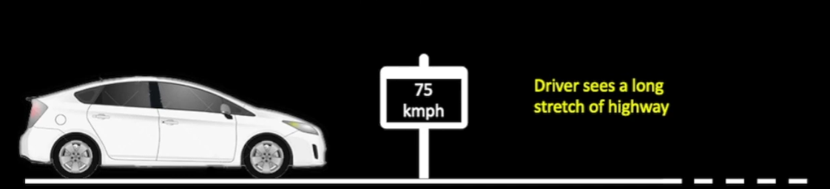
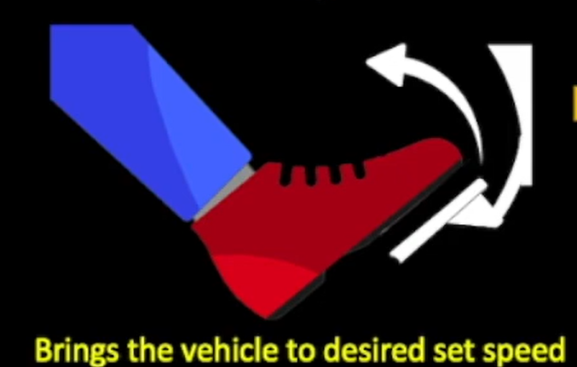
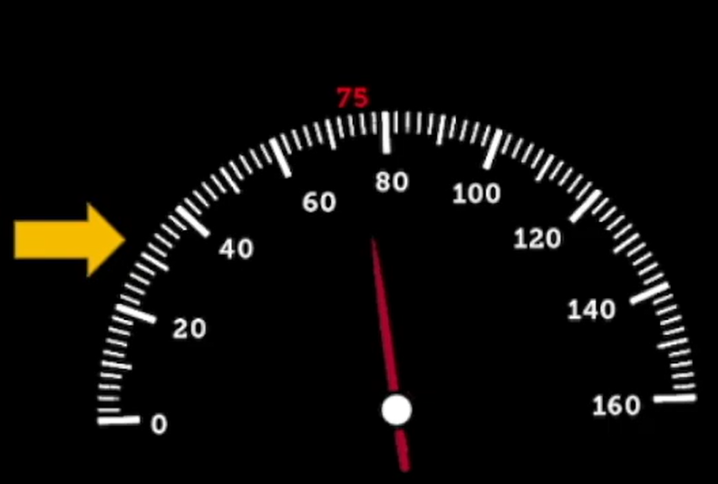
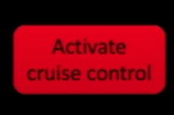
5

Slide 6
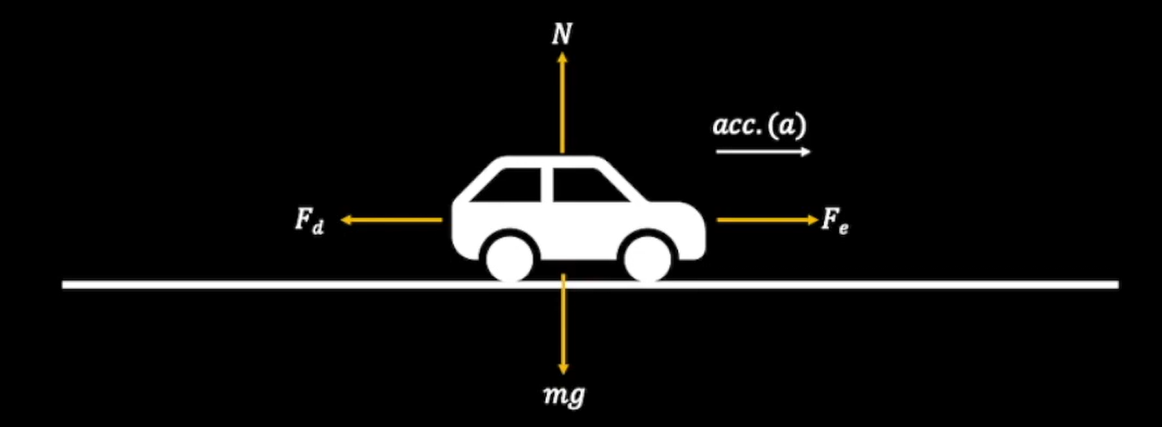
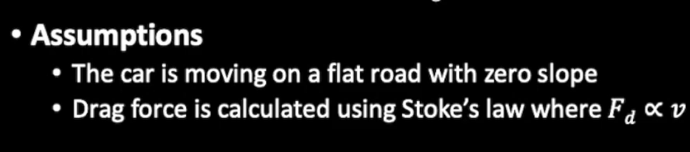
Mg- Force due to gravity.
N- Normal Reaction.
Fe- Engine Force.
Fd- Drag Force.
6

Slide 7
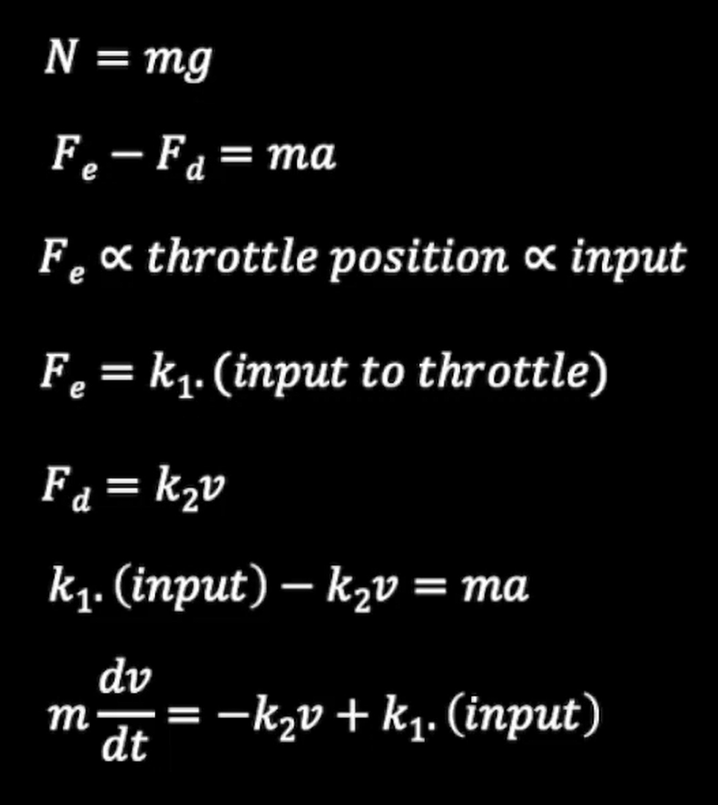
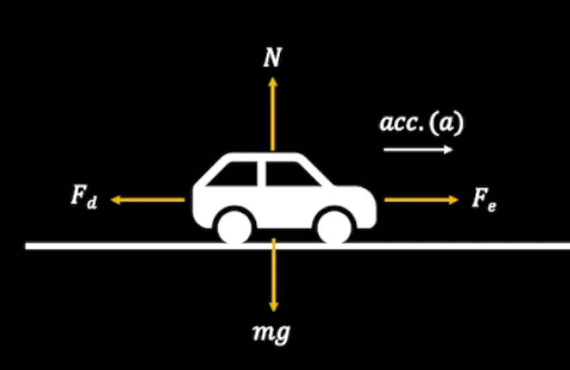
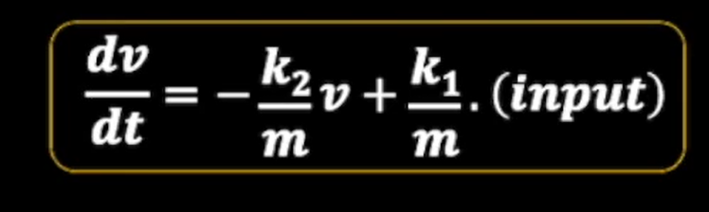
Vehicle dynamics are expressed as a first-order differential equation representing the balance between driving force, resistive forces, and inertia.
7

Slide 8
Conclusion
The system should be able to maintain the desired set speed under different conditions and disturbance.
Disturbances such as road slope or drag force can be added to test system robustness.
8

Slide 9
THANK YOU!!
9

