Slide 1


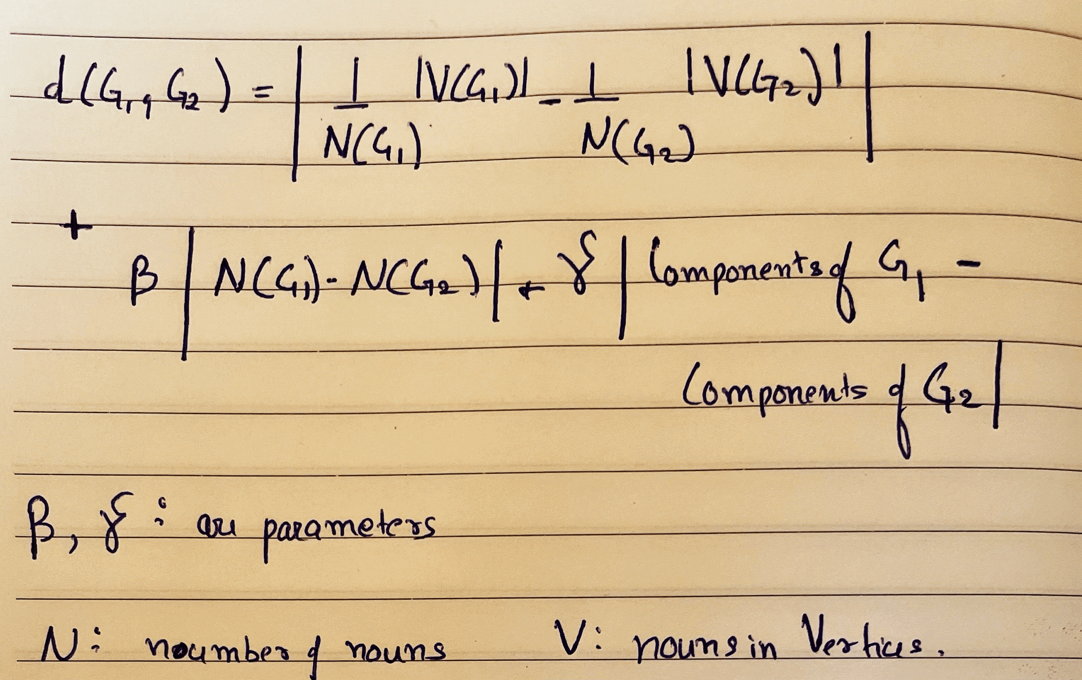
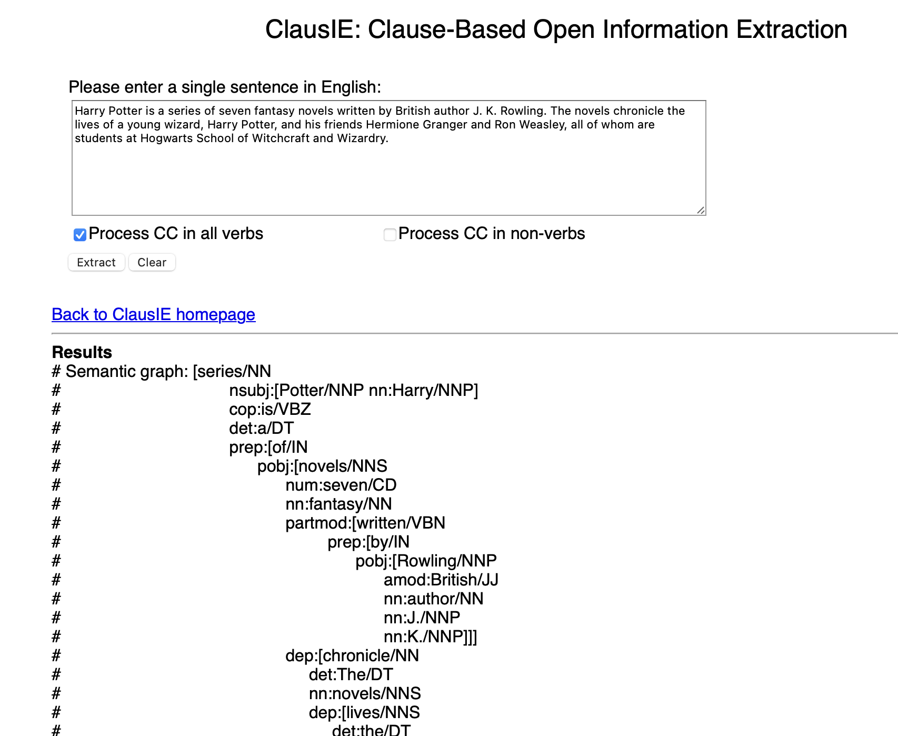
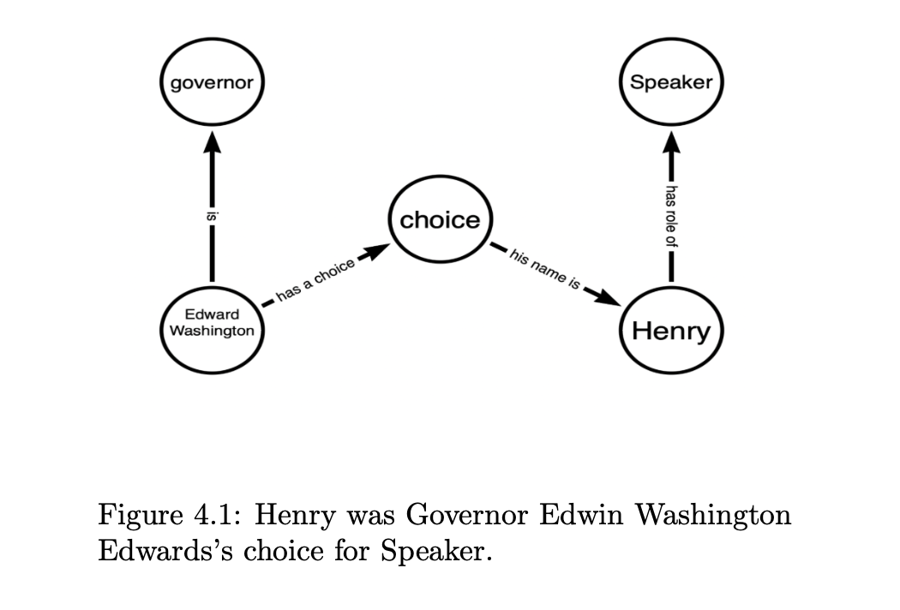
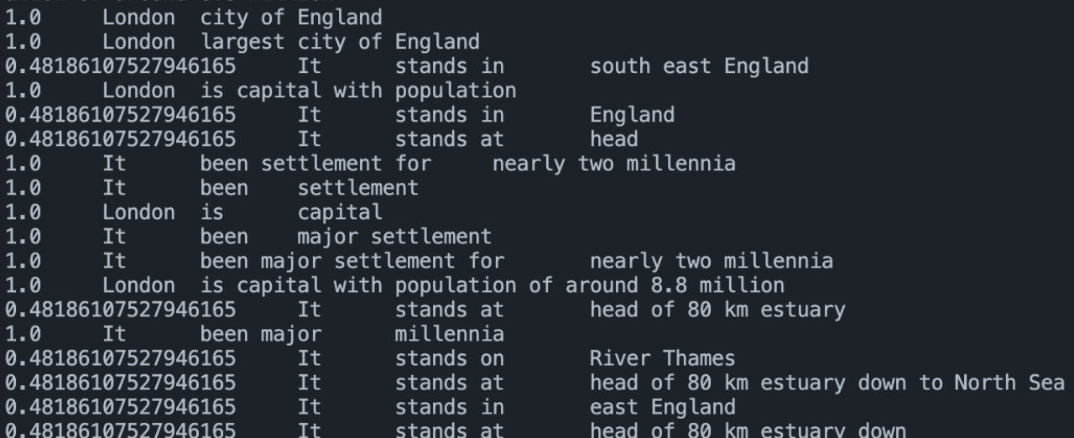

Knowledge Graph Quality Metrics
Dr. Raghava Mutharaju Pranav Sharma
Indraprastha Institute of Information and Technology
Literature Review
Abstract
Empirical Research
Analysis
Assessment Factors in OIE Model Performance:
Factors considered in the evaluation include the number of extracted triplets, ensuring a quantitative measure of extraction performance.
The completeness of sentence coverage is evaluated, providing insights into how well each model captures information from the input text.
The accuracy of extracted relationships is a key parameter in assessing the quality of information extraction by the OIE models.
Noun-Based Node Transformation for Entity Recognition:
The study goes beyond triplet comparison by considering the transformation of nouns into nodes within the extracted triplets.
This transformation aims to provide insights into the effectiveness of each OIE model in identifying and representing entities within the text.
Identification of Entity Recognition Capabilities:
By comparing the number of noun-based nodes across different models, the study aims to identify potential advantages or limitations in entity recognition capabilities.
In the burgeoning field of knowledge representation, the construction and maintenance of high- quality knowledge graphs (KG’s) play a pivotal role in ensuring the accuracy and reliability of information.
This research endeavors to establish a comprehensive framework for assessing the quality of knowledge graphs, introducing novel matrices and metrics tailored to capture the intricacies of knowledge representation.
Our approach involves the development of quantifiable measures that evaluate aspects such as completeness, consistency, accuracy, and contextual relevance within a knowledge graph.
Now after getting to know all the different types of graphs and their role, the main point of this research is to get to know some distance or we can say some metrics for measuring the quality of graphs and then to label as in which Information extraction algorithm is more accurate and better than others.
This First one is Stanford IE, it is an open-source Java implementation of an Open Information Extraction (OIE) system developed by the Stanford Natural Language Processing Group. It is a tool that extracts relation triples, typically binary relations, from plain text.
Then ClausIE is a novel approach to open information extraction (OIE) that extracts relations and their arguments from natural language text. ClausIE differs from traditional OIE systems in that it operates at the clause level, rather than the sentence level. This allows ClausIE to capture more fine-grained information about the relationships between entities.
OpenIE6 is a state-of-the-art open information extraction (OIE) system that utilizes an iterative grid labeling and coordination analysis approach. It excels in extracting comprehensive and accurate relation triples from natural language text.
The comparison of the hand developed graphs with the graphs developed by IE models lead us to finalise some relation between the quality of the graphs.
the first metrics was to count the number of triplets develoeped which was further ruled out by more precise relation developed, which is represented by the mathematical relation as follow.
Background Study
the first term represents how much separated the data is and how efficiently the nodes are containing the data.
second term gives a brief description of much complete is graphs as in how much information does it contains with reference to ideal graph or the main sentence.
the third term here gives the completeness of edge relation.
Evaluating the quality of KGs poses challenges due to the absence of a single metric that comprehensively assesses all aspects.
Evaluation of IE algorithms involves comparing them to an ideal KG, characterized by completeness, consistency, and accuracy.
Practical challenges in creating a perfect KG lead researchers to use approximations, such as manually curated KGs or those extracted from gold standard datasets.
Methods for KG Quality Assessment:
Researchers evaluate the quality of KGs by not only comparing IE algorithms to an ideal KG but also employing various other methods.
Evaluation methods include human expert assessments, automated tools for quality assessment, and real-world application testing to gauge the impact of KGs.
Conclusion
after proving the three distance axioms, that are
d(G1, G1) = 0
d(G1, G2)+ d(G2, G3) >= D(G1, G3)
D(G1, G2) = D(G2, G1)
we can say that we have relation that can get distance between any two graphs numerically.
By incorporating these multiple metrics, the proposed framework provides a comprehensive and rigorous approach to evaluating the quality of KGs extracted from IE algorithms. This approach can help identify the strengths and weaknesses of different OIE models.
SCAN QR to meet the Project Supervisor
Copyright © IIITD 2023, ALL RIGHTS RESERVED

