Slide 1

HR Attrition Analysis & Prediction System
Name: Pranav Patil
Role: Data Analyst / ML Enthusiast
Tools: Python, SQL, Machine Learning, Streamlit, FastAPI

Slide 2




Understanding the Attrition Challenge
What is Employee Attrition?
Costly for Organizations
High attrition leads to significant expenses in recruitment, training, and lost productivity.
The voluntary or involuntary departure of employees from an organization.
Importance of Early Prediction
Proactive identification allows for timely intervention, improving retention and reducing costs.

Slide 3

Project Objectives: A Strategic Approach
01
02
Analyze Attrition Patterns
Identify Key Drivers
Deep dive into historical data to uncover trends and behaviors.
Pinpoint the most influential factors contributing to employee turnover.
03
04
Build Predictive Models
Deploy Interactive System
Develop robust machine learning models for accurate attrition forecasting.
Create a user-friendly tool for HR to assess attrition risk in real-time.

Slide 4

Dataset Overview: The Foundation of Our Analysis
1
HR Employee Dataset
Comprehensive data capturing various employee attributes.
2
Records & Features
Approximately 1,500 records with 35 descriptive features.
3
Target Variable
Attrition: Binary classification (Yes / No).
4
Data Types Utilized
Numerical, categorical, and ordinal data types processed.

Slide 5





Data Cleaning & Preparation: Ensuring Data Quality
Handling Missing Values
Feature Selection
Strategically imputed or removed to maintain data integrity.
Identified and prioritized features most relevant to attrition.
Encoding Categorical Variables
Train-Test Split
Transformed qualitative data into numerical format for model compatibility.
Stratified split to ensure representative distribution of the target variable.

Slide 6
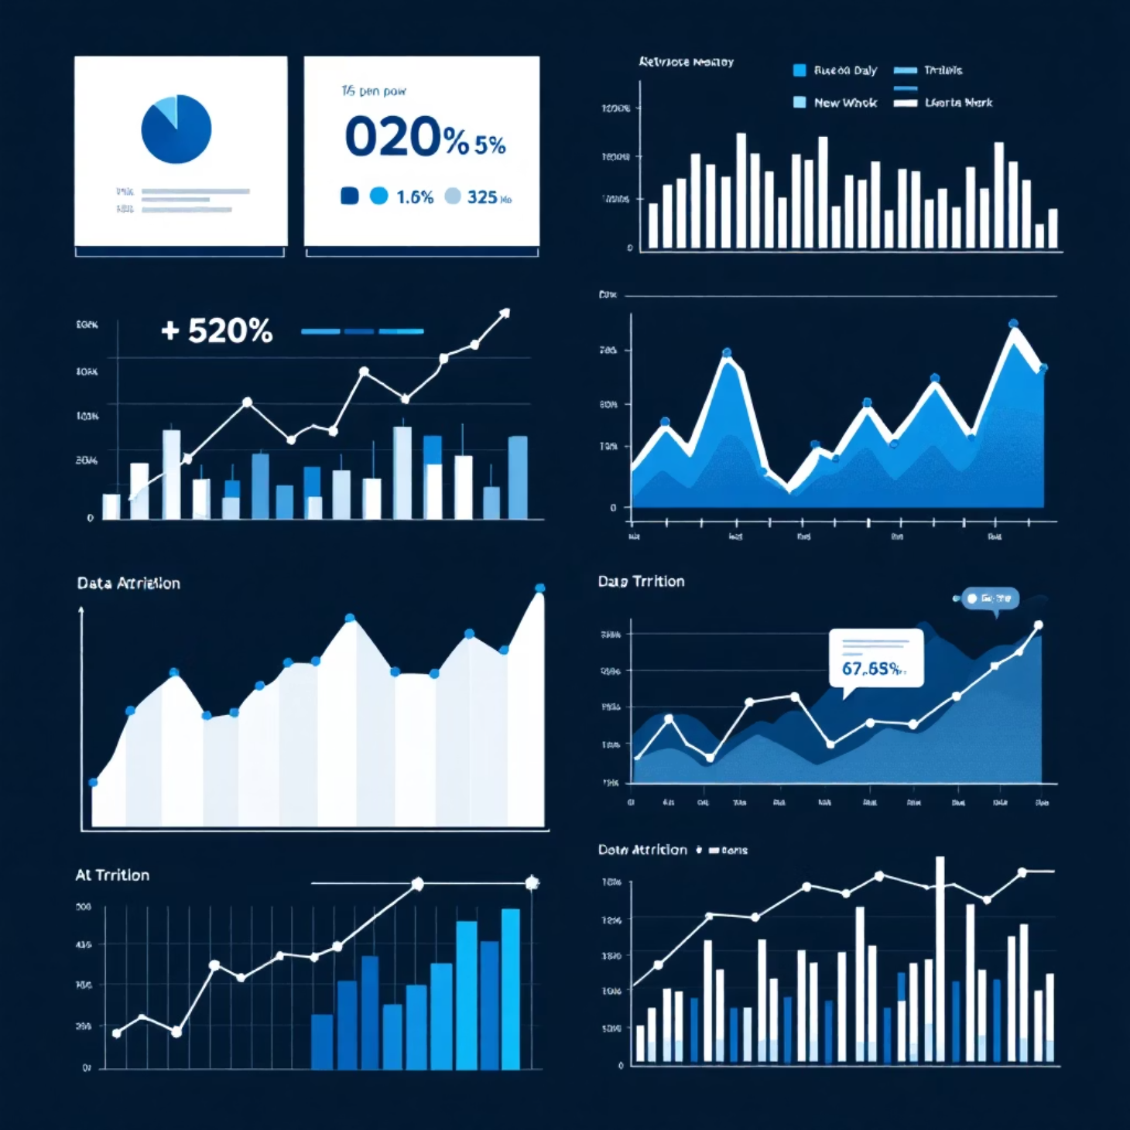
Exploratory Data Analysis (EDA): Uncovering Insights
Key Observations
Attrition Distribution: Uneven class distribution observed, indicating imbalance.
Years at Company: Employees with fewer years show higher attrition rates.
Job Satisfaction: Lower satisfaction strongly correlates with increased attrition.
Work-Life Balance: Poor balance is a significant predictor of employee departure.

Slide 7

SQL Analysis: Business Insights from Raw Data
SQL for Business Insights
Sample Queries
Leveraged SQL to extract and aggregate key data points for trend analysis.
Queries focused on department-wise attrition, salary-level attrition, and average tenure.
Analysis Workflow Role
SQL served as the initial data exploration and aggregation layer, informing feature engineering.

Slide 8

Machine Learning Models: Predicting Attrition
Logistic Regression
A strong baseline model for binary classification, providing interpretable coefficients.
Decision Tree
Captures non-linear relationships and interactions between features, easy to visualize.
Random Forest
Ensemble method mitigating overfitting and improving generalization through multiple trees.
Why Multiple Models?
To compare performance, identify robust patterns, and leverage diverse algorithmic strengths.

Slide 9



Model Evaluation Strategy: Beyond Accuracy
75%
80%
77%
Precision
Recall
F1-Score
Proportion of correctly identified attrition cases among all predicted positive.
Proportion of actual attrition cases correctly identified by the model.
Harmonic mean of Precision and Recall, balancing both metrics.
Due to class imbalance, accuracy can be misleading. Focusing on Precision, Recall, and F1-score provides a more comprehensive evaluation, with Recall being critical for early warning systems to minimize missed attrition cases.

Slide 10
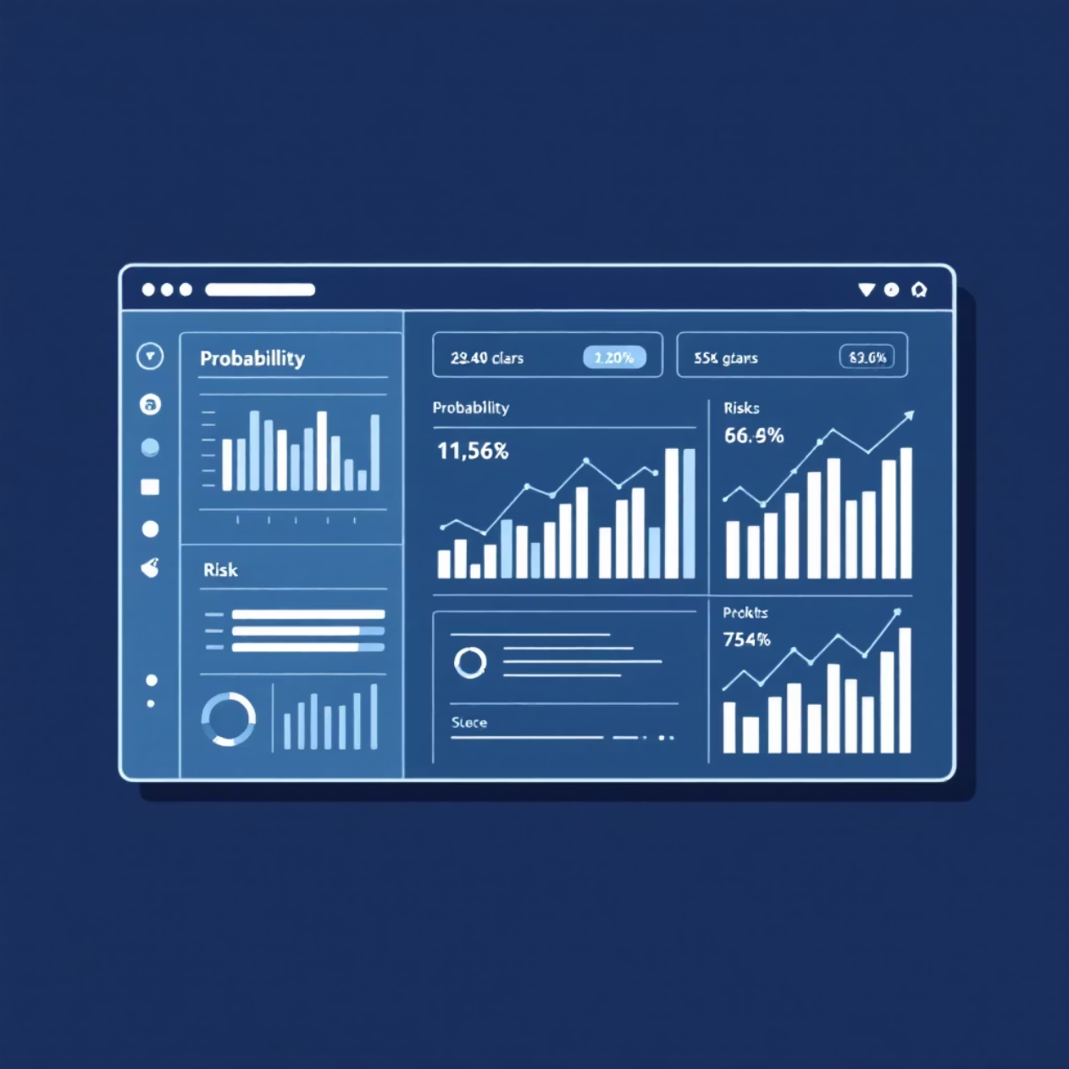
Threshold & Business Logic: Practical Application
Probability-Based Prediction
Models output a probability score, indicating the likelihood of attrition.
Custom Threshold (0.25)
A lower threshold prioritizes identifying potential attrition cases earlier.
Trade-off: Recall vs. Precision
Optimized for higher recall at the expense of some precision, ensuring fewer false negatives.
Business Reasoning
An early warning allows HR to intervene proactively, even if some predictions are false positives. The cost of a false negative (losing an employee) outweighs the cost of a false positive (unnecessary intervention).

Slide 11

Thank You!
I appreciate your time and attention to this presentation on HR Attrition Analysis & Prediction.
For any questions or further discussion, please feel free to reach out.
Name: Pranav Patil
Role: Data Analyst / ML Enthusiast
Contact: patil7757pranav@gmail.com

