Slide 1

PROJECT TITLE
ML PROJECT | CSE | SECTION 4
SPAM EMAIL
CLASSIFICATION
Machine Learning project focused on detecting spam and ham messages using supervised text classification.
COURSE
MACHINE LEARNING
USING NAIVE BAYES
AND SUPPORT VECTOR
MACHINE
COURSE CODE
25SC2107E
BRANCH
CSE
SECTION
4
PROJECT MEMBERS- K. Pranav — 2520030477
Abhay Tripathi — 3520030353
GUIDED BY: Ms. Jyothsna Datti
DEPARTMENT OF COMPUTER SCIENCE & ENGINEERING
A.Y. 2026–27

Slide 2
ABSTRACT
ML PROJECT | CSE | SECTION 4
Spam classification is an important machine learning application for improving digital communication security and reducing unwanted, misleading and fraudulent messages. This project uses the spam.csv dataset containing labelled ham and spam text messages. The main objective is to build an automated classification framework that can distinguish legitimate messages from spam using natural language preprocessing, feature extraction and supervised machine learning.
PROJECT
ABSTRACT
The text is cleaned and transformed into numerical vectors using CountVectorizer and TF-IDF. Naive Bayes and Support Vector Machine are then trained and compared using Accuracy, Precision, Recall, F1-Score and Confusion Matrix. The expected outcome is an efficient and interpretable model that reduces false spam detection while improving reliable message filtering.
5,572 RAW MESSAGES
2 CLASSES
TF-IDF FEATURES
NB/SVM MODELS
SPAM EMAIL CLASSIFICATION USING NAIVE BAYES AND SUPPORT VECTOR MACHINE
A.Y. 2026–27

Slide 3
INTRODUCTION TO THE PROJECT
ML PROJECT | CSE | SECTION 4
WHY SPAM
DETECTION?
ML WORKFLOW
The project follows a standard text-classification pipeline. The raw message is cleaned, converted into numerical vectors using CountVectorizer and TF-IDF, and then passed to Naive Bayes and Support Vector Machine classifiers. Comparing these models helps identify which method gives stronger spam detection with lower false positives and false negatives.
Unsolicited bulk messages affect productivity, storage management and cyber security. Spam messages often include advertisements, phishing attempts, fraudulent links and misleading content. Since the volume of digital messages is high, manual filtering is slow and unreliable. Therefore, an automated machine learning approach is useful for identifying suspicious text patterns and separating spam from legitimate messages.
TEXT
→
CLEAN
→
VECTORIZE
→
CLASSIFY
→
OUTPUT
SPAM EMAIL CLASSIFICATION USING NAIVE BAYES AND SUPPORT VECTOR MACHINE
A.Y. 2026–27

Slide 4
REQUIREMENT ANALYSIS
ML PROJECT | CSE | SECTION 4
REQUIREMENTS
SPECIFICATIONS
Operating System & IDE
Windows 10/11 or Ubuntu Linux; Jupyter Notebook, Google Colab or Visual Studio Code
Programming & Libraries
Python 3.10+, Scikit-learn, Pandas, NumPy, Matplotlib and Seaborn
Dataset & Storage
spam.csv dataset containing labelled ham/spam text messages; CSV-based storage
ML Pipeline
Text cleaning, CountVectorizer / TF-IDF Vectorizer, Naive Bayes and Support Vector Machine
Evaluation & Hardware
Accuracy, Precision, Recall, F1-Score and Confusion Matrix; 4 GB RAM minimum; GPU not required
SPAM EMAIL CLASSIFICATION USING NAIVE BAYES AND SUPPORT VECTOR MACHINE
A.Y. 2026–27

Slide 5
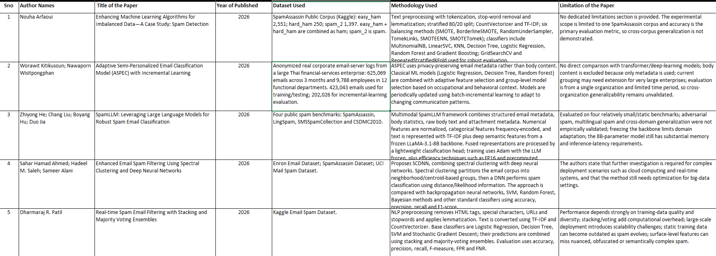
LITERATURE REVIEW – PART 1
ML PROJECT | CSE | SECTION 4
PAPERS 1–5
Literature papers are grouped exactly like the Excel sheet: five studies per slide, showing authors, title, year, dataset, methodology and limitation.
SPAM EMAIL CLASSIFICATION USING NAIVE BAYES AND SUPPORT VECTOR MACHINE
A.Y. 2026–27

Slide 6
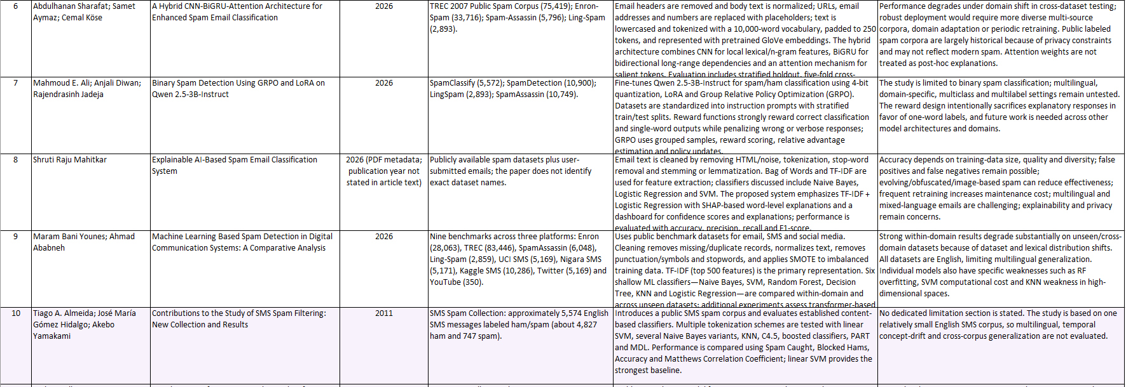
LITERATURE REVIEW – PART 2
ML PROJECT | CSE | SECTION 4
PAPERS 6–10
SNO
AUTHORS
TITLE
YEAR
DATASET
METHODOLOGY
LIMITATION
Literature papers are grouped exactly like the Excel sheet: five studies per slide, showing authors, title, year, dataset, methodology and limitation.
SPAM EMAIL CLASSIFICATION USING NAIVE BAYES AND SUPPORT VECTOR MACHINE
A.Y. 2026–27

Slide 7
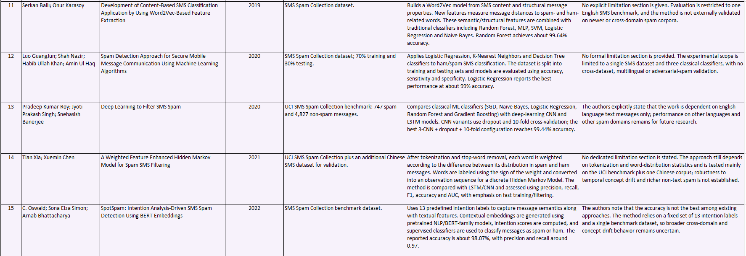
LITERATURE REVIEW – PART 3
ML PROJECT | CSE | SECTION 4
PAPERS 11–15
SNO
AUTHORS
TITLE
YEAR
DATASET
METHODOLOGY
LIMITATION
Literature papers are grouped exactly like the Excel sheet: five studies per slide, showing authors, title, year, dataset, methodology and limitation.
SPAM EMAIL CLASSIFICATION USING NAIVE BAYES AND SUPPORT VECTOR MACHINE
A.Y. 2026–27

Slide 8
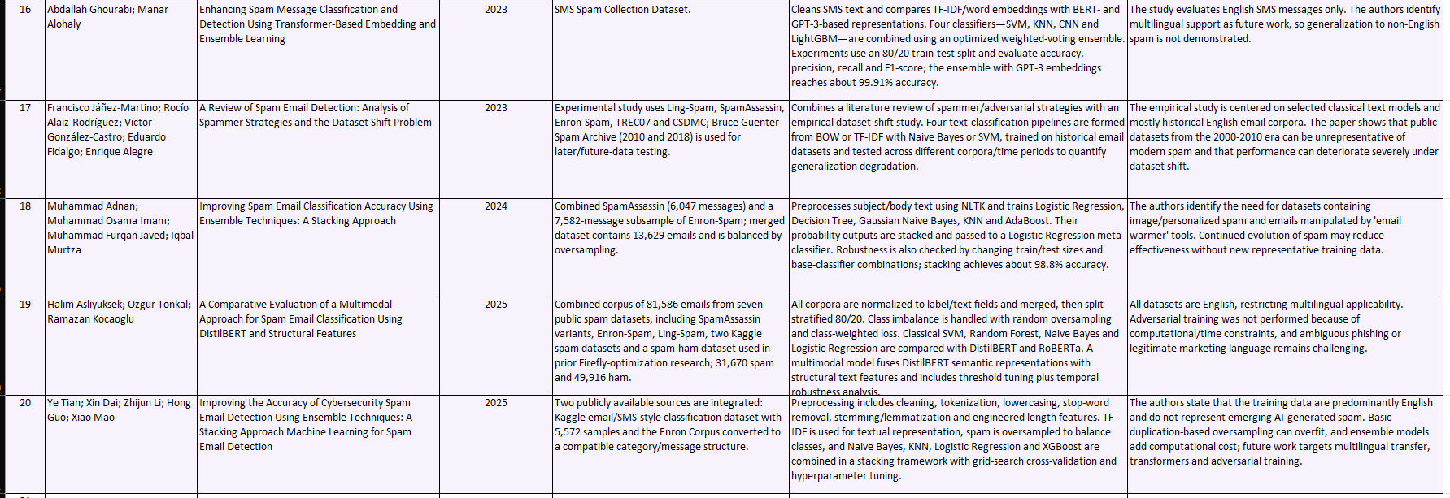
LITERATURE REVIEW – PART 4
ML PROJECT | CSE | SECTION 4
PAPERS 16–20
SNO
AUTHORS
TITLE
YEAR
DATASET
METHODOLOGY
LIMITATION
Literature papers are grouped exactly like the Excel sheet: five studies per slide, showing authors, title, year, dataset, methodology and limitation.
SPAM EMAIL CLASSIFICATION USING NAIVE BAYES AND SUPPORT VECTOR MACHINE
A.Y. 2026–27

Slide 9
EXPLORATORY DATA ANALYSIS
ML PROJECT | CSE | SECTION 4
DATASET
OVERVIEW
CLEANING
PROCESS
PROPERTY
VALUE
Keep only label and message text columns.
Rename v1 to label and v2 to message.
Remove empty unnamed columns and duplicate rows.
Create length, word, digit, uppercase and punctuation features.
Prepare the dataset for vectorized classification.
Raw shape
5,572 × 5
Useful columns
v1, v2
Target
ham / spam
Duplicates
403
Clean rows
5,169
EDA confirms that the dataset is suitable for a text-classification pipeline and reveals the class imbalance that must be considered during evaluation.
SPAM EMAIL CLASSIFICATION USING NAIVE BAYES AND SUPPORT VECTOR MACHINE
A.Y. 2026–27

Slide 10
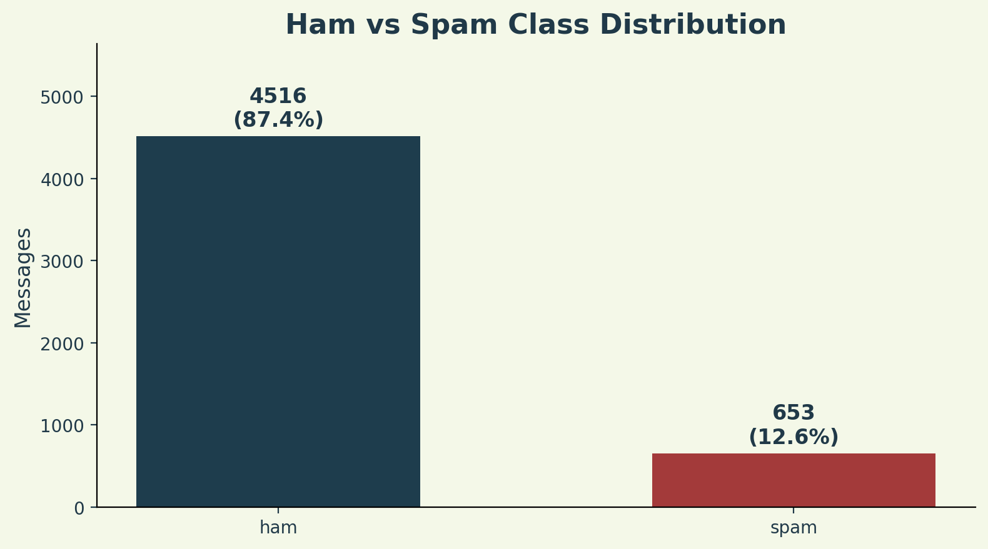
EDA – CLASS DISTRIBUTION
ML PROJECT | CSE | SECTION 4
HAM VS
SPAM
After cleaning, the dataset contains 4,516 ham messages and 653 spam messages. This shows clear class imbalance, with ham messages being much more frequent than spam messages.
4,516 HAM MESSAGES
653 SPAM MESSAGES
87:13 APPROX. RATIO
Because of imbalance, Precision, Recall and F1-Score are more meaningful than Accuracy alone.
SPAM EMAIL CLASSIFICATION USING NAIVE BAYES AND SUPPORT VECTOR MACHINE
A.Y. 2026–27

Slide 11
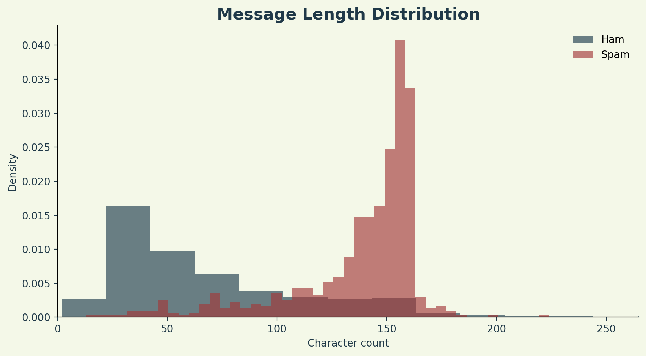
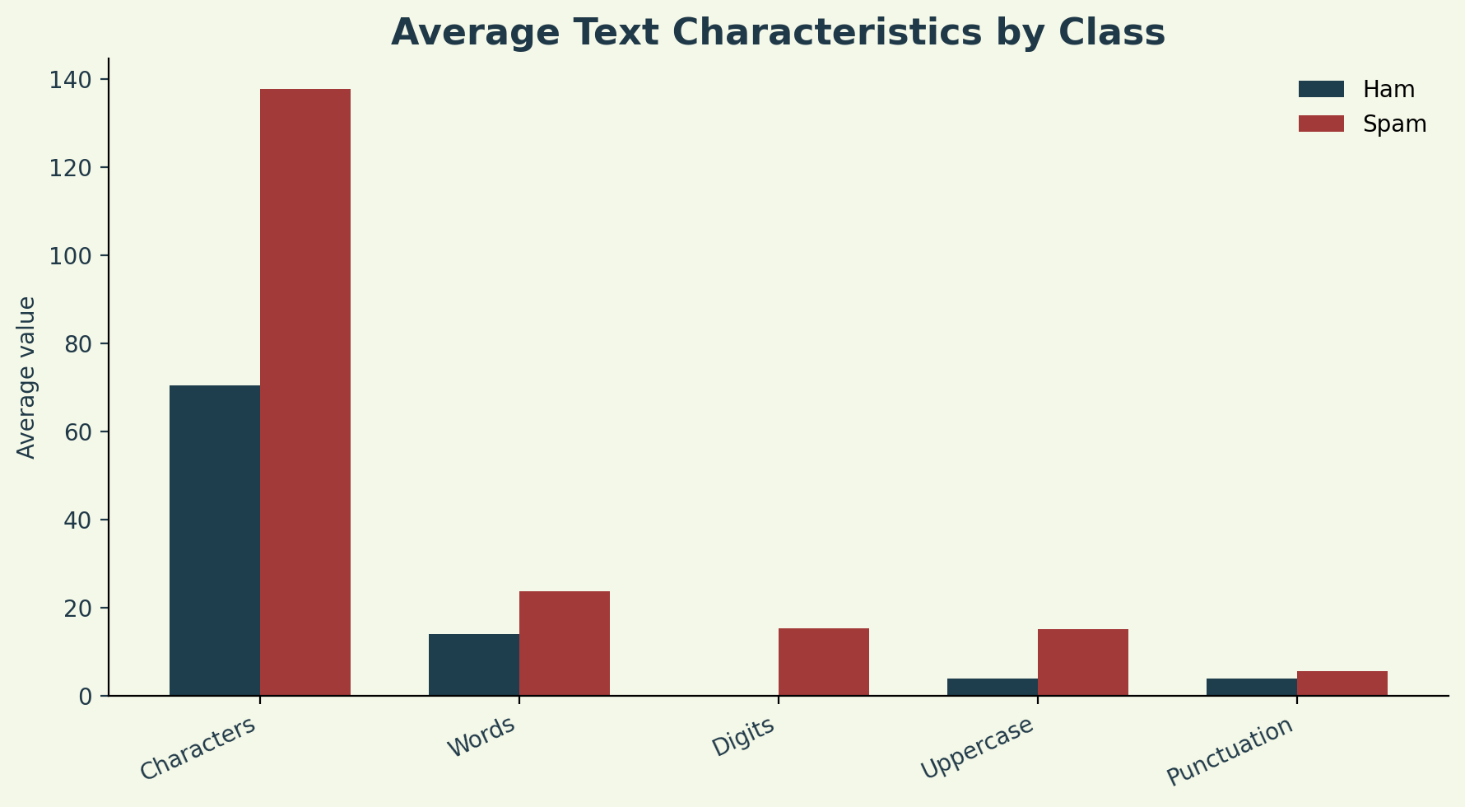
EDA – TEXT CHARACTERISTICS
ML PROJECT | CSE | SECTION 4
Spam messages generally show stronger text signals such as longer length, more digits, more uppercase characters and more punctuation. These engineered features make EDA meaningful for an NLP dataset.
SPAM EMAIL CLASSIFICATION USING NAIVE BAYES AND SUPPORT VECTOR MACHINE
A.Y. 2026–27

Slide 12
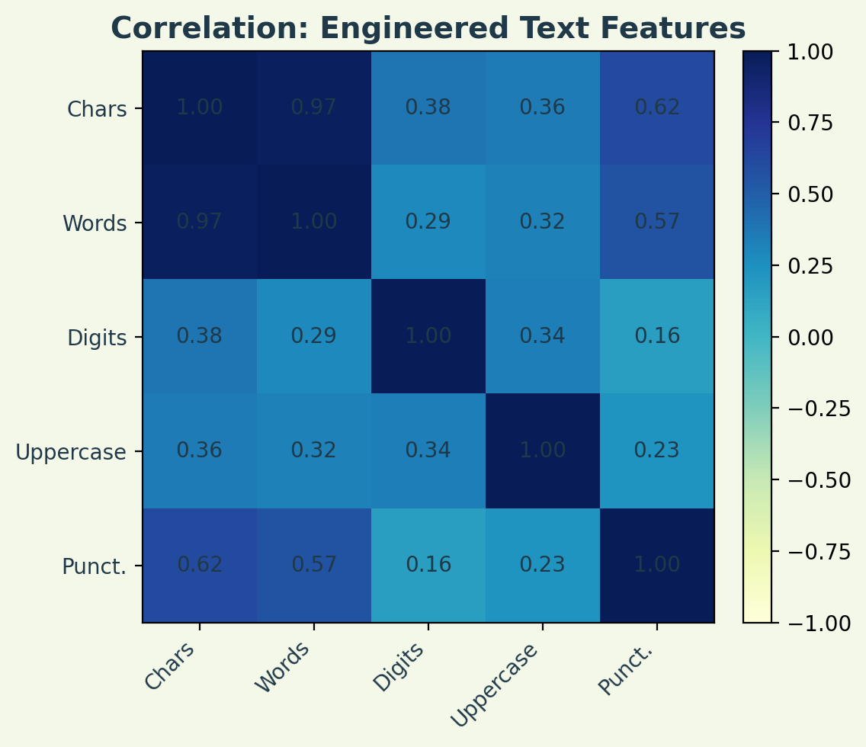
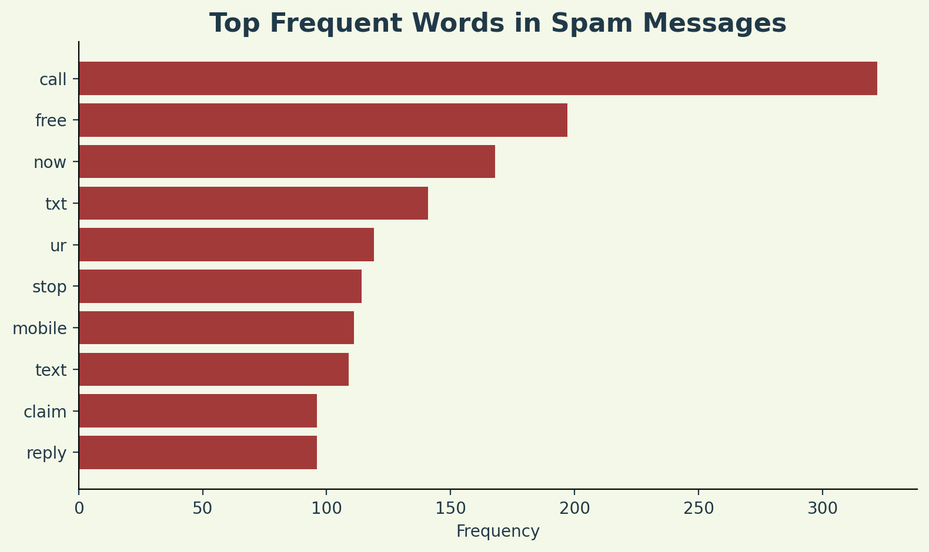
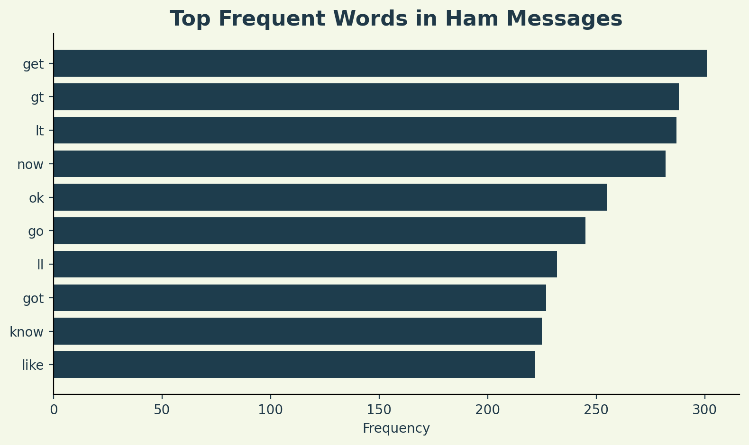
EDA – WORDS AND CORRELATION
ML PROJECT | CSE | SECTION 4
Frequent-word analysis highlights vocabulary differences between ham and spam. The correlation heatmap is calculated only on engineered numerical text features, making it valid for this text-based dataset.
SPAM EMAIL CLASSIFICATION USING NAIVE BAYES AND SUPPORT VECTOR MACHINE
A.Y. 2026–27

Slide 13
DATASET DESCRIPTION
ML PROJECT | CSE | SECTION 4
PROJECT
DATASET
WHY IT
FITS
Dataset file: spam.csv
Raw records: 5,572 labelled messages
Clean records after duplicate removal: 5,169
Main columns: label and message
Labels: ham and spam
Storage format: CSV
The dataset is suitable for supervised machine learning because every message has a known ham/spam label. Its short text format makes it ideal for preprocessing, vectorization and comparison of Naive Bayes and SVM models. The class imbalance also makes the project academically useful because it requires careful evaluation beyond simple accuracy.
CSV STORAGE
2 CLASSES
5,169 CLEANED ROWS
NLP PROBLEM TYPE
SPAM EMAIL CLASSIFICATION USING NAIVE BAYES AND SUPPORT VECTOR MACHINE
A.Y. 2026–27

Slide 14
CONCLUSION
ML PROJECT | CSE | SECTION 4
CONCLUSION
This project demonstrates how machine learning can be used to classify spam and ham messages from labelled text data. The EDA phase identifies important dataset characteristics such as missing values, duplicates, class imbalance, message length patterns and frequent words. The literature review shows that spam classification has progressed from classical TF-IDF and Naive Bayes models to ensembles, transformers and LLM-based approaches.
Overall, the project provides a clear and practical workflow: clean the text, transform it into numerical vectors, train Naive Bayes and SVM models, and evaluate them using Precision, Recall, F1-Score and Confusion Matrix. The final system can support safer digital communication by detecting unwanted spam messages efficiently.
THANK YOU
SPAM EMAIL CLASSIFICATION USING NAIVE BAYES AND SUPPORT VECTOR MACHINE
A.Y. 2026–27

