Slide 1
Project Title
Exploratory Data Analysis and Visualization of Zepto Product Dataset
Pranav Hinge (SRN: 31241130)
Guided by: Dr. Jagadish Tawade

Slide 2
Abstract
• Focus on EDA and visualization of Zepto dataset
• Analysis of pricing, discounts, inventory
• Insights for pricing and stock optimization
• Demonstrates importance of data-driven retail decisions

Slide 3
Index
1. Introduction
2. Methodology
3. Data Visualization
4. Conclusion

Slide 4
Introduction
• Importance of data in e-commerce
• Dataset includes pricing, discounts, stock levels
• Use of EDA + visualization for insights
• Helps optimize pricing & inventory

Slide 5
Objectives
• Clean and preprocess data
• Perform EDA
• Visualize trends with charts
• Analyze pricing & discount patterns
• Study inventory and stock behavior
• Generate insights for business decisions

Slide 6
Methodology
• Data Collection
• Data Preprocessing
• Exploratory Data Analysis
• Visualization (Matplotlib & Seaborn)

Slide 7
Data Preprocessing
• Remove missing values
• Correct data types
• Handle duplicates
• Detect outliers

Slide 8
Data Visualization Techniques
• Heatmaps for correlation
• Histograms & boxplots
• Bar plots, scatter plots
• Pairplots for multivariate analysis

Slide 9
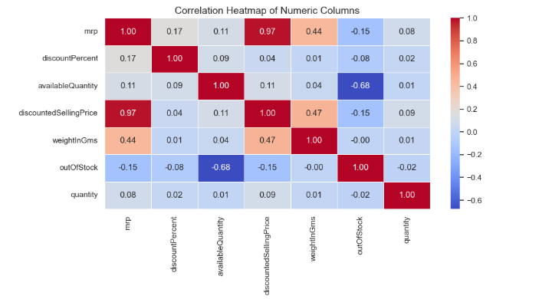
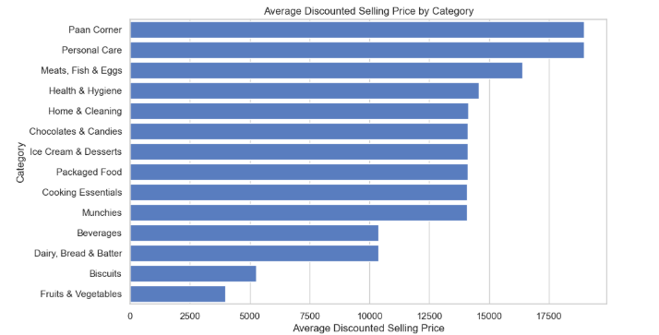

Slide 10
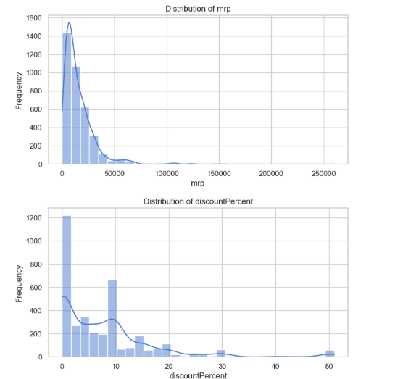
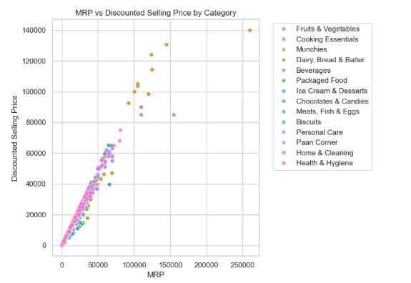

Slide 11
Conclusion
• Majority discounts <10%
• Strong correlation between MRP & discounted price
• Cooking Essentials most stocked category
• EDA supports better pricing & inventory management

