Slide 1


SQL COMPLETE TUTORIAL
Joins
“If data is split across tables, how do we combine it to answer business questions?” Answer = JOINS
A JOIN is used to combine rows from two or more tables based on a related column (usually a key).
Join = connect tables using a common column
SQL Joins are used to combine rows from two or more tables based on a related column between them. They help in retrieving connected data stored across multiple tables.
Instructor – Swapnjeet S | Lead Data Analyst (11+ Yrs of Exp) | Data Tutorials (220K+ YT Subscribers)

Slide 2
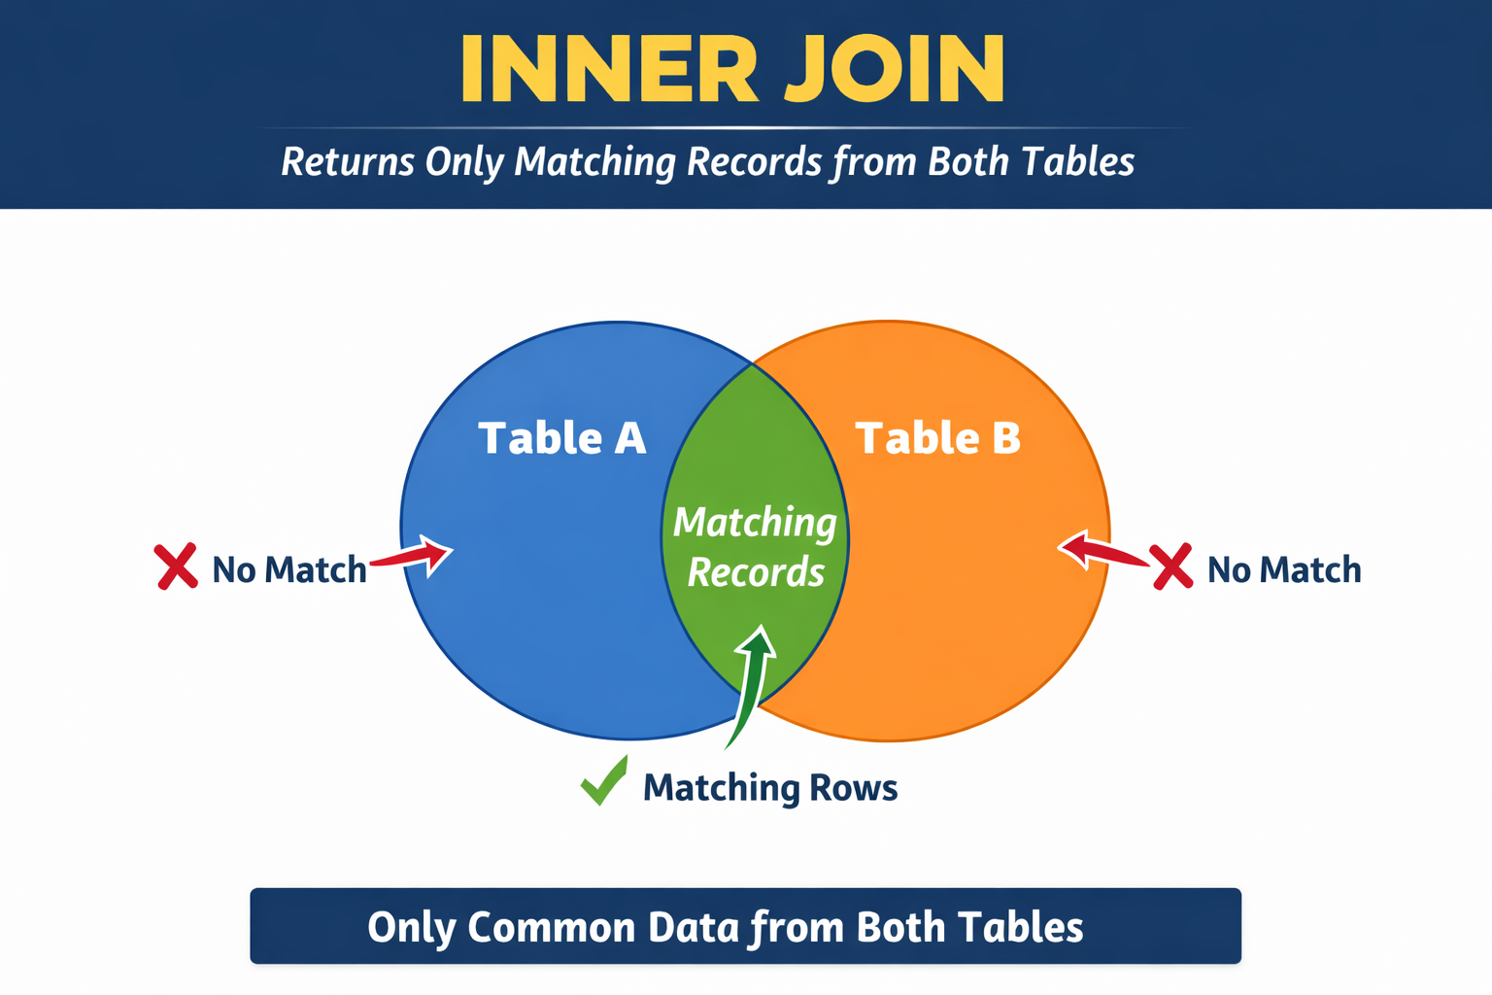
SQL COMPLETE TUTORIAL
Inner Join
The INNER JOIN in SQL returns only the rows where there is a matching value in both tables. It combines records based on a related column and excludes non-matching rows.
Simple words:
If match exists → show row If match does NOT exist → ignore row
Think like Intersection of two tables
SELECT columns
FROM table1
INNER JOIN table2
ON table1.common_column = table2.common_column;
Instructor – Swapnjeet S | Lead Data Analyst (11+ Yrs of Exp) | Data Tutorials (220K+ YT Subscribers)

Slide 3
SQL COMPLETE TUTORIAL
Inner Join
order_id | customer_id | order_date | product | quantity | sales
5001 | 101 | 2025-01-01 | Laptop | 1 | 55000
5002 | 102 | 2025-01-02 | Mouse | 2 | 1000
5003 | 101 | 2025-01-05 | Keyboard | 1 | 1500
5004 | 103 | 2025-01-07 | Monitor | 1 | 12000
5005 | 103 | 2025-01-10 | Tablet | 1 | 20000
5006 | 104 | 2025-01-11 | Mobile | 1 | 18000
5007 | 105 | 2025-01-12 | Charger | 2 | 800
5008 | 106 | 2025-01-15 | Headphones | 1 | 2500
5009 | 106 | 2025-01-18 | Camera | 1 | 45000
5010 | 107 | 2025-01-20 | Printer | 1 | 9000
5011 | 108 | 2025-01-21 | Desk | 1 | 7000
5012 | 108 | 2025-01-22 | Fan | 1 | 2000
5013 | 111 | 2025-01-25 | SSD | 1 | 5000
5014 | 112 | 2025-01-27 | RAM | 2 | 6000
customer_id | customer_name | city | email | phone
101 | Rahul | Delhi | rahul@gmail.com | 9000011111
102 | Priya | Mumbai | priya@gmail.com | 9000022222
103 | Amit | Pune | amit@gmail.com | 9000033333
104 | Sneha | Chennai | sneha@gmail.com | 9000044444
105 | Karan | Delhi | karan@gmail.com | 9000055555
106 | Neha | Kolkata | neha@gmail.com | 9000066666
107 | Vikas | Hyderabad | vikas@gmail.com | 9000077777
108 | Anjali | Bangalore | anjali@gmail.com | 9000088888
109 | Rohit | Delhi | rohit@gmail.com | 9000099999
110 | Meera | Pune | meera@gmail.com | 9000012121
Instructor – Swapnjeet S | Lead Data Analyst (11+ Yrs of Exp) | Data Tutorials (220K+ YT Subscribers)

Slide 4
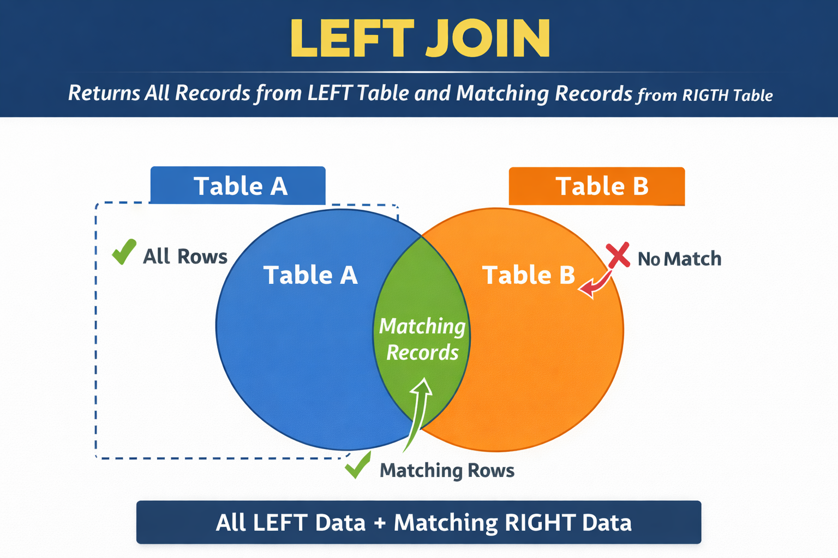
SQL COMPLETE TUTORIAL
Left Join
A LEFT JOIN returns ALL records from the LEFT table and only matching records from the RIGHT table.
If no match is found in the right table, NULL values are returned for the right table columns.
Simple words:
Left table → ALWAYS included
Right table → only if match exists
No match → NULL
SELECT columns
FROM table1
LEFT JOIN table2
ON table1.common_column = table2.common_column;
Instructor – Swapnjeet S | Lead Data Analyst (11+ Yrs of Exp) | Data Tutorials (220K+ YT Subscribers)

Slide 5
SQL COMPLETE TUTORIAL
Left Join
RIGHT TABLE
order_id | customer_id | order_date | product | quantity | sales
5001 | 101 | 2025-01-01 | Laptop | 1 | 55000
5002 | 102 | 2025-01-02 | Mouse | 2 | 1000
5003 | 101 | 2025-01-05 | Keyboard | 1 | 1500
5004 | 103 | 2025-01-07 | Monitor | 1 | 12000
5005 | 103 | 2025-01-10 | Tablet | 1 | 20000
5006 | 104 | 2025-01-11 | Mobile | 1 | 18000
5007 | 105 | 2025-01-12 | Charger | 2 | 800
5008 | 106 | 2025-01-15 | Headphones | 1 | 2500
5009 | 106 | 2025-01-18 | Camera | 1 | 45000
5010 | 107 | 2025-01-20 | Printer | 1 | 9000
5011 | 108 | 2025-01-21 | Desk | 1 | 7000
5012 | 108 | 2025-01-22 | Fan | 1 | 2000
5013 | 111 | 2025-01-25 | SSD | 1 | 5000
5014 | 112 | 2025-01-27 | RAM | 2 | 6000
LEFT TABLE
customer_id | customer_name | city | email | phone
101 | Rahul | Delhi | rahul@gmail.com | 9000011111
102 | Priya | Mumbai | priya@gmail.com | 9000022222
103 | Amit | Pune | amit@gmail.com | 9000033333
104 | Sneha | Chennai | sneha@gmail.com | 9000044444
105 | Karan | Delhi | karan@gmail.com | 9000055555
106 | Neha | Kolkata | neha@gmail.com | 9000066666
107 | Vikas | Hyderabad | vikas@gmail.com | 9000077777
108 | Anjali | Bangalore | anjali@gmail.com | 9000088888
109 | Rohit | Delhi | rohit@gmail.com | 9000099999
110 | Meera | Pune | meera@gmail.com | 9000012121
Instructor – Swapnjeet S | Lead Data Analyst (11+ Yrs of Exp) | Data Tutorials (220K+ YT Subscribers)

Slide 6
SQL COMPLETE TUTORIAL
Left Join
LEFT TABLE
order_id | customer_id | order_date | product | quantity | sales
5001 | 101 | 2025-01-01 | Laptop | 1 | 55000
5002 | 102 | 2025-01-02 | Mouse | 2 | 1000
5003 | 101 | 2025-01-05 | Keyboard | 1 | 1500
5004 | 103 | 2025-01-07 | Monitor | 1 | 12000
5005 | 103 | 2025-01-10 | Tablet | 1 | 20000
5006 | 104 | 2025-01-11 | Mobile | 1 | 18000
5007 | 105 | 2025-01-12 | Charger | 2 | 800
5008 | 106 | 2025-01-15 | Headphones | 1 | 2500
5009 | 106 | 2025-01-18 | Camera | 1 | 45000
5010 | 107 | 2025-01-20 | Printer | 1 | 9000
5011 | 108 | 2025-01-21 | Desk | 1 | 7000
5012 | 108 | 2025-01-22 | Fan | 1 | 2000
5013 | 111 | 2025-01-25 | SSD | 1 | 5000
5014 | 112 | 2025-01-27 | RAM | 2 | 6000
RIGHT TABLE
customer_id | customer_name | city | email | phone
101 | Rahul | Delhi | rahul@gmail.com | 9000011111
102 | Priya | Mumbai | priya@gmail.com | 9000022222
103 | Amit | Pune | amit@gmail.com | 9000033333
104 | Sneha | Chennai | sneha@gmail.com | 9000044444
105 | Karan | Delhi | karan@gmail.com | 9000055555
106 | Neha | Kolkata | neha@gmail.com | 9000066666
107 | Vikas | Hyderabad | vikas@gmail.com | 9000077777
108 | Anjali | Bangalore | anjali@gmail.com | 9000088888
109 | Rohit | Delhi | rohit@gmail.com | 9000099999
110 | Meera | Pune | meera@gmail.com | 9000012121
Instructor – Swapnjeet S | Lead Data Analyst (11+ Yrs of Exp) | Data Tutorials (220K+ YT Subscribers)

Slide 7
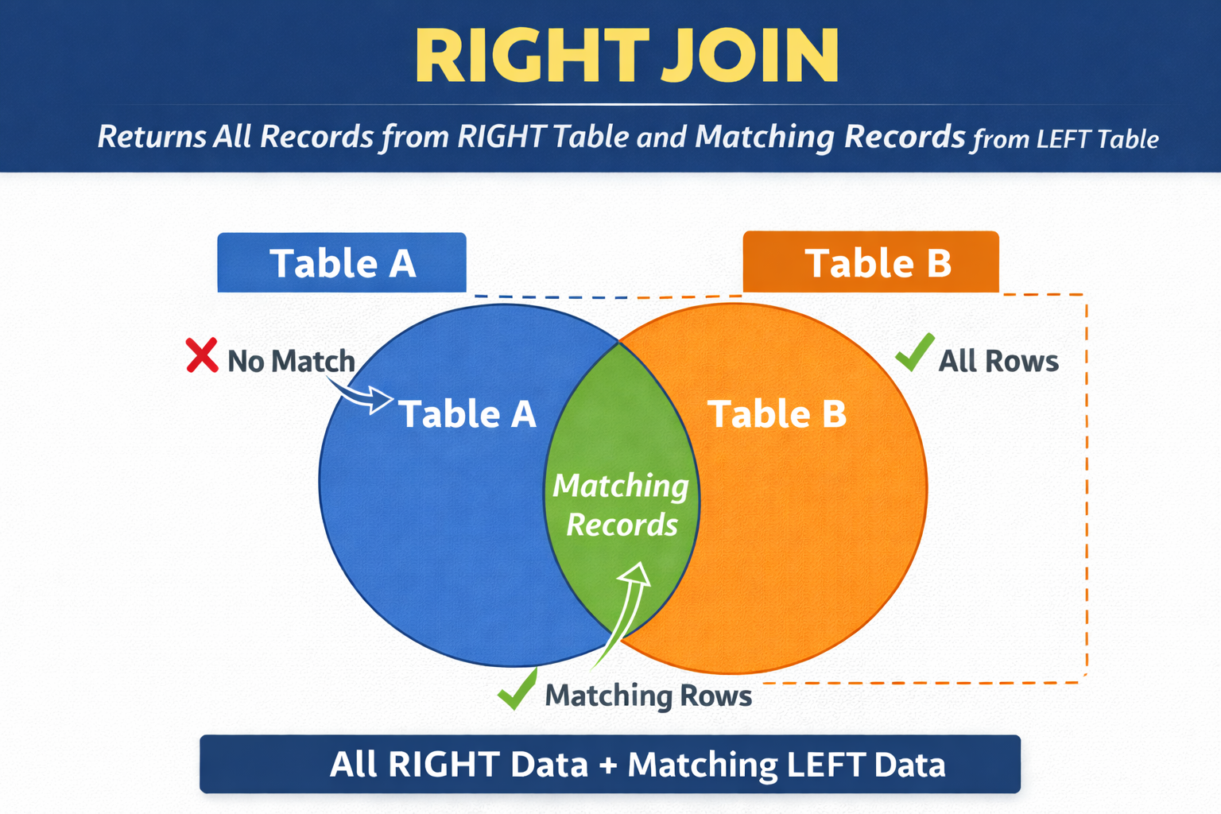
SQL COMPLETE TUTORIAL
Right Join
A RIGHT JOIN returns all rows from the RIGHT table, and only matching rows from the LEFT table.
If no match is found in the left table, NULL values are returned for the left table columns.
Simple words:
Right table → ALWAYS included
Left table → only if match exists
No match → NULL
SELECT columns
FROM table1
RIGHT JOIN table2
ON table1.common_column = table2.common_column;
Instructor – Swapnjeet S | Lead Data Analyst (11+ Yrs of Exp) | Data Tutorials (220K+ YT Subscribers)

Slide 8
SQL COMPLETE TUTORIAL
Right Join
RIGHT TABLE
order_id | customer_id | order_date | product | quantity | sales
5001 | 101 | 2025-01-01 | Laptop | 1 | 55000
5002 | 102 | 2025-01-02 | Mouse | 2 | 1000
5003 | 101 | 2025-01-05 | Keyboard | 1 | 1500
5004 | 103 | 2025-01-07 | Monitor | 1 | 12000
5005 | 103 | 2025-01-10 | Tablet | 1 | 20000
5006 | 104 | 2025-01-11 | Mobile | 1 | 18000
5007 | 105 | 2025-01-12 | Charger | 2 | 800
5008 | 106 | 2025-01-15 | Headphones | 1 | 2500
5009 | 106 | 2025-01-18 | Camera | 1 | 45000
5010 | 107 | 2025-01-20 | Printer | 1 | 9000
5011 | 108 | 2025-01-21 | Desk | 1 | 7000
5012 | 108 | 2025-01-22 | Fan | 1 | 2000
5013 | 111 | 2025-01-25 | SSD | 1 | 5000
5014 | 112 | 2025-01-27 | RAM | 2 | 6000
LEFT TABLE
customer_id | customer_name | city | email | phone
101 | Rahul | Delhi | rahul@gmail.com | 9000011111
102 | Priya | Mumbai | priya@gmail.com | 9000022222
103 | Amit | Pune | amit@gmail.com | 9000033333
104 | Sneha | Chennai | sneha@gmail.com | 9000044444
105 | Karan | Delhi | karan@gmail.com | 9000055555
106 | Neha | Kolkata | neha@gmail.com | 9000066666
107 | Vikas | Hyderabad | vikas@gmail.com | 9000077777
108 | Anjali | Bangalore | anjali@gmail.com | 9000088888
109 | Rohit | Delhi | rohit@gmail.com | 9000099999
110 | Meera | Pune | meera@gmail.com | 9000012121
Instructor – Swapnjeet S | Lead Data Analyst (11+ Yrs of Exp) | Data Tutorials (220K+ YT Subscribers)

Slide 9
SQL COMPLETE TUTORIAL
Right Join
LEFT TABLE
order_id | customer_id | order_date | product | quantity | sales
5001 | 101 | 2025-01-01 | Laptop | 1 | 55000
5002 | 102 | 2025-01-02 | Mouse | 2 | 1000
5003 | 101 | 2025-01-05 | Keyboard | 1 | 1500
5004 | 103 | 2025-01-07 | Monitor | 1 | 12000
5005 | 103 | 2025-01-10 | Tablet | 1 | 20000
5006 | 104 | 2025-01-11 | Mobile | 1 | 18000
5007 | 105 | 2025-01-12 | Charger | 2 | 800
5008 | 106 | 2025-01-15 | Headphones | 1 | 2500
5009 | 106 | 2025-01-18 | Camera | 1 | 45000
5010 | 107 | 2025-01-20 | Printer | 1 | 9000
5011 | 108 | 2025-01-21 | Desk | 1 | 7000
5012 | 108 | 2025-01-22 | Fan | 1 | 2000
5013 | 111 | 2025-01-25 | SSD | 1 | 5000
5014 | 112 | 2025-01-27 | RAM | 2 | 6000
RIGHT TABLE
customer_id | customer_name | city | email | phone
101 | Rahul | Delhi | rahul@gmail.com | 9000011111
102 | Priya | Mumbai | priya@gmail.com | 9000022222
103 | Amit | Pune | amit@gmail.com | 9000033333
104 | Sneha | Chennai | sneha@gmail.com | 9000044444
105 | Karan | Delhi | karan@gmail.com | 9000055555
106 | Neha | Kolkata | neha@gmail.com | 9000066666
107 | Vikas | Hyderabad | vikas@gmail.com | 9000077777
108 | Anjali | Bangalore | anjali@gmail.com | 9000088888
109 | Rohit | Delhi | rohit@gmail.com | 9000099999
110 | Meera | Pune | meera@gmail.com | 9000012121
Instructor – Swapnjeet S | Lead Data Analyst (11+ Yrs of Exp) | Data Tutorials (220K+ YT Subscribers)

Slide 10
SQL COMPLETE TUTORIAL
Full Outer Join
A FULL OUTER JOIN returns all records from both tables.
LEFT JOIN + RIGHT JOIN combined
Simple words:
If a match exists → show combined data
If no match → show NULL for the missing side
SELECT columns
FROM table1
FULL OUTER JOIN table2
ON table1.common_column = table2.common_column;
Instructor – Swapnjeet S | Lead Data Analyst (11+ Yrs of Exp) | Data Tutorials (220K+ YT Subscribers)

Slide 11
SQL COMPLETE TUTORIAL
Full Outer Join
LEFT TABLE
order_id | customer_id | order_date | product | quantity | sales
5001 | 101 | 2025-01-01 | Laptop | 1 | 55000
5002 | 102 | 2025-01-02 | Mouse | 2 | 1000
5003 | 101 | 2025-01-05 | Keyboard | 1 | 1500
5004 | 103 | 2025-01-07 | Monitor | 1 | 12000
5005 | 103 | 2025-01-10 | Tablet | 1 | 20000
5006 | 104 | 2025-01-11 | Mobile | 1 | 18000
5007 | 105 | 2025-01-12 | Charger | 2 | 800
5008 | 106 | 2025-01-15 | Headphones | 1 | 2500
5009 | 106 | 2025-01-18 | Camera | 1 | 45000
5010 | 107 | 2025-01-20 | Printer | 1 | 9000
5011 | 108 | 2025-01-21 | Desk | 1 | 7000
5012 | 108 | 2025-01-22 | Fan | 1 | 2000
5013 | 111 | 2025-01-25 | SSD | 1 | 5000
5014 | 112 | 2025-01-27 | RAM | 2 | 6000
RIGHT TABLE
customer_id | customer_name | city | email | phone
101 | Rahul | Delhi | rahul@gmail.com | 9000011111
102 | Priya | Mumbai | priya@gmail.com | 9000022222
103 | Amit | Pune | amit@gmail.com | 9000033333
104 | Sneha | Chennai | sneha@gmail.com | 9000044444
105 | Karan | Delhi | karan@gmail.com | 9000055555
106 | Neha | Kolkata | neha@gmail.com | 9000066666
107 | Vikas | Hyderabad | vikas@gmail.com | 9000077777
108 | Anjali | Bangalore | anjali@gmail.com | 9000088888
109 | Rohit | Delhi | rohit@gmail.com | 9000099999
110 | Meera | Pune | meera@gmail.com | 9000012121
Instructor – Swapnjeet S | Lead Data Analyst (11+ Yrs of Exp) | Data Tutorials (220K+ YT Subscribers)

