Slide 1
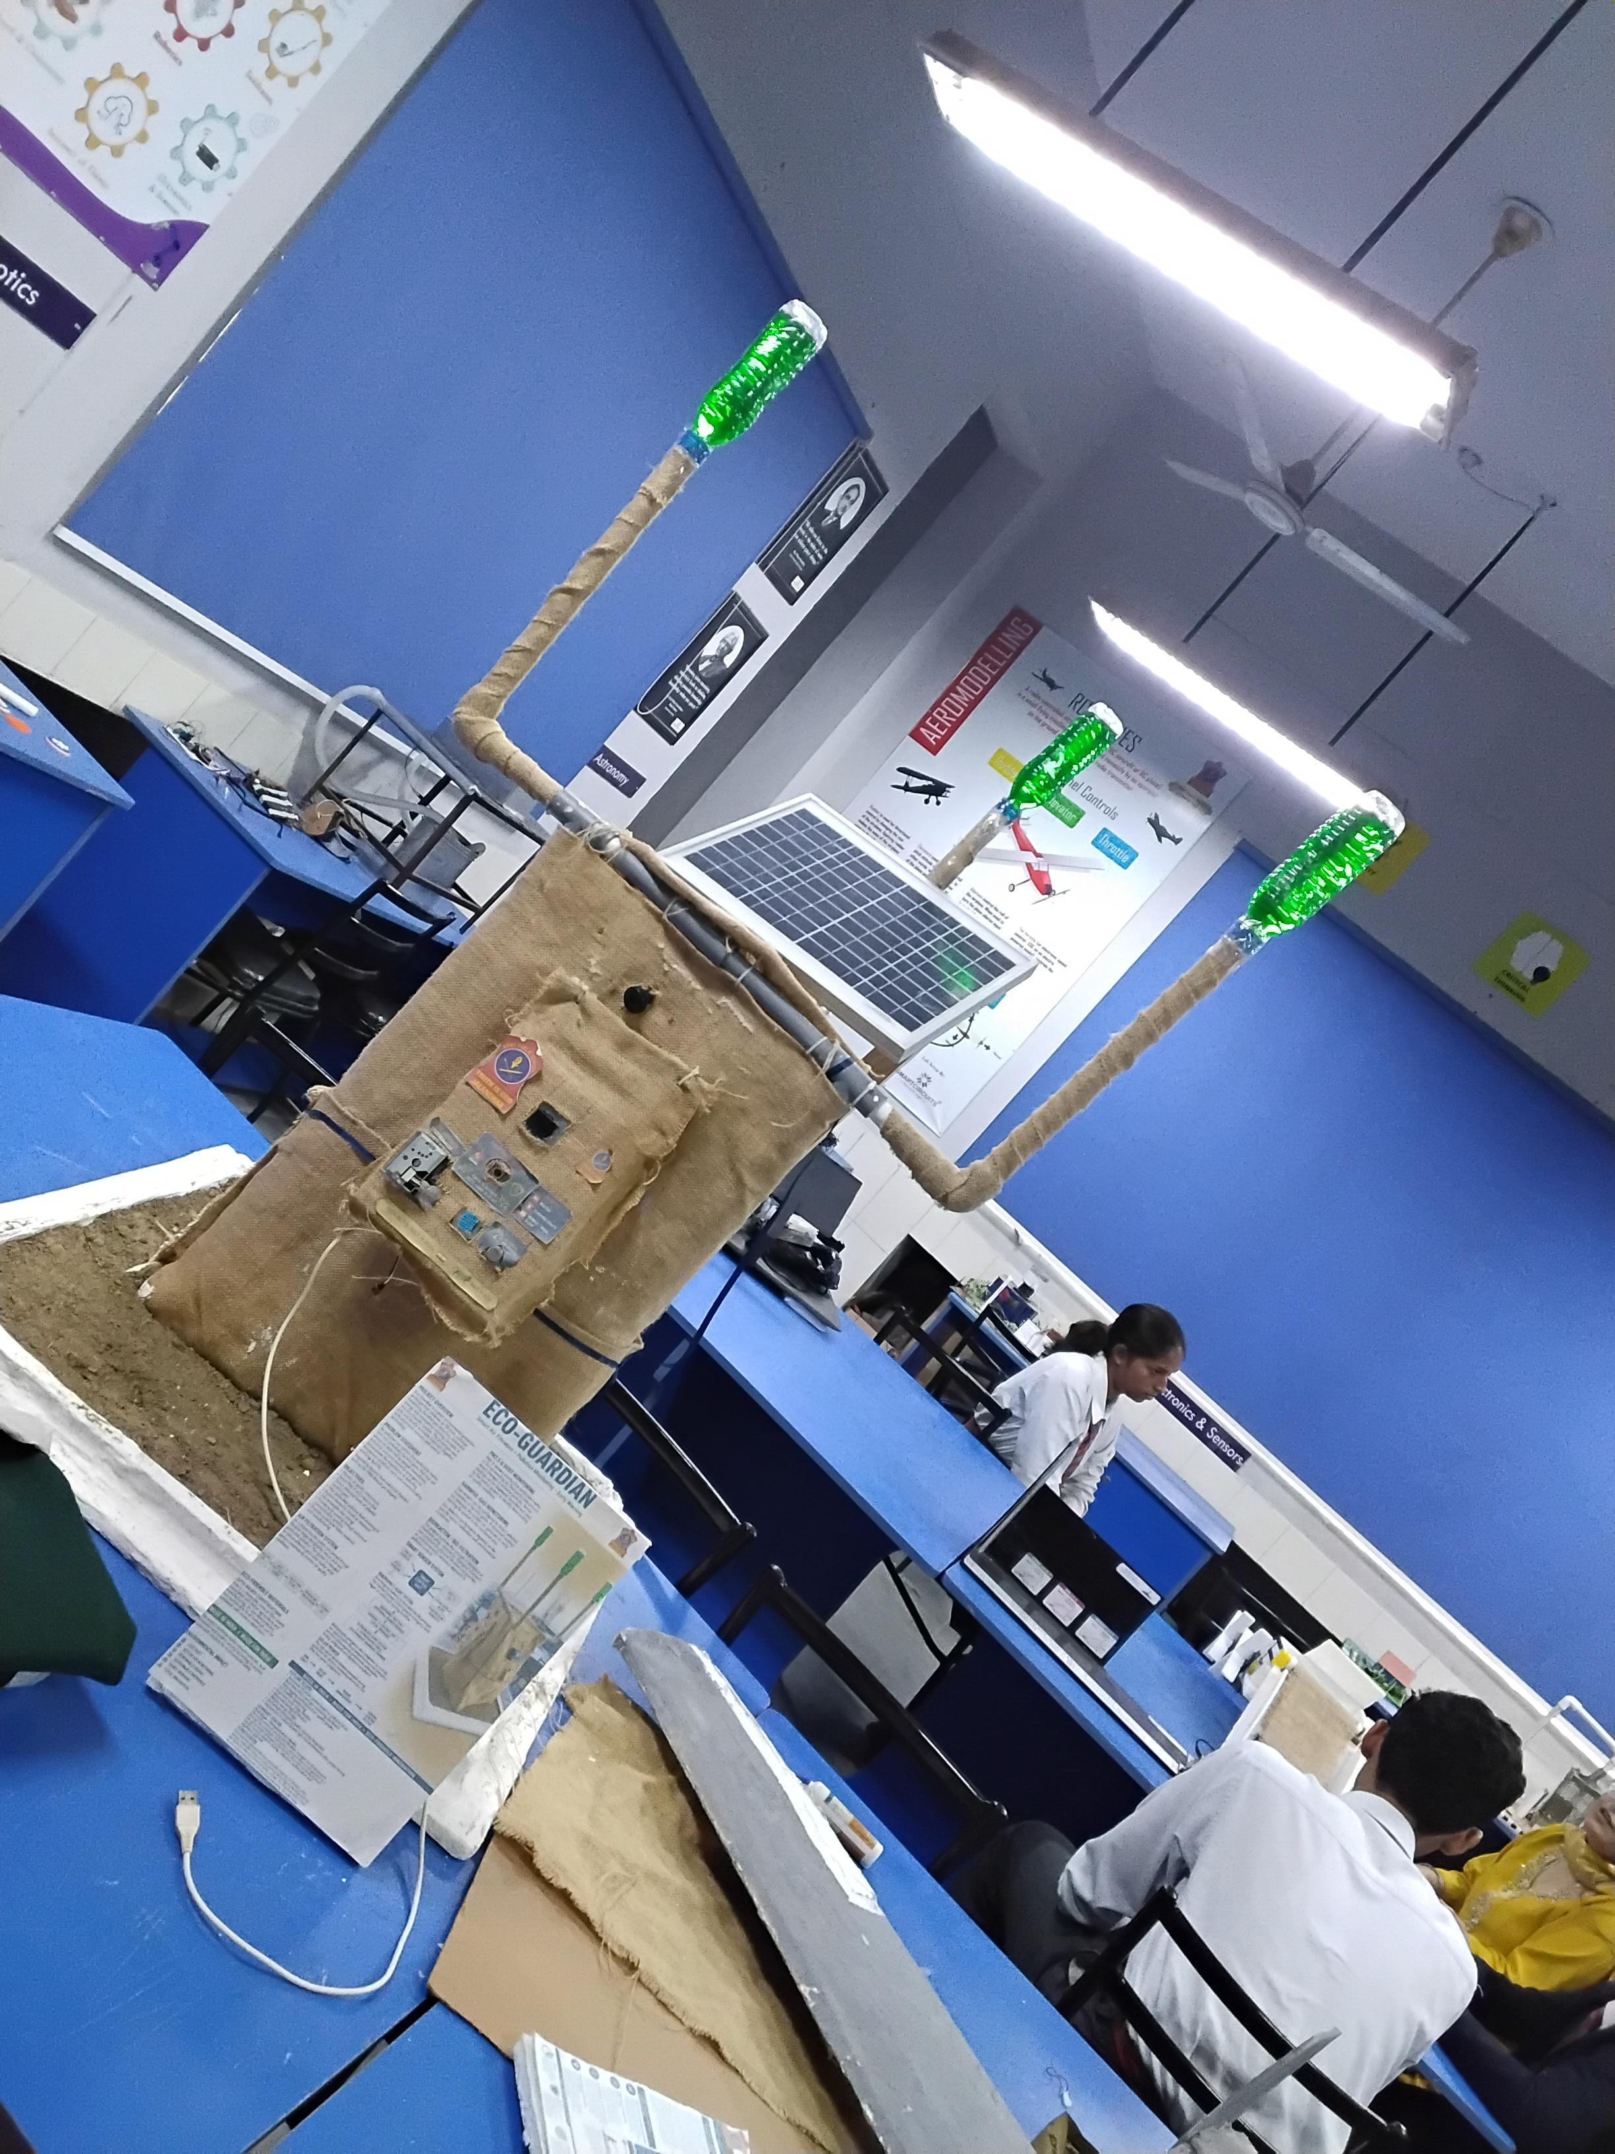
BHARAT INNOVATION CHALLENGE 2.0 // GRAND FINALE
Eco Guardian
AI Environmental Sentinel & Civic Infrastructure
Decentralized, solar-powered multi-modal sentinel uniting real-time toxic gas radar, active dust misting, automated civic road repair, and 24/7 citizen SOS safety.
★ Indigenous Jute Chassis · DPDT Act 2023 Compliant Data Backbone · Edge AI Intelligence
FOUNDER & HARDWARE LEAD
Pranav Kumar Mishra
Embedded Circuits, Sensors & Power
PITCH PRESENTER & STRATEGY
Naman Padhwal
Stage Pitch Defense & Communications Lead
FACULTY MENTOR
Keshav Aggarwal
STEM Cell, Army Public School Jalandhar Cantt

Slide 2
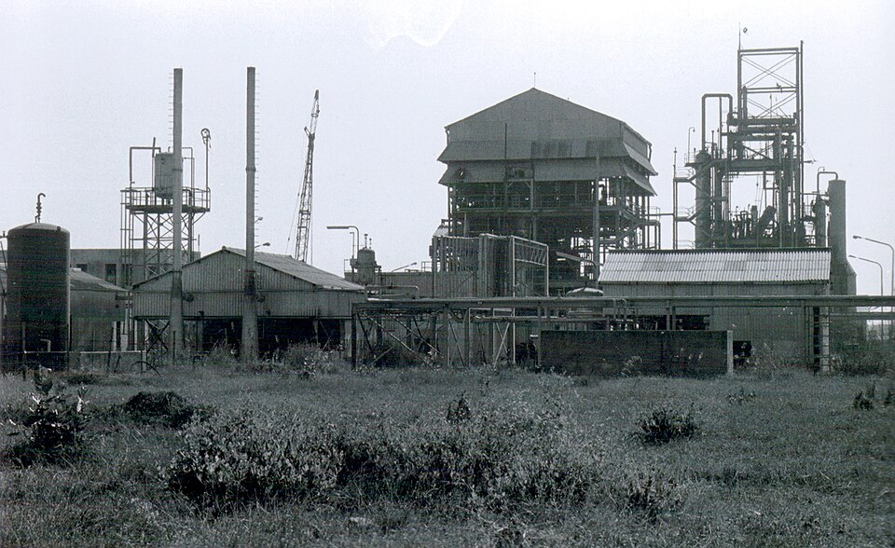
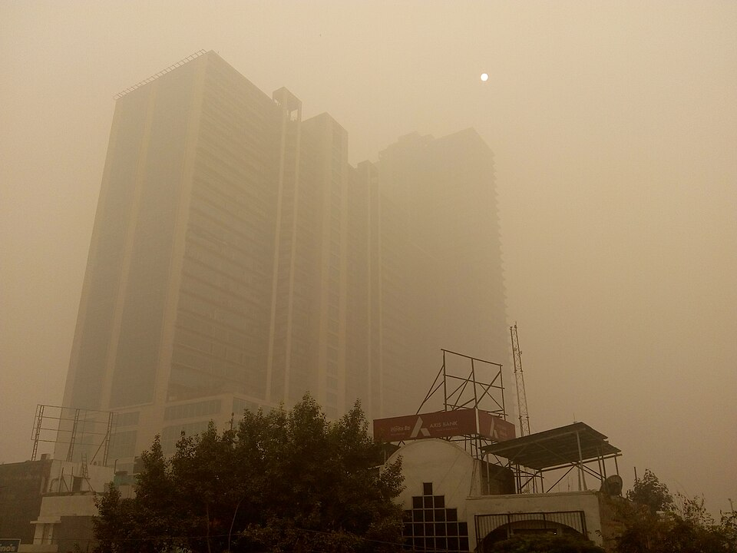
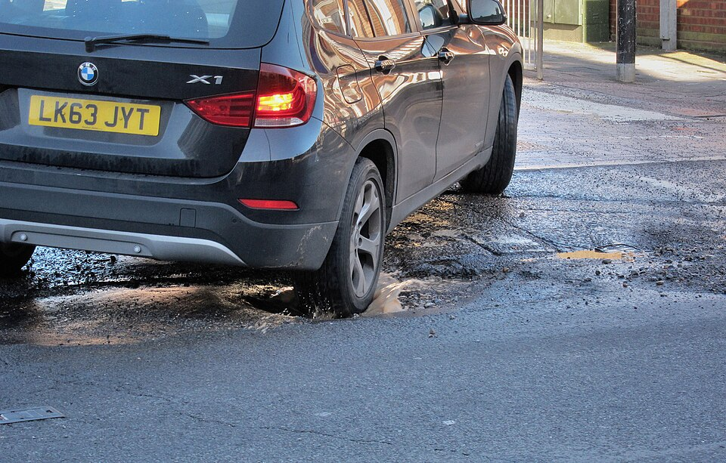
02 / PROBLEM & OPPORTUNITY
The Invisible Crisis: When Senses Fail, Tragedy Follows
THE HISTORICAL LESSON
Bhopal: Invisible Gas
• Silent & invisible chemical gas leak
• Human senses react only after fatal damage
• Public streets still lack ppm early alarms
★ CRITICAL NEED: Autonomous on-site gas defense
THE MODERN CRISIS
1.67M Smog Deaths
• 92% Indians breathe toxic air above WHO limits
• ₹2.7 Lakh Crore ($36.8B) annual GDP drain
• Purifiers trapped indoors; roads exposed
★ THE BLIND SPOT: Zero outdoor active purification
THE CIVIC PARALYSIS
150,000+ Fatal Crashes
• Unreported potholes cause fatal daily crashes
• Inspection relies on slow manual complaints
• Takes 3–4 weeks for road repair crews to mobilize
★ OPPORTUNITY: Automated CV road defect triage
THE VERDICT: Passive monitors and siloed cameras do not save lives.
Bharat needs a single, unified sentinel that sounds toxic gas alarms, scrubs dust on the spot, and dispatches civic teams dynamically.

Slide 3
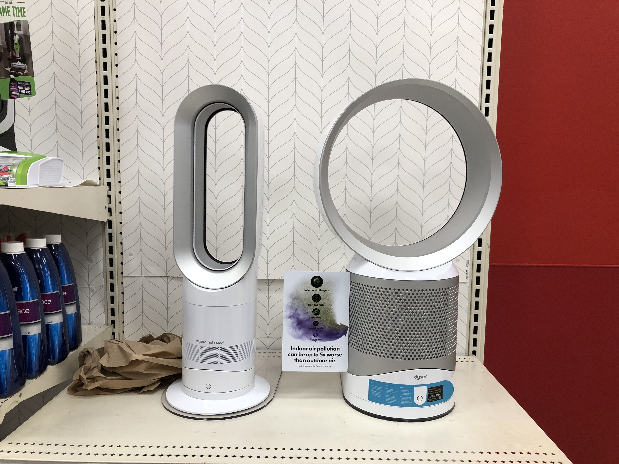
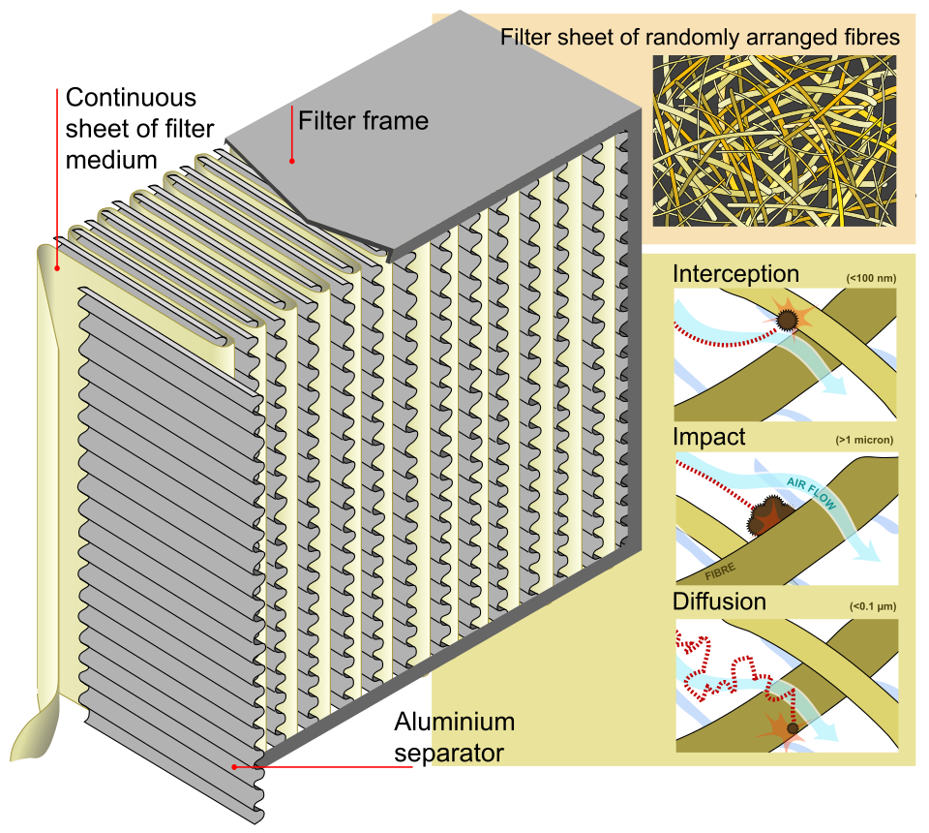

03 / EXISTING SOLUTIONS & GAP ANALYSIS
The Legacy Trilemma: Expensive, Passive, and Fragmented
CONSUMER PURIFIERS
Dyson / Philips
₹25k – ₹45k
❌ Trapped inside luxury single rooms
❌ Zero toxic gas leak alarms
❌ 100% grid fossil-fuel dependent
❌ Zero public road or civic utility
STANDALONE AQI NODES
Prana Air / Airveda
₹15k – ₹70k
❌ Passive thermometer—no cleansing
❌ Factory recalibration return required
❌ Zero automated worker dispatch
❌ No citizen SOS emergency link
INDUSTRIAL CAAQMS
CPCB Macro Stations
₹50 Lakhs+
❌ Astronomical CapEx (unaffordable)
❌ Requires specialized scientists
❌ Placed 10+ km apart (blind to leaks)
❌ Zero on-site active mitigation
ECO GUARDIAN SENTINEL
Integrated Platform
₹22,000
✔ Continuous toxic gas & PM2.5 radar
✔ Active cyclonic filtration & mist
✔ Automated Zomato-style PWD triage
✔ Physical 24/7 Citizen SOS button
✔ 100% Solar & indigenous jute
THE COMPETITIVE CONVERGENCE: 4 Fragmented Point Products → 1 Unified Platform
Eco Guardian replaces expensive indoor purifiers, passive sensors, and manual road surveys with one off-grid solar sentinel at 1/10th the cost.

Slide 4
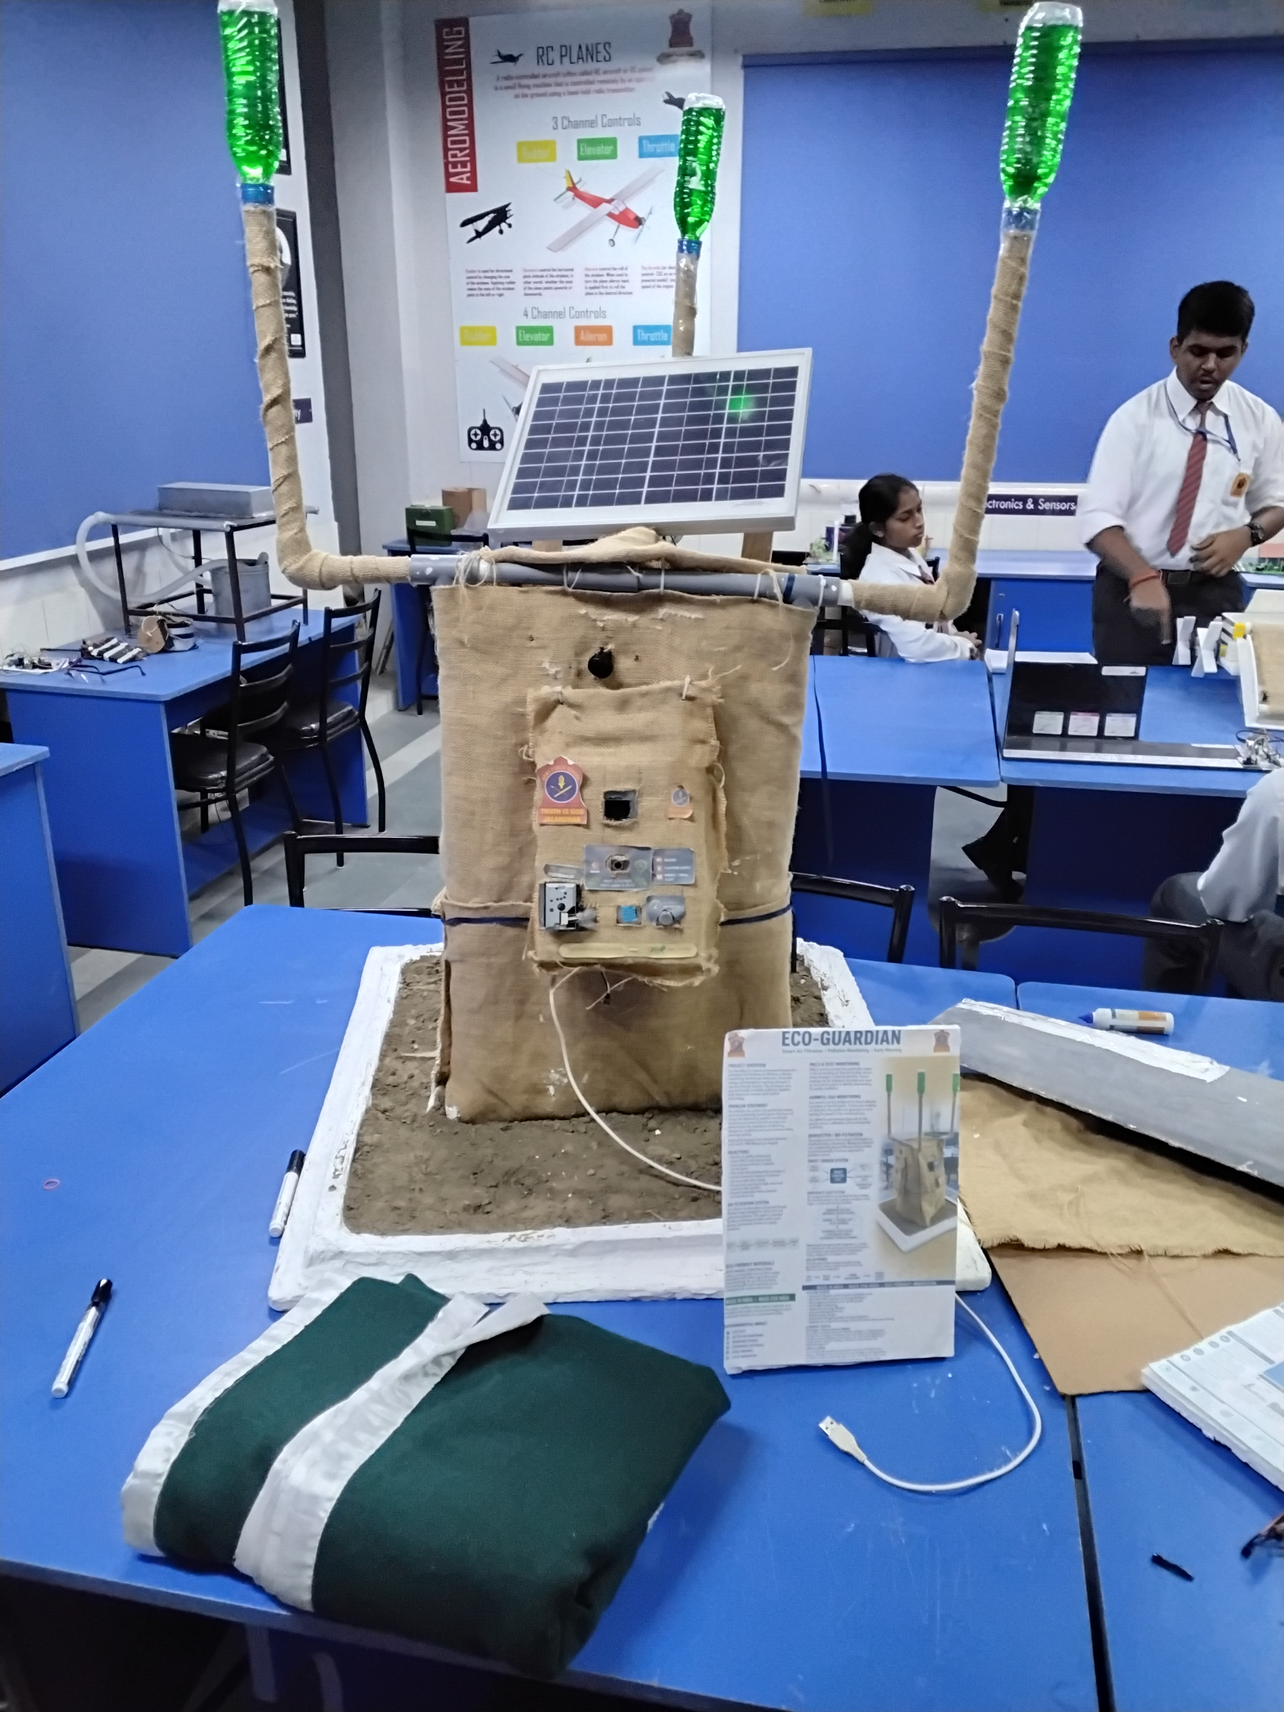
04 / OUR SOLUTION
Eco Guardian: The Autonomous Sense-Filter-Protect Sentinel
PILLAR 1: SENSE & WARN
Environmental Gas Radar
• Sharp Optical Sensor tracks PM2.5 in real time
• MQ-135 array detects CO₂, ammonia & toxic VOCs
• Onboard SSD1306 OLED gives instant visual AQI
★ PREVENTS BHOPAL-SCALE EMERGENCIES
PILLAR 2: FILTER & PURIFY
Active On-Site Cleansing
• Dual high-flow blowers engage at AQI > 100
• Ultrasonic mist precipitation settles PM2.5 fast
• 100% off-grid solar panel with LiFePO4 battery
★ PURIFIES AIR WHERE CITIZENS BREATHE
PILLAR 3: DISPATCH & PROTECT
Civic Sentinel & Citizen SOS
• Edge Vision auto-audits potholes & civic debris
• Zomato-style engine auto-routes nearest PWD crew
• Physical 24/7 Citizen SOS button dials Dial 112
★ ACTS & PROTECTS CITIZENS ON THE SPOT
CORE ENGINEERING RIGOR: Localized Autonomous Action
Instead of transmitting useless distress data to distant servers, Eco Guardian filters the air right there, sounds early alarms right there, and protects citizens on the spot.

Slide 5
05 / TECHNOLOGY & INNOVATION
Dual-Tier Edge Architecture: Edge Intelligence & DPDT-Compliant Cloud
TIER 1: POLE-LEVEL HARDWARE & SENSING
Edge Microcontroller & Multi-Modal Sensors
• ESP32-S3 Dual-Core Brain: Sub-second sensor polling, PWM motor control, and 72-hour local buffer.
• Camera & Solid-State LiDAR: Continuous road topology scanning, pothole profiling & civic defect audit.
• Chemical & Particulate Array: Sharp GP2Y10 dust + MQ-135 gas calibrated with laboratory regression curves.
• 100% Off-Grid Solar Power: Integrated PV panel with LiFePO4 battery reserve operating indefinitely.
TIER 2: NATIONAL DATA BACKBONE & PUBLIC SAFETY
DPDT-Compliant AI & Civic Dispatch Cloud
• Strict DPDT Act 2023 Compliance: Real-time edge blurring strips faces and license plates irreversibly.
• Central CV & Pothole Engine: Municipal command integration routes detected damage with exact tools required.
• Physical 24/7 Citizen SOS Link: Dedicated panic button on every pole connects instantly to Police & EMS (112).
• High-Margin Data Monetization: Streams anonymized peak pollution & micro-climate heatmaps to enterprise EV & health.
THE PRIVACY BACKBONE: Built for National Scale & Enterprise Trust
Our edge AI irreversibly strips all personal identifiers before cloud ingest, unlocking high-value data monetization with zero citizen privacy risk.

Slide 6
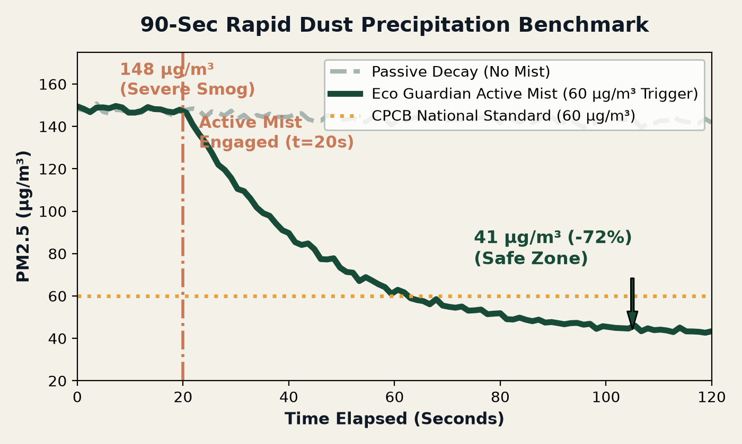
06 / PROTOTYPE / MVP / DEMONSTRATION
Bench-Tested Reality: Functional Prototype & Verified Telemetry
EMPIRICAL BENCH VALIDATION FINDINGS
• PM2.5 Rapid Precipitation: 148 → 41 µg/m³ in 90 seconds (72.3% drop via ultrasonic misting).
• Autonomous Closed-Loop: Blower triggers at AQI > 100; gas priority alert dispatched via ntfy.sh in < 1s.
Physical Jute Chassis
Bio-sealed natural body with misting & filtration towers.
ESP32 Sensor Brain
Sharp GP2Y10, MQ-135 gas, OLED & WiFi web portal.
HARDWARE VALIDATION STATUS: TRL-4 Lab-Validated Working Prototype
Every component is physically wired, verified on bench, and demonstrated live before the jury—zero fabricated numbers or speculative hardware claims.

Slide 7
07 / MUNICIPAL DISPATCH ENGINE
Zomato-Style Automated Road Repair & Civic Triage Engine
1. DETECTION & CV TRIAGE
Camera & LiDAR Surface Scan
• Optical Camera & LiDAR continuously scan road corridors
• Automatic CV classification: pothole, crater, missing cover
• Calculates required repair materials (cold mix, asphalt volume)
• Flags high-risk hazards for immediate emergency response
★ SECTOR 1 DWARKA PILOT SIMULATION
2. ZOMATO-STYLE DISPATCH
Dynamic Worker Allocation
• System queries municipal database of active repair crews
• Evaluates worker real-time location, tools, and workload
• e.g. Worker finishing job in Sector 2 routed to Sector 1
• Task pushed to mobile terminal with exact GPS & materials
★ DYNAMIC PROXIMITY ROUTING
3. 24/7 CITIZEN SOS
Public Emergency Link
• Physical illuminated panic button on every sentinel pole
• Connects distressed citizens to Police & EMS (Dial 112)
• Two-way encrypted audio-video channel opens on activation
• Deterrent strobe LED & siren engages to disperse threats
★ ZERO CITIZEN SMARTPHONE REQUIRED
CROSS-SECTOR UTILITY: From School Gates to Industrial Corridors
Eco Guardian turns passive utility poles into intelligent public sentinels that repair roads faster and protect citizens 24/7.

Slide 8



08 / IMPACT & OUTCOMES
Quantifiable Civic, Environmental & Public Safety Impact
72% PM2.5 Cut
SDG 3: GOOD HEALTH
80% Faster Fixes
SDG 11: SUSTAINABLE CITIES
100% Solar Off-Grid
SDG 13: CLIMATE ACTION
Clean Breathing Zones
• Cleanses immediate breathing zones outside schools & clinics
• Prevents acute respiratory disease from toxic VOCs & ammonia
• Eliminates toxic gas exposure before irreversible lung damage
★ PREVENTS BHOPAL-SCALE RESPIRATORY CRISES
Automated Road Safety
• Cuts road defect turnaround from 3–4 weeks to under 48 hours
• Eliminates fatal pothole crashes and optimizes municipal crews
• 24/7 Citizen SOS button provides instant emergency security
★ TURNS ROADS INTO AUTONOMOUS SMART GRIDS
Clean Energy & Biomaterials
• Operates 100% off-grid via solar PV and LiFePO4 battery reserve
• Indigenous jute composite body eliminates plastic toxic waste
• Zero ongoing grid carbon footprint throughout 10-year lifecycle
★ CIRCULAR BIODEGRADABLE CRADLE-TO-GRAVE DESIGN
PROACTIVE PREVENTION OVER REACTION: Measurable Multi-Domain Impact
Eco Guardian directly aligns with UN SDGs to deliver measurable particulate drops, faster road fixes, and 24/7 citizen emergency protection.

Slide 9
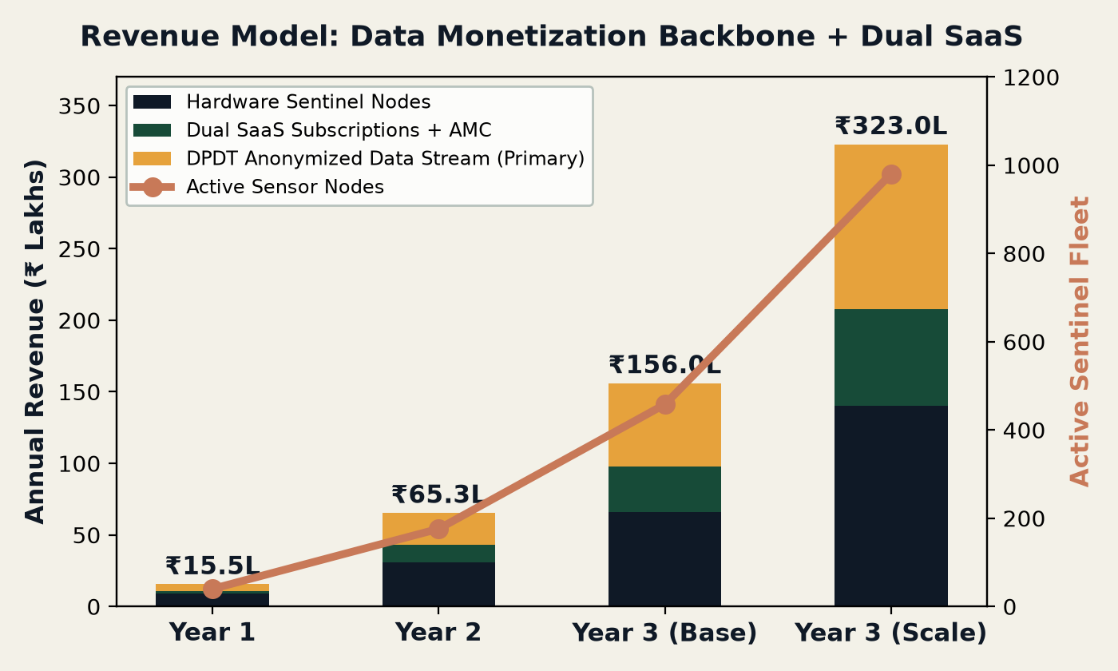
09 / BUSINESS MODEL & REVENUE STREAMS
Multi-Tiered Monetization: DPDT Data Stream + Dual SaaS Subscriptions
THREE DIVERSIFIED REVENUE STREAMS
1. DPDT Environmental Data Monetization (PRIMARY REVENUE)
• Licensing anonymized peak pollution heatmaps & micro-climate datasets.
• Customers: EV networks, logistics, health & insurance corporations.
• 100% compliant with DPDT Act 2023 (Zero personal identity retention).
2. Municipal Smart City SaaS Subscription (₹599 / node / mo)
• Automated PWD road defect auditing, worker routing & SOS dispatch fees.
3. Enterprise & Campus SaaS + Hardware (₹1,200 / mo + ₹22k)
• Real-time air quality dashboards, ESG compliance & STEM educational feeds.
FINANCIAL TRAJECTORY & COMPOUNDING VALUE
• Year 1: ₹15.5L (40 nodes) · Year 2: ₹65.3L (176 nodes) · Year 3: ₹1.56 Cr to ₹3.23 Cr.
• The intelligence grid serves as the recurring backbone powering high-margin data streams.
HIGH-MARGIN RECURRING BACKBONE: 70%+ Recurring Margins
Hardware seeds the city footprint; anonymized data licensing and dual SaaS subscriptions unlock high-margin recurring cash flows.

Slide 10
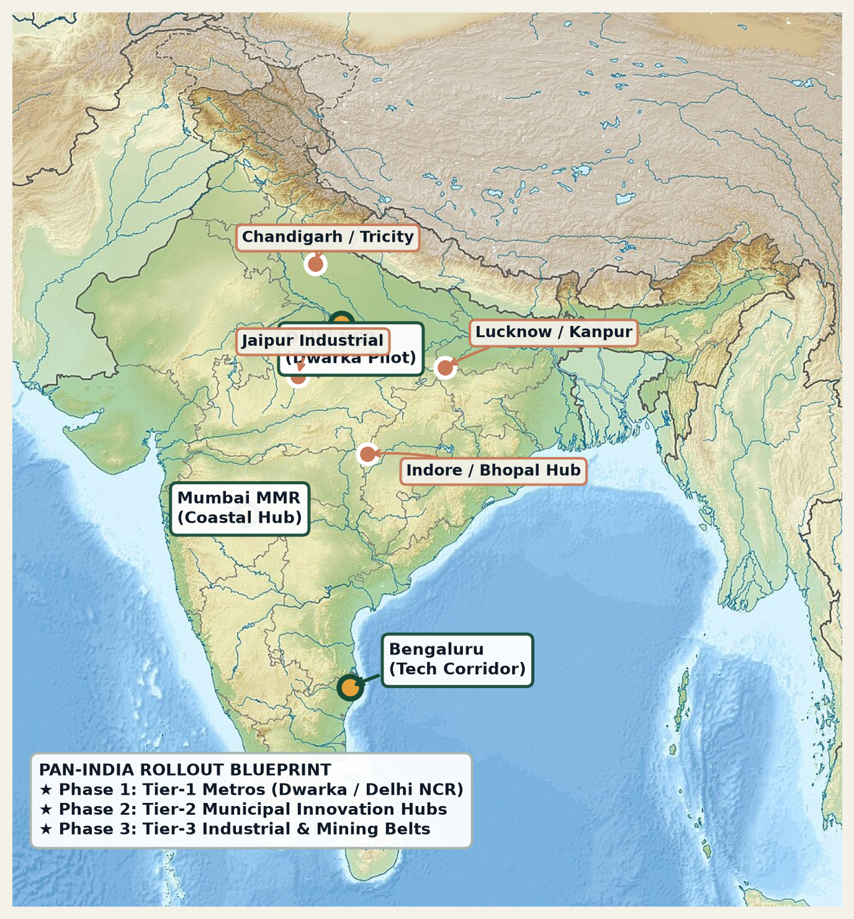
10 / FEASIBILITY & SCALABILITY
Pan-India Scalability & Municipal Expansion Blueprint
GOVERNMENT COLLABORATION & EXPANSION BLUEPRINT
Phase 1: Tier-1 Metros (Dwarka Pilot Anchor)
• Deploy 30–50 sentinel nodes in collaboration with municipal corporation.
• Prove Zomato-style pothole triage & school breathing safety corridors.
• Validate DPDT Act compliant data licensing with commercial EV networks.
Phase 2: Tier-2 Municipal Innovation Hubs
• Expand across high-growth Tier-2 cities via Smart Cities Mission tenders.
• Deploy municipal SaaS dashboard at ₹599/node/mo for automated road audits.
• Establish regional assembly hubs utilizing local Indian jute supply chains.
Phase 3: Tier-3 Industrial & Chemical Safety Belts
• Deploy in chemical corridors and factory clusters to prevent toxic gas disasters.
• Integrate with national disaster management authorities (NDMA) for early alarms.
SCALING PHILOSOPHY: Rapid Cluster Density before National Spread
By anchoring dense municipal pilots in Tier-1 & Tier-2 cities, Eco Guardian establishes reference case studies to win state-wide Smart Cities tenders.

Slide 11
11 / COMPETITIVE ADVANTAGE
The Multi-Domain Moat: Clean Air, Civic AI & Public Safety
Capability / Parameter | Consumer Air Purifiers | Commercial AQI Nodes | Industrial CAAQMS | Eco Guardian Sentinel
Multi-Gas & Toxic Leak Alert | ❌ None (PM only) | ⚠️ Limited / CO₂ only | ✔ Reference CPCB Grade | ✔ Instant VOC & Gas Radar
Active Local Air Cleansing | ✔ Single Room (Indoor) | ❌ Passive Sensor Only | ❌ Monitoring Only | ✔ Dual Blower & Mist Cleansing
Automated Civic Road Dispatch | ❌ No Civic Utility | ❌ No Civic Utility | ❌ Macro Data Only | ✔ Zomato-Style Worker Triage
Citizen 24/7 SOS Panic Button | ❌ No Safety Feature | ❌ No Safety Feature | ❌ No Safety Feature | ✔ Physical Dial-112 SOS Button
DPDT Act Compliant Data Stream | ❌ No Public Data | ❌ No Civic Data | ⚠️ Static Macro Only | ✔ Monetizable Urban Intelligence
THE UNFAIR ADVANTAGE: All-In-One Unified Hardware-AI Sentinel
Competitors sell isolated point products. Eco Guardian delivers an integrated environmental shield, road audit network, and public safety infrastructure in a single solar node.

Slide 12
12 / TEAM & CAPABILITIES
Execution Engine: Hardware Mastery, Edge AI & Deep Mentorship
FOUNDER & HARDWARE LEAD
Pranav Kumar Mishra
• Embedded Firmware & C++ on ESP32 / STM32 architectures.
• Sensor Calibration: Linear regression models for optical dust & gas.
• Power Architecture: MPPT solar charging & LiFePO4 BMS.
• Rapid Prototyping: 3D CAD modeling & natural composite fabrication.
PITCH PRESENTER & STRATEGY
Naman Padhwal
• Pitch Presentation Lead: Spearheading live technical demo & slide narration.
• Jury Q&A Delivery: Communicating problem-solution fit & business model.
• Strategic Alignment: Coordinating audience engagement & positioning.
• Dedicated Presenter: Focused on stage delivery while founder leads hardware.
FACULTY MENTOR & INSTITUTION
Keshav Aggarwal
• Faculty Mentor, Army Public School, Jalandhar Cantt STEM Cell.
• Institutional Guidance: Laboratory test chamber verification & review.
• Rigorous Quality Control: Ensuring peer-reviewed scientific accuracy.
• Regional Support: Enabling localized field testing in North India.
EXECUTION COMPETENCY: Complementary Engineering & Vision
A balanced technical unit bridging physical circuits, stage advocacy, and institutional governance to turn lab prototypes into public infrastructure.

Slide 13
THANK YOU
Eco Guardian: Guarding Every Breath, Empowering Every City
We are now open for Jury Questions & Live Hardware Demonstration
Presenter: Naman Padhwal | Founder: Pranav Kumar Mishra | Mentor: Keshav Aggarwal
Army Public School Jalandhar Cantt • National Grand Finale, BIC 2.0
contact@ecoguardian.in • www.ecoguardian.in

Slide 14
14 / FUNDING ASK & DE-RISKING MILESTONES
Capital Deployment: Deploy 30 Multi-Modal Nodes & Prove Tier-1 Pilots
TOTAL CAPITAL ASK: ₹15,00,000
Instrument: Incubation Grant / CSR Pilot Sponsorship / Pre-Seed Equity
BUDGET ALLOCATION (FORMULA-DRIVEN):
• 30% (₹4.50 L) — Pilot Batch BOM (30 Pre-Series Nodes @ ₹15k BOM)
• 25% (₹3.75 L) — Certified Reference Lab Co-Location & CPCB Alignment
• 20% (₹3.00 L) — DPDT Data Pipeline & Zomato-Style Dispatch API
• 15% (₹2.25 L) — Municipal Field Pilot Installation & Servicing
• 10% (₹1.50 L) — Entity Incorporation, IP Patent Filing & Compliance
WHAT ECO GUARDIAN WILL DELIVER IN 12 MONTHS:
✔ 30 Live Operational Sentinels: Deployed across 3 municipal wards and 5 campuses with live data feeds.
✔ DPDT-Compliant Data API Launch: First paying enterprise data licensing contracts for peak pollution datasets.
✔ Zomato-Style Civic Dispatch: Proven automated logging and dispatch of 500+ road defects to PWD teams.
✔ CPCB Calibration Audit: Published drift, accuracy, and 90-day uptime report benchmarked against reference stations.
✔ Adult-Governed Legal Entity: Incorporation of Pvt Ltd entity with parent/guardian director & provisional patents.
READY FOR COMMERCIAL PILOT EXECUTION
Pranav Kumar Mishra (Founder) · Naman Padhwal (Presenter) · Keshav Aggarwal (Mentor) · APS Jalandhar Cantt · contact@ecoguardian.in

